Slide 1
Avantis Education
Paul Gooday

Slide 2
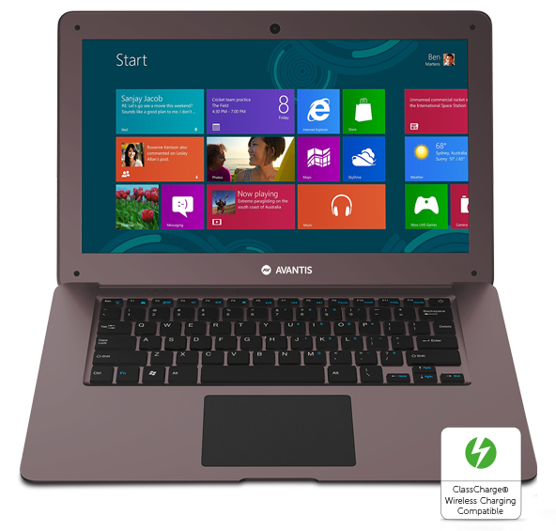
ClassBook

Slide 3
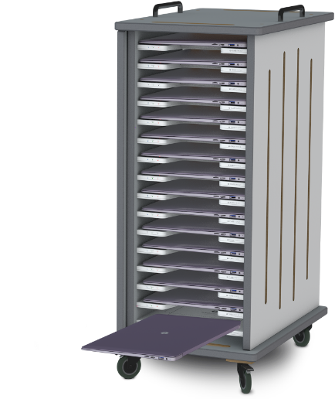
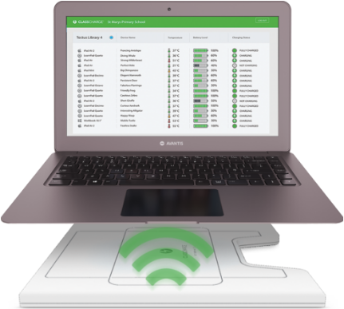
Wireless Charging

Slide 4
Windows 10 Home

Slide 5

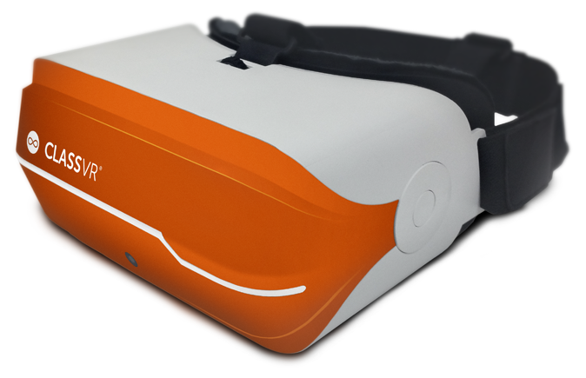
ClassVR Integrated Headset

Slide 6
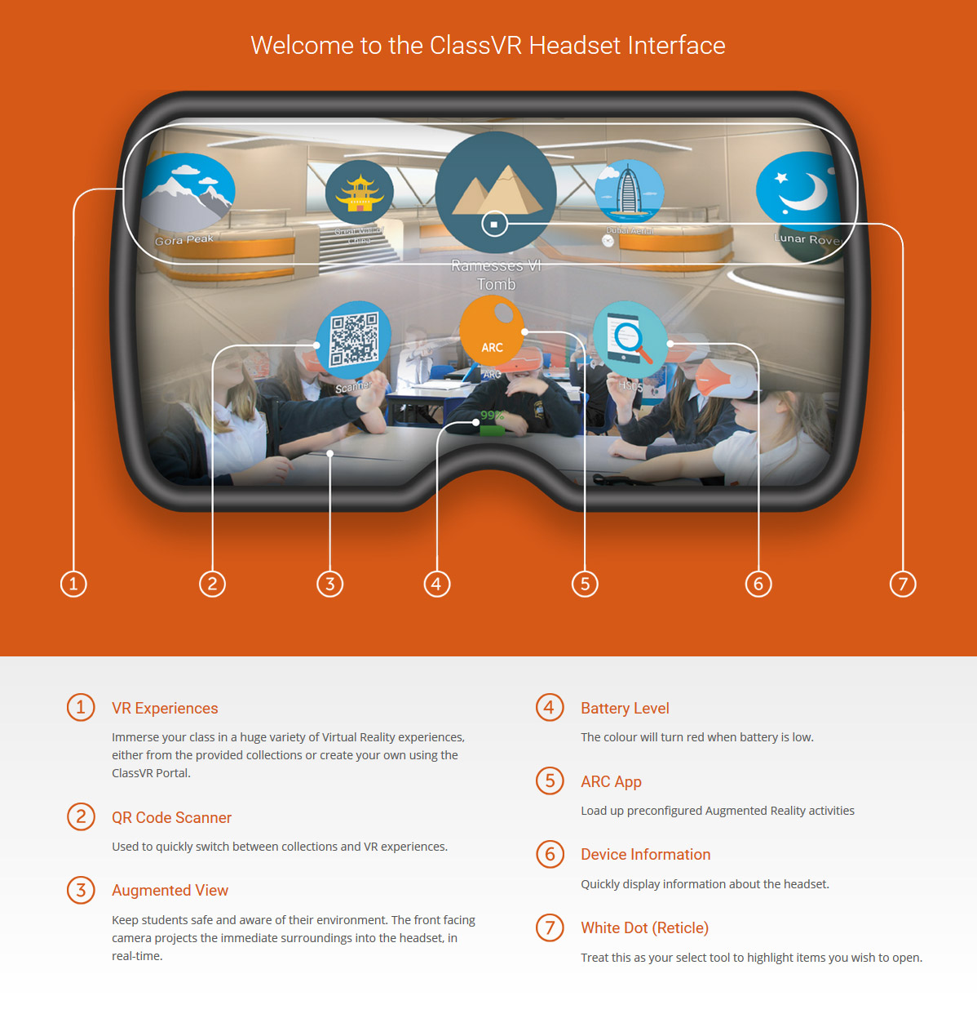
Viewfinder

Slide 7
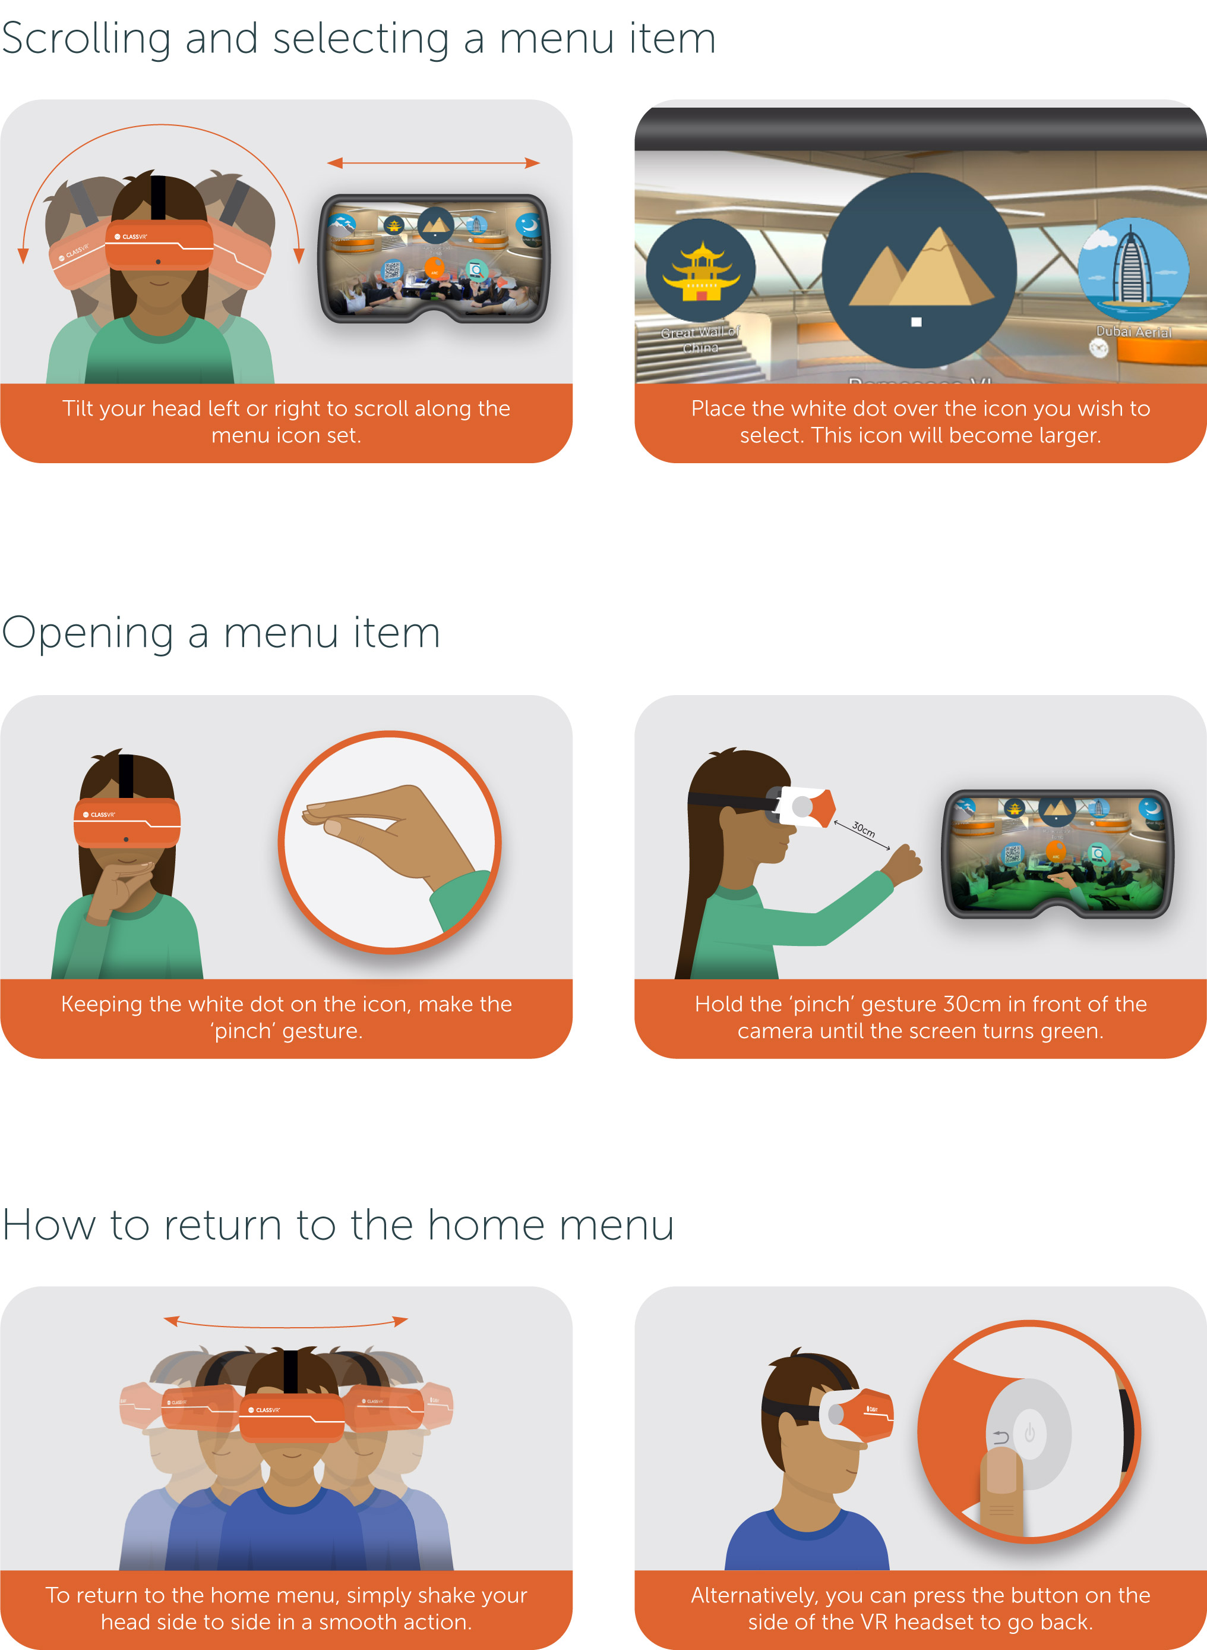
Gesture control

Slide 8
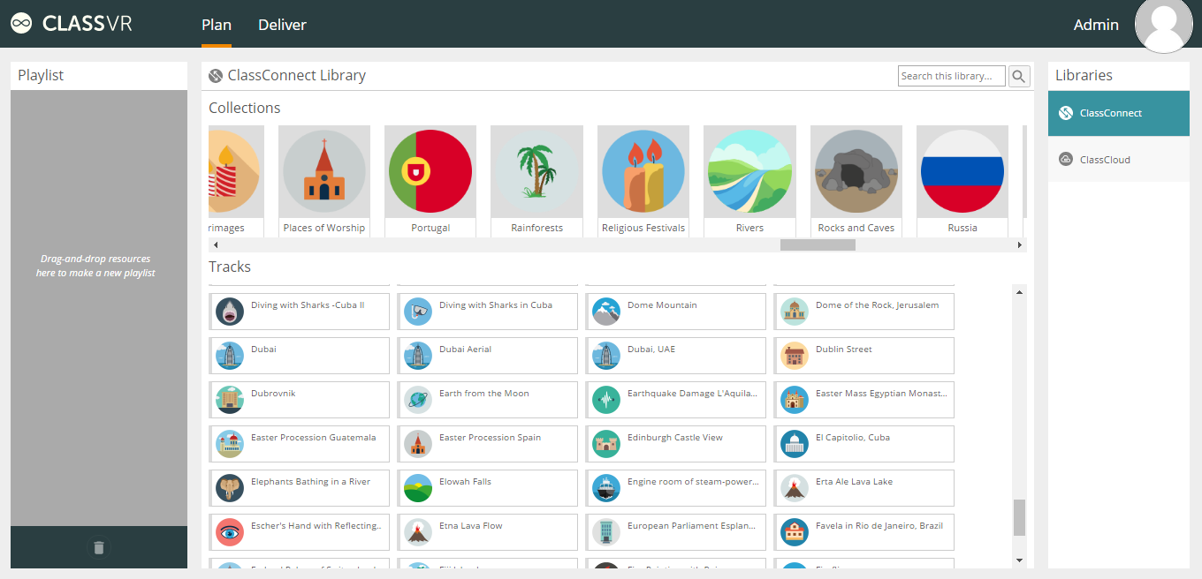
VR Content Library

Slide 9
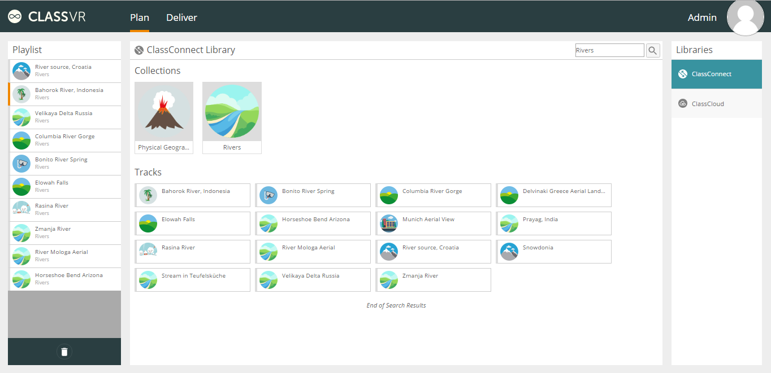
Playlist creation

Slide 10
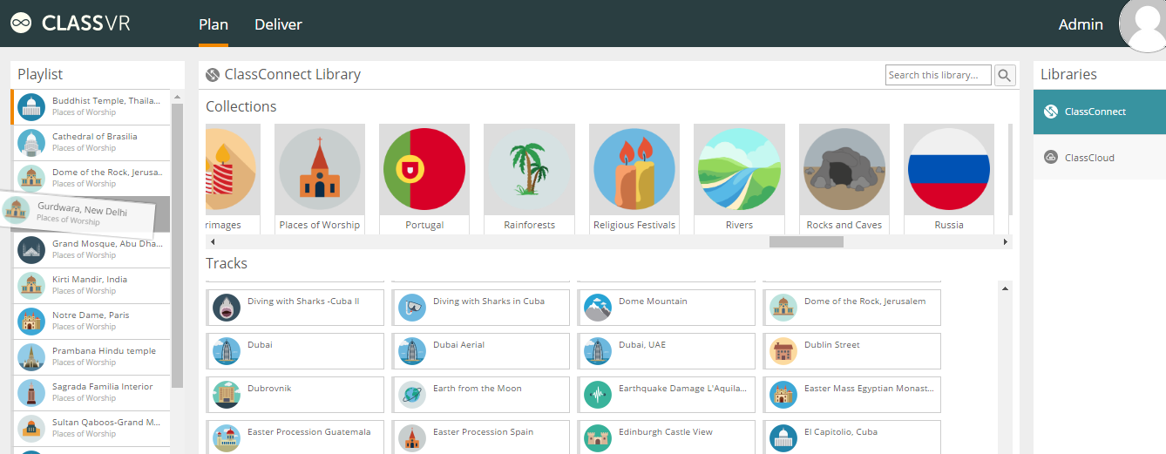
Amend

Slide 11
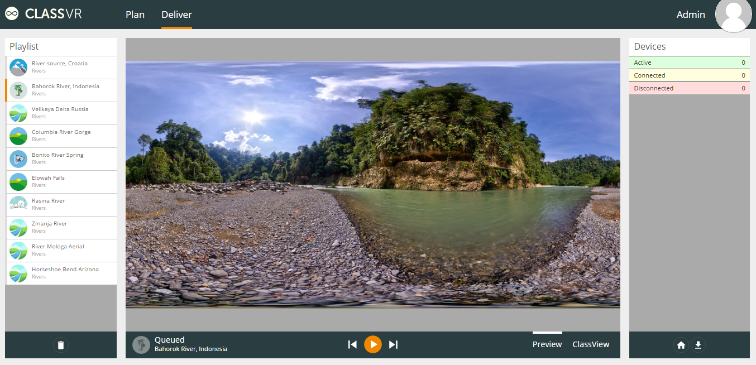
Deliver

Slide 12
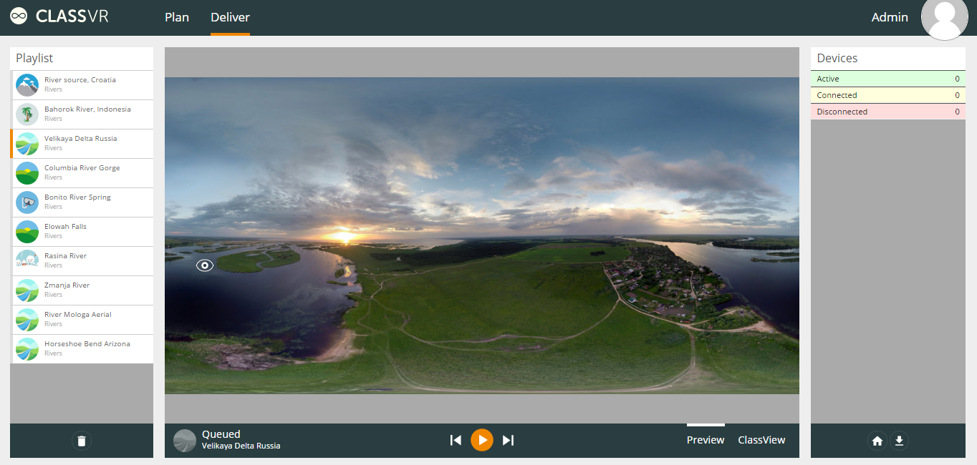
Create your own dynamic hotspots

