Slide 1



Explaining VR in the Classroom

Slide 2
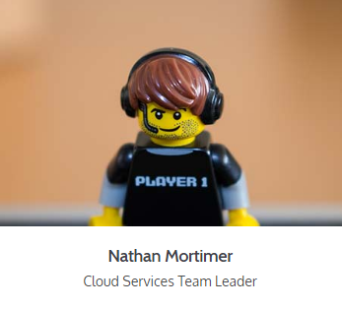
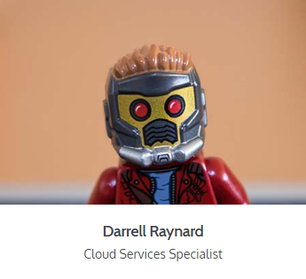
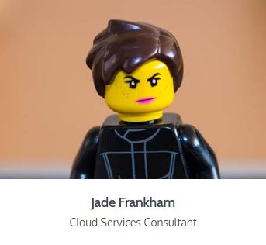
The Team
Notes:
Nathan on Intro talking about Haptic and our partnership with Google

Slide 3
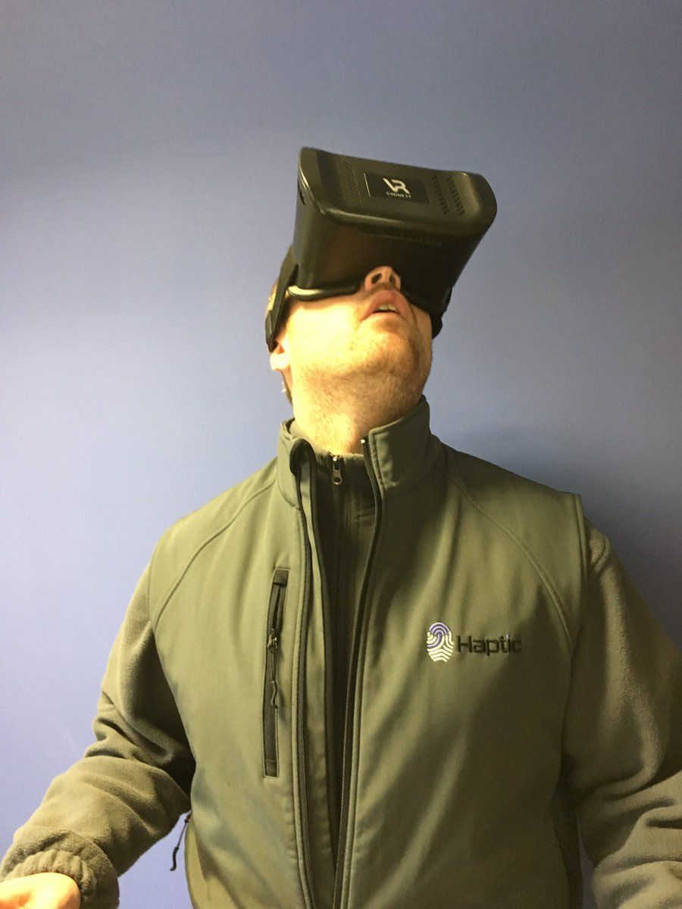
VR in the Classroom - Is it a Gimmick?
Notes:
On to Jade
Address that VR is a Gimmick - but a USEFUL one!
Some people love it, others think it’s a waste of time - my job is to present the facts - it’s up to you what you think
Can anyone here name what was considered a Gimmick that you now use at your schools?
When I was at school, the idea of using a mobile phone was prohibited, BYOD wasn’t an option - Can anyone think of any others?
How about...

Slide 4


“Students today can’t prepare bark to calculate their problems. They depend on their slates, which are more expensive. What will they do when the slate is dropped and it breaks? They will not be able to write.” (Teachers Conference, 1703)
“Students today depend upon paper too much. They don't know how to write on slate without getting chalk dust all over themselves. They can't clean a slate properly. What will they do when they run out of paper?” (Principal's Association, 1815)
"Ballpoint pens will be the ruin of education in our country. Students use these devices and then throw them away. The American virtues of thrift and frugality are being discarded. Business and banks will never allow such expensive luxuries." (Federal Teacher, 1950)
Notes:
Slate, Paper, Ball-point pens… These are just some of the “gimmicks” that are being used in the classroom every day - not so much slate though - I hope!
Where would we be without them?
What I want you to think about when it comes to VR is In the next 50-300 years, will there be quotes like these about VR/Chromebooks/iPad etc?
So when it comes to VR in the classroom, are there any apps that you can think of?

Slide 5

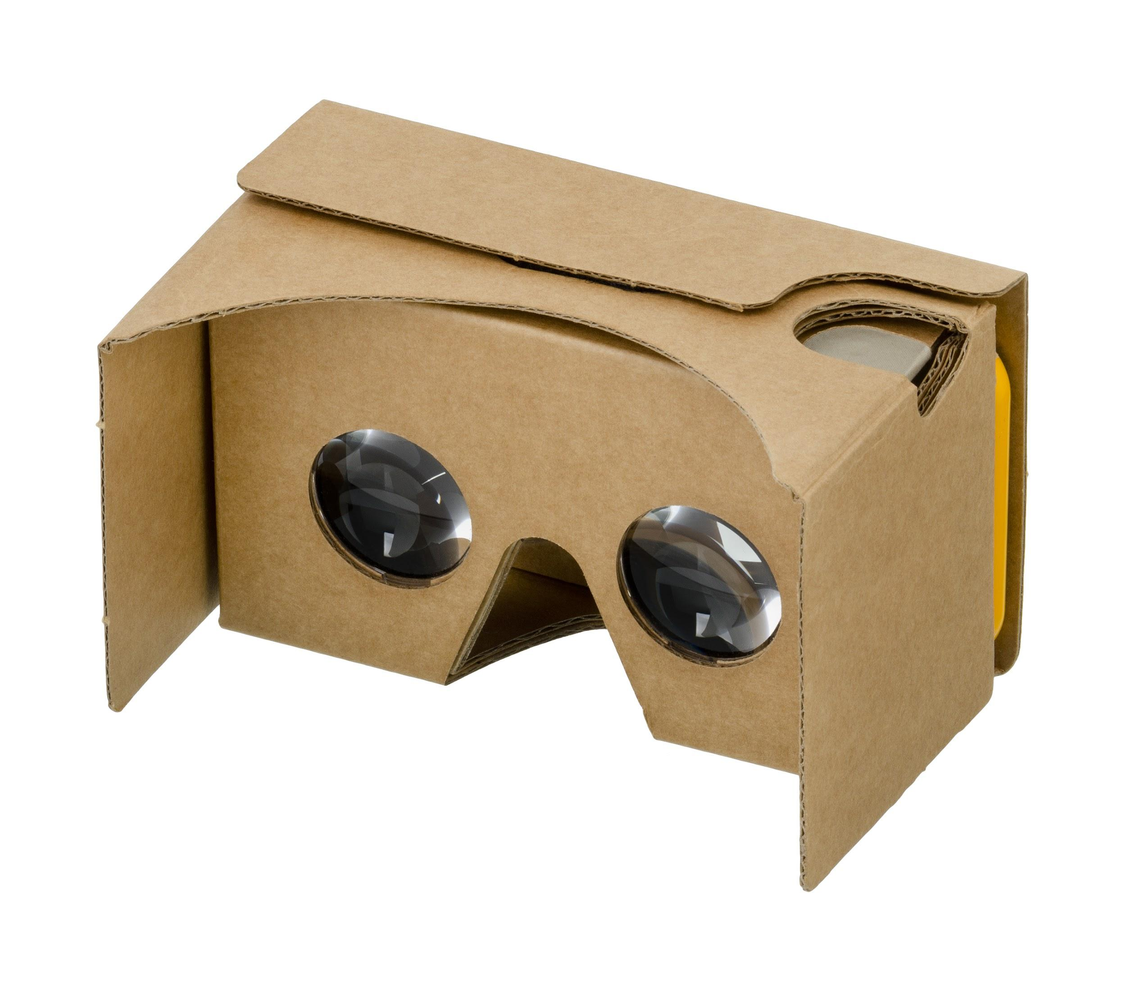
1 Million+
Notes:
Over 1 million student users on Expeditions and that number is growing - Number is sure to grow with AR being released in the near future
Ask people locally to you
Pioneer programme or using it themselves
So Jade you’ve told us that it’s a gimmick and that it’s popular - but why should we be using it? What are the benefits?

Slide 6
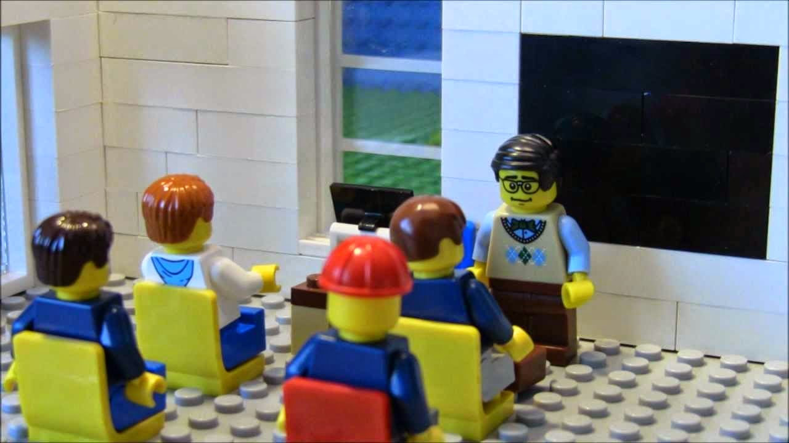
Discussion points
Increases student engagement
Brings variety
FREE Learning Resources!
Notes:
Increases student engagement - Career day at Montsaye, mandem hold tight asking to know more
Discussion points - Egypt example, Pyramids, students are probing to know more
Brings variety - Booking out laptops, reading from text books. Breaking away from routine
Free learning resources - Tes.com, IT’S FREE, doesn’t take more than a few minutes to have the info at your fingertips
And if the hundred upon thousands of subjects and materials isn’t enough… there is Create your own content.

Slide 7


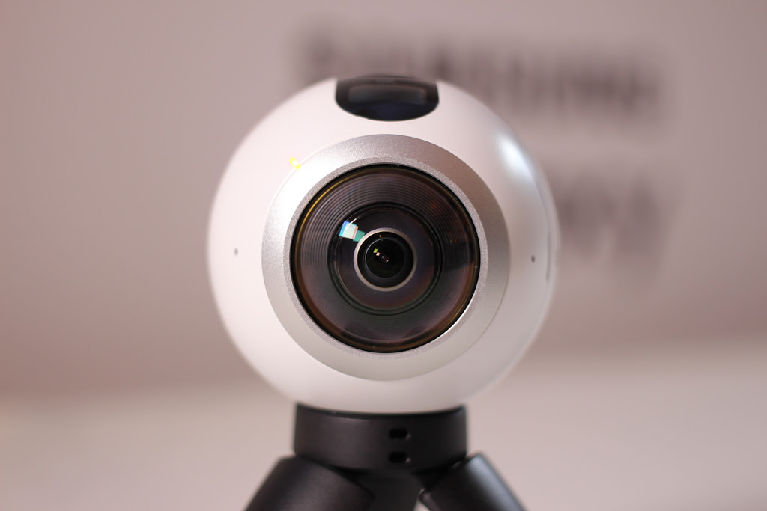
Create your own!
Notes:
Create your own content
Samsung 360 cameras going cheap - two lenses 180 on each side.
Schools are uploading to YouTube 360
One school I can think of is Invicta Primary school creating the 360 Museum, visited by people internationally - link
We’ve done the gimmick, the numbers, the reasons why and now we go onto how to make this a reality.

Slide 8
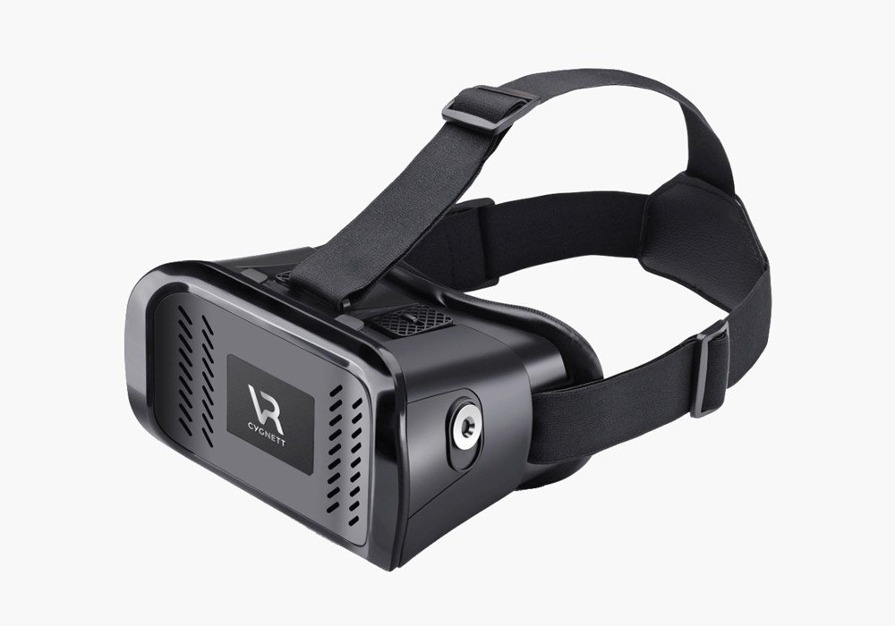
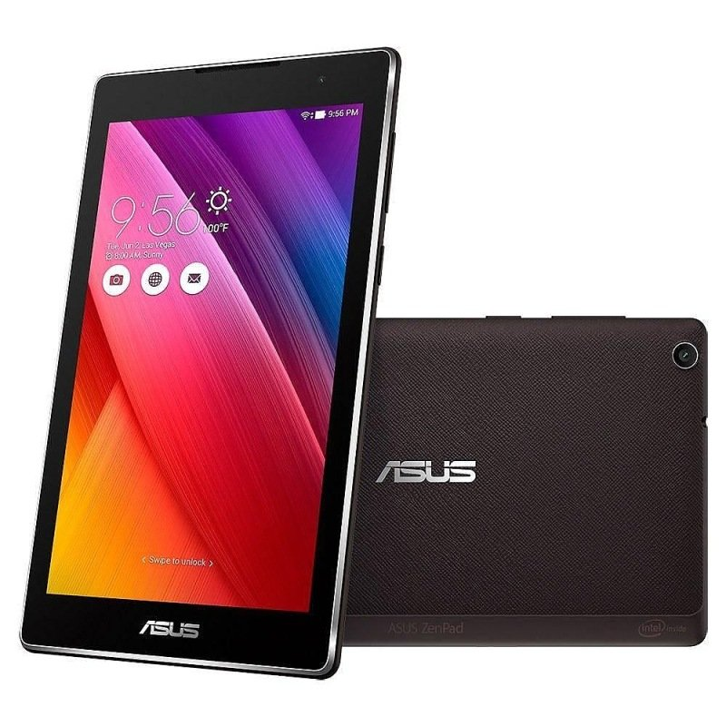
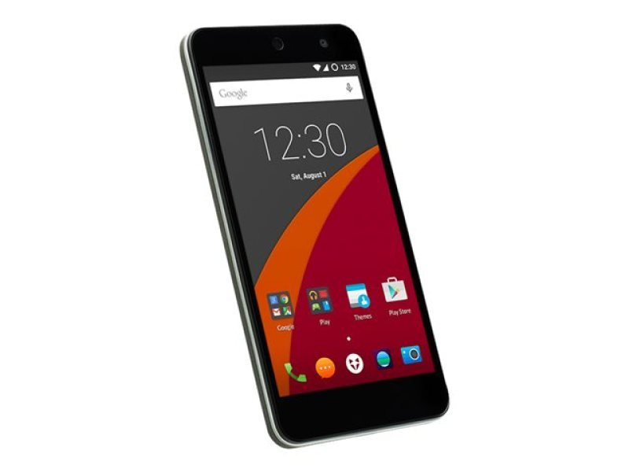
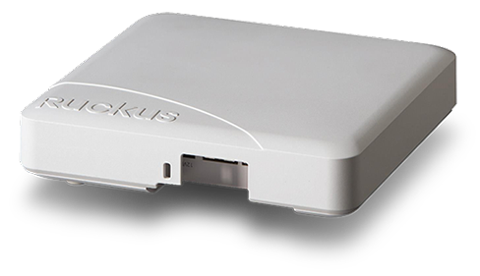
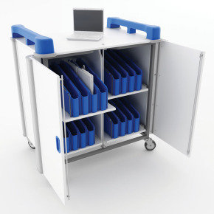
The Haptic Kit
1x Training Session
Notes:
Teacher Device - Android, 2GB RAM, 16GB Storage
Student device - 5” screen, fits comfortably in headsets, 16GB storage, plenty of space, can be upgraded with SD card, 2GB RAM = fast
Cygnett headset/Google Cardboard - can hold up to 5.5” screen device, cygnett is sturdy & robust, with magnetic clips & Cardboard - does what it says
Charging trolley - safe place to secure devices and charge
1x training session so you’re not left in the dark on how to set up the set
Ruckus AP - creating a closed network, NO access to the internet - you can link the devices to your WiFi if you want to.

Slide 9
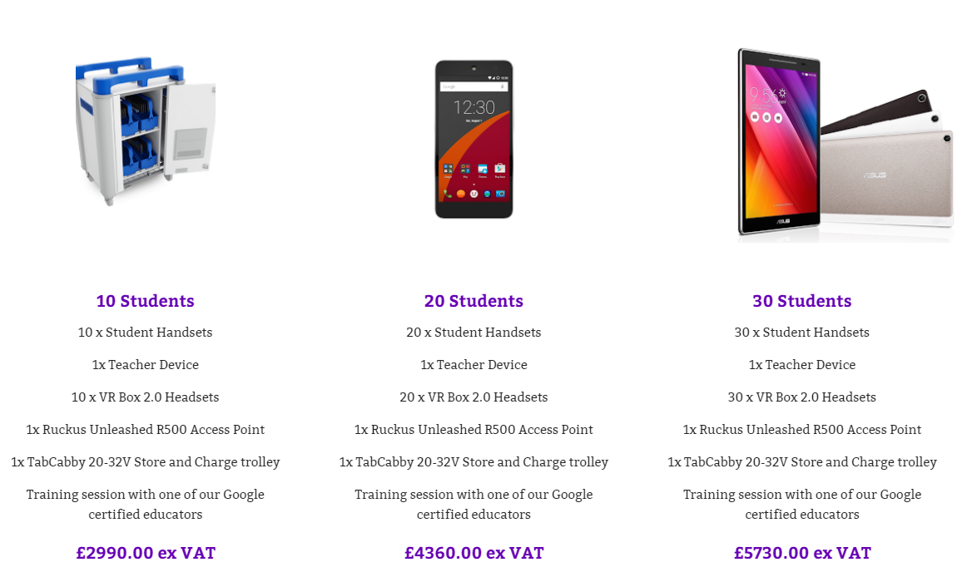
Notes:
Not everyone can afford 30 devices per class, may not want that many, we do bundles, interchangeable!
We do offer leases too
Now that I’ve talked your ear off I’m sure you’d actually like to see how this works, so I’ll pass you onto our specialist Darrell...

Slide 10
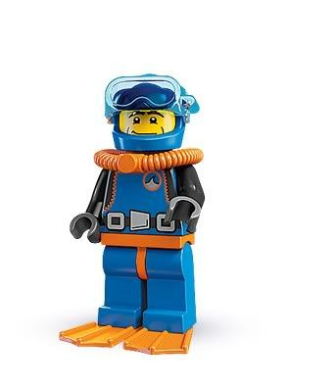
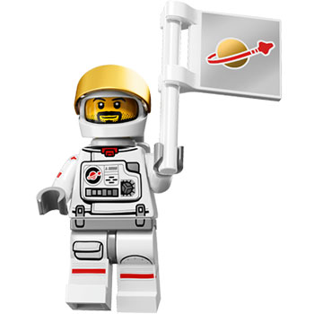

Demonstration
Notes:
Jade & Darrell
Need to mention that AR is coming in the Autumn 2017

Slide 11

Any Questions?
Thank you for your time
https://goo.gl/jlvzXu
Notes:
Darrell goes into VR and the link to GSFE

