Slide 1


Is Web Filtering a Dying Technology?
Phil Smith
Head of Product
www.smoothwall.com

Slide 2

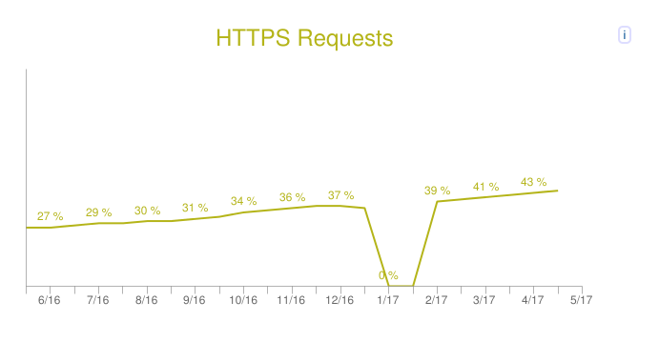
The Secure Web
Source: httparchive.org

Slide 3
Man in the Middle (MITM)
User
Server
Web request
Site certificate and key signed by Certificate Authority (CA)
I recognise that CA, here’s my key, let’s talk

Slide 4
Man in the Middle (MITM)
User
Proxy
Server
Web request
Site certificate and key signed by Certificate Authority (CA)
Site certificate and key signed by Proxy
I recognise that CA, here’s my key, let’s talk
I recognise that CA, here’s my key, let’s talk
CA

Slide 5
HTTP Strict Transport Security (HSTS)
User
Server
HTTP Web request
Redirect to HTTPS
OK, if you insist, HTTPS Web request
Notes:
Forces clients to use HTTPS
Protects against MITM attacks which request HTTP connections
Not an issue for filters that distribute the MITM self-signed CA

Slide 6
HTTP Strict Transport Security (HSTS)
User
Proxy
Server
HTTP Web request
Redirect to HTTPS
OK, if you insist, HTTPS Web request
Site certificate and key signed by Certificate Authority (CA)
CA
Site certificate and key signed by Proxy
Notes:
Forces clients to use HTTPS
Protects against MITM attacks which request HTTP connections
Not an issue for filters that distribute the MITM self-signed CA

Slide 7

HTTP Public Key Pinning (HPKP)
User
Proxy
Server
Company Root CA Trust Anchor
Intermediary CA
Pin doesn’t match
Proxy Root CA Trust Anchor
example.com certificate
Example.com certificate
### Hashed pin
### Hashed pin
CA
Notes:
Forces clients to use HTTPS
Protects against MITM attacks which request HTTP connections
Not an issue for filters that distribute the MITM self-signed CA

Slide 8


HTTP Public Key Pinning (HPKP)
User
Proxy
Server
Company Root CA Trust Anchor
Intermediary CA
Pin doesn’t match
Proxy Root CA Trust Anchor
example.com certificate
Example.com certificate
### Hashed pin
### Hashed pin
It’s OK
CA
Notes:
Forces clients to use HTTPS
Protects against MITM attacks which request HTTP connections
Not an issue for filters that distribute the MITM self-signed CA

Slide 9
Server Name Identification
User
Proxy
Server
HTTPS Web request <SNI=example.com>
Determine certificate from SNI
Example .com certificate and key signed by Certificate Authority (CA)
Example.com certificate and key signed by Proxy
I recognise that CA, here’s my key, let’s talk
I recognise that CA, here’s my key, let’s talk
CA
Notes:
Allows multiple certificates on same IP and port – connection can present different certificates
Used for policy generation in filters
Sites that don’t use SNI (presumably dedicated IPs) – Gmail…
Options
Block HTTPS with no SNI header – might be an issue for some applications, Dropbox
Monitor valid IPs with no SNI header – again, list Dropbox IPs as valid
Grab the domain from the certificate

Slide 10
Server Name Identification
User
Proxy
Policies based on:
Blocking no-SNI traffic
Allowing from known IP list (Dropbox, Google Drive, etc)
Domain name from presented certificate
HTTPS Web request <No SNI>
CA
Notes:
Allows multiple certificates on same IP and port – connection can present different certificates
Used for policy generation in filters
Sites that don’t use SNI (presumably dedicated IPs) – Gmail…
Options
Block HTTPS with no SNI header – might be an issue for some applications, Dropbox
Monitor valid IPs with no SNI header – again, list Dropbox IPs as valid
Grab the domain from the certificate

Slide 11
TLS 1.3
TLS 1.2
TLS 1.3
Client Hello
Ciphers
Client Hello
Ciphers, Key
Server Hello
Ciphers, Key,
Certificate
Server Hello
Ciphers, Key,
Certificate, Finished
Key
Finished
Finished
HTTPS Get
Finished
HTTPS Get
Notes:
Not expected to make a difference to MITM

Slide 12


Application-Specific Encryption
Telegram
What’s App

Slide 13
Filtering in 2017
URL
filtering
Egress filtering
SSL inspection
Blocking
= Event
Search term filtering
Content
inspection
Content modification

Slide 14
Filtering in 2017
What happens when you can’t filter?

Slide 15



Department for Education
Whilst it is essential that governing bodies and proprietors ensure that appropriate filters and monitoring systems are in place; they should be careful that “over blocking” does not lead to unreasonable restrictions as to what children can be taught with regards to online teaching and safeguarding

Slide 16
Ofsted Inspection Considers...
…how well the school prepares pupils positively for life in modern Britain and promotes the fundamental British values of democracy, the rule of law, individual liberty and mutual respect for and tolerance of those with different faiths and beliefs and for those without faith…
…how well leaders and governors promote all forms of equality and foster greater understanding of and respect for people of all faiths (and those of no faith), races, genders, ages, disability and sexual orientations (and other groups with protected characteristics)…

Slide 17



A Path to Good Intentions
A Path to Good Intentions
Leads to a hellish problem for schools
Specified authorities will be expected to ensure children are safe from terrorist and extremist material when accessing the internet in school, including by establishing appropriate levels of filtering.
…staff have training that gives them the knowledge and confidence to identify children at risk of being drawn into terrorism…
…encourage and support schools to move
from locked down to managed [e-safety] systems…

Slide 18
What are the main areas of risk?
Content
being exposed to illegal, inappropriate or harmful material
Contact
being subjected to harmful online interaction
Conduct
personal behaviour that increases the likelihood of harm
“From September 2016 all governing bodies and proprietors should be doing all that they reasonably can to limit children’s exposure to the above risks from the school or colleges IT system. As part of this process you should ensure your school has appropriate filtering and monitoring systems in place”.

Slide 19
Filtering in 2017
What happens when you can’t filter?

Slide 20
Monitoring to Supplement Filtering
Monitoring
Application
usage
Chain of events:
search term to web site to chat app
Legitimate
transactions:
search terms, chat
Transactions at source:
what is typed into what window and what happened
Context is key

Slide 21
Safeguarding
Filtering
Event
+
+
Monitoring
Intent

Slide 22



Is There Another
Paradigm Shift?
Filtering & Monitoring
School
Home

Slide 23

Is There Another
Paradigm Shift?
Filtering & Monitoring
Filtering & Monitoring
Filtering & Monitoring
School
Home

Slide 24

Different Strokes?
Primary School Student
Vulnerable Student
SecondarySchool Student
Further Education Student
Teacher
Whitelist
Filtering Only
Whitelist
Filtering and Monitoring
Time of Day Policies
Open Access & Monitoring
Monitoring Only

Slide 25
Some Other Questions
What about BYOD?
What about guest services?
What about shared devices?
How to deal with 1:1 devices (school owned)?
What about 1:1 school/home devices (parent owned)?
Where’s the crossover between school and home responsibilities?
Should parents be running filtering and monitoring services as well as the school?
And….where does GDPR fit into this puzzle?

Slide 26
Is Web Filtering a Dying Technology?
www.smoothwall.com

Slide 27
Is Web Filtering a Dying Technology?
No !
It has now become just one tool in a much larger arsenal of systems
www.smoothwall.com

