Slide 1
Importance of Backup & Disaster Recovery
Michael Gould
Education Specialist Client Adviser

Slide 2
Background
Founded 1998 – Data Management & Protection Specialist
  Backup & Disaster Recovery (2005 education)
  Archiving / Data Tiering
Protect data in 12,000+ schools
75 Local Authorities
Capita’s only approved SIMS backup partner
ISO27001 & ISO9001 certified

Slide 3
Challenges of Backup & Disaster Recovery

Slide 4
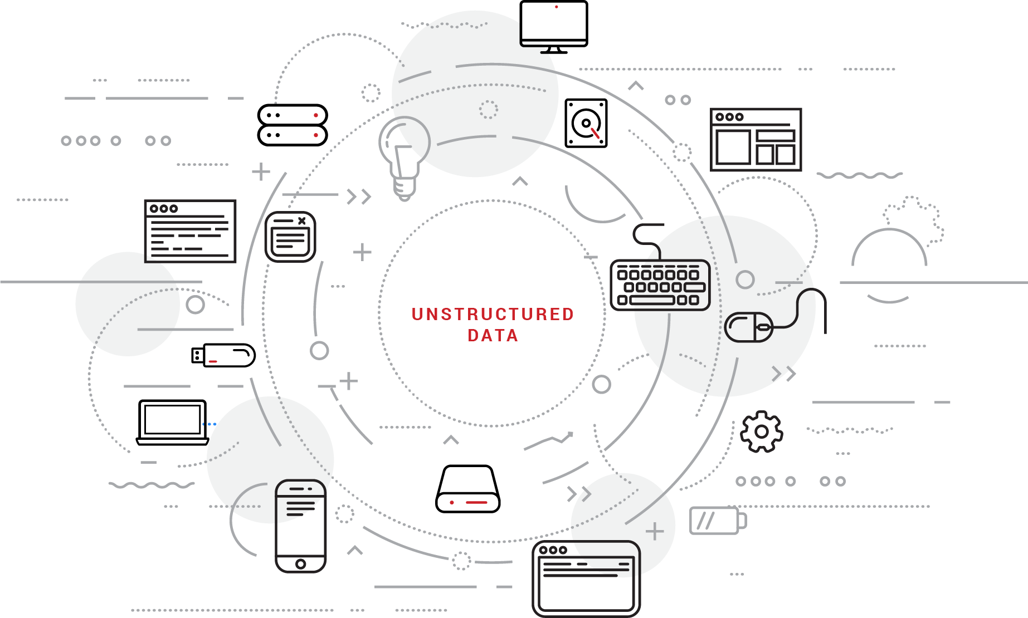
Data is Exploding
Data is growing at 40% ANNUALLY
Redundant, Obsolete & Trivial = 70% +
Unstructured data & BYOD
Data’s on the move
Store, Manage & Protect?

Slide 5
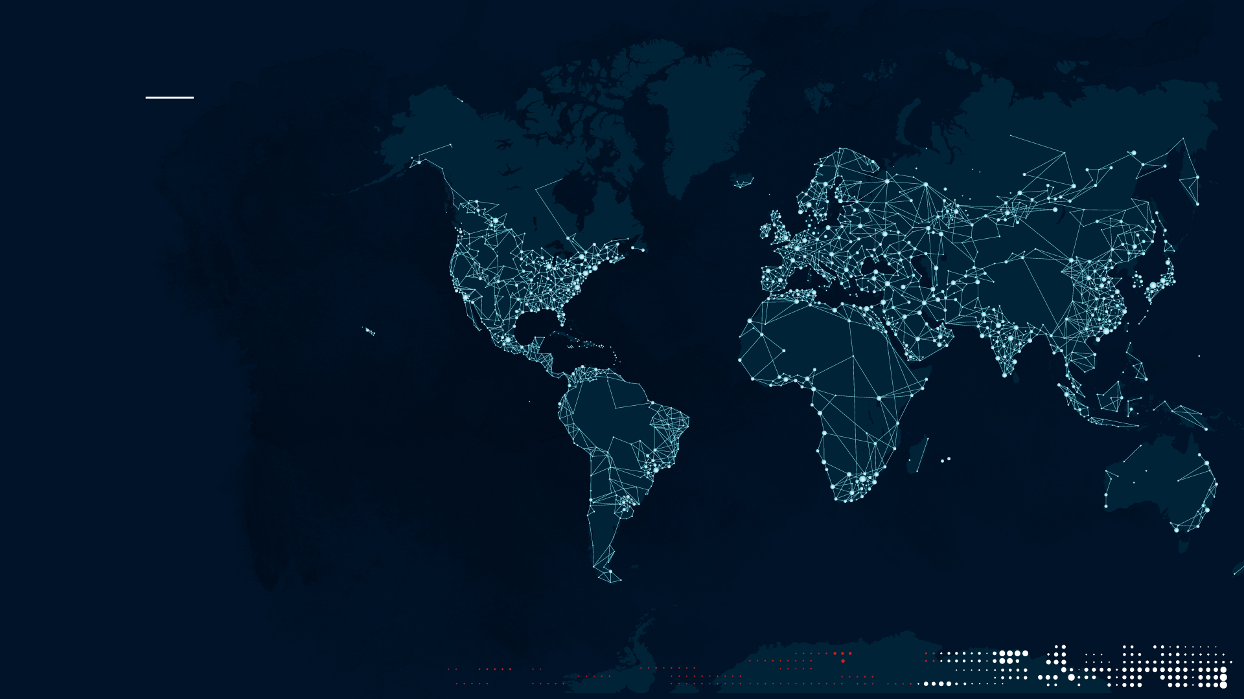
Ransomware & Cyber Threats
  Estimated 4 million ransomware viruses
  Cost including downtime for SMB’s businesses $75 billion
  WannaCry
    300,000 organisations in 150 countries.
  2016 3,500% rise in attacks.
  600% rise in strains of ransomware.

Slide 6

Compliance
Data Protection Act (DPA)
  Information Commissioners Office (ICO)
Schools Financial Value Standards (SFVS)
  Point 25, Section D (“… must have offsite backup….)”
General Data Protection Regulation (GDPR) – 2018
  4% Revenue or €20mn fines

Slide 7
Challenges with traditional approaches to Backup &DR
Cost & Complexity
Unreliable
Unsecure
Limited Scalability
High, upfront capital expenditure cost
Disaster Recovery is Expensive
  Often no second site for DR
Time Consuming – management/administration
‘Human’ element
Data Retention
Speed of Backup & more importantly, speed of Recovery

Slide 8
Addressing The Challenges

Slide 9

Choosing the right technology?
Efficient
Speed – Reduce backup/recovery times
Scalable
Predictable costs
Compliant
Automated
Resilient & Reliable
Secure
Off-site

Slide 10
Choosing the Service Provider?
Secure UK data centres – keep 2 x copies offsite
Support Levels/Agreements
Reference sites
Compliance
  Financially backed Terms & Conditions
  ISO certified
  GDPR
Does it work? Make sure you try before you buy!
Retention of data

Slide 11

Questions To Ask Your Service Provider
Can I trial it?
Will the new solution enable you to meet legislation and regulation requirements?
Where and how is the platform supported? In other words, is the provider’s support team local and can you speak to them in person and over the phone?
Where is data being stored?
What are the SLAs and terms and conditions of the contract? Financially backed?
Are there any hidden costs such as a cost for downloading data or
performing restores?

Slide 12
Real life Backup and DR

Slide 13

A True Recovery
Daniel Sapseid – Network Manager

Slide 14
Challenges Faced With Previous Backup Technology
Legacy tape system had became time intensive and causing management time to escalate heavily.
Backups began overrunning the allotted backup window, taking up to 2 full days to complete.
The process required manual intervention to ensure 24-48 hours of backup processing wasn’t wasted.
Notes:
Before I implemented cloud backup I was facing many of the inherent challenges of a tape backup solution. Backups running over, manual intervention needed etc.

Slide 15





Advantages of moving to cloud
Simplicity – Backups are fully automated
Security – End to end encryption and DPA compliant
Flexibility – No hardware cost, pay for what I use
Performance – incremental (full) backups take less than an hour
Support – 24/7/365 support from UK team
Notes:
I reviewed my solution and knew that cloud would be a suitable replacement and should solve my pains. I have found some of the advantages of the new backup solution to be…

Slide 16
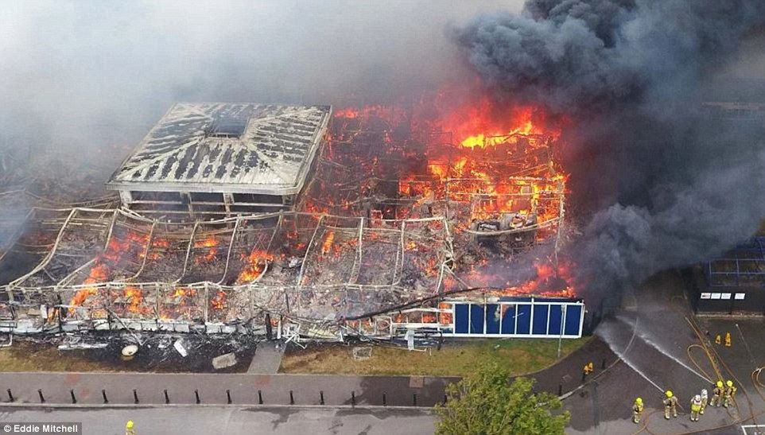
The Disaster
Notes:
As I’m sure many people are aware, in August 2016, there was a disaster at the school

Slide 17
Bad Things Happen!
8am on Sunday 21st August. 5 days before the start of the academic year, whilst building work was being carried out, an accidental fire started.
The entire site was engulfed with all onsite infrastructure and backups destroyed.
A community centric Academy, with 400 students who had no school to come back to.

Slide 18
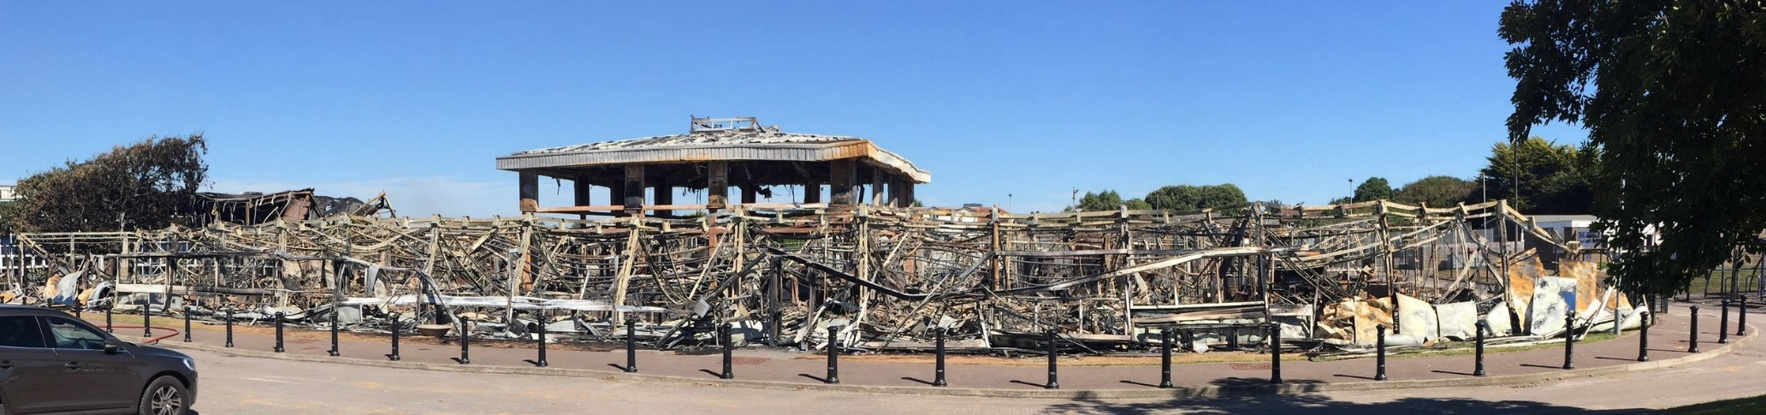
The Aftermath

Slide 19
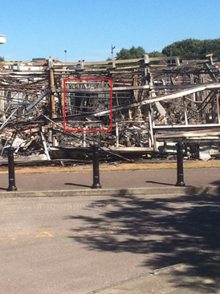
What Was Left of My Server Room

Slide 20
How I recovered data
Critical data was restored within 2 hours (Domain Controller & SIMS).
All data was restored in 8-10 hours.
Allowed us to begin the process of returning to some normality.
Got back up to operational capacity much sooner than expected.
Allowed me to worry about the 101 other jobs I needed to do!
In summary, I was able to recover 100% of my environment.

Slide 21
Next steps
Spent the entire first day on the phone to suppliers & members of MAT & school SLT
Purchase new laptops for staff, projectors for temporary accommodation.
Phones diverted and new system installed.
Speaking with loss adjustors and insurance companies regarding new equipment.

Slide 22
Advice
Ensure that a list of suppliers, with what service they provide, contact numbers, account managers etc. is available at another location. Useful for Premises as well as ICT.
Complete list of all students and staff contact details at another location.
Full inventory.
Notes:
We hold an encrypted memory stick at a local primary school (part of same MAT) with suppliers details for IT & Premises, student database, staff contact details & emergency school closure policy. Reciprocal agreement we hold copy for them, update the data ½ termly. We also hold a copy of this memory stick in both our buildings on site. SLT & myself only ones with encryption password.
Insurance company wanted a full inventory not just of ICT equipment but classroom furniture, text books, stationary, everything basically. We then had to place new orders offset against what we had pre-fire. The full inventory was non existent before the fire took myself and SBM 2 weeks to collate all information from departments regarding what was in their classrooms.

Slide 23
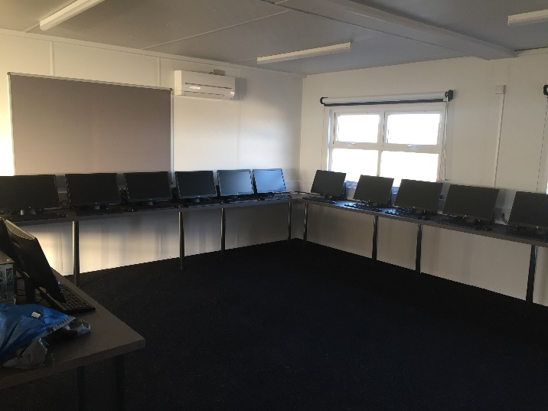
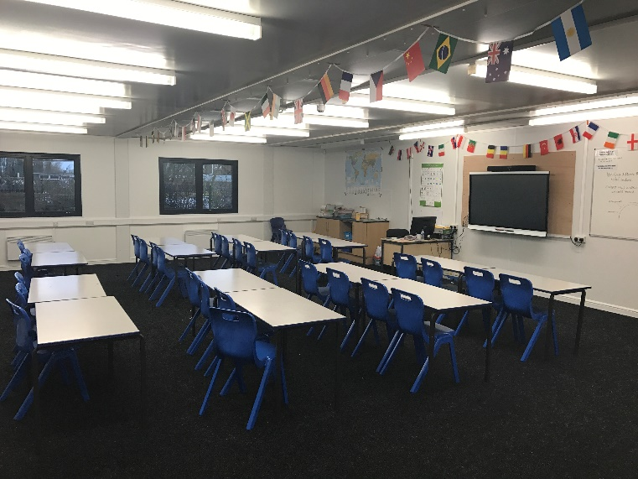
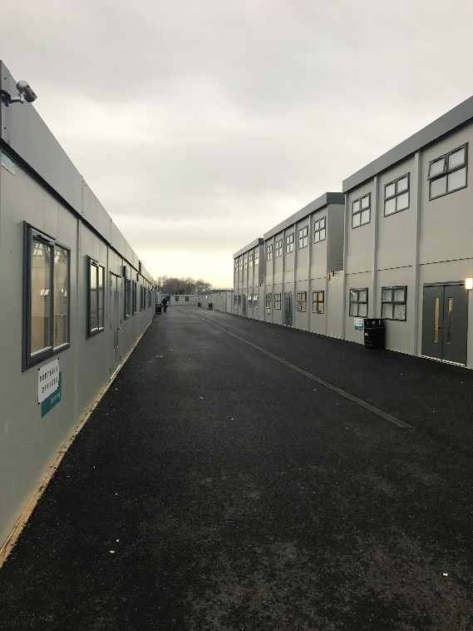
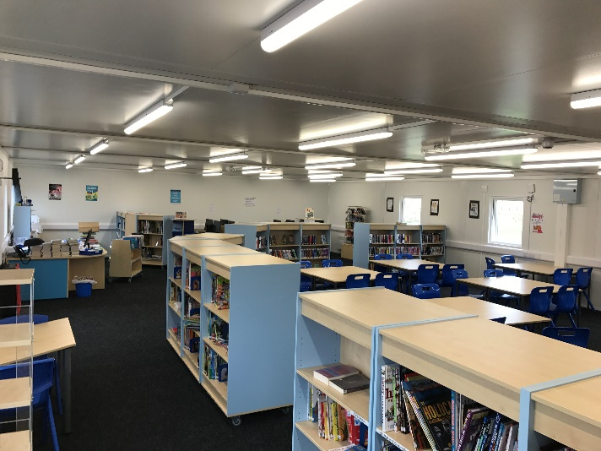
Current School - Portacabins

Slide 24
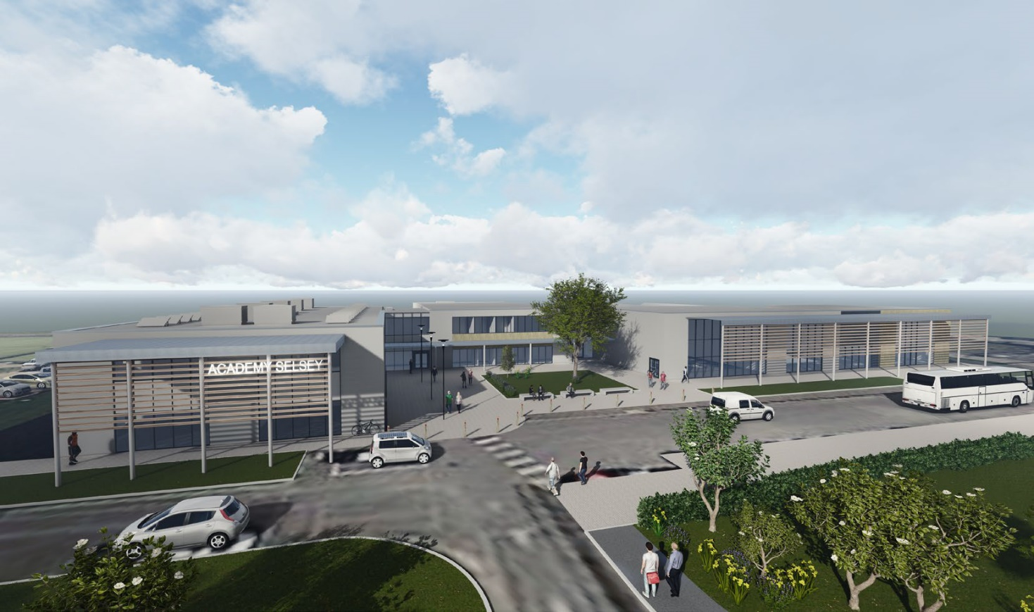
New School – Summer 2018

Slide 25
Any Questions?
Notes:
12 years of managing and maintaining cloud platforms

