Slide 1

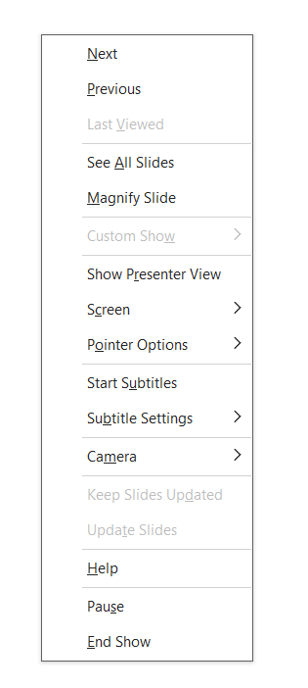

Have you my PowerPoint Bug?
Rob Holmes – Edugeek Forums – 2024
Please Pause now!
Start the presentation from here in PowerPoint Desktop. Listen to my dull Yorkshire tones in my narration for instructions to find out.
You’ll need speakers or headphones to hear the bug (And my instructions).
Notes:
Hi, welcome to my little test to see if you have the PowerPoint bug I’m looking for, which Microsoft have said doesn’t exist.
I’m wanting to check I’m not going mad, and this is a wider bug in PowerPoint. Or if it’s limited to a set of builds. Or it might be I’m just mad and Microsoft are right.
In a second, please right click on this slide and pause the presentation. Then sit and wait a second or two to see what happens. If you don’t hear anything for 10 seconds, you can advance the slide. Try pausing now.
Hopefully you’ve paused and you’re not hearing this, if not, pause now or you’ll miss bug test.

Slide 2
Let me know!
Let me know on the thread if you do or not.
Please let me know the build version number of your Office install.
      This can be found in File>Account>About PowerPoint
Notes:
If you’re hearing this, but you still have a ladybird on your screen! Congratulations, you’ve got the bug just like me! View advance to Slide 2 as I’d like to hear from you that you have the bug. If you can let me know your Office build number please. Then I can report back to Microsoft another build with the issue.
Or if you have the green background ‘Let me know’ slide when you're hearing this, you’ve progressed to Slide 2 as you didn’t hear anything once paused, which means the bug isn’t present for you. Again, please let me know you didn’t have the bug and your build number.
Thank you for taking part in my big test!

