Slide 1


Slide 2
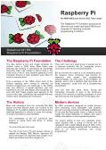
Datasheet 001
The Raspberry PI Foundation

Slide 3

Datasheet 101
The Raspberry PI Product Release

Slide 4
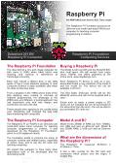
Datasheet 201
The Raspberry PI Computer

Slide 5
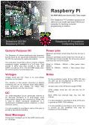
Datasheet 202
The Raspberry PI General Purpose I/O

Slide 6
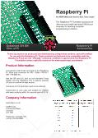
Datasheet 351
The Raspberry PI Accessories

Slide 7
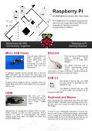
Datasheet 401
The Raspberry PI Connecting Together

Slide 8
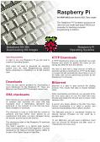
Datasheet 501
The Raspberry PI Downloading Images

Slide 9
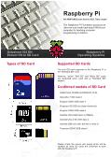
Datasheet 502
The Raspberry PI Extract to SD Card

Slide 10
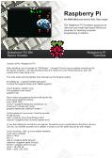
Datasheet 701
The Raspberry PI Space Invader Tutorial
articles@ frambozenbier.org

Slide 11

Marketing Bundle
All flyers and marketing materials

Slide 13


An introduction to the
Raspberry Pi
By Liam Fraser

Slide 14
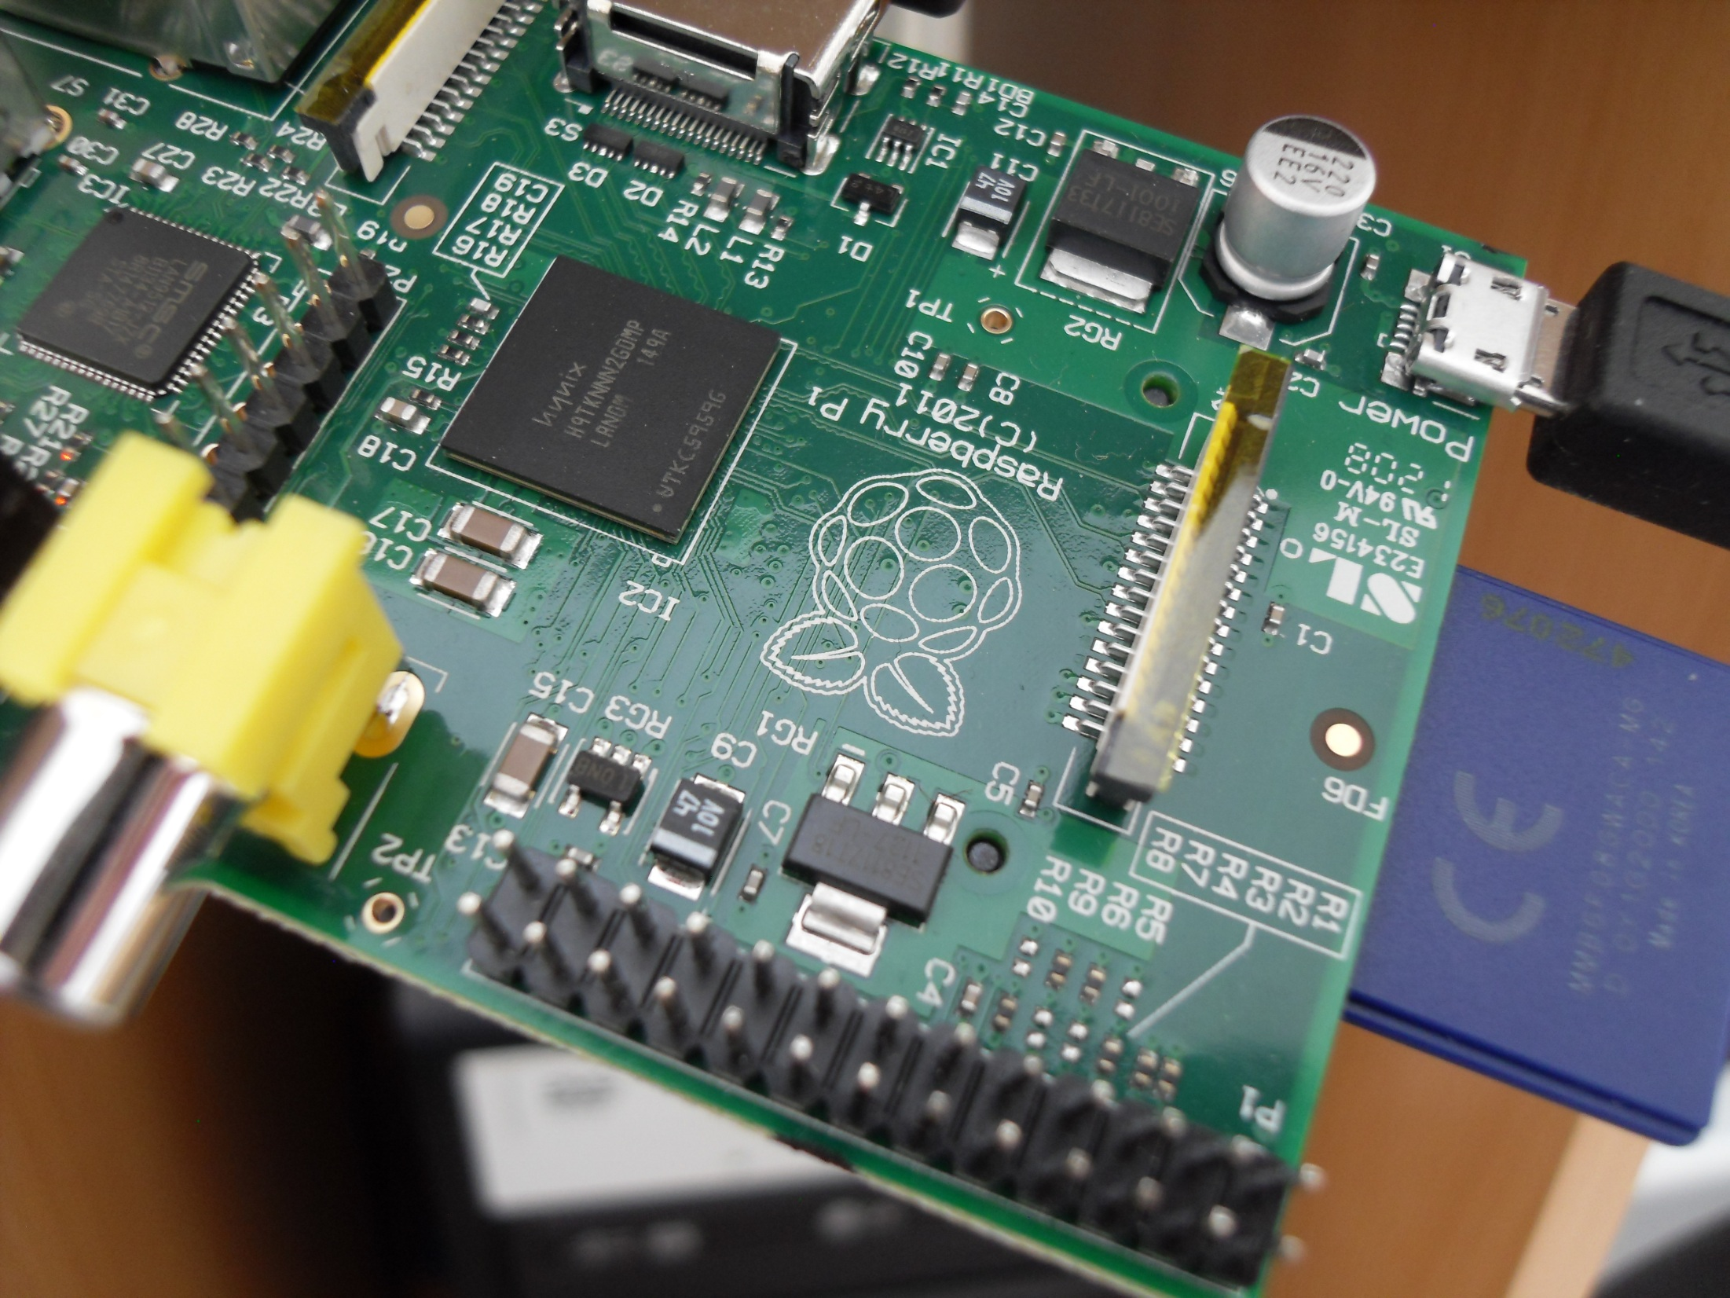

Slide 15
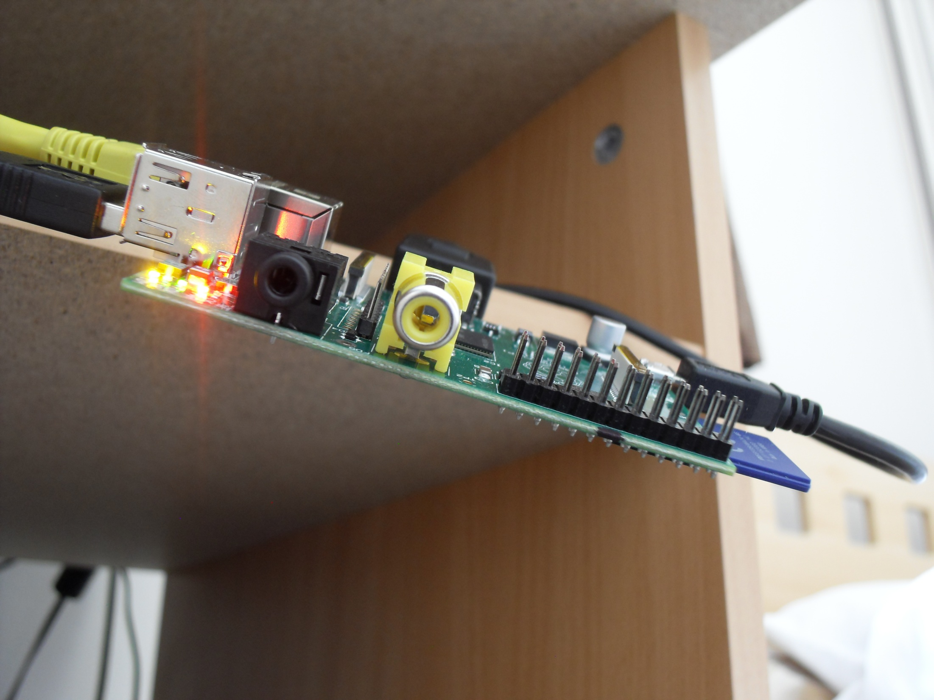

Slide 16
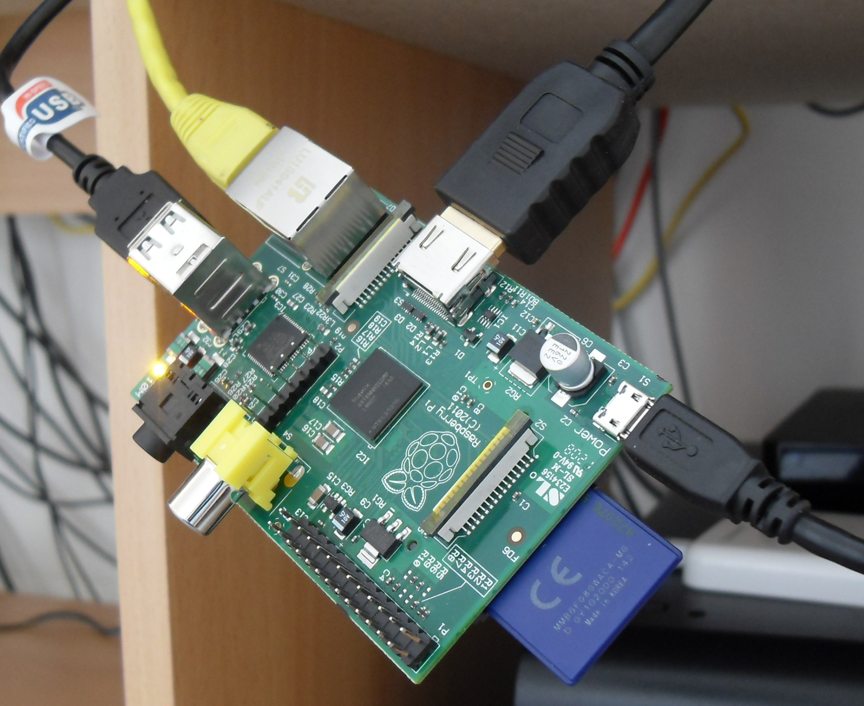

Slide 17
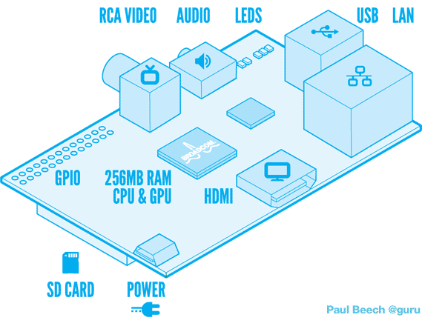
The Basics
Model A and Model B
Costs $25 for model A and $35 for model B
HDMI (or DVI), or Composite
Needs an SD card to boot

Slide 18

Why Pi?

Slide 19

Power
MicroUSB – typical phone charger connection
Only consumes a few watts
Needs a powered hub for power hungry devices

Slide 20





The Distros

