Slide 1


An introduction to the
Raspberry Pi
By Liam Fraser

Slide 2
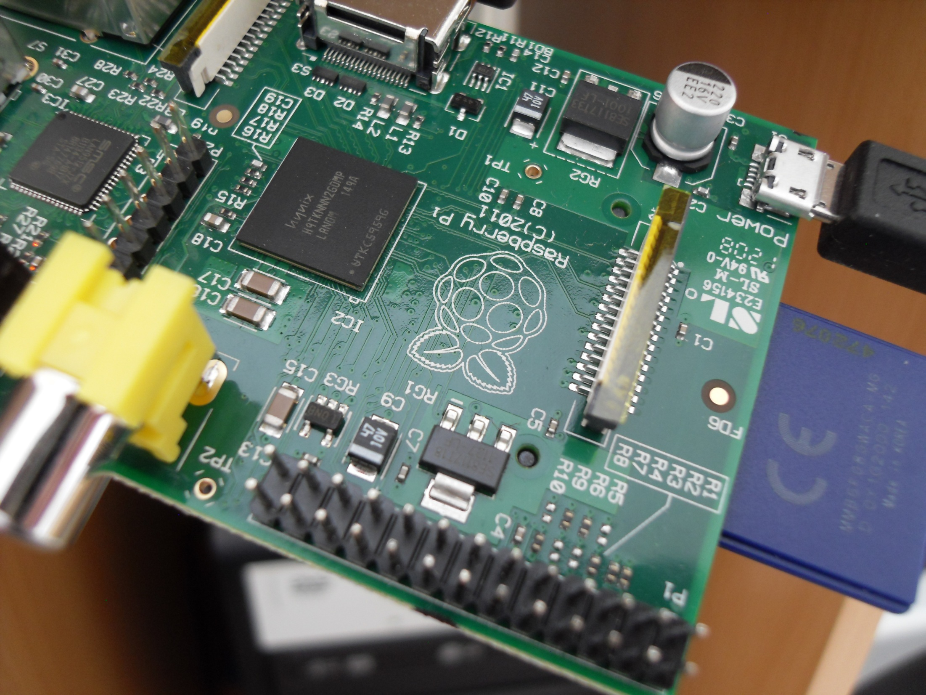

Slide 3
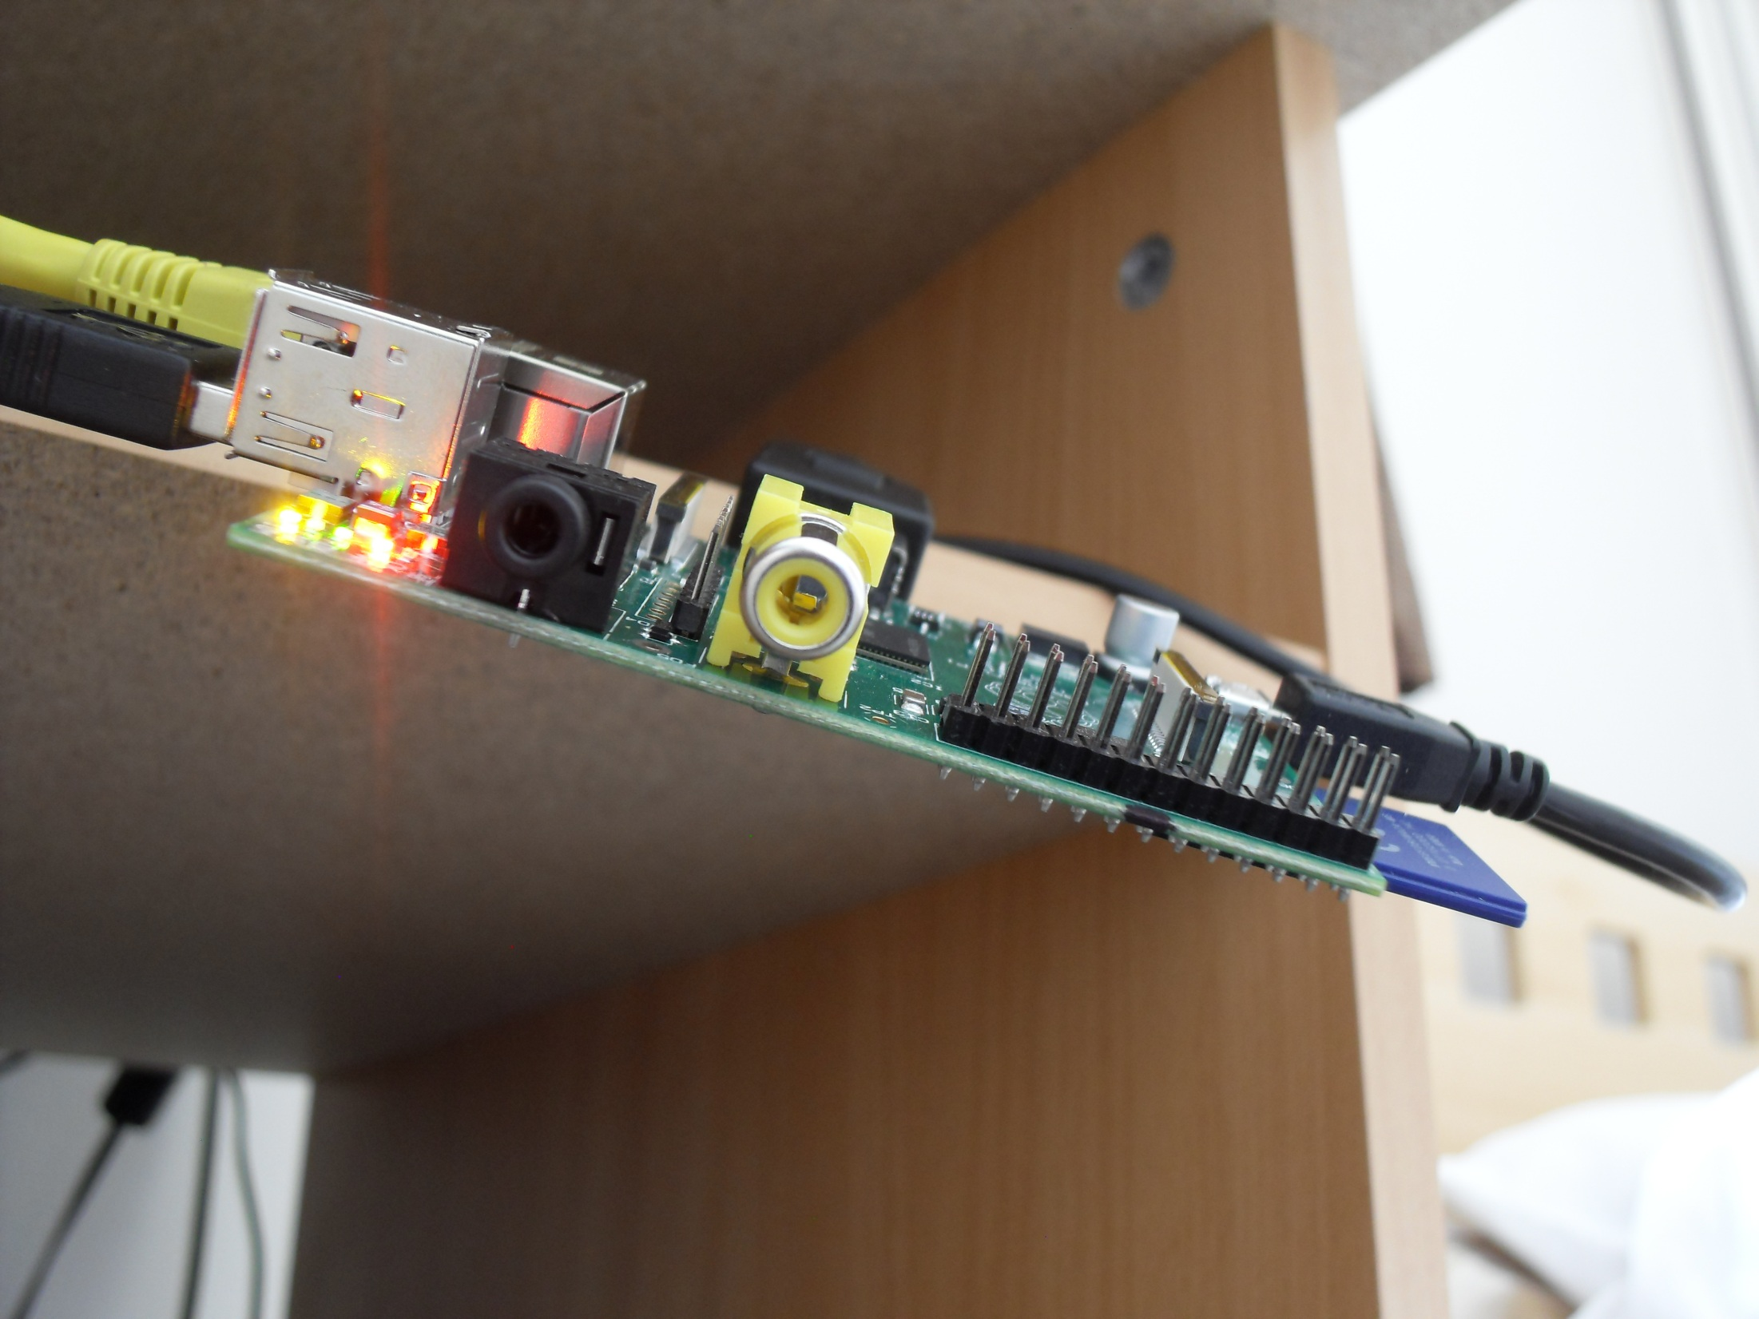

Slide 4
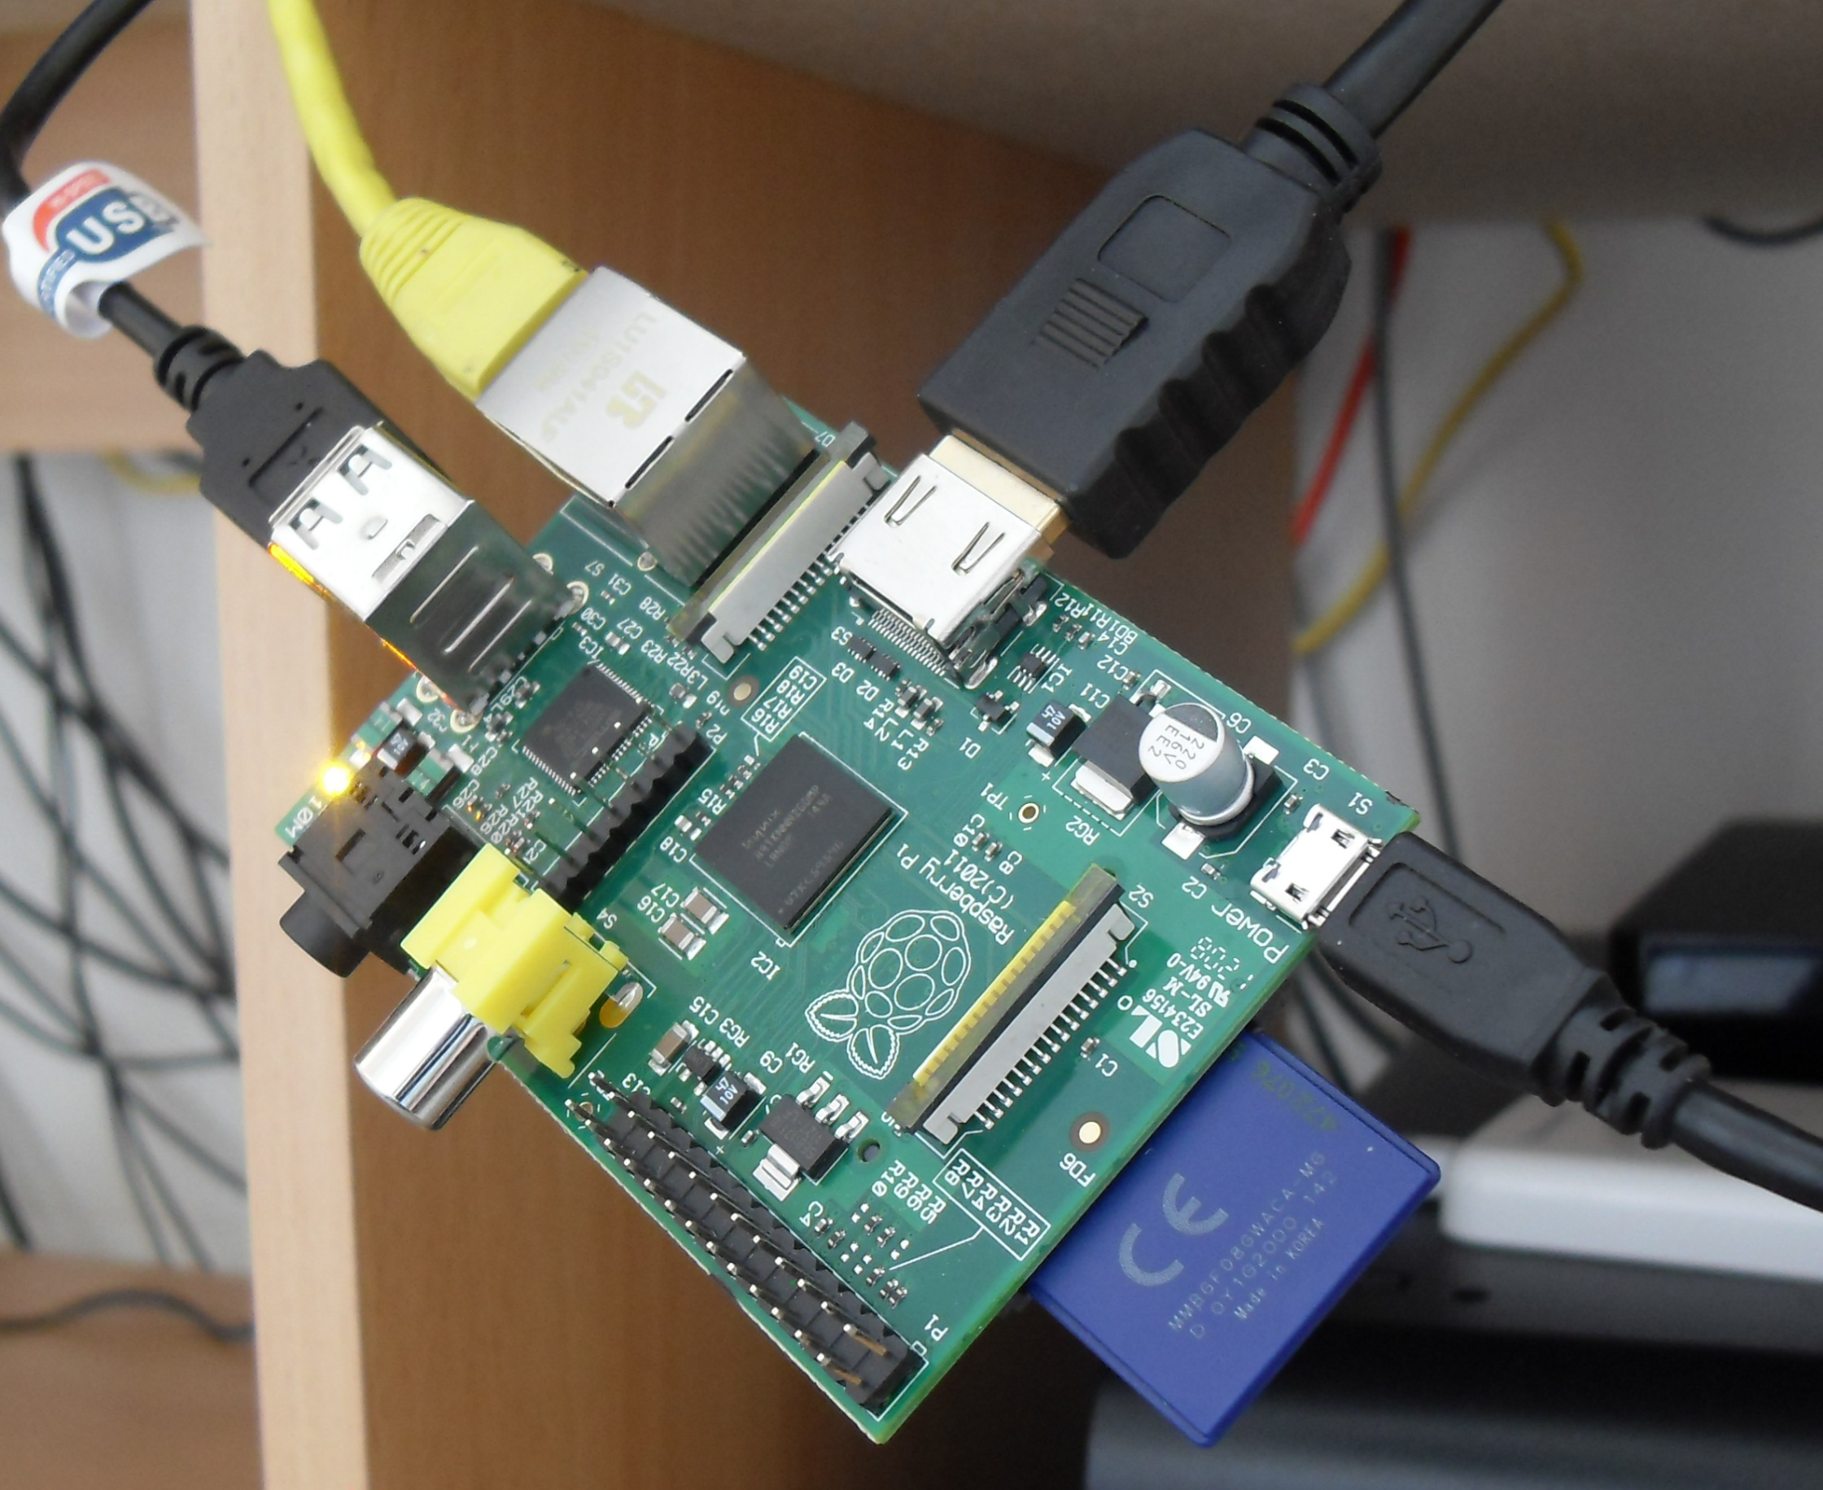

Slide 5
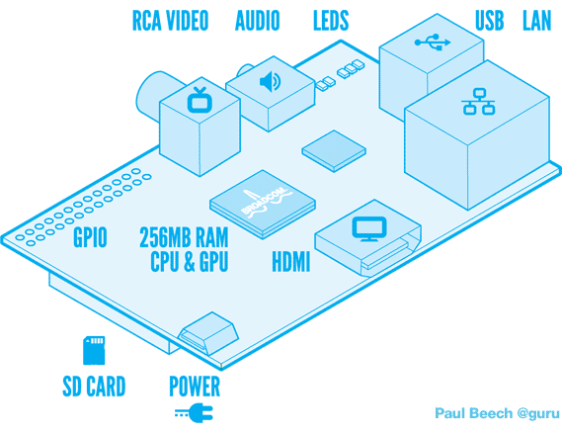
The Basics
Model A and Model B
Costs $25 for model A and $35 for model B
HDMI (or DVI), or Composite
Needs an SD card to boot

Slide 6

Why Pi?

Slide 7
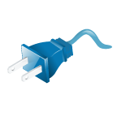
Power
MicroUSB – typical phone charger connection
Only consumes a few watts
Needs a powered hub for power hungry devices

Slide 8





The Distros

