Slide 1


Mark
McManus
Office 365 for Education
Notes:
Key Point:
Cloud is the next paradigm shift/evolution of computing
Talk Track:
The major shift underway in IT today is indisputably cloud computing. While the resulting transformation is not happening overnight, the disruption caused by the cloud is undeniable, as are the benefits and opportunities.
Some call it the next evolution of computing, the next generation application model -- we call it a game changer. It's fundamentally changing the world of software and IT and will impact every player in the IT world, from service providers and systems architects to developers and even end users -- employees.

Slide 2

Why use Cloud Services?
Agility
Focus
Economics
Notes:
Key Points:
Several key drivers to cloud adoption
Top three: Agility, Focus & Economics
These benefits accrue to all types of clouds – private and public – although certain drivers realize greater benefits in one type of cloud over another
Talk Track:
What are the top drivers of cloud adoption? After looking at research by industry analysts and studies we've done ourselves, turns out it’s also about agility, focus and economics.
Let’s start with agility, which has several facets. Everything moves more quickly in the cloud – and that’s true of course since cloud computing makes faster delivery of applications to users and customers possible. But, at the same time, cloud also speeds up your ability to respond to changes in business demand and direction. All of the IT infrastructure you need to deliver apps or scale-up to meet demand is essentially ready for you at the “flip of a switch.” So, the next time the marketing department launches a campaign and doesn't tell anybody, your public Website won’t be under water. It's very easy to scale up and down quickly to meet demand. Cloud also makes it easy to deliver agile solutions to your end users… making it possible for your people to work from nearly anywhere, at any time, across devices – securely and efficiently.
On to our second cloud driver, the one we call "focus”… Say normally you commute to the city every day, but your car is in the shop, and you decide to take light rail instead for the rest of the week. Light rail has wi-fi, so you’re able to catch up on work instead of focusing on maneuvering through traffic jams. When cloud computing takes the underlying IT infrastructure off your plate, you no longer have to worry about it. Your IT staff is able to focus on higher-level parts of the stack, managing those applications SLAs, rolling out new applications, adding value rather than running engines.
And finally, there’s economics. This is really about lowering delivery costs and increasing hardware utilization/efficiencies. Cloud pools together resources – hardware, facilities, operations and power – so you can buy broader sets of them on YOUR schedule – at a lower overall cost. As you get more and more servers in your cloud, you gain various economies of scale for both public and private clouds. We're going to talk more about types of cloud environments, but keep in mind that the cost for public cloud computing is less than private cloud for all points relative to economy of scale. That's because of additional utilization that you can get on public cloud. You can get utilization across multiple sectors, across multiple time zones, and so you can drive your utilization up, which fundamentally drives your costs down.
So, agility, focus and economics are key motivating factors for companies to tap into cloud computing , and those benefits accrue to all types of clouds – public, private, etc.

Slide 3

Cloud Obstacles
Security
Compliance
Compatibility
Notes:
Key Points:
Cloud brings lots of opportunities
But we realize companies have concerns – obstacles to adopting cloud technologies
Top three we’re seeing are security, compliance and compatibility
These obstacles can be overcome
Talk Track:
While we’re excited about the improvements the cloud transformation will bring to companies around the world, we recognize there are some real and perceived barriers to cloud adoption.
We've seen research from almost every analyst firm that shows similar results -- with the top three cloud adoption obstacles being in the area of security, compliance and compatibility.
Security and privacy are the highest concern from organizations and that’s consistent worldwide. We also hear more and more about regulatory concerns. As people think about adopting cloud technologies, especially in certain geos, in certain industries, regulatory and compliance has really risen to become a major concern.
And then, of course, there's compatibility, which centers on concerns around particular features or gaps in the cloud platform as an obstacle.
Our product teams have been working in the direction of cloud computing for years, and so we’re very familiar with helping customers through these obstacles as their trusted advisor. Let’s dig into Microsoft’s strategy to cloud computing for businesses.
(CLICK – ADVANCE TO NEXT SLIDE)
Obstacles Source:
Companies Building Private Clouds Focus on Infrastructure But Not Operations, Forrester Research, Inc., November 23, 2010.
Base: 649 North American and European Enterprise IT executives and technology decision makers. Question: “What are your firm’s concerns, if any, with pay-per-use hosting of virtual servers(also known as cloud computing infrastructure-as-a-service or IaaS)?”

Slide 4





IT Continuum
Physical
Virtual
IaaS
PaaS
SaaS
On Premise
Cloud Services
Notes:
Physical – Many colleges still have a server per application. This is highly inefficient and costly – energy, space, time, IT budget
Virtual – Microsoft provides a solution that enables significant reduction in the number of fileservers – Hyper-V – one college dropped from 21 Servers to 5 including resilience!
Iaas – Virtual machines in the cloud
Paas – run your application in the cloud
AZURE services from Microsoft
Saas – the full stack – just configure to you requirements

Slide 5
Cloud Services
  on premises
  Infrastructure
(as a Service)
  Platform
(as a Service)
  Software
(as a Service)
Application
Application
  You manage
Applications
Applications
Data
  You manage
Data
Data
Data
Runtime
Runtime
Runtime
Runtime
  Managed by vendor
  You manage
Middleware
Middleware
Middleware
Middleware
  Managed by vendor
O/S
O/S
O/S
O/S
Virtualization
Virtualization
  Managed by vendor
Virtualization
Virtualization
Servers
Servers
Servers
Servers
Storage
Storage
Storage
Storage
Networking
Networking
Networking
Networking

Slide 6


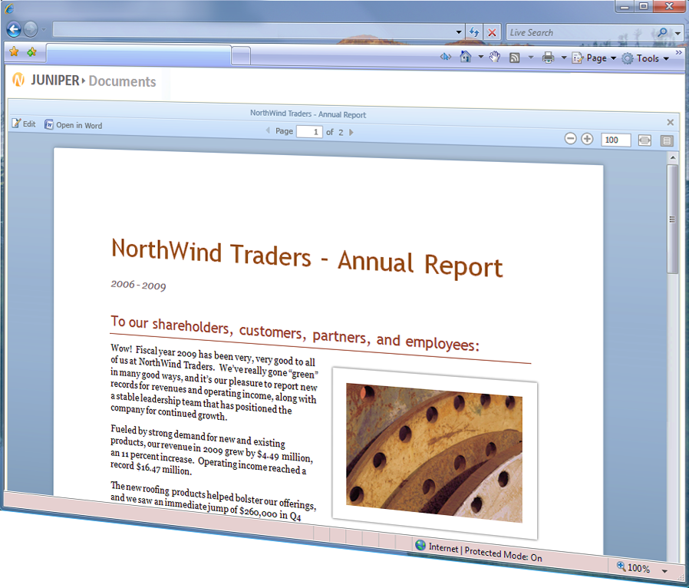
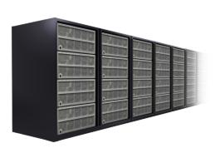









Hybrid strategy
The cloud on your terms
Meeting student and educator needs
Online
On-premises
Unified Communications
Enterprise Content Management
Search and Discover
Learning Analytics
Collaboration
Notes:
his also fundamentally explains why customers like yourself consider Microsoft when it comes to your productivity solution. There are really three things that we believe separate Microsoft from every other competitor in this space, and why we think you should bet on Microsoft for productivity.
1. We’re the only company that is focused on providing the best productivity experience across the PC, the phone, and the browser. Take any competitor in this space—some of them focus on the PC and they have no browser and no phone story. Some of them are completely browser-based. They have no rich client and they have no phone. We believe that your users, and you as users, really do want to use the PC, the phone, and the browser in your daily world. You want to be able to get to your email, no matter what device you’re using. You want to be able to get to your Office documents, no matter what device you’re using. And we’re making that possible with Office 2010, SharePoint 2010, Exchange 2010. We want you to be able to work on your documents, and when someone touches it in the browser, they don’t clobber all of the things that someone did in the rich client. We round-trip the Office documents from the PC, to the phone, to the browser, and back, and nobody else does that. Your investment in Office documents is huge; you do not want to lose that.
We’ve also designed this so that we do things in the PC that are unique from the phone and the browser. We do things in the browser that are unique from the PC and the phone. And we do things on the phone that are unique from the PC and the browser. We haven’t just taken our long list of capabilities and turned a bunch of stuff off and stuck it in the browser. When you’re in the browser, you get unique value that the browser brings to you. When you’re on your mobile phone, you can take photos; we’ll automatically drop those photos into your OneNote digital notebook, and that gets synced up over the cloud, and people who are using their PCs and their browsers see those photos. We don’t have that capability on the PC. So, PC, phone, and browser—the best experience for each one of them.
2. We give you the cloud on your terms. We don’t give you a technology ultimatum where you must move to the cloud to use our technology. We give it to you on your terms. What does that mean? It means that a customer like the Kentucky Department of Education can implement our cloud based messaging and collaboration solution to all of their users – students, educators and staff. And, other educational institutions, such as Middlesex university can choose a hybrid approach with students on cloud services and educators and staff remaining on an on-premises solution. And so you can have the cloud on your terms. We believe that is very, very important, and we’re dedicated to helping you think about how to use the cloud in the most effective way.
3. Finally, the third reason we believe that you should bet on Microsoft is because we have the broadest vision for what productivity actually is. Productivity is not about desktop documents. It’s not about word processing and spreadsheets. That was twenty years ago. We believe modern productivity combines the things you see at the bottom of this slide in a very seamless experience.
Search and Discover: 21st century enabled learning is no longer about lectures and textbook. The new model is about discovery and learning.
Collaboration: It means great collaboration
ECM: It means enterprise class content management for your educational institution. Why do you have different publishing systems for your intranet, and your extranet, and your Internet? You want your users to have the office tools they’re familiar with and integrate those with your single enterprise content management system.
Learning Analytics: We believe in self-service Learning Analytics. Our tools making it incredibly easy for you to visualize and share your information across your educational institution.
UC: And of course we believe modern productivity means unified communications.
No other company takes this broad of view of what productivity means.

Slide 7





Microsoft Data Centres
Investments
$2.3B+ in cloud infrastructure
200+ services, delivered 24x7
Geo-distributed datacenters
Rapid modular model
30,000+ engineers
Operational Excellence
Federated operations
centers 24x7
Standardized reporting
Secure, compliant infrastructure
FISMA certified, SAS 70
& ISO 27001 compliant
Carbon footprint reduction
Notes:
What does it take to do this successfully. Well, you can’t head-fake your way into building these cloud platforms and services, this isn’t a game of basketball. It takes a blend of expertise and the right investments to pull this off.
NO OTHER company can match Microsoft today in our experience on running and building services. We know what it takes to do this, because we’ve been running services at Internet scale for years – from MSN in 1995, to Hotmail, Windows Live, and Bing, today.
For example, we handle:
9.9 billion messages a day via Windows Live Messenger
600 million unique users every month on Windows Live & MSN
1 Petabyte+ of updates served every month by Windows Update to millions of servers and hundreds of millions of PCs worldwide
5M LiveMeeting conference minutes per year
Forefront for Exchange filters 1B emails per month
To support this and our business cloud services, we’ve made and continue to make significant investments in our datacenter infrastructure that our cloud services run on – resulting in a number of advantages: financially backed SLAs, a standard cost operating model, industry-leading modular datacenter models, a consumption-based chargeback model, and the ability to achieve global targets like a Power Usage Effectiveness (PUE) of 1.25.
This is all alongside our full commitment in the engineering discipline and the operations discipline around delivering the cloud.
Deeper Details on Microsoft Global Foundation Services (GFS)
Infrastructure Services Operations – Microsoft Global Foundation Services (GFS) manages our global network of data centers and provides 1) Physical and Site Security 2)Critical Environments Support (Power, Water, Redundancy) and 3) Technical Support (Racks, Servers, Switches) with a focus on operational excellence to deliver lowest cost and highest service delivery globally.
Data Center Innovation – GFS continues to deliver effective and efficient DC and infrastructure designs that deliver the most value to our internal customers. Today this means our IT Pre-Assembled Components (ITPACs) for our future modular data centers will provide a lower cost CAPEX per Mega Watt, enhanced speed to market, and reduction in OPEX. ITPACs are a game changer.
Global Capacity – When choosing future datacenter sites, we take into account over 35 weighted criteria, including close proximity to an ample and stable power source and fiber optic networks, affordable pool of skilled labor, affordable energy rates, taxes, and capacity capabilities needed for our local, regional and global customers to determine the long-term viability of each site.
Utility pricing – this is how GFS charges its customers by consumptions units and Consumption statements are issued every 30 days to customers for: Compute (VM / hour), Storage ($ per GB), Network (traffic), Incidents (tickets)
SOC/NOC – GFS manages the Microsoft Operations Center (MOC) that is a Tier 1 federated Ops center with failover in Redmond, India and California to ensure business continuity 24 x 7 x 365. The MOC is focused on delivering a comprehensive incident management and service support, with world class quality of service for 200 + property groups supporting incident management in a highly cost efficient model. They process more than 150K tickets a month supporting incidents, change management, release management and problem management. They are the first line of operational support for our cloud properties. Turnkey operations take a service from on-boarding to tooling through support. MOC supports non-windows environment.
MOC uses MS Change as a primary change management tool (most universally recognized change management tool)
Consumption Reporting: New Cost Model focuses on measuring and forecasting capacity utilization, cost driver transparency and accountability, and investment optimization and is aligned with ‘Improve Cost’ strategic theme. Key measurements: $/kW, $/Mbps, $/Incident, $/Server to provide transparent, accurate volume & rate insight by cost pool aligned to native cost. Standard rates by region, where applicable, provide greater predictability for BGs’ online COGS
Hardware Services – GFS provisions hardware via various standards programs such as containers, ITPACs and the Azure and MACH server programs.

Slide 8






Live@edu Momentum - Student email
21 M Users WW
users four months ago
90% cost savings over existing email solution
6M+ UK users on Live@edu
88% of UK HE hosted institutions on Live@edu
60+ UK Universities on Live@edu
Summer deployments of 250,000+ UK students to move to Live@edu
Notes:
Microsoft is not new to Cloud Services
Hotmail 1990’s
Live@Edu 2000’s – free email for students and staff
Momentum, success
50 universities signed up, strong summer pipeline,
15M WW users, 3.5M in the UK,
41% Universities on cloud, 88% Live@edu

Slide 9
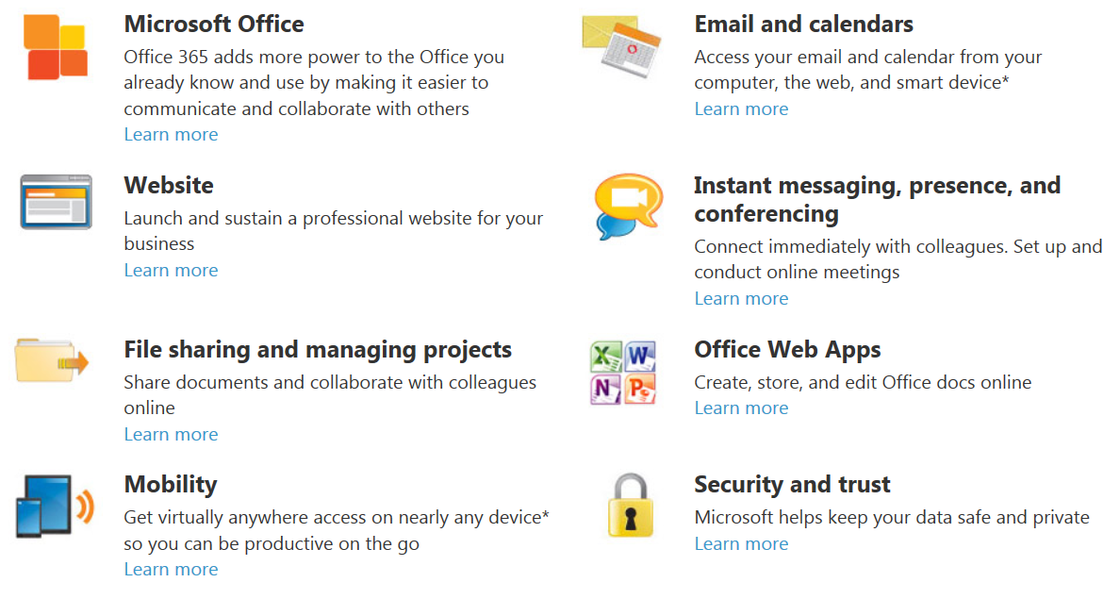
What is Office 365?

Slide 10



What is Office 365?
25GB Mailbox
Integrated personal archiving
Exchange Control Panel
Free/busy coexistence
Cross premises management
IM & Presence across firewalls
GAL/Skill search in SharePoint
Online meeting with desktop sharing
Activity feeds
Contact photos
Click to communicate from Office contact cards
Windows Live federation
My Sites to manage and share documents
Access documents offline
Improved Team & Project Sites
Document-level permissions to protect sensitive content
Share documents securely with Extranet Sites
Cross site collection search
Notes:
Building upon our success in the marketplace and based on what we have heard from our customers, with Office 365 we will be introducing a set of new features across all workloads and the platform

Slide 11
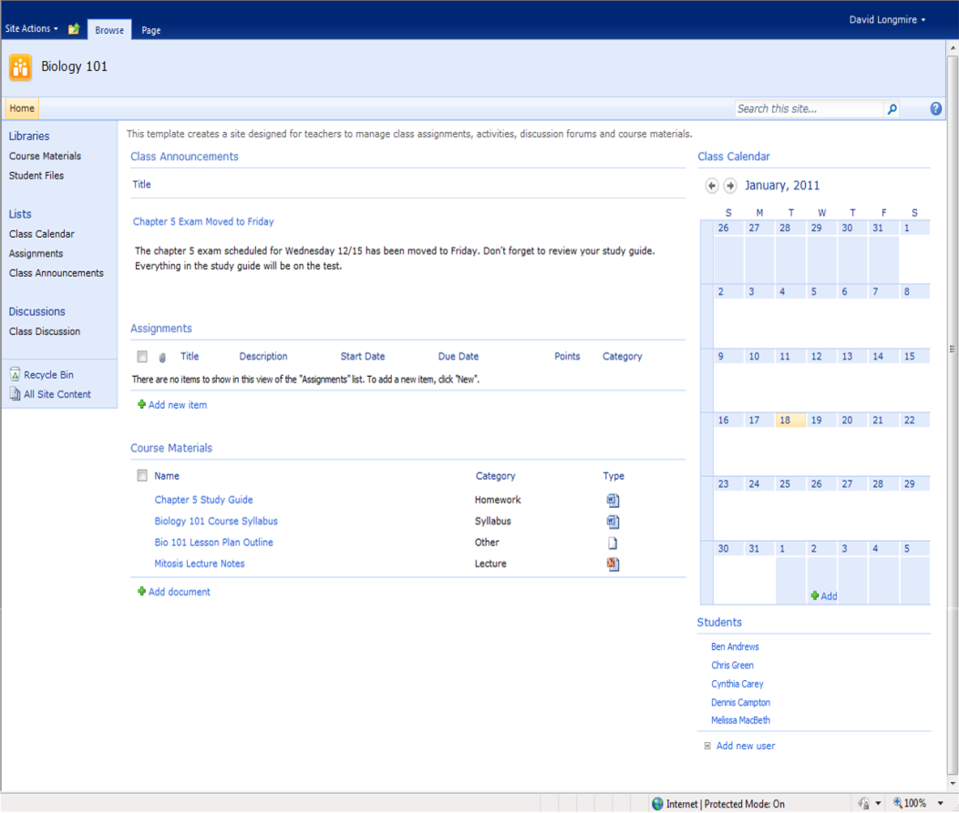
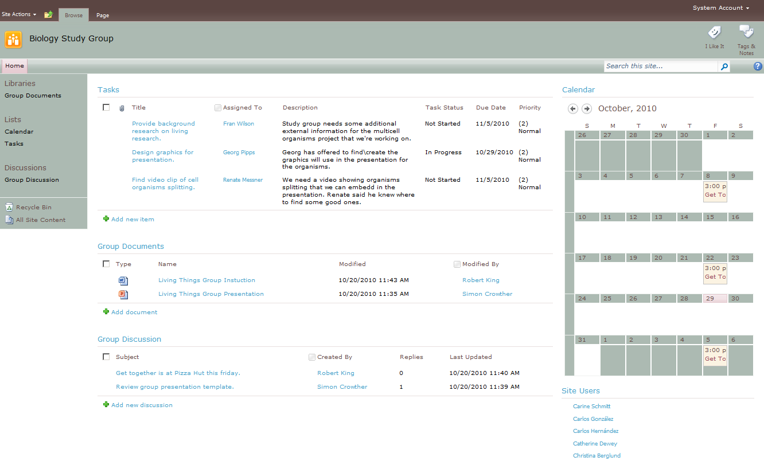
Education Templates
“Out of Box” Templates available through Office.com
Additional Templates coming soon
Class Site
Study Group Site
Notes:
http://office.microsoft.com/en-us/templates/classroom-and-study-group-templates-TC102561970.aspx

Slide 12



Benefits of Office 365
Significant savings
  Less Hardware
  Reduced Energy costs
  Release valuable resource
Accessibility
  Anytime Anywhere access
Any Device
  Supports personal choice

Slide 13

Benefits of Office 365
Easy Collaboration
  Project and team sites easily created
  Share documents control access
Document Fidelity
  Consistency between web and local access
Familiar tools
  Minimum learning curve

Slide 14
Office 365 for education
Plan A4
A Family of A (Academic) Plans
Plan A3
Voice
Office Pro Plus
Office Pro Plus
Free for Staff & Students
Home Use Rights
up to 5 PCs
Home Use Rights
Up to 5 PCs
No Faculty/Staff purchase required
Voicemail & advanced archive capabilities
Voicemail & advanced archive capabilities
Plan A2
Access, Excel, Forms,
Visio Services
Access, Excel, Forms,
Visio Services
Plan A1
Office Web Apps
Office Web Apps
Office Web Apps
IM & Presence
IM & Presence
IM & Presence
IM & Presence
SharePoint Online - Collaboration
SharePoint Online - Collaboration
SharePoint Online - Collaboration
SharePoint Online - Collaboration
Exchange Online
Conferencing
Conferencing
Conferencing
Conferencing
Email, calendar, AV/AS, Personal Archive
Email, calendar, AV/AS, Personal Archive
Email, calendar, AV/AS, Personal Archive
Email, calendar, AV/AS, Personal Archive
Email, calendar, AV/AS, Personal Archive
Students
Free
Free
Free
Subscription
Subscription
Faculty & Staff
Free
Free
Free
Subscription
Subscription

Slide 15
Office 365 for education
A Family of A (Academic) Plans
Exchange Online | Plan A1 | Plan A2 | Plan A3 | Plan A4
Students
Free
Free
Free
Subscription
Subscription
Faculty & Staff
Free
Free
Free
Subscription
Subscription
Email & Calendaring
Advanced administration capabilities, active directory integration and 24/7 IT administration support | l | l | l | l | l
Email with 25GB mailbox storage | l | l | l | l | l
Calendar and contacts | l | l | l | l | l
Premium anti-spam and anti-virus filtering | l | l | l | l | l
Personal archive | l | l | l | l | l
Advanced archive capabilities, unlimited email storage |  |  |  | l | l
Communications & Collaboration
Sites to share documents and information |  | l | l | l | l
Instant messaging and video calls |  | l | l | l | l
Online meetings |  | l | l | l | l
Office Productivity Tools
Document viewing and light editing with Office Web Aps |  |  | l | l | l
Complete and full-featured set of office productivity applications - Office Professional Plus |  |  |  | l | l
Home Use Rights for up to 5 PCs |  |  |  | l | l
Publish Access Databases, share Excel workbooks, build InfoPath Forms, and share Visio business processes and diagrams |  |  |  | l | l
Advanced Communications
Hosted voicemail |  |  |  | l | l
Enterprise voice capabilities |  |  |  |  | l
Free for students – no faculty/staff purchase required

Slide 16
Early Customer Feedback for Office 365
“Before moving to Office 365 for education, the IT department would receive daily notifications of errors and outages plaguing our email system. After moving to Office 365, we haven't received a single notification.”
Tom Mortimer
Director, Information and Communication Services
University of Dundee
“As Office 365 builds on the experience our Students have already gained through using Desktop MS products, the transition has been extremely straightforward and hassle free.”
Eric Stone
IT Services Manager
East Norfolk Sixth Form College
“We would have had to invest thousands to have ensured the level of uptime and support that Office 365 for education provides as a standard service.”
Julian Elve
Head of Information Services
The Schools Network (formerly SSAT)
“Our students and academic staff are delighted by Office365 because it is both intuitive to use but all aspects have a familiar look-and-feel. They are all asking whether Office365 could displace more/all of the other stand-alone applications which bedevil teaching environment.”
Paul Hopkins
IT Director
University of West London

Slide 17
Office 365 - Your Privacy Matters
No Advertising
  No scanning of School information
  No profiling for advert products
No Mingling
  College data separate from
  consumer data
Data Portability
  College data totally portable
Advert free
Privacy
Portable

Slide 18

Office 365 - Independently Verified
IS0 27001
Certified for ISO27001
  The first Cloud service to be accredited
EU Model Clauses
  First Cloud service to sign up to clauses
Data Process Agreement
  Adheres to local compliance laws
EU Data Laws
Adheres to
Local laws

Slide 19
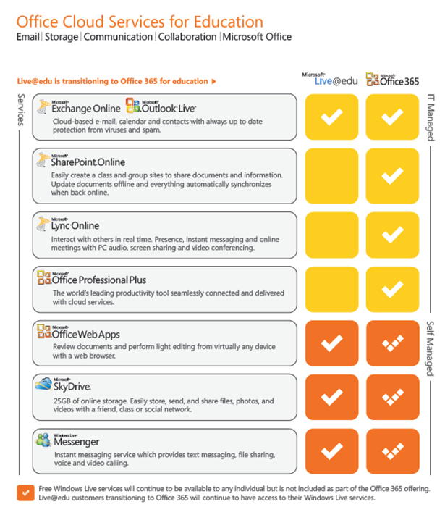
Key Differences
10Gb Pooled + 500Mb PT
500Mb fixed per tenant
Managed Storage
Federated Services
Single Sign On

Slide 20
Useful sites
Service Descriptions
http://www.microsoft.com/download/en/details.aspx?id=13602
Office 365 deployment guide
http://blogs.msdn.com/b/ukliveatedu/archive/2012/04/24/essential-reading-office-365-for-education.aspx
Assessment and Planning toolkit
http://blogs.msdn.com/b/ukliveatedu/archive/2012/05/02/is-your-it-environment-ready-for-office-365-for-education.aspx
Microsoft Office 365 Main Site
http://www.microsoft.com/en-us/office365/online-software.aspx#fbid=gUZS0S28way
Security, Compliance and Privacy information
http://www.microsoft.com/en-us/office365/trust-center.aspx#fbid=gUZS0S28way
Office 365 Video introductions
http://office.microsoft.com/en-gb/videos/office-365-for-enterprises-a-tour-for-administrators-HA102654955.aspx?redir=0
Video tour giving a user perspective
http://office.microsoft.com/en-gb/videos/office-365-a-tour-for-users-HA102657904.aspx?CTT=5&origin=HA102654955

Slide 21
markmcm@microsoft.com
Thank You
Twitter: @MarkSMcManus

Slide 22




Office 365 Offerings – Standalone Offerings - Student
Workload
Standalone SKUs
Key Features
Exchange Online (Plan 1)
£0.00
Email, Calendar, Contacts, Discovery, AV/AS
Exchange Online (Plan 2)
£ 0.76
Voicemail and archiving
SharePoint Online (Plan 1)
£0.00
Advanced portal for collaboration, AV
SharePoint Online (Plan 2)
£ 0.76
Forms, data visualization, Access/Excel/Visio Services
Lync Online (Plan 1)
£0.00
Instant Messaging and Presence, AV
Lync Online (Plan 2)
£0.00
Virtual meetings
Office Professional Plus
£1.01
Client productivity applications and Web Apps
Office Web Apps (Plan 1)
£0.00
Office Web productivity applications and
SharePoint Online Plan 1
Office Web Apps (Plan 2)
£0.76
Office Web productivity applications and
SharePoint Online Plan 2
Plan 2 offers include all features from Plan 1; offers are inclusive and not additive
Estimated retail prices listed above per user, per month

Slide 23
Office 365 Offerings – Standalone Offerings - Faculty
Workload
Standalone SKUs
Key Features
Exchange Online (Plan 1)
£0.00
Email, Calendar, Contacts, Discovery, AV/AS
Exchange Online (Plan 2)
£1.51
Voicemail and archiving
SharePoint Online (Plan 1)
£0.00
Advanced portal for collaboration, AV
SharePoint Online (Plan 2)
£1.51
Forms, data visualization, Access/Excel/Visio Services
Lync Online (Plan 1)
£0.00
Instant Messaging and Presence, AV
Lync Online (Plan 2)
£0.00
Virtual meetings
Office Professional Plus
£1.34
Client productivity applications and Web Apps
Office Web Apps (Plan 1)
£0.00
Office Web productivity applications and
SharePoint Online Plan 1
Office Web Apps (Plan 2)
£1.51
Office Web productivity applications and
SharePoint Online Plan 2
Plan 2 offers include all features from Plan 1; offers are inclusive and not additive
SharePoint Online Extra Storage: £0.15
Exchange Online Archiving : £0.76
Estimated retail prices listed above per user, per month

Slide 24
Office 365 for education
Plan A4
A Family of A (Academic) Plans
Plan A3
Voice
Office Pro Plus
Office Pro Plus
Free for Staff & Students
Home Use Rights
up to 5 PCs
Home Use Rights
Up to 5 PCs
No Faculty/Staff purchase required
Voicemail & advanced archive capabilities
Voicemail & advanced archive capabilities
Plan A2
Access, Excel, Forms,
Visio Services
Access, Excel, Forms,
Visio Services
Plan A1
Office Web Apps
Office Web Apps
Office Web Apps
IM & Presence
IM & Presence
IM & Presence
IM & Presence
SharePoint Online - Collaboration
SharePoint Online - Collaboration
SharePoint Online - Collaboration
SharePoint Online - Collaboration
Exchange Online
Conferencing
Conferencing
Conferencing
Conferencing
Email, calendar, AV/AS, Personal Archive
Email, calendar, AV/AS, Personal Archive
Email, calendar, AV/AS, Personal Archive
Email, calendar, AV/AS, Personal Archive
Email, calendar, AV/AS, Personal Archive
Students
Free
Free
Free
£2.01/month
£2.41/month
Faculty & Staff
Free
Free
Free
£3.61/month
£4.82/month
Office Professional Plus Subscription : £1,01 (student), £1.43 (Faculty)
SharePoint Online Extra Storage: £0.15
Exchange Online Archiving: £ 0.76
Estimated retail prices listed above per user, per month

Slide 25
Office 365 for education
A Family of A (Academic) Plans
Exchange Online | Plan A1 | Plan A2 | Plan A3 | Plan A4
Students
Free
Free
Free
£2.01/month
£2.41/month
Faculty & Staff
Free
Free
Free
£3.61/month
£4.82/month
Email & Calendaring
Advanced administration capabilities, active directory integration and 24/7 IT administration support | l | l | l | l | l
Email with 25GB mailbox storage | l | l | l | l | l
Calendar and contacts | l | l | l | l | l
Premium anti-spam and anti-virus filtering | l | l | l | l | l
Personal archive | l | l | l | l | l
Advanced archive capabilities, unlimited email storage |  |  |  | l | l
Communications & Collaboration
Sites to share documents and information |  | l | l | l | l
Instant messaging and video calls |  | l | l | l | l
Online meetings |  | l | l | l | l
Office Productivity Tools
Document viewing and light editing with Office Web Aps |  |  | l | l | l
Complete and full-featured set of office productivity applications - Office Professional Plus |  |  |  | l | l
Home Use Rights for up to 5 PCs |  |  |  | l | l
Publish Access Databases, share Excel workbooks, build InfoPath Forms, and share Visio business processes and diagrams |  |  |  | l | l
Advanced Communications
Hosted voicemail |  |  |  | l | l
Enterprise voice capabilities |  |  |  |  | l
Free for students – no faculty/staff purchase required
Estimated retail prices listed above per user, per month

