Slide 1

Bring Your Own Device
Russell Dyas
Impero Software

Slide 2
Who Am I?
Russell Dyas:
- Educational Technologist
- Quality Assurance Manager
Previous to Impero:
- Marketing & PR Manager For EduGeek.net
- Network Manager For Over Ten Years Working In
Schools and Colleges.
- Provided ICT Advice & Expertise To Various National
Bodies Such As NAACE and BECTA.

Slide 3
How We Got Here
90’s
  Tony Blair came into power started funding projects connected with ICT in
  education.
  The key figure was all about Pupil To Computer Ratio
Early 2000’s
  Various projects especially in the USA around one laptop per child.
Now
  Then the credit crunch hit and that one laptop per child model was not
  viable option.
  Due to cost saving education establishments have started to look at Bring
  Your Own Device

Slide 4
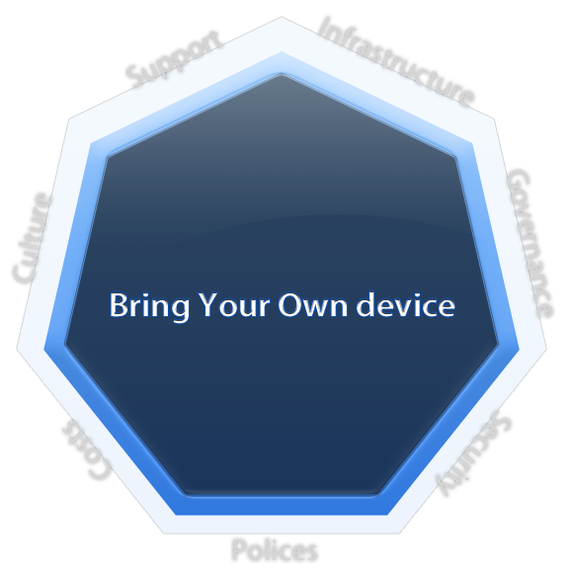
Bring Your Own Device
Implementation Model

Slide 5

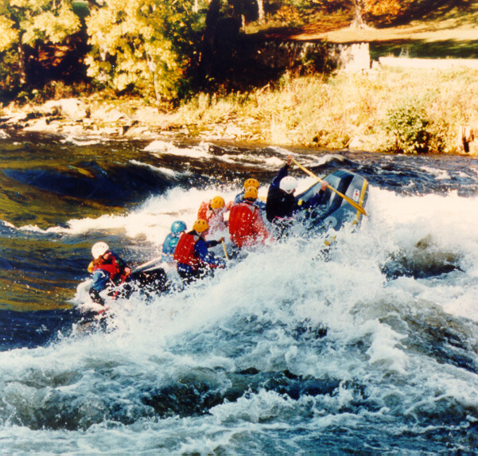

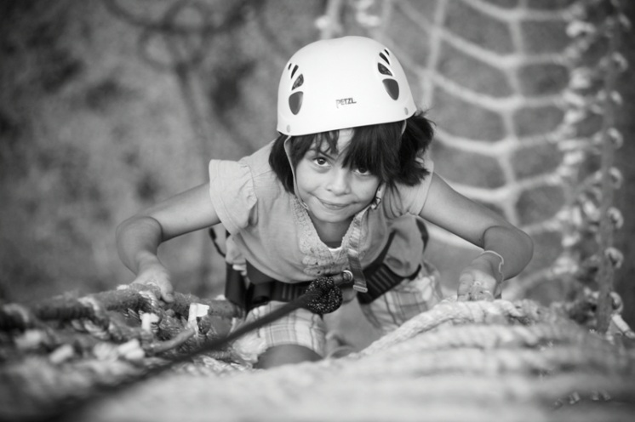
Challenges

Slide 6
Support
Different Hardware Types
  Laptops
  Mobile Phones
  Netbooks
Different Hardware Types
  Laptops
  Mobile Phones
  Netbooks
Where Does Technical Support Start & End

Slide 7
Infrastructure
  Can your existing setup cope
  Wireless
Existing management tools will they support BYOD

Slide 8
Security
  Patch Management
  Antivirus
Logging

Slide 9
Governance
  Licensing
  Education Software will it run on the OS installed on the students devices.
Cloud based solutions still can have problems running on different platforms.
Safeguarding

Slide 10
Policies
  Time to rip up all your old policies and start writing new ones
  Enforcing AUP

Slide 11
Culture
  Students can bring device but teaching staff need to be empowered.
  Have you got any teaching tools that can be ran on student devices
Training what do Your suppliers offer
Is it free or does it cost
What type technical, teacher or both
Set expectations
What can and can’t be one.

Slide 12
What Next
  Plan what you want from BYOD implementation
  Educational outcomes
  Cost savings over longer term
Audit what you currently have. Look at each of the areas and work what you have currently got
Infrastructure
Support/Licensing
Governance
Security
Policies
Culture
Cost
  What other areas can we save at same time
  Power management
  Software consolidation

Slide 13
Any Questions?
Download the presentation &
found out more at
www.imperosoftware.com/edit2012/edit.html

