Slide 1


Presentation date: 07/06/12
Prepared by: Epson UK Ltd
PRINTING THAT DOESN'T COST THE EARTH

Slide 2


IF I COULD OFFER YOU A PRINTER THAT IS…
THE GREENEST ON THE MARKET
ALLOW YOU TO BRING PRINTING BACK INTO THE CLASSROOM
AND AT VERY LOW COST PER PAGE
Would that get your interest?

Slide 3
BEATING THE RECESSION
‘…as we emerge from the recession new technologies will act as a catalyst for drawing costs out of operations, going green and increasing productivity’
2010 Info Trends

Slide 4
MICRO PIEZO® TECHNOLOGY IS THIS CATALYST

Slide 5
MICRO PIEZO® DELIVERS AN UNASSAILABLE ‘GREEN’ ADVANTAGE OVER ANY OTHER PRINTING TECHNOLOGY

Slide 6

MICRO PIEZO ® TECHNOLOGY
TECHNOLOGY DESIGNED FOR SCHOOLS AND BUSINESSES
UNASSAILABLE ADVANTAGE OVER ANY OTHER PRINTING TECHNOLOGY
GREATER DEGREE OF FREEDOM IN MEDIA CHOICE – INCLUDING ENVELOPES, BANNERS AND THICK CARD
NON CONTACT PRINTING
DESIGN SIMPLICITY
SIMPLE MECHANICAL PROCESS

Slide 7
MICRO PIEZO ® TECHNOLOGY
TECHNOLOGY DESIGNED FOR SCHOOLS AND BUSINESSES
UNASSAILABLE ADVANTAGE OVER ANY OTHER PRINTING TECHNOLOGY
PRECISE CONTROL – EXCELLENT PRINT QUALITY AND HIGH SPEED
NO HEAT INVOLVED - ALLOWS USE OF VERY FAST DRYING INKS
EXCELLENT PRINT HEAD DURABILITY

Slide 8
WHY IS 70% OF THE LASER MARKET STILL MONO?
Colour laser running costs too high > 10p per page
Small colour lasers too expensive to run;
large ones expensive to buy
Unexpectedly high colour laser maintenance costs; replacement drums, fusers, belts cost as much as the printer
Colour laser warm up time – long wait for first page to print
User complexity – users do not like to change the toners
FIXED

Slide 9
HAS BUSINESS INKJET BEEN A VIABLE ALTERNATIVE?
More consumer orientated than business
Low Print Quality on plain paper
Slow double-sided printing
Low yield ink cartridges
No professional print emulations (PCL / PS) – required by many businesses
Expensive to print
Limited duty cycle - are they tough enough?
Concerns over water resistance, smudging, fading
FIXED

Slide 10
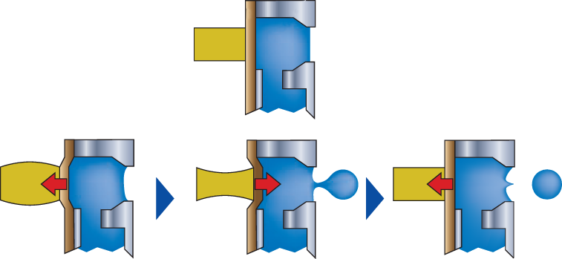
WHAT IS MICRO PIEZO ® TECHNOLGY?
MICRO PIEZO® TECHNOLOGY → PRECISE DROPLET CONTROL
Micro Piezo® Method
Oscillating Plate
Ink Reservoir
A mechanical process
Enables precise control of ink droplet → Drop on demand
Increased response speed
No heat involved
Ink head lasts lifetime of product
Piezoelectric
Element
Pull
Push
Pull
Notes:
Micro Piezo is a mechanical printing method, and possesses a number of advantages over the heat-based thermal systems used by other printer manufacturers, such as accuracy and precision.

Slide 11
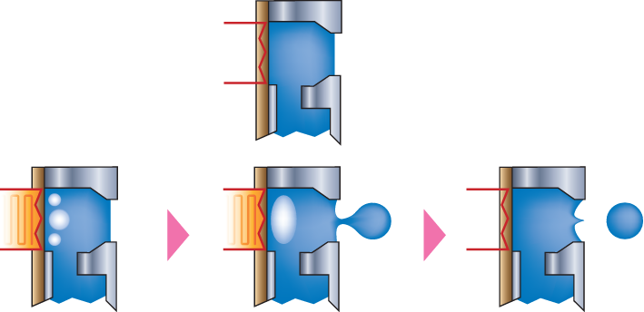
WHAT IS MICRO PIEZO ® TECHNOLGY?
MICRO PIEZO® TECHNOLOGY → PRECISE DROPLET CONTROL
Micro Piezo® Method
Oscillating Plate
Ink Reservoir
A mechanical process
Enables precise control of ink droplet → Drop on demand
Increased response speed
No heat involved
Ink head lasts lifetime of product
Piezoelectric
Element
Pull
Push
Pull
Heat-based Thermal Method
Heat based process
Less control of ink droplet – heat less easy to turn on/off precisely
The movement of the ink is less precise reducing accuracy
Ink head often require replacement
Heater
Heating
Heating
Notes:
Micro Piezo is a mechanical printing method, and possesses a number of advantages over the heat-based thermal systems used by other printer manufacturers, such as accuracy and precision.

Slide 12
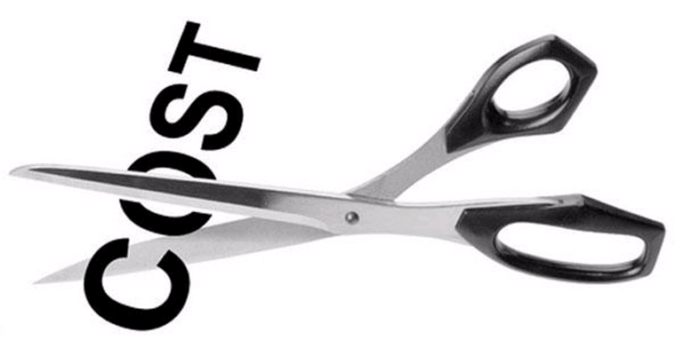
TAKING THE COST OUT OF PRINTING IN SCHOOLS

Slide 13
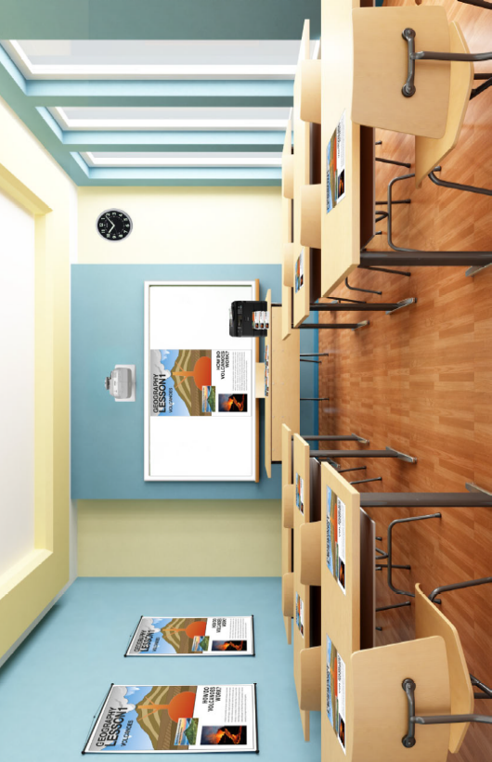
DRAWING OUT THE COST OF PRINTING IN SCHOOLS
Up to 50% lower cost per page
Power consumption: cut power consumption by 80% compared to a colour laser
No heat generation – printer can be located anywhere
Duplex printing
High yield cartridges 3,400 pages
No fusers, belts or drums to change
Reduced IT resource – the easiest cartridges to change – minimal intervention
Tough - designed for school usage
Notes:
13

Slide 14
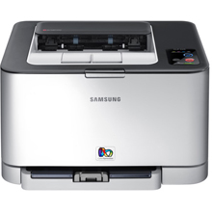
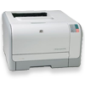
TOP SELLING COLOUR LASERS
WHICH ONE WOULD YOU CHOOSE?
1-10 PPM
#1 MARKET LEADER
£101
#2
£109
£200
Pricing taken from Printerland.co.uk May 2012

Slide 15
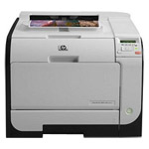
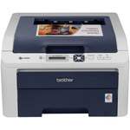
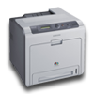
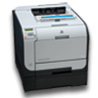
TOP SELLING COLOUR LASERS
WHICH ONE WOULD YOU CHOOSE?
1-10 PPM
11-20 PPM
#1 MARKET LEADER
£101
#2
£109
£300
#1 MARKET LEADER
#2
£106
£200
#4
£275
#3
Pricing taken from Printerland.co.uk May 2012

Slide 16
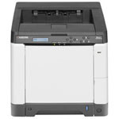
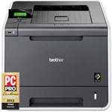
TOP SELLING COLOUR LASERS
WHICH ONE WOULD YOU CHOOSE?
1-10 PPM
11-20 PPM
21-31 PPM
#1 MARKET LEADER
£101
#2
£109
£235
#2
£300
#1 MARKET LEADER
£346
#1 MARKET LEADER
#2
£106
£200
#4
£275
#3
Pricing taken from Printerland.co.uk May 2012

Slide 17
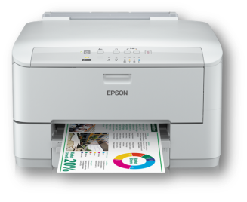
TOP SELLING COLOUR LASERS
WHICH ONE WOULD YOU CHOOSE?
1-10 PPM
11-20 PPM
21-31 PPM
MICRO PIEZO
£110
#1 MARKET LEADER
£101
#2
£109
£235
#2
£300
#1 MARKET LEADER
£346
#1 MARKET LEADER
#2
£106
£200
#4
£275
#3
Pricing taken from Printerland.co.uk May 2012

Slide 18

TOP SELLING COLOUR LASERS
WHICH ONE WOULD YOU CHOOSE?
Total cost of ownership analysis
Cost of printer + cost of printing
Total cost to print 10,000 colour pages
This equates to 1 years worth of printing – 800 pages per month – 40 per day

Slide 19
TOTAL COST OF OWNERSHIP
10,000 COLOUR PAGES
Notes:
19

Slide 20
TOTAL COST OF OWNERSHIP
10,000 COLOUR PAGES – APPROX 1 YEAR PRINTING, 1 PRINTER
Notes:
20

Slide 21
TOTAL COST OF OWNERSHIP
10,000 COLOUR PAGES – APPROX 1 YEAR PRINTING, 1 PRINTER
Potential saving of £800 per year per printer
In a school with 20 printers this could deliver savings of nearly £50k over 3 years
Notes:
21

Slide 22
TOP SELLING COLOUR LASERS
WHICH ONE WOULD YOU CHOOSE? COST PER PAGE
13.21p per page
1-10 PPM
11-20 PPM
21-31 PPM
MICRO PIEZO
£110
#1 MARKET LEADER
3.5p per page
13.21p per page
£101
#2
£109
18.3p per page
8.5p per page
£235
12.38p per page
#2
£300
#1 MARKET LEADER
£346
9.8p per page
12.3p per page
9.49p per page
14.3p per page
#1 MARKET LEADER
#2
£106
£200
#4
£275
#3
Pricing taken from Printerland.co.uk May 2012

Slide 23
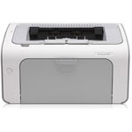
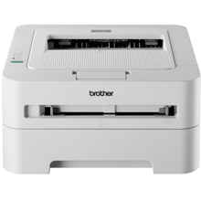
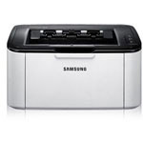
TOP SELLING MONO LASERS
WHICH ONE WOULD YOU CHOOSE?
1-20 PPM
#1 MARKET LEADER
£67
#2
£50
#3
£48
Pricing taken from Printerland.co.uk May 2012

Slide 24
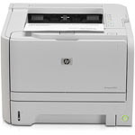
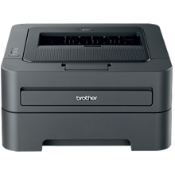
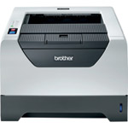
TOP SELLING MONO LASERS
WHICH ONE WOULD YOU CHOOSE?
1-20 PPM
21-30 PPM
#1 MARKET LEADER
£67
#2
£50
#3
£160
£48
#3
#1 MARKET LEADER
£109
#2
£127
Pricing taken from Printerland.co.uk May 2012

Slide 25
TOP SELLING MONO LASERS
WHICH ONE WOULD YOU CHOOSE?
1-20 PPM
21-30 PPM
MICRO PIEZO
#1 MARKET LEADER
£67
2.7p per page
#2
£50
£110
1p per page
2.3p per page
#3
£160
£48
#3
2.4p per page
1.6p per page
#1 MARKET LEADER
£109
#2
£127
2.3p per page
1.4p per page
Pricing taken from Printerland.co.uk May 2012

Slide 26
TOTAL COST OF OWNERSHIP
30,000 MONO PAGES
Notes:
26

Slide 27
TOTAL COST OF OWNERSHIP
30,000 MONO PAGES
Notes:
27

Slide 28
TOTAL COST OF OWNERSHIP
30,000 MONO PAGES
Potential saving of £200-600 per printer
In a business with 20 printers this could deliver savings of £12k across the fleet
Notes:
28

Slide 29
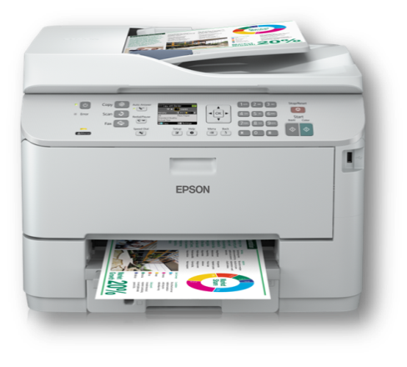



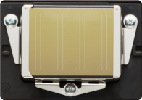
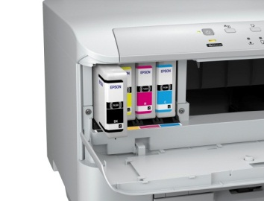
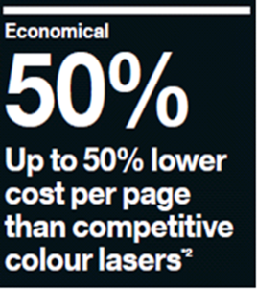
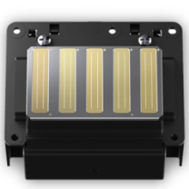
MICRO PIEZO ™ TECHNOLOGY
GREENEST PRINTING TECHNOLOGY
Ecological – 80% lower energy consumption compared to competitive colour lasers
75% less CO₂ generated over life
No heat generation
No ozone or particulates
Duplex printing
High yield cartridges 3,400 pages
Micro Piezo™ printer
Micro Piezo™ print head technology delivers outstanding print quality for all business applications.
Notes:
The Epson WorkForce Pro is ideal for sharing in a small workgroup
It is solid, professional and robust – ideal for busy work areas
High-yield ink cartridges (up to 3,400 pages) cut print cost by up to 50%
80% lower energy consumption compared to competitive colour lasers
Greener than a colour laser printer - 75% less CO₂ is generated over the life cycle
PCL and genuine PostScript drivers ensure seamless integration
Very simple to use – the large capacity cartridges are so easy to replace

Slide 30
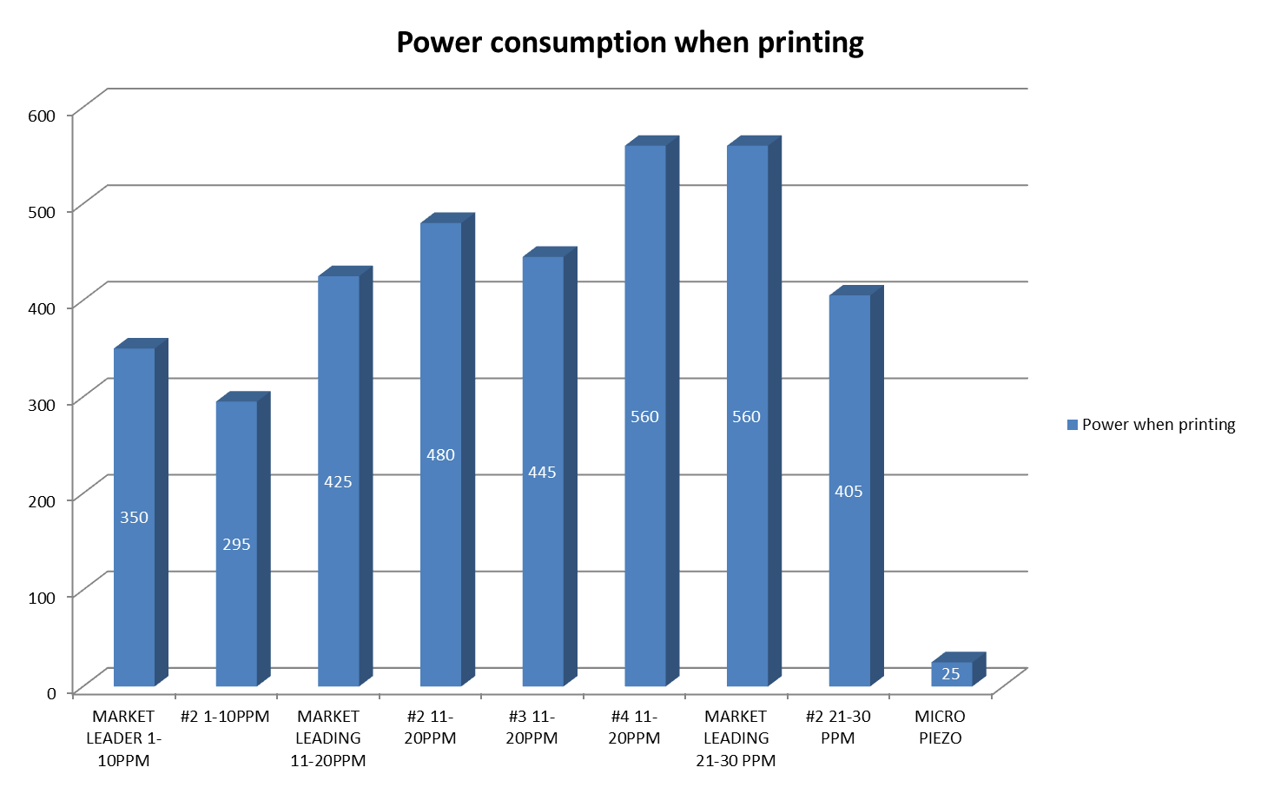
MICRO PIEZO™ TECHNOLOGY
GREENEST PRINTING TECHNOLOGY
Up to 80% lower power consumption compared to colour laser
Data taken from manufacturers published information

Slide 31



MICRO PIEZO™ TECHNOLOGY
REDUCING ENVIRONMENTAL IMPACT
Micro Piezo technology demonstrates a clear commitment to the environment – these innovative products that are reliable, recyclable and energy efficient
Global Warming Impact across life Cycle
(CO₂ equivalent : kg)
SAVE
Micro Piezo
106
Paper
Cost
Energy
Time
Space
The environment
Laser
434

Slide 32

Increasing Productivity
Keeping children and teachers focussed in the classroom

Slide 33
BALANCED DEPLOYMENT
KEEP PRINTING IN THE CLASSROOM
Print where you need it – creating the perfect balance between a large shared MFD and local shared low cost print
Cut waste - reduce un-picked up printed pages or printing twice
Cut movement of children (and teachers) around school
No warm-up time – no delay
Print from ipads
Integrate print into classroom activities

Slide 34
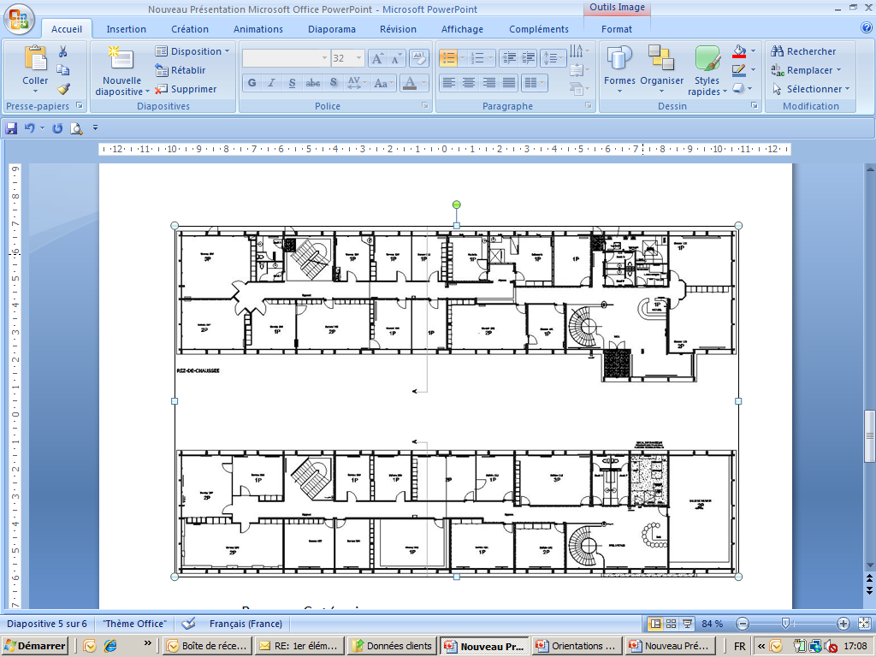
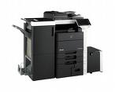
BALANCED DEPLOYMENT
KEEP PRINTING IN THE CLASSROOM – DOES THIS SCENARIO MAKE SENSE?
Low cost printing
Easy control and management
Lack of flexibility for children and teachers
Paper wastage – unpicked up work

Slide 35

BALANCED DEPLOYMENT
KEEP PRINTING IN THE CLASSROOM
Low cost printing retained
Easy control and management
Complete flexibility
Limited wastage
Balanced

Slide 36

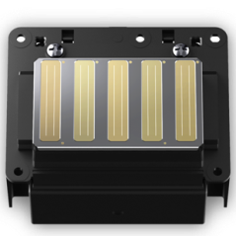
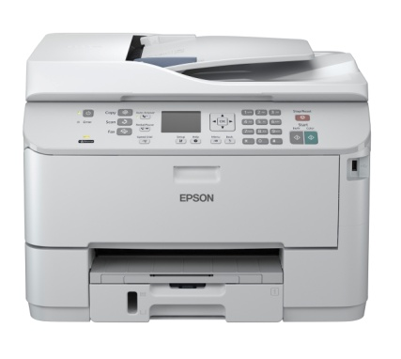


NEW TECHNOLOGY
APPLE AIRPRINT ENABLED
Print directly from Apple iPad, iPhone or iPod Touch
No need to install a driver or configure the printer queue.
Simply select the Printer and print. It's that simple.
Super-fast double-sided printing
Printer must be connected to network
First page out in less than 8 seconds
Notes:
he WorkForce Pro is the best solution for Small office / Home office. It has a solid, professional and robust look and feel.
Up to 50% lower print costs than colour lasers up to 20ppm delivers genuine savings
Low energy consumption keeps cost low
The WorkForce Pro delivers super-fast, printing across the network ,via USB or WiFi with the first page out in less than 8 seconds
Epson Connect enables mobile printing from smartphones and tablet PCs. The printer can also be assigned an email address for printing from anywhere.
Print directly from your iPad, iPhone or iPod touch using AirPrint

Slide 37








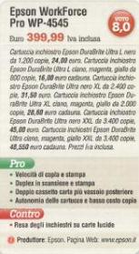




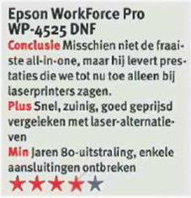

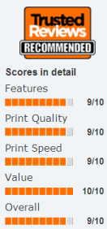
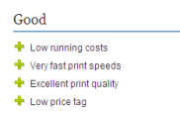






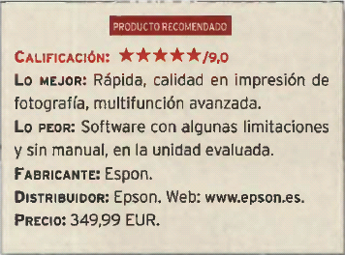
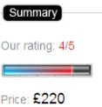
AND THE RESULTS…
MANY AWARDS WON

Slide 38
BUSINESS PRINTING IS CHANGING
SUMMARY
New Micro Piezo technology is now changing the world of education and business printing
Delivering ‘the best of both worlds’ compared to laser
It is the ‘ecological choice’ with 80% lower energy consumption compared to a colour laser
It is the ‘economical choice’ with up to 50% lower cost per page compared to a colour laser printer
.

Slide 39
Please come and see this award winning new technology on Stand xxx

Slide 40
Thank You
Any questions?

Slide 41
Presentation date: 07/06/12
Prepared by: Epson UK Ltd
PRINTING THAT DOESN'T COST THE EARTH

