Slide 1

Smoothwall @ Edugeek Conference
June 2012

Slide 2
Who, What, How Long?
Tom Newton, Product Manager, Smoothwall
First I'm going to admit I wrote this last night in the hotel
Then I'm going to talk about Facebook & its ilk for a bit
Then I'm going to cover what we've been up to at Smoothwall
..and then it's your turn to talk to me :)

Slide 3
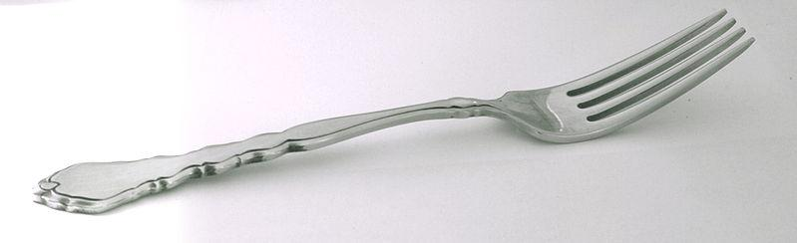
Why is Facebook like a dinner fork?

Slide 4
New Etiquette
Before the invention of the fork, possibly the only civilised thing to have been invented in Sheffield, people largely ate with a knife.
When the fork was invented, suddenly a bunch of rules sprang up:
Which hand do I use? (Americans still get this wrong)
How do I show I have finished eating?
Which fork do I use first?

Slide 5
Facebook Needs to Socialise
Right now, facebook is an early fork. It is easy to use, and most people can get a rudimentary grasp on how to use it but it lacks any real accepted etiquette, for example:
Inappropriate updates and images: things we might not normally share with quite so many people
Noisy or boring people: no I do not want to know about your farm
Anti-social behaviour: bullying, generally being a tit
We would NOT accept these behaviours at lunch with friends

Slide 6
Why is This Difficult?
Wide variety of cultures - need to agree: Left or Right hand, in the land of international connectivity, this matters!
Warp-speed uptake: naught to everyone in 5 years
It is not through "lack of oversight", as your actions on facebook are visible to those whose opinions matter the most: friends and peers

Slide 7
Any Ideas Then?
Social networks need to find ways to punish anti-social users - and hand these methods to their peer groups
Children need to be taught how to use these implements as soon as they can pick them up
This will mean "decriminalising" social networks in schools
(See I told you this was slightly relevant)
...which means more work fun for you and me!

Slide 8
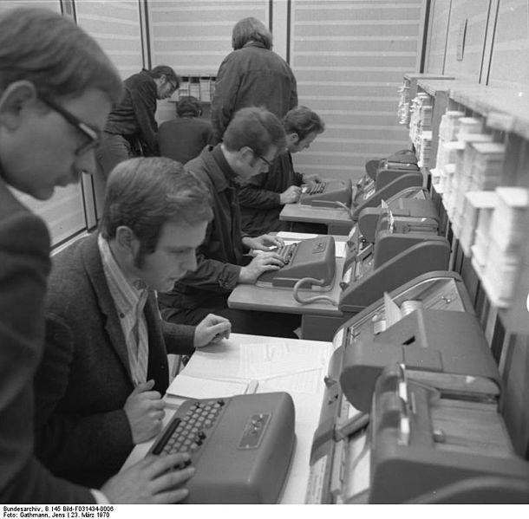
What are Smoothwall up to?
Quick overview of what we've done since last year
...and (some of) what we are planning this year

Slide 9
Guardian 3
Started release May 2011
Now more users than G2!
Still early days... more to come
Small features such as:
  Youtube "safesearch" mode
  New categories like "read only facebook"

Slide 10
New UI Look & Feel
Nice modern look!
Process-based design
Well received by almost everybody
Some good feedback, which we are acting on
Expect more UI improvements - particularly workflow

Slide 11
Quotas
released: April '12
Flexible time based policies in Guardian3
"Allow facebook for an hour a day"
Websense parity (actually a bit better)
No bandwidth quotas (separate product)
Per-day quotas only
Clustering comes (a little bit) later

Slide 12
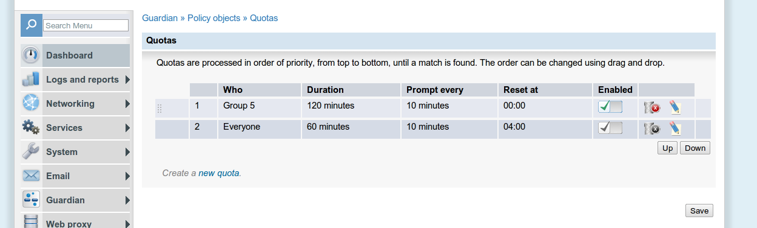
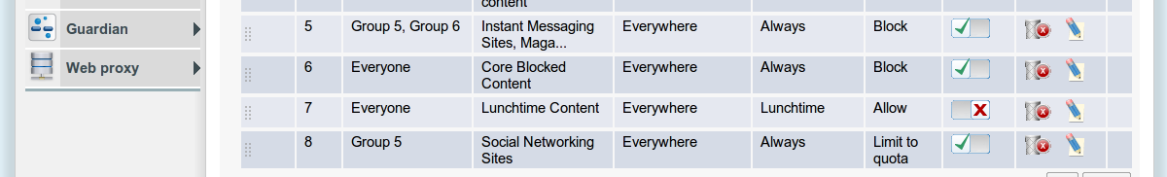
Quota Screenshots

Slide 13
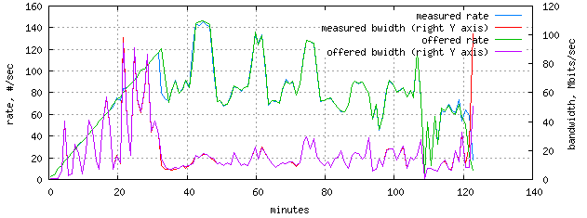
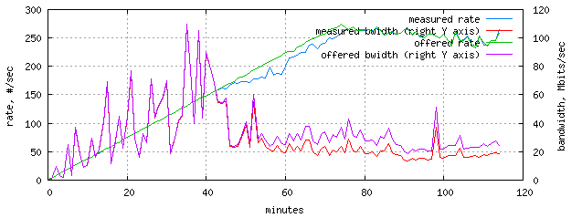
SSL Updates
Been in Closed Beta for a while
Supports future improvements to handling of all types of secure sites
Not that exciting from a feature focus... but performance improvements much more than expected

Slide 14
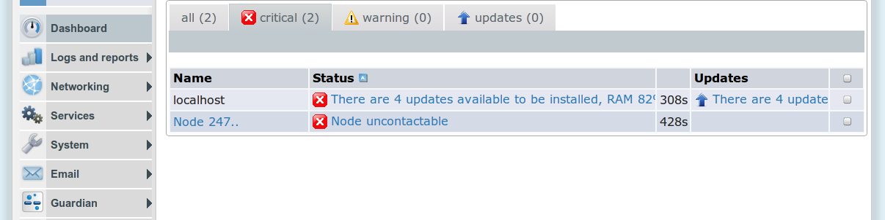
Basic Central Management
Real Soon!
Monitor clusters or disparate systems
Extends existing "replication" tools
Adds full cluster support to quotas
Allows remote updates, and tracking of updates across systems
First cut into central management - a statement of intent

Slide 15

SSL Cookie Login
July '12
No need to keep window open to stay logged in
Designed for "BYOD" and non-PC devices
Improved performance and reliability of existing code
Notes:
image: adamr/freedigitalphotos.net

Slide 16
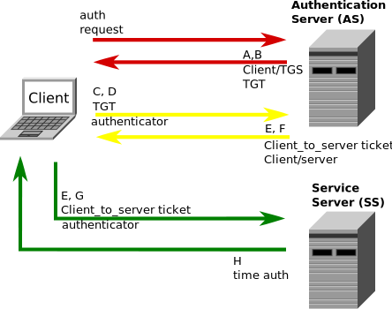
Summer 2012
Kerberos Auth - Windows 8 and seamless Mac Authentication support. Will also include some fixes and minor improvements to the G3 engine. This project has passed PoC stage, and development is well underway. Guardian3 with Kerberos auth has been demonstrated. Beta testers wanted!.
Kerberos: Dull but useful

Slide 17

You tell me
http://smoothwall.uservoice.com/
Bring me more FEEDBACK! I love it :)
Still testing the uservoice system

