Slide 1
Data Protection Act – 2012 Update
Rick Byers
Head of Operations, CTI Group

Slide 2
Welcome to the EduGeek Conference 2012
Who am I?
  Head of Operations for the CTI Group, an international software house, dealing this most of the worlds mobile tier 1 telcos and their data
  Responsible for all CTI Group information security globally
  Member of the British Computer Society Information Security Group (BCS ISSG)
What Are we going to talk about in this session?
  DPA 2012 update
  PECR – aka ‘Cookie Law’

Slide 3
Disclaimer
I am not a lawyer!
If you have a question around certain parts of law, seek professional, legal advice
It might not be any different, but because you’ve paid for it, you’ll feel better!
I am a cynic

Slide 4
Data Protection Act
What is it?
  It’s a piece of legislation, across the EEA (not just the EU), that is supposed to allow the free transfer of personal data, whilst safeguarding that data.
What is it not?
  It’s not designed to stop the flow of data
  Although some countries implement more stringent laws than others
  It’s not designed to stop people knowing things

Slide 5
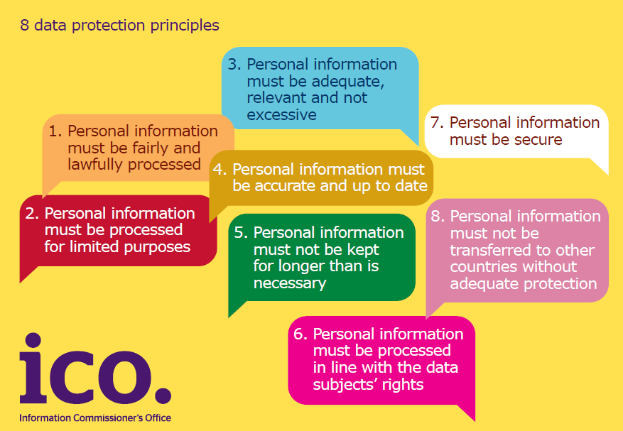
The 8 Principles

Slide 6
OK, what are my responsibilities? - Musts
You must obey the law – sort of goes without saying
The law can be found here: http://www.legislation.gov.uk/ukpga/1998/29/contents
You (your organisation) must be registered with the DPA, if it processes Personal Data
Notes:
Remember you are responsible for your data, even after it has left your control.
The recent fine on Brighton hospital of £325k after harddisks containing sensitive data were stolen are showing the ICO has more teeth than ever, and is prepared to use them. In this case an individual was asked to destroy the hard disks and sold them on ebay. More details here: http://www.bbc.co.uk/news/uk-england-sussex-18293565
Remember if you are the Data Controller it’s YOUR data and YOUR responsibility.

Slide 7
Privacy and Electronic Communications Regulation (PECR), or ‘Cookie Law’

Slide 8
Changes to the Law
The Privacy and Electronic Communications Regulations (PECR) aka the Cookie Law
  Question: What is it?
  Answer: It’s an EU Directive, which, itself, is not a law, but it’s an instruction to all EU countries that they must have a law.
The actual change, in wording, is small, compared to it’s impact.
Notes:
It came into force on the 26th May 2011, and is being enforced from 26th May 2012
Although nick named the ‘Cookie Law’ it covers more technologies than just cookies –
The Regulations apply to cookies and also to similar technologies for storing information. This could include, for example, Local Shared Objects (commonly referred to as “Flash Cookies”), web beacons or bugs (including transparent or clear gifs).

Slide 9
The Previous Law
This rule was set out in Regulation 6 of the Privacy and Electronic Communications Regulations 2003 (PECR):
6. (1) Subject to paragraph (4), a person shall not use an electronic communications network to store information, or to gain access to information stored, in the terminal equipment of a subscriber or user unless the requirements of paragraph (2) are met.
(2) The requirements are that the subscriber or user of that terminal equipment
  (a) is provided with clear and comprehensive information about the purposes of the storage of, or access to, that information; and
  (b) is given the opportunity to refuse the storage of or access to that Information
THIS HAS NOW BEEN REPLACED WITH...

Slide 10
The New Law
EU Directive 2009/136/EC: amended Article 5(3) of the EPrivacy
(UK amendments in Regulation 6 of the Privacy and Electronic Communications Regulations 2003):
6 (1) Subject to paragraph (4), a person shall not store or gain access to information stored, in the terminal equipment of a subscriber or user unless the requirements of paragraph (2) are met.
(2) The requirements are that the subscriber or user of that terminal equipment-
  (a) is provided with clear and comprehensive information about the purposes of the storage of, or access to, that information; and
  (b) has given his or her consent.
Notes:
That is how 6 words can make our lives more difficult!

Slide 11
Who Does This Affect?
The regulations state that it is the website owner who is liable for obtaining the consent.
This means that even if it is 3rd party tools (such as Google Analytics) used,the responsibility lies with the web site owner.

Slide 12
What Does This Mean In Practice?
Consent to use of personal data can be indicated only after a transparent statement has been given to the data subject
Only statements or actions that indicate the data subject’s agreement constitute valid consent. Saying or doing nothing will not be viewed as valid consent. For example, default privacy settings, default browser settings or preticked boxes do not qualify as valid consent.
Does it have to be “prior” consent?
ICO not concerned with who obtains consent, but that valid consent is obtained.
Notes:
Not clear as to whether it has to be Prior consent – what happens if you start tracking as soon as someone lands?
Talk about the ‘Brown M&M’ clause.

Slide 13

Brown M&Ms not Allowed

Slide 14
Exception (singular!)
Consent not required where cookie is “strictly necessary” for a service requested by a user.
  Example is where goods are added to an online basket – site will “remember” what is being bought.

Slide 15
ICO Guidance
ICO published further guidance in May 2012: http://www.ico.gov.uk/for_organisations/privacy_and_electronic_communications/the_guide/cookies.aspx
More detail on what is meant by consent. The advice says ‘consent must involve some form of communication where an individual knowingly indicates their acceptance.’
The guidance explains that cookies used for online shopping baskets and ones that help keep user data safe are likely to be exempt from complying with the rules.
However, cookies used for most other purposes including analytical, first and third party advertising, and ones that recognise when a user has returned to a website, will need to comply with the new rules.
The ICO will focus its regulatory efforts on the most intrusive cookies or where there is a clear privacy impact on individuals.
Notes:
No brown M&Ms
‘Likely’ not definitely!

Slide 16
What Does This Mean For A School?
There are 2 areas of impact:
Internal School systems – do you use cookies, do 3rd party tools and frameworks (such as Moodle and Joomla) use cookies in a way which are not needed as part of their core functionality (eg Google Analytics)
External School website, open to the public at large

Slide 17
Recommendations
For both situations – do an audit to understand the scope of the issue.
For #1 – update your AUP, to include a tick box to show informed consent that cookies may be used.
For #2 - Look at commercial tools to help. There are several for Joomla, and many other popping up now that this issue has some traction.
Look at temporarily removing GA and other similar technologies.
Notes:
‘Seek first to understand and then to act’
Information around cookie audits can be found with the information pack

Slide 18
Things That Are Not Clear Yet
OK, so I’ve changed my web site, and seek permission to use cookies, what do I do with this information?
How should I store it?
How long for?
How is it to be audited?
How often to people need to be asked for their permission?
Notes:
There is little, or no, guidance in this area yet. As usual with laws, the words are very simple, but the impact may be huge!

Slide 19
PECR Summary
No longer an option to do nothing
Audits to understand what cookies being used and what they do
Review 3rd party sites
Consider privacy notices
Consider how best to obtain consent
Redraft Terms and Conditions
Use your audits as a chance to revisit overall data protection
compliance issues
Consent must involve some form of communication
  Eg: clicking an icon, sending an email
Ideally, consent is obtained before the cookie is set.

Slide 20
Other Changes the ICO is Looking At
More fines are being implemented at present
ICO looking to maximise publicity and sector impact
Increasing use of undertakings and audits
Prison sentences likely to be confirmed
Personal liability
  offence under DPA and due to neglect or deliberate act by senior staff or
  unlawful obtaining or disclosure of personal data without data controller consent

Slide 21

Thank You for your time
– any questions?

