Slide 1

SIMS MAT Reporting
Notes:
The biggest change in the way our schools are run has been the academies programme and the linking of those academies together into MATs
From September 2018 the change as far as MATs are concerned is the fact that the MAT itself, as well as the individual academies within it comes under the OFTSED framework. click
There are Key measures for MATS to try to prove they are making a difference
Every MAT will want something different because they are all different.
What is needed is a completely flexible, easily edited solution which a trust can manage itself once set up, as they expand and what they want changes.

Slide 2
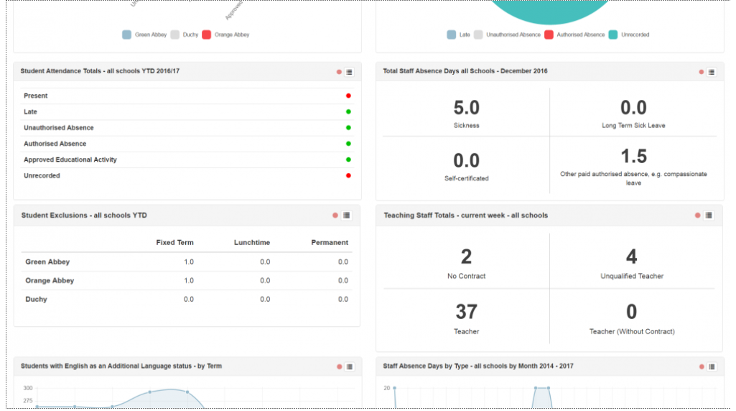
SchoolView
Notes:
Current offering is SchoolView, which for some MATs has provided answers to ‘demographic’ questions such as numbers of students or attendance.

Slide 3
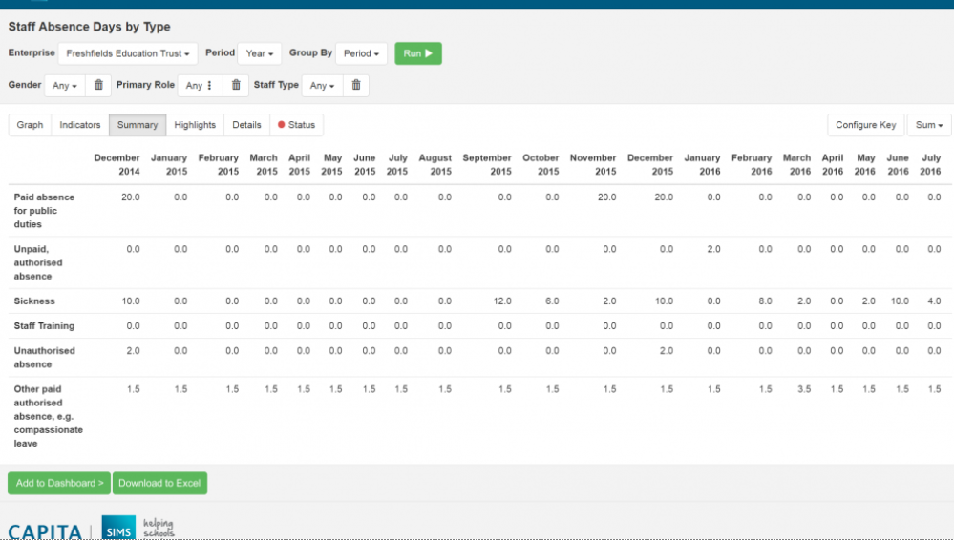

Slide 4
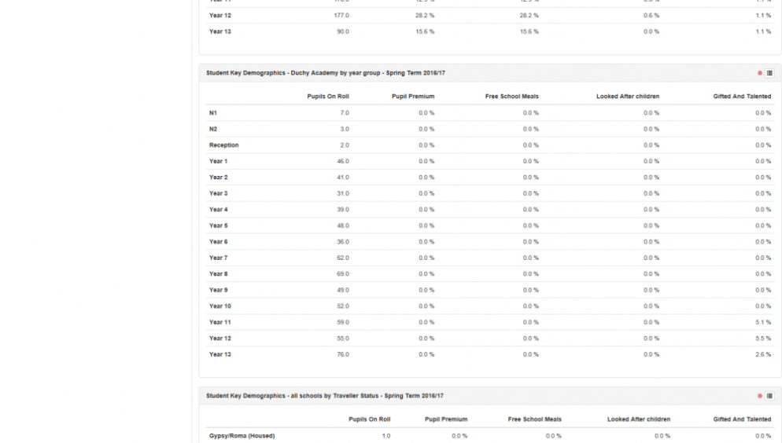
Notes:
It also does well where items with different names need to be consolidated across a MAT, such as the names given to different behaviour types, where there is a synchronization process.
However it only deals in a limited way with assessment, and only statutory assessment at that, so for MATS which want to track student performance during the year and show progress to OFSTED, it does not do that. So what do we do instead?

Slide 5
SIMS MAT Reporting
Notes:
What was needed was a solution which was all of the following:
Easy to set up
Easy for MATs to edit and maintain themselves
Cost effective
Web based
Secure
Powerful

Slide 6
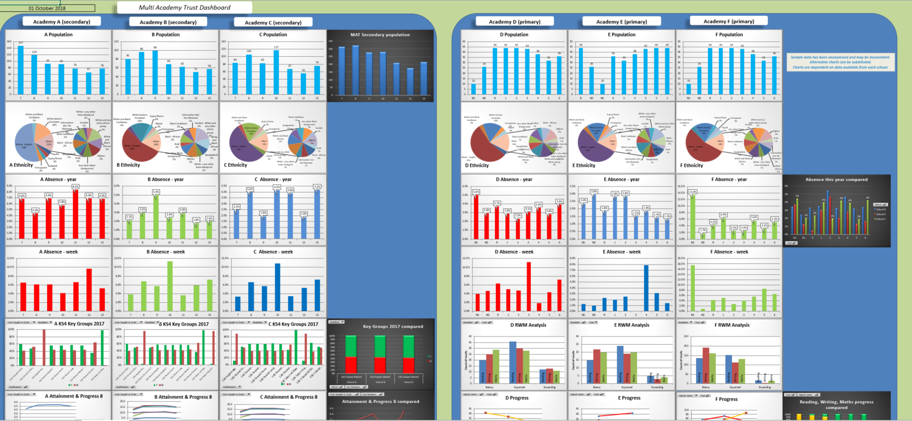
Notes:
Up until now our answer has been to send outputs from reports to Excel. A number of trusts using this very successfully. Works really well but hard for the Trust to make alterations for themselves. Takes consultancy and so therefore cost. It is also not web based. Can continue to offer this if needed.
The problem is that by definition, what MATs want will, for all sorts of reasons, be very different one MAT from another, and what is more, constantly evolving as they add more academies, more or different measures need to be analysed due to external or internal requests. We needed a solution where the MAT does not wait for a change request to be put in place, or for an expert to make a bespoke change for them, but where they can make the changes themselves using powerful but largely familiar and intuitive software. In other words we needed not a single product but a process the MATs can manage themselves, which is not only very cost effective but also quick.

Slide 7
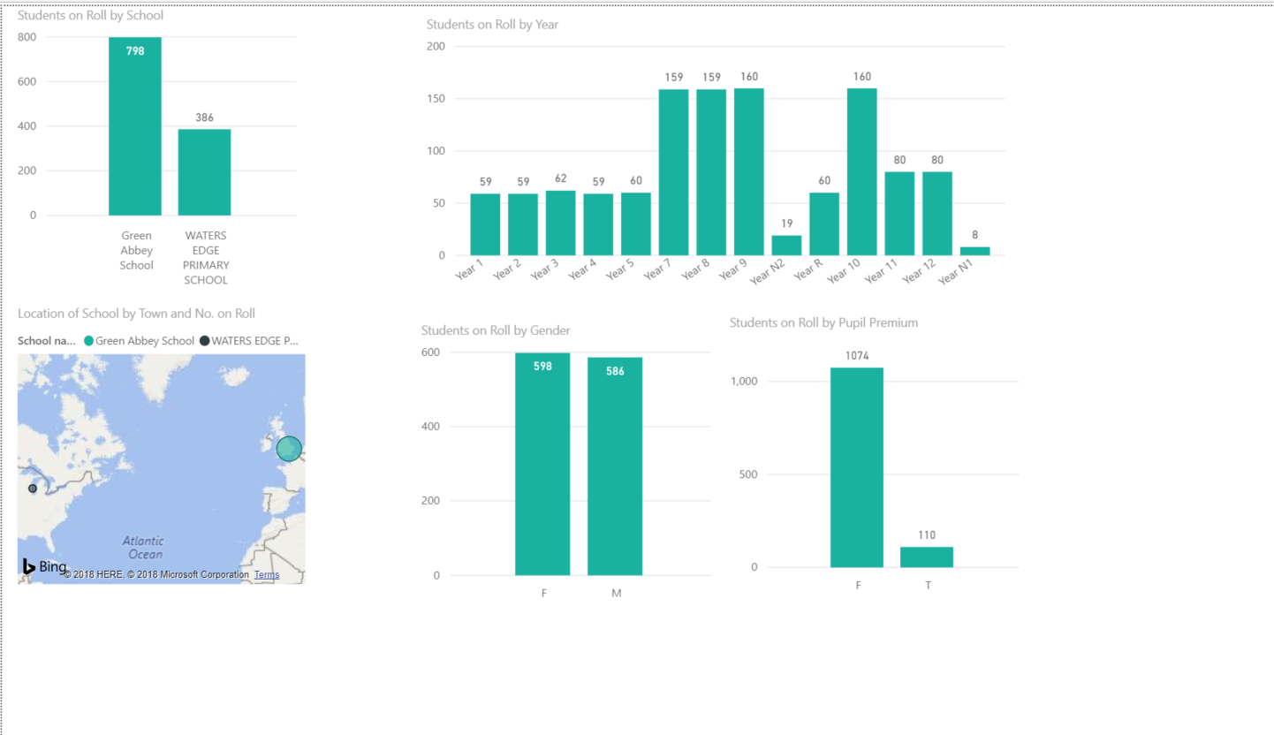
Notes:
This is end user view of what we came up with, a process which extracts data from SIMS and presents, in this case in Power BI, but could be any similar package such Tableau or Google Data Studio.
Easy to set up
Easy for MATs to edit and maintain themselves
Cost effective
Web based
Secure
Powerful
It is a solution which is all of the above and which uses existing technology in SIMS and from Microsoft.
Apart from cost, ease of development etc., this gives the MAT the ownership of the set up, and, lets them simply use standard world wide web tools. In other words, what we are giving MATs is the ability to carry out a process, rather than a specific fixed piece of software. If they want help with that set up process then fine, and we or indeed you SSUs can charge for that help, but if not the whole point is that it is simple enough for them to manage themselves and, from our point of view, vitally, weds them to continue using SIMS. Lastly, we have found that Power BI seems to be the weapon of choice for MATs as regards analysis tools so are often familiar with the end software before we even start the process.

Slide 8
SIMS MAT Reporting
Using Command Reporter and Power BI
How does it work?

Slide 9
Part 1 - SIMS
Using standard SIMS reports
As long as it can be reported on from SIMS…..
Consistency across MAT, particularly in assessment
What data to extract
GDPR
Data Redundancy
Where to send the outputs
Notes:
In many ways, the solution is the easy bit. There are many questions the Trust will need to address about consistency of data, what they want to extract (is it appropriate at trust level to collect identifiable pupil level data?)
The raw data needs to be ‘posted’ somewhere. In the cloud, most easily a shared One Drive account. Are there issues with this in terms of security?

Slide 10
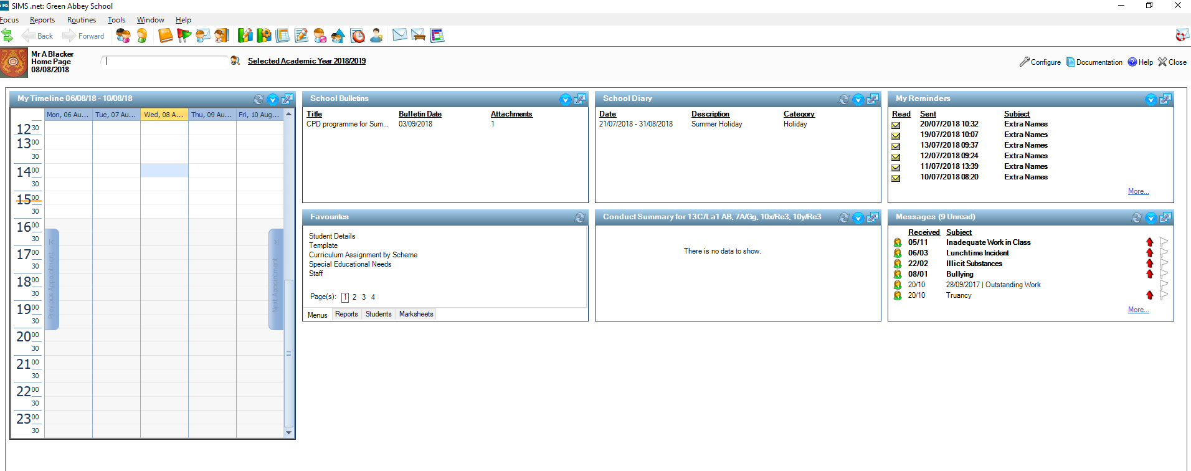
Notes:
Any data can be extracted in a SIMS report, including variable dates

Slide 11
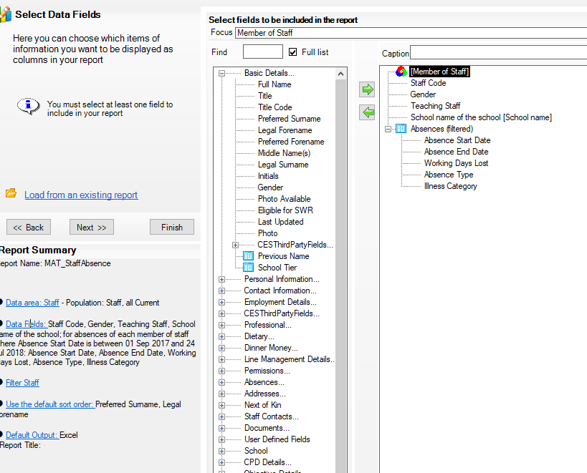
Notes:
Such as ones with variable dates which you cannot do in SIMS alone e.g. Attendance in the last 4 weeks; staff absence in the last 7 days.
So you first need to agree a set of reports across the MAT which will collect the data you want. These can easily be added to later so you could just start with basic school and student data, plus maybe attendance.

Slide 12
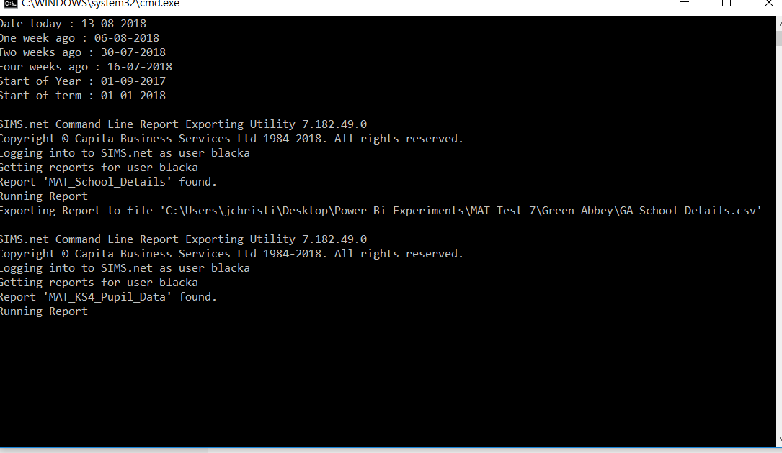
Command Reporter
Notes:
What you then need is for Command Reporter to run these reports on a schedule and send the output csv files to a location of the MAT’s choice. The access to this location is vital in that it must be available whether or not the user is logged on when running the scheduled task which runs the batch file. Also the syntax of Command Reporter is so precise and easy to get wrong, so…..

Slide 13
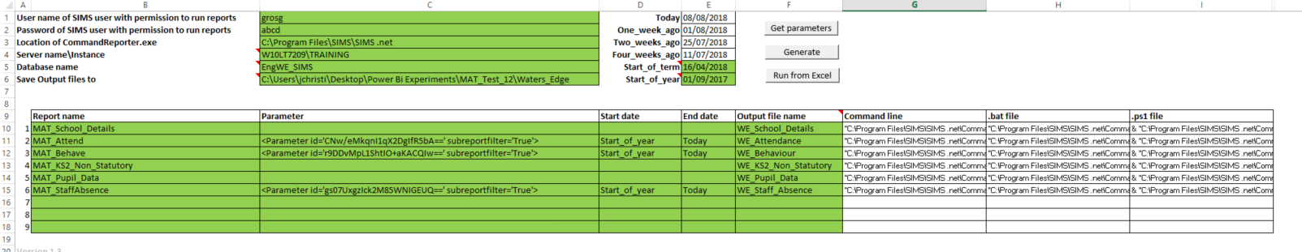
Command Reporter Utility
Notes:
This is the really clever bit where this utility makes the very difficult syntax easy by making the lines you need for a batch file in a few moments

Slide 14
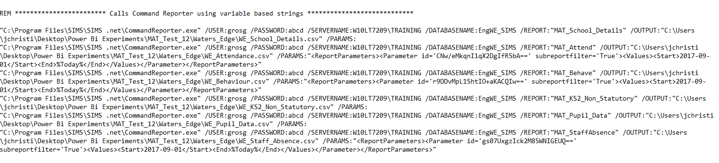
Batch file
Notes:
Copy these lines into the example batch file, and run the batch file

Slide 15
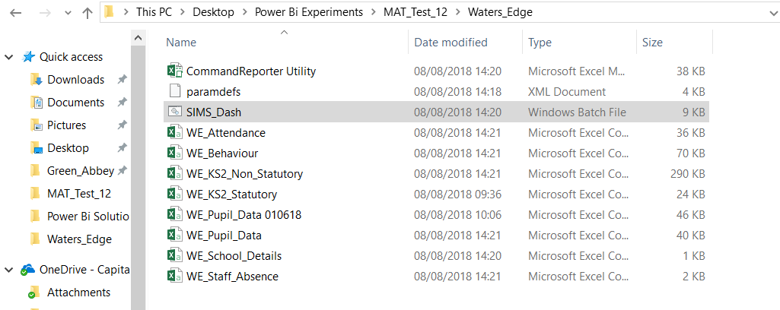
Set of report outputs for each school
Notes:
You should end up with a set of outputs in the location of your choice.

Slide 16
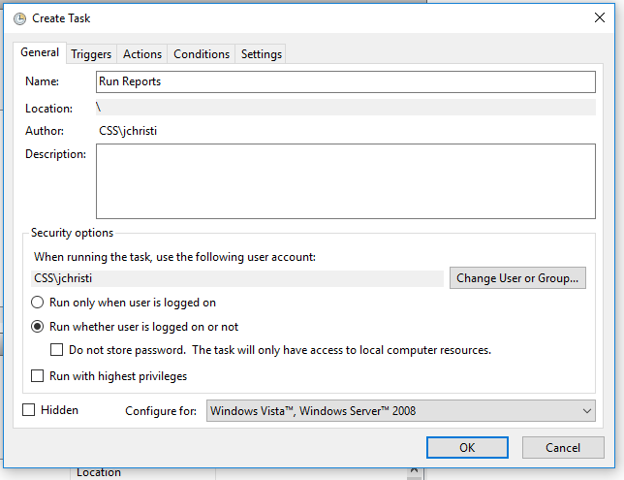
Scheduled task to refresh data
Notes:
Set up a scheduled task to run this batch file, and it must be configured to run whether the user is logged on or not.

Slide 18
Part 2 – Power BI
Using Power BI Desktop.
Free to schools but need Pro licence to publish and share
Notes:
You will need Power BI desktop, which is free to schools but they have now changed the licence rules so you will need a Pro licence for all those who want to publish these reports and share them with others, and so will those in receipt of those sharing invitations

Slide 19
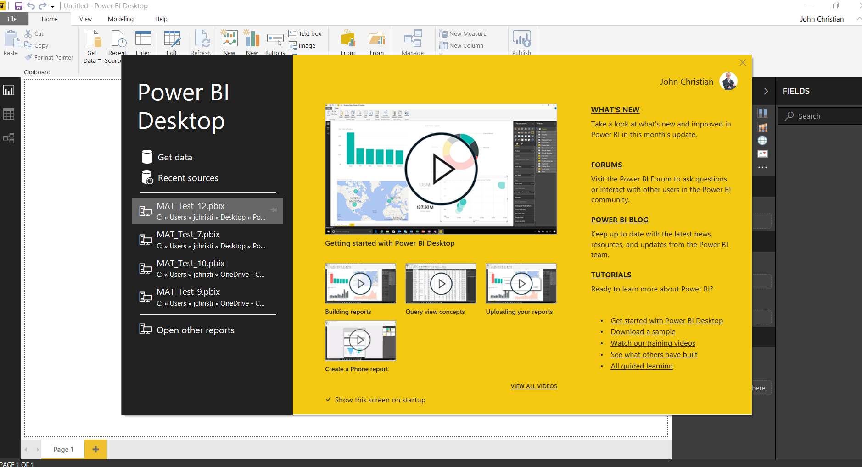

Slide 20
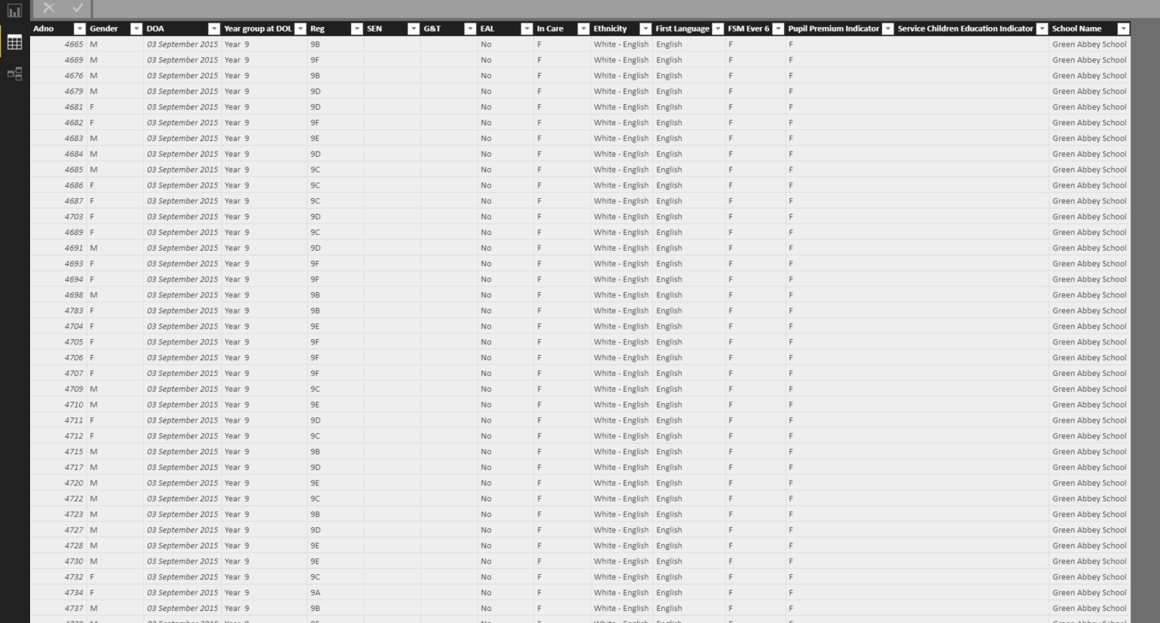
Import raw data
Notes:
Import the raw data and edit it to match your requirements. This managing of the raw data is often glossed over by tutorials which want to get on to the pretty graphs, but getting this bit right is absolutely vital

Slide 21
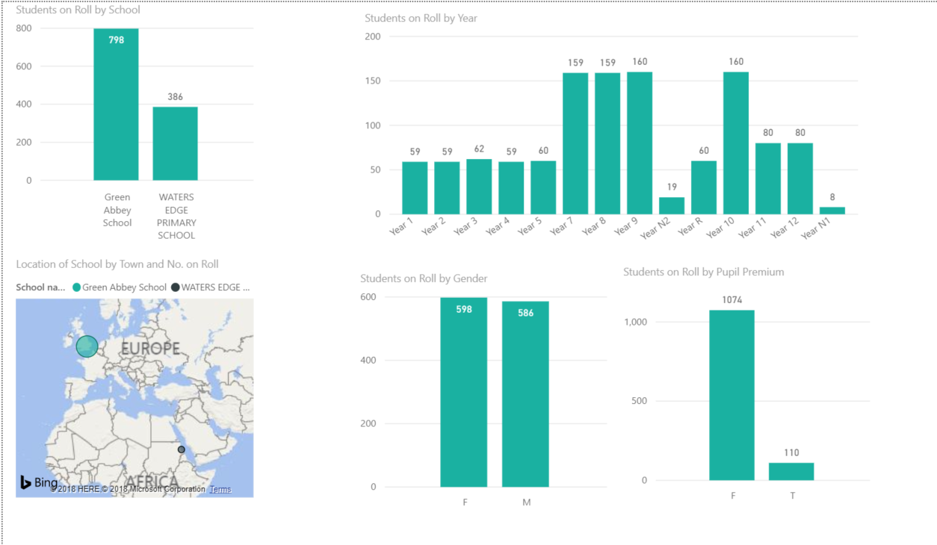
Make reports to your own design
Notes:
Make reports to match the requirements of the MAT. There are reports catering for all needs, including MAPS

Slide 22
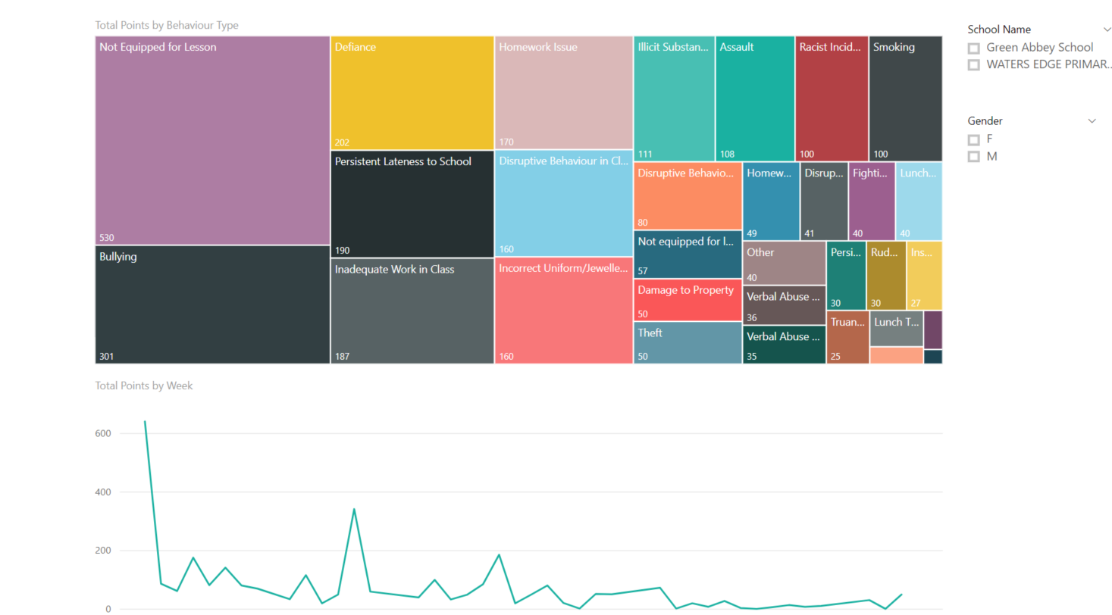
Notes:
Various other ways of showing the data

Slide 23
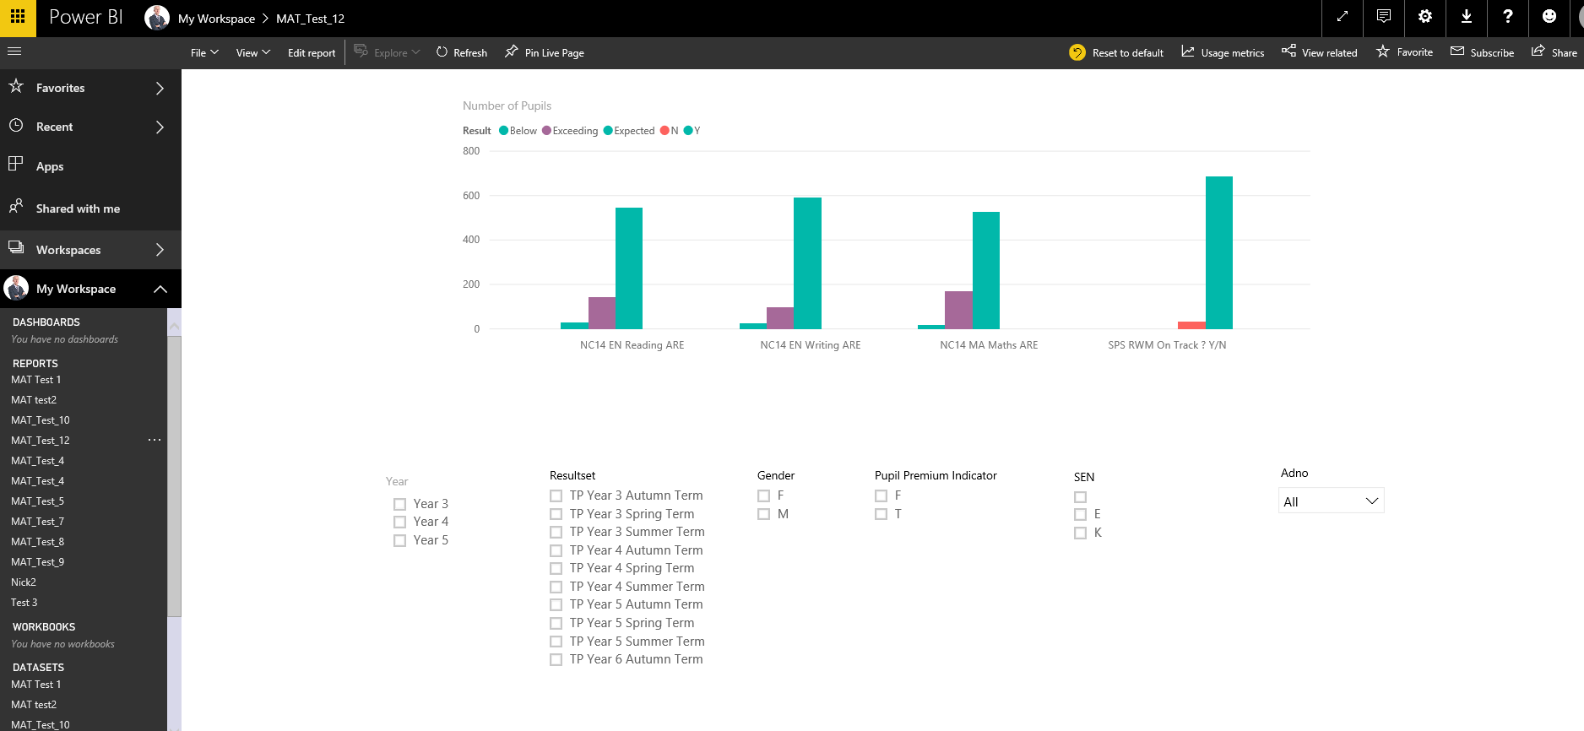
Publish and share the reports
Notes:
Once you have what you want simply click publish to put the report on line in a secure environment, to which only you have access initially,
This makes a copy of the raw data from your local computer (unless it was already on line) and copies it into the cloud

Slide 24
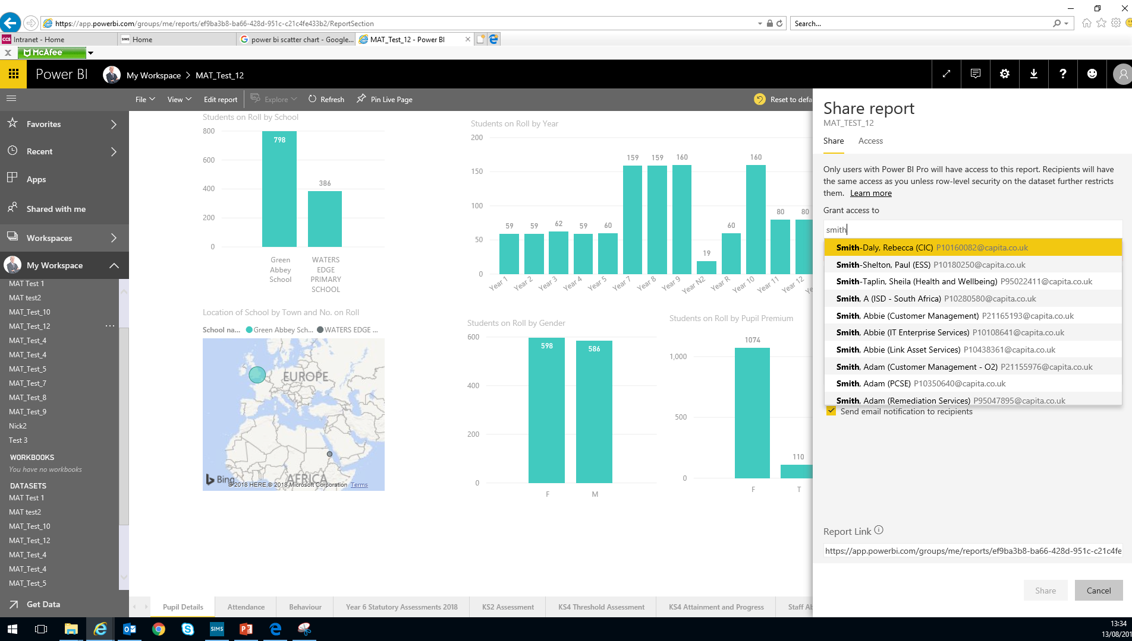
Notes:
Then you share the report to those inside (or if you wish, outside) your organisation.

Slide 25
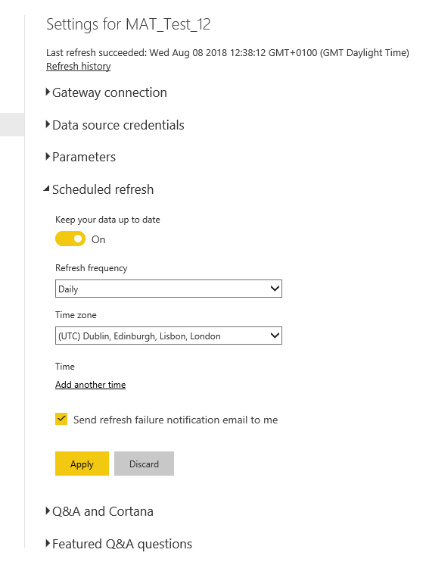
Set up a schedule to refresh the data and graphs
Notes:
So the raw SIMS data is refreshed by the scheduled task running the batch file. The simplest way of refreshing your shared report is to simply click Publish again, and this will overwrite the previous version and update the data to the latest one. While you are developing the reports, this is by far the best way.
However, when you have finished setting up the complete report and you want the process to continue updating by itself, the on line set of data is refreshed using another piece of software which needs downloading called Power BI Gateway, and you then make a link to where the original data source is and then set up a refresh routine of that data so that it keeps the on line version up to date too

Slide 26
SIMS 8
Notes:
Developing processes by which the extraction from SIMS will be very straightforward, by API.

Slide 28
Thank You

