Slide 1
Impacts of a youthful population
Learning objective-
The impacts of population change- social, economic, and political- youthful populations.

Slide 2
Dependency ratio
What would a dependency ratio equation look like for a youthful population?
The number of non-economically active
=
_______________________________________________
X 100
The number of economically active

Slide 3
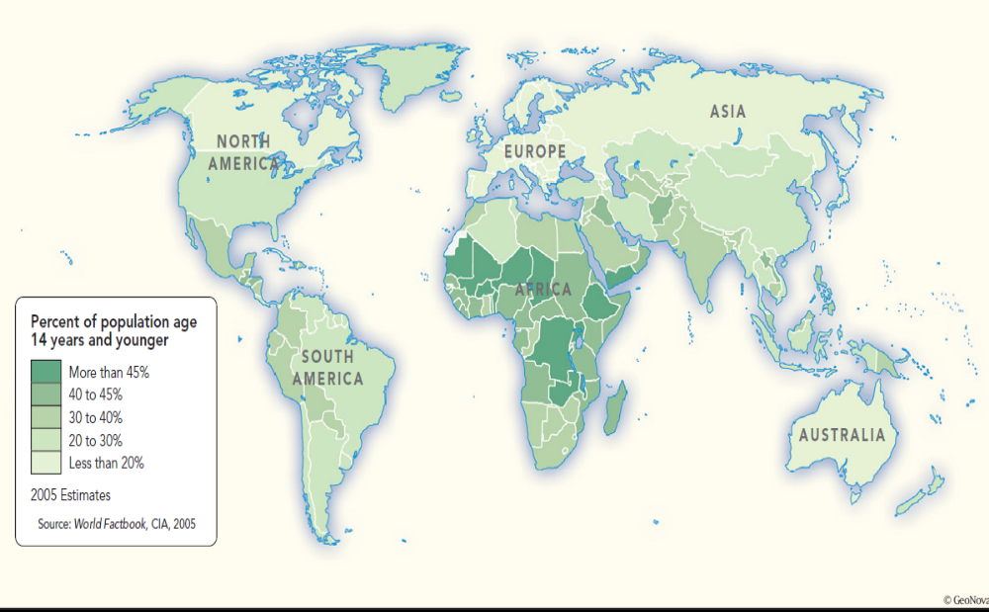
Where are the World’s YOUTH Located?
G, S, A
S- (high in a high, low in a low,)
A- (low in a high and high in a low)

Slide 4

Causes of Youthful Populations
Can you think of any?
High birth rates caused by:
Lack of family planning
No education about contraception
High infant mortality
Primary based economy
No care for old dependents from government
Immigration of young dependents
Tradition and status of large families (prestige)

Slide 5
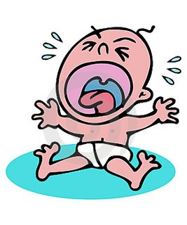
Problems caused by Youthful Populations
Can you think of any?
Negative Impacts of Youthful
populations might include:
Pressure on education.
Pressure on food supplies
Pressure on housing
Increased cost of child benefits paid by the government.
Potentially high unemployment rates depending on the economy.
Potentially higher crime rates.
Cost of healthcare (midwives, health visitors, etc.) for Government.
Spending diverted from defense, transport, etc.
These youths will all eventually become older dependents.
Pressure on environment to create room

Slide 6
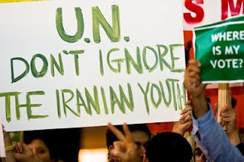
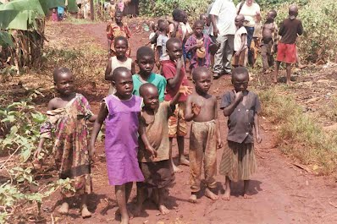
Benefits of a Youthful Population
Can you think of any?
Educated and IT literate population (many elderly people are unfamiliar with new technology).
Abundance of future workers to provide a large tax base for the country.
Strong military in the future.
Large future market (young people are often interested in consumer goods).

Slide 7
Solutions to an Youthful Populations
Solutions to an Youthful Population might include:
Anti-natalist policy (e.g. China’s one Child Policy)
Increased immigration of economically active.
Investment in the education of youths.
Privatised education (remove cost from government)
Privatised healthcare (remove cost from government)
Removal of child benefits. [Is this realistic?]
Reduce birth rates (family planning, contraception, etc.)
Reduce infant mortality rates (people then normally have less babies)
Greater care of old dependents (less children needed to care for elderly – breaking traditions).
Immigration restrictions (for younger people).

Slide 8
We must remember that
the costs and benefits
will vary for MEDC’s and
LEDC’s.
So will the SOLUTIONS

Slide 9
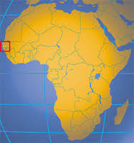

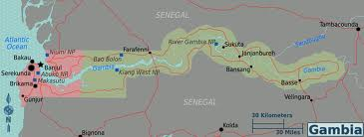
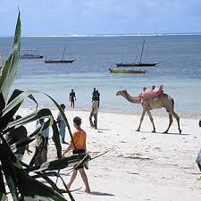
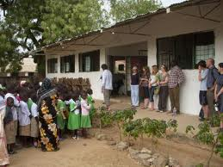
Youthful Populations
Case Study: The Gambia

Slide 10
Gambia’s location
Case Study: The Gambia
Describe the location of The Gambia

Slide 11
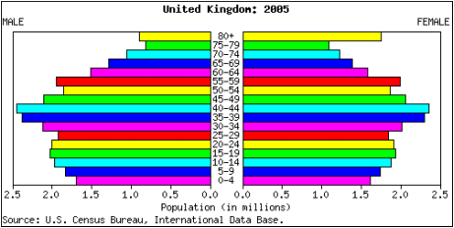
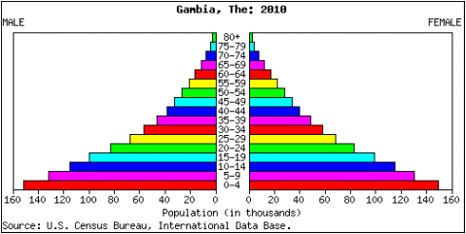
The Gambia's population is mostly under 20 years old, but the UK's bulges between 30 and 50 years. The population of the Gambia is mainly young with more than half (about 63.55%) is below 25 years. Elderly persons of 65 years and above account for 2.8% of the population.
Why do you think this is? What implications would this have on each country's work force? On their schools? What about the countries' health care systems, hospitals and clinics? Can you think of some reasons that might suggest why there are not many people living past middle age in The Gambia? Take a moment to attempt to answer each question, jot some ideas down.

Slide 12
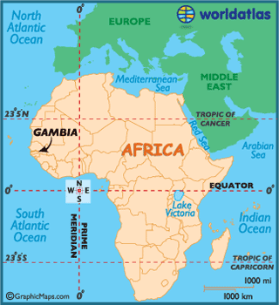
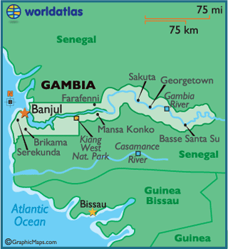
Gambia’s Youthful Population
The Gambia is the smallest African country and 95% of Gambia’s population are Muslim.
There has been a taboo on contraceptives and the birth rate is high, on average each woman in her life time will have 7 children.
The birth rate is 40 per 1000 population and for every 1000 children born 11 mothers will die in child birth. People do not live much beyond 40 – 50, the life expectancy for women is 57 and for men 53.
The Gambia is a very poor country, there is not enough money to build infrastructure and develop towns. Healthcare is very limited and the infant mortality rate is 73 per 1000.

Slide 13
The Gambia’s Youthful Population
Why so many young people?
Traditionally women have little influence over family size.
Religious beliefs discourage family planning and the use of contraception- Muslim- 95%
Culturally issues surrounding sex are a taboo subject and not discussed, particularly with young people.
Rural economy dominated by subsistence farming (goats, cattle, maize, rice and ground nuts) therefore children are an economic benefit as they can assist on the farm. http://www.studymode.com/essays/Causes-And-Effects-Of-Gambia's-Youthful-1609465.html

Slide 14
The Gambia’s Youthful Population
The education is very poor in woman as only 615 of girls go to primary school and ¾ women are unable to write. This means that the next generation will not be bale to get jobs and provide and income.
More children are working to fund their family and to keep them alive 1 in 3 children between age 10 and 14 works, this may be on a farm or in the local community they have to sacrifice their education so they can survive and live.

Slide 15
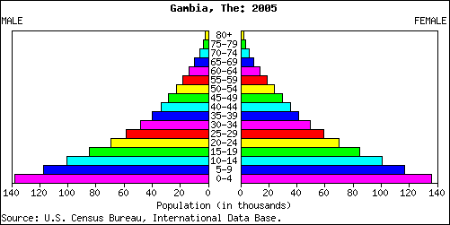
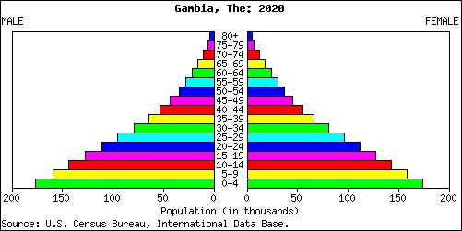

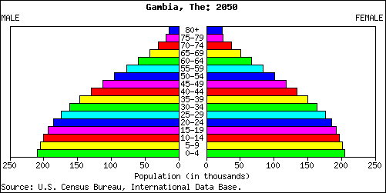
Comparing Pyramids

Slide 16
Some solutions/changes
Contraception
As a Non-Governmental Organisation (NGO) in the Gambia, ‘Futures’ targeted rural areas to increase the use of contraception to reduce family sizes. They have set up clinics in rural communities to educate women and men on the use of contraceptives, and the benefits of smaller families. They have used posters, handing out radios, and other country-wide campaigns to explain that using a condom is no longer embarrassing. These awareness campaigns have reduced the BR to 3%.
2) Health
To reduce the infant mortality rate funding from Canada is used to provide free vaccination for children. Improved maternity care helps the mothers to survive. Parents are encouraged to space out the births so that mother has enough time to recover.
3) Managing Resources
The German government are funding a forest management scheme. The plan is to plant new forests and educate the population on how to look after and use the forests.

Slide 17

Case Studies
The Gambia and Uganda also have youthful populations and face their own set of problems.
Read the article on Uganda and complete this table on your books – use a full page:
Key Facts | Causes | Effects | Solutions

Slide 18
http://www.youtube.com/watch?v=Y6bgMWzJ6Rk&feature=related
http://www.pumpkin-interactive.co.uk/collections/geography/products/managing-youthful-populations

