Slide 1

The Pitfalls of Social Networking
Impact on your professional reputation/position

Slide 2
privacy
inappropriate content
validity and bias
cyberbullying
media literacy
extremism
phishing
fraud
viruses
identity theft
online reputation
copyright
private comments, Public
inappropriate comments

Slide 3





What is Social Networking?
so·cial net·work·ing
Noun: The use of a dedicated Web site to communicate informally with other members of the site, by posting messages, photographs, etc.
Can we tell you what to do in your private lives?

Slide 4
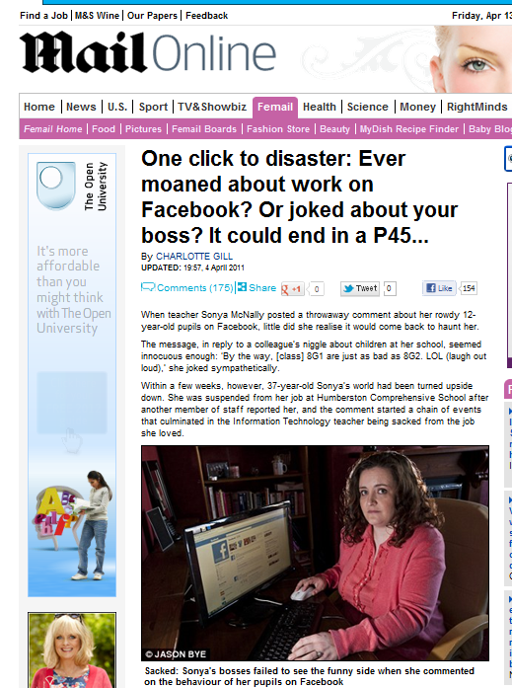
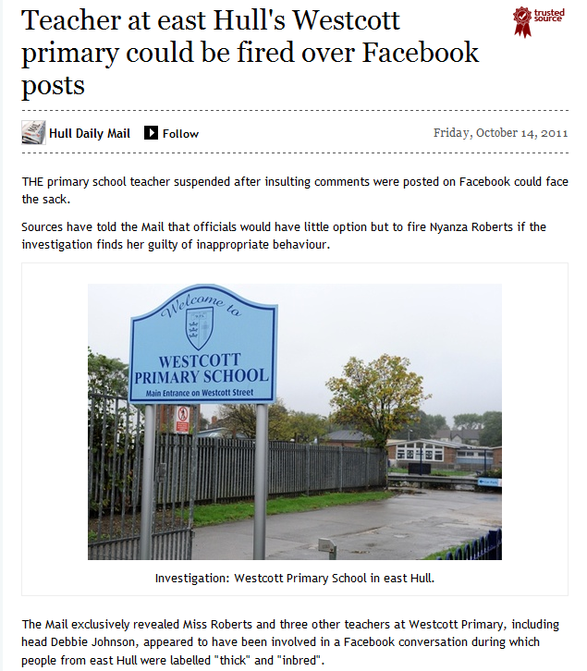
So what are the risks?
The message, in reply to a colleague’s niggle about children at her school, seemed innocuous enough: ‘By the way, [class] 8G1 are just as bad as 8G2. LOL (laugh out loud),’ she joked sympathetically.
Within a few weeks, however, 37-year-old Sonya’s world had been turned upside down. She was suspended from her job at **** Comprehensive School....
“Teachers at ***** Primary, including the head appeared to have been involved in a Facebook conversation during which people from East Hull were labelled "thick" and "inbred".

Slide 5
So what are the risks?
Publishing private comments
Misappropriation of images of you
Potential for cyberbullying (from/to staff, parents or students)
False or malicious allegations
Damage to personal & professional reputation
Suspension pending investigation?

Slide 6
MGS Policy and Professional Advice
I will ensure that my information systems use will always be compatible with my professional role.
I understand that school information systems may not be used for private purposes, without specific permission from the Headteacher.
I understand that the school may monitor my information systems and Internet use to ensure policy compliance.
I will respect system security and I will not disclose any password or security information to anyone other than an appropriate system manager.
I will not install any software or hardware without permission.
I will ensure that personal data is kept secure and is used appropriately, whether in school, taken off the school premises or accessed remotely.
I will respect copyright and intellectual property rights.
I will report any incidents of concern regarding children’s safety to the school e‑Safety Coordinator or the Designated Child Protection Coordinator.
I will ensure that any electronic communications with pupils are compatible with my professional role.
I will promote e-safety with students in my care and will help them to develop a responsible attitude to system use and to the content they access or create.
Dangers on the Internet
There is no controlling body for the internet. Information is therefore not always accurate.
Care must be taken when downloading any information from the Internet because of the potential for damage to the network. Only reputable service providers must be used. Games and screen savers must not be downloaded.
If in doubt do not download (printing from the Internet is not downloading) and see a member of the IT Team
The school may exercise its right to monitor the use of the school’s information systems, including Internet access, the interception of e-mail and the deletion of inappropriate materials where it believes unauthorised use of the school’s information system may be taking place, or the system may be being used for criminal purposes or for storing unauthorised or unlawful text, imagery or sound.

Slide 7
Baseline guidance for staff using
Social Networking
You must not allow any pupil to access personal information you post on a social networking site. For your own protection:
You must not add a pupil to your ‘friends list’.
(You should declare to SMT existing relationships with pupils at MGS)
You must not interact socially with former pupils under the age of 18.
It is advisable not to add former pupils over the age of 18 to your friends list to maintain maximum professional distance.
You must ensure that personal information is not accessible via a ‘Public’ setting, but ensure it is set to a ‘Friends only’ level of visibility.
You should not contact any pupil privately via a social networking website, even for school-related purposes.

Slide 8
Baseline guidance for staff using
Social Networking
You should take steps to ensure that any person contacting you via a social networking website is who they claim to be, and not an imposter, before allowing them access to your personal information.
Unless authorised to do so, you must not post content on websites that may appear as if you are speaking for the school.
You should not post any material online that can be clearly linked to the school that may damage the school’s reputation.
You should avoid posting any material clearly identifying yourself, another member of staff, or a pupil, that could potentially be used to embarrass, harass, or defame the subject.

Slide 9

Notes:
168 Million Emails, 694,445 Google searches, 695,000 status updates, 370,000 SKYPE Minutes, 600 New YouTube Videos AND ONE MORE FUTURE RUINED

