Slide 1
Overland Storage
The Storage Conundrum
Neil Cogger
Pre-Sales Manager

Slide 2


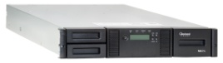
Storage Issues Today
Data quantities are increasing
  IDC predicts by 2020 data could grow by 50x volume
  E.g. increased AV content of work
Backup windows are being stretched
Budgetary constraints
Networked Clients
NAS Appliance
Ethernet LAN
Tape Library

Slide 3
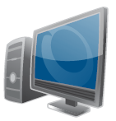
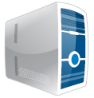
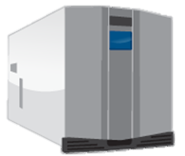


Overland Storage Solutions
Networked Clients
NAS
Network Attached Storage
Advantages:
Easy to Install
Easy to Use
Easy to Share
Easy to Grow
Heterogeneous
Tape
Autoloaders and Libraries
Advantages:
High Performance
Highly Scalable
Flexible Connectivity
Long Media Life
Ethernet LAN
NAS Appliance
SAS or FC
VTL
Virtual Tape Library
Advantages:
Easy to Install
Easy to Use
Fast Backup/Restore
Flexible Connectivity
Server
Backup Server
Backup Server
SAN
LAN
VTL Appliance
Tape Library

Slide 4
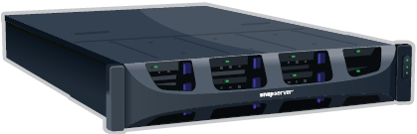
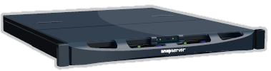
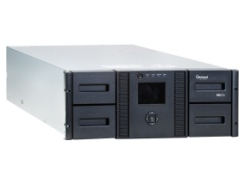
End-to-End Solutions for Storage, Backup and DR
WAN
SnapServer DX2
SnapServer DX2
Ethernet LAN
Ethernet LAN
SAS
WAN
SnapServer DX1
Ethernet LAN
NEO Tape Library
REO VTL Appliance
Notes:
Overland Storage offers the complete end to end package for data protection and disaster recovery.
Remote replication between SnapServer NAS systems
Nearline backup to a REO Virtual Tape Library
Tape Archival

Slide 5

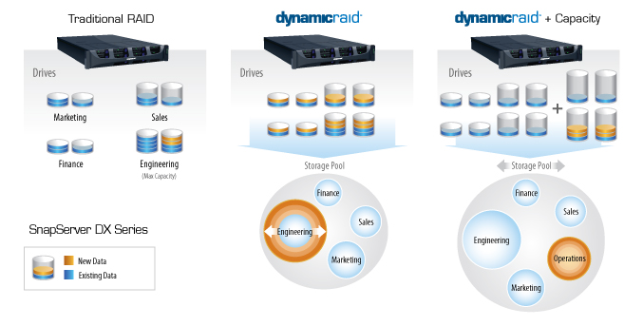
= Improved Storage Utilization
SnapServer DX2
Ethernet LAN
Features:
Limitless volume creation in seconds with a few clicks of the mouse
Capacity is easily added to volumes without business disruption or downtime
Volumes can shrink and grow independently – no volume migration
Benefits:
All the benefits of thin provisioning without risk of data loss when real capacity no longer exists
Reduce acquisition costs & manage growth through “just-in-time” storage acquisition
Improve – even double – storage utilization

Slide 6
Remote Replication with SnapServer NAS
WAN
SnapServer DX2
SnapServer DX2
Ethernet LAN
WAN
SnapServer DX1
Ethernet LAN

Slide 7
SnapServer Advantages, Use Cases and Applications
With SnapServer you get…
  Local Storage: Immediate access to shared storage
  Performance: High performance storage ideal for file serving, virtualization, backup and database hosting
  Flexibility: Auto-provision volumes with DynamicRAID
  Scalability: Capacity expansion by adding shelves or drives or replacing disks with larger ones
  Reliability: Redundant power, proven Linux based GuardianOS
  Compatibility: CIFS, NFS, AFP, iSCSI, FTP, HTTP
  Disaster Recovery: Replicate locally or remotely with Snap Enterprise Data Replication software
  Backup: Can be integrated into backup environments with various 3rd party backup agents
LAN

Slide 8
Local Backup and Archiving with REO and NEO
Backup Agent
SnapServer DX2
SAS
NEO Tape Library
Ethernet LAN
SAS
Backup Server
NEO Tape Library
REO VTL Appliance

Slide 9

VTL Advantages, Use Cases and Applications
With VTL you get…
  Recovery Time: Immediate access to backed-up data
  Performance: High performance storage ideal for a small backup window
  Scalability: Easily add capacity with additional drives
  Reliability: Redundant connections, resilient networks and RAID protection
  Availability: Access the online backup repository at anytime
  Streaming: Easily run multiple jobs simultaneously
  Staging: Create a tiered DR strategy with an integrated tape solution
  Integration: Support all backup software packages leveraging ISV Dedup
Disk-2-Disk
SnapServer DX1
Backup Server
SAN
LAN
VTL Appliance

Slide 10

Top Drivers for Continuing Need of Tape
Extreme Data Growth
IDC predicts by 2020 data could grow by 50x volume
Economics
Tape has the lowest cost per gigabyte and the lowest power consumption and space requirements
High Cost of Data Loss
Average cost per incident = $6.5million*
Organizational Mandates
IT managers tasked with continually improving efficiency of backup/archive process
Regulatory Compliance
Worldwide legislation regarding data retention is on the rise
Budget Constraints
Forcing IT managers to reduce storage cost of ownership
*Ponemon Institute – Annual Cost of Data Breach Study

Slide 11
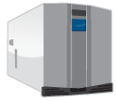
Solutions for End-to-End Data Protection
Overland Storage offers all of the pieces for end-to-end storage, backup, and disaster recovery
  SnapServer NAS with remote replication for DR
  Virtual Tape for efficient backups and fast restores
  Tape Libraries for data archiving

