Slide 1

Connecting Meraki via a 3rd party firewall/proxy
Simon Tompson
EMEA Solutions Architect

Slide 2
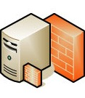
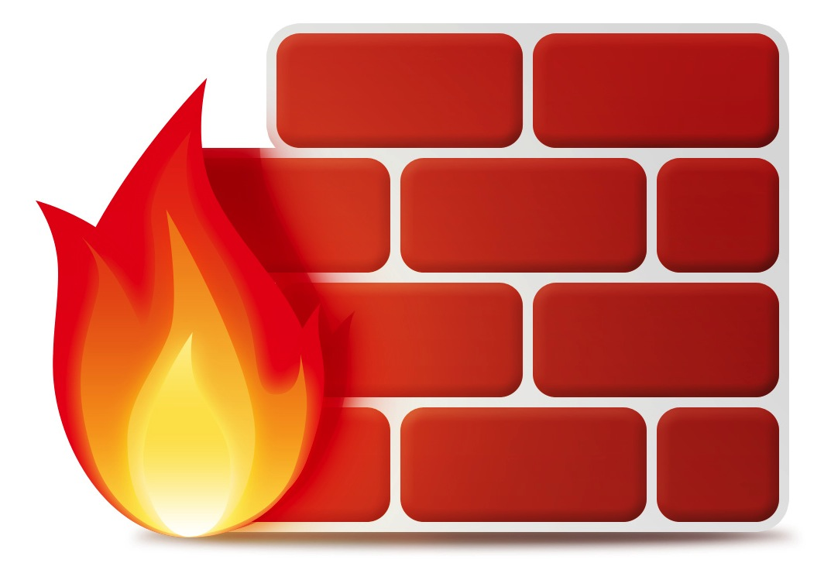

Architectural Overview
Internet
LEA Firewall / Proxy
WAN
School Firewall
LAN Equipment

Slide 3
The challenge
All Meraki devices are designed to be managed via a public cloud and require persistent access to the internet using dedicated TCP/UDP ports
Management is exclusively via a web browser, typically using an SSL connection on port 443
How do you configure Meraki equipment and firewalls/proxies to ensure manageability?

Slide 4
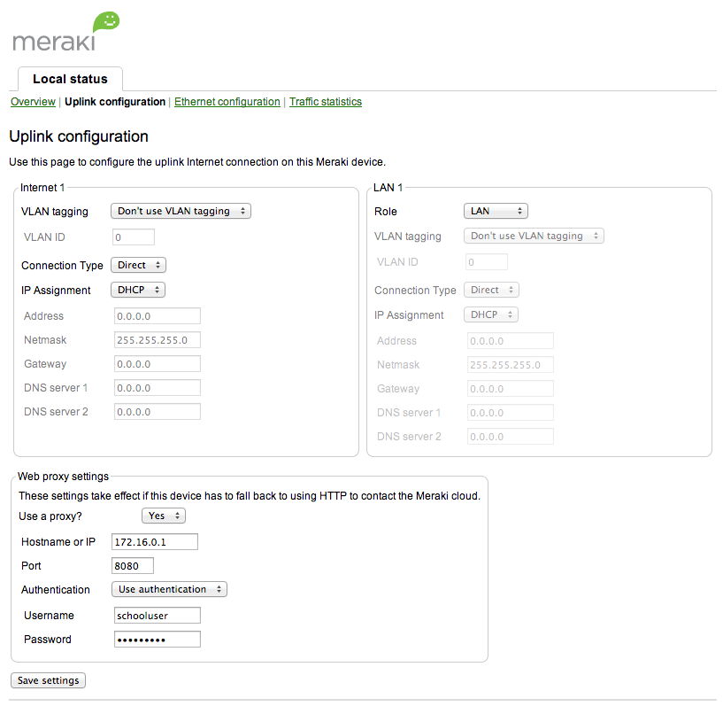
Configuring proxy access on Meraki equipment

Slide 5
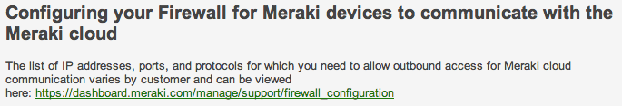
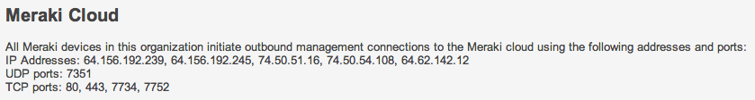
Configuring Firewalls
Each Meraki organisation (collection of networks comprising Meraki
equipment), uses a unique set of IP addresses and ports to communicate
to the management cloud.
It’s easy to find your unique ports via the Meraki dashboard…
Here’s an example of the information provided…

Slide 6


