Slide 1
Flexible Workstyles: Anywhere Productivity
Notes:
Opening
Users want seamless, consistent, and secure on-demand access to their applications, data, and settings from almost any location and across many devices (e.g., laptops, mobile devices, smartphones, and home PCs). Our solutions can help you give users that flexible work experience so that they can connect from virtually everywhere, on the devices they choose, from inside or outside the corporate network.
You can provide secure access to applications, data, and personal settings on any corporate PC. Applications, data, and personal settings simply follow users, keeping them productive when they switch PCs and even when they are disconnected from the network. In short, you can keep users happy and productive by providing them access to their personalized Windows experiences across multiple connected or disconnected PCs while maintaining the level of control and security that you require.
We have a great story here, and I’m going to start the story at the beginning. How do you enable users to work from almost anywhere and connect to corporate resources?

Slide 2





Productivity on the Road
Exchange
SharePoint
Data servers
Lync
FIREWALL
SkyDrive
DirectAccess
  WINDOWS 8 ADVANCEMENTS
  Access through local server when travelling
  More scalable
  Ease of Deployment
  Deployment Wizard
  Part of RAS Server Role
  Utilize existing infrastructure
  Support for one-time password
  Mobile broadband enhancements
  BENEFITS
  Persistent internet connection
  Easy and secure access to corporate data behind firewall
  Seamless personal data access
  One device for life and work when travelling
Mobile Broadband
Notes:
Productivity on the Road
Key Messages:
With Windows 8 and Office 2010, users can more securely access the data, apps, files, and people they need in order to stay productive on the road.
DirectAccess in Windows Server 2012 provides users with a more secure Internet connection through encryption and instantly links them to important documents.
During the day, Lync allows them to chat with colleagues, and at night, they can also stay connected to their family through their Windows Live account.
With Windows Server 2012, deployment of DirectAccess does not require any changes to the existing network infrastructure, including IP addressing schemes.
Our technologies will enable a workstyle that makes work and personal connections easier.
Workforces are becoming more mobile. Traditionally, mobile workers connect to intranet resources with a VPN. However, using a VPN can be cumbersome:
Connecting to a VPN takes several steps, and users need to wait for authentication.
Any time users lose their Internet connection, they need to re-establish the VPN connection.
Connecting to VPNs can be challenging, because they require ports other than 80 (HTTP) and 443 (HTTPS) to be open.
Because of these inconveniences, many users avoid connecting to a VPN, making their PCs out-of-date and creating additional headache for IT.
Also, enterprises want to ensure that their employees can communicate and collaborate effectively, regardless of their geographical location.
DirectAccess is only supported by Windows 7 Enterprise and Windows 8 Enterprise.
[CLICK]
With DirectAccess, a user can access data, apps, files, and people more securely so that he can stay productive on the road without having to go through VPN connection. A user’s laptop is already set up with DirectAccess. As soon as he logs on to his computer, it automatically connects to his corporate resources via an encrypted connection tunnel, as long as he has Internet access via mobile broadband or Wi-Fi hotspots, no matter where he is. At the same time, using the same secure connection, his PC can be monitored, patched, and provisioned by his IT department. For instance, his PC will automatically go through a scanning process to ensure that the latest antivirus software is in place and no viruses are reported before connection is granted.
We first introduced DirectAccess in Windows 7 Enterprise and Windows Server 2008 R2, and it was a great capability for users but it was hard for IT to deploy. A significant improvement for DirectAccess in Windows 8 Enterprise and Windows Server 2012 is the ability for deployment to utilize the existing network infrastructure. For example, deployment of DirectAccess does not require IT departments to deploy IPv6 (although they still have the opportunity to leverage the underlying security of IPv6); instead, they can use Windows Server 2012 for the purposes of address translation.
Users can keep up with their personal lives, too. They can stay connected to family and friends through their Windows Live account at night. They can talk to their family and catch up on what they are doing. They can look up new photos of friends’ children, and they can listen to new pieces of music that their kids just learned to play—all from SkyDrive, where their spouse load everything the family does. All users need to do is to log on to their personal Windows Live account, and they can participate in the joy and happiness of family and friends, even when they are thousands of miles away.
DirectAccess and an Internet connection instantly helps users link to important documents. And during the day, Lync allows them to chat with colleagues, while Windows Live allows them to keep in touch with family and friends at night. For all kinds of users, our workstyle solutions make work and personal connections easier.

Slide 3

Direct Access
Connecting from Anywhere
  Always connected
  Connects to nearest server
  DirectAccess Media Manager
  Multi-factor authentication
Deploy, Manage, and Scale with Ease
  Unified Remote Access Management Console
  Offsite PC deployment and domain join
  Use existing network infrastructure
  Scale to meet requirements
Security and PC Health Management
  Always-on update delivery
  Ensure PC health compliance
  Flexible authentication models
Data Security
Notes:
DirectAccess
DirectAccess in Windows Server 2012 with Windows 8 Enterprise can help you keep users more productive on the road.
[CLICK]
It helps them connect from anywhere. It provides an always-on connection to the corporate network that is seamless and secure; and connects to the nearest server automatically while users are traveling. DirectAccess also supports intuitive multi-factor authentication (i.e., Trusted Platform Module [TPM] and simplified one-time passwords).
[CLICK]
While DirectAccess is good for users, it’s also easy for IT to deploy, manage, and scale. You can use your existing network infrastructure, taking advantage of existing IP addressing schemes. A certificate infrastructure is not required for simple deployments. In Windows Server 2012, you can deploy DirectAccess in as few as four steps, and you manage both DirectAccess and VPNs from a single console. Of course, DirectAccess will scale to meet your requirements.
[CLICK]
Additionally, DirectAccess can help safeguard the security of your environment and the health of your PCs. For example, you can deliver updates anytime clients are connected to the Internet. With NAP integration, you can prevent access to the corporate network until the PC’s health is compliant. And DirectAccess offers flexible authentication methods and provides end-to-edge and end-to-end data encryption.

Slide 4









Mobile Broadband and Platform Enhancements
Mobile
Broadband
Platform
Enhancements
Metered
connections
Active connection minimized
Aware applications
are smart
Accidental network interconnects blocked
Users control
non-critical
update delivery
Enhanced Wireless
Radio Controls
Notes:
Mobile Broadband and Platform Enhancements
DirectAccess isn’t the only technology that can help keep users productive on the road. Windows 8 also offers mobile broadband and platform enhancements to help keep them connected.
[CLICK]
In Windows 8, mobile broadband is treated as a “metered connection.” Applications that are metered-connection aware are smart about content delivery over them. Additionally, users can control non-critical update delivery when they are using metered connections.
[CLICK]
Windows 8 includes other platform enhancements. For example, it can minimize active connections. It can block accidental interconnections between corporate and non-corporate networks. Additionally, Windows 8 provides enhanced wireless radio controls, including an easy to turn on airplane mode.

Slide 5
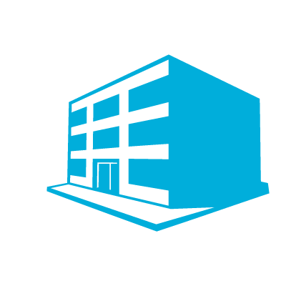








BranchCache
  Windows S 8 advancements
  BranchCache
  Small cache block size reduces network bandwidth requirements
  Intelligent data compression
  Encryption on cache
  More scalable
  Printing
  The document is sent directly to the local printer, while print request only is routed to the print server in datacenter
  BENEFITS
  Users in the branch office can download and print documents faster
  Frees up network bandwidth
  Saving costs – support more people in branch offices with same hardware; no WAN Optimizers needed
Notes:
BranchCache
Key Messages:
Windows 7 and Windows Server 2008 R2 introduced a built-in branch office optimization technology called BranchCache, which can replace expansive hardware-based WAN acceleration solutions.
Windows 8 and Windows Server 2012 offer advancements to BranchCache. Data traffic over a slow network is further optimized in terms of performance and user experience, whether that traffic is users accessing the network or printing large files or manipulating data.
Although user experience and productivity in branch offices are critical to business success, it can often be challenging to deliver a great experience to a branch office, due to limited network bandwidth from the data center to branch offices. Hence, branch-office users often have to wait a long time to download apps and data over the network.
Windows 7 and Windows Server 2008 R2 introduced a built-in branch office optimization technology called BranchCache, which can replace expansive hardware-based WAN acceleration solutions.Windows 8 and Windows Server 2012 offer advancements to BranchCache. Data traffic over a slow network is further optimized in terms of performance and user experience, whether that traffic is users accessing the network or printing large files or manipulating data.
[CLICK] With BranchCache in Windows 8, users can spend more time working, not waiting. BranchCache stores content closer to the end user, decreasing wait times and using bandwidth in an efficient manner. BranchCache provides two different deployment methods, just like with Windows 7. In distributed cache mode, PC clients act as the data cache. (This mode is recommended for branches without any server infrastructure.) In hosted cache mode, servers at the branch locations provide the data cache functionality. (This mode is recommended for larger branches.) BranchCache in Windows 8 improves network and data delivery performance. It pre-loads or distributes content to branch offices, ensuring immediate availability and reducing network usage during peak times. It also reduces print file data traversing the network, resulting in faster print response. Also, BranchCache now has the capability to cache more than just files and print jobs—it can also cache third-party apps, SharePoint, and more.
[CLICK] BranchCache in Windows 8 significantly improves the user print experience in the branch office. BranchCache in Windows 8 uses data duplication and direct printing, where print jobs from a branch office are redirected to local printers without sending data to the print servers located in the data center—a method that reduces network traffic. With this feature, users don’t need to deploy costly WAN-optimization appliances specifically for printing purposes.
[CLICK] IT pros can deploy, manage, and scale with ease with BranchCache in Windows 8. Windows 8 and Windows Sever 2012 offer several enhancements to BranchCache functionality, including the ability to encrypt data and enable PCs to discover the BranchCache service automatically via Active Directory. These enhancements provide greater ease of deployment by eliminating the need to set up encryption or a specific configuration for each employee’s machine. With Windows 8 and Windows Server 2012, IT can support more users in a branch office. IT can cluster several servers to work together to perform as a single hosted cache, and IT can support as many users in the branch office as required by simply adding cache servers working in the background to provide access to critical data.

Slide 6
BranchCache
Spend time working, not waiting
Deploy, manage, and scale with ease
Users access data from local caches
Distributed cache mode
Hosted cache mode
Streamlined deployment and management
Multisite deployment via a single GPO
Client computer configuration is automatic; configurable via GPOs
Delivers encrypted caches without PKI or hard drive encryption
Improved network and delivery performance
Pre-load or distribute content
Reduce print-file data on network
Scales from home office to large locations
Multiple hosted cache servers for large offices
Extensible Storage Engine database technology
Notes:
BranchCache
BranchCache helps users spend more time working and less time waiting.
[CLICK] They can access data from local caches, decreasing wait times. The distributed-cache mode stores content on client computers and the hosted-cache mode stores content on servers.
[CLICK] With BranchCache, you can further improve network and data delivery performance. First, you can pre-load or distribute content to branch offices, ensuring immediate availability and reducing network usage during peak times. Second, BranchCache can reduce the amount of print-file data moving over the network to improve print response time.
Similar to DirectAccess, BranchCache is great for users, but it’s also great for IT. You can deploy, manage, and scale BranchCache easily.
[CLICK] Deployment and management is streamlined. It supports multisite deployments via a single Group Policy Object. Client computer configuration is automatic and configurable through Group Policy, and it delivers encrypted caches without requiring a public key infrastructure or additional drive encryption.
[CLICK] Last, BranchCache scales from small home offices to large enterprise locations. You can deploy multiple hosted cache servers for large offices, for example. Extensible Storage Engine database technology allows a single hosted cache server to meet the demands of more people.

Slide 7




Data and Apps Across Windows Devices
ConfigManager
App-V 5.0 (MDOP) / RemoteApp (RDS)
Folder Redirection, UE-V
User Settings
  BENEFITS
  Change the device, keep your experience
  Personalized, consistent, online & offline experience
  Apps and data follow users
  Great touch, pen and handwriting
  Centralized management of apps and data (IT)
  Local data is protected (IT)
+ Apps
+ Data
User Settings+ Apps + Data
BitLocker Drive Encryption
BitLocker Drive Encryption
Notes:
Data and Apps Across Windows Devices
Key Messages:
With Windows 7 Flexible Workstyle solutions, multiple Windows-based devices could be personalized for people who used different machines throughout the work day.
In Windows 8, combined with the Microsoft Desktop Optimization Package (MDOP)—Microsoft User Experience Virtualization (UE-V) and Application Virtualization (App-V)—user experience is further enriched and streamlined, delivered through the upcoming MDOP updates.
With Microsoft UE-V, a user can go back and forth between different OSs (e.g., between Windows 7 and Windows 8).
With the new version of App-V, virtual applications will work more like installed applications.
As device proliferation grows, users need to go from device to device more often. In the past, switching devices meant spending a lot of time keeping everything in sync and up to date. [CLICK] However, with Windows 8 and MDOP, users don’t have to worry about synchronizing data or settings when they [CLICK] switch computers. Their apps, data, and settings can be easily available across devices.
A set of technologies in Windows (including Roaming User Profiles and Folder Redirection) plus App-V in MDOP, Windows Server 2012, System Center 2012 Configuration Manager allow users to access their personal desktop from many devices.
When you use Roaming User Profiles, Folder Redirection, and Offline Files (built into Windows), all their settings and data are automatically stored in a company server and made available locally in cache on their devices, so users can use them even when not connected online. Every time they log on to their PCs, they always have the latest settings and documents no matter which computer they use.
And with App-V, no application is installed on their PCs: When they log on to their computer, a software agent automatically populates the icons of the applications that they have access to. Once they click an icon, the application will stream down and be cached locally for their use. Thus, just as with settings and data, they always have the latest version of the application when they log on, no matter which computer they’re using.
Imagine a user who is on the road. She realizes that she needs access to a new retail app so that she can show her customer the latest designs. She can just request access from the application catalog by using the Add or Remove Programs tool on her PC or by going to a corporate app portal. (Both adding and removing are enabled via Configuration Manager.) Once she is approved and IT grants her access in the app server, the icon of this app simply shows up on her PC.
[CLICK]
Our technologies keep apps, data, and settings connected to individuals and not just devices, so people can have consistent experiences both online and offline, stay productive, and have the flexibility to enjoy their preferred workstyle. At the same time, these technologies give the IT department centralized management of application access and delivery based on rules and policies.
One of the challenges of Roaming User Profiles is going back and forth between different OS versions. The old OS might not know how to handle the changes to the registry that the new OS will make. Also, users have to reconfigure their apps when they log on from a different Windows instance or when they use session-based desktops. With Microsoft UE-V in MDOP, a user can go back and forth between different OS (e.g., Windows 7 and Windows 8) because UE-V smartly detects the OS version and maps settings into the appropriate locations for each OS. UE-V will automatically roam the application settings for both physical and virtual applications.
Combined with DirectAccess, which provides an always-on connection to the corporate network, Folder Redirection, UE-V, and App-V are a powerful way to provide users consistent access to their data, settings, and apps. I’ll talk more about these technologies in the remainder of this session. Starting with Folder Redirection.

Slide 8

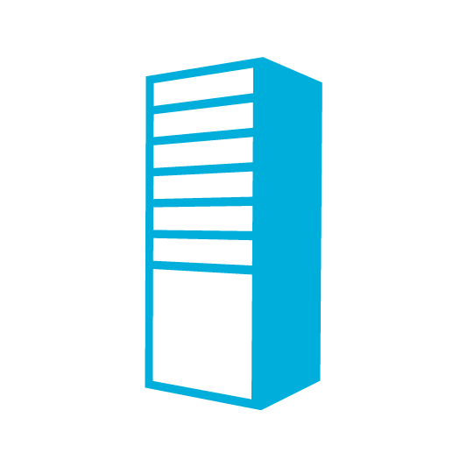
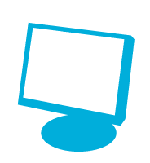


Folder Redirection
Move documents out of the user profile to a centralized location on the network
Benefits
  Provide uninterrupted access
  Reduce the size of the user profile
  Centralize management of documents
  Simplify backup and recovery
Notes:
Folder Redirection
Key Messages:
Provide full-time access to users’ files from any PC
Offline Files provides access to redirected folders when disconnected
Centralizes files to simplify backup and recovery, and enables easy PC replacement
Reduces the size of roaming user profiles, improving logon and logoff performance
Folder Redirection is not new, but it’s an essential part of our Anywhere Productivity story. It moves folders out of users’ profiles and to a central location on the network. Then, it points applications to those folders on the network. That way, users have full-time access to their documents, pictures, videos, and other files from any PC they use.
Offline Files in Windows 8 helps ensure that users have access to their files even if they aren’t connected to the network. When they connect again, Offline Files will synchronize their changes.
Folder Redirection has additional benefits beyond providing access to users’ files on each PC they log on to. It helps centralize users’ data to make backing it up easier and to help get users back to work more quickly in the event that they get a new PC or their PC fails and they get a replacement. It also helps reduce the size of user profiles. Using Roaming User Profiles can improve logon and logoff performance when users have many large files in their profile folders.

Slide 9





Configuring Folder Direction
Share a folder for redirection
Configure a GPO for Folder Redirection
Optionally limit the GPO’s scope
Notes:
Configuring Folder Redirection
Configuring Folder Redirection is simple:
[CLICK] Create and share a folder for redirection on a file server. Use similar permissions as you would when sharing a folder for home folders. Give authenticated users permission to create folders in the root folder only. Then, give CREATOR OWNER full control of subfolders and files.
[CLICK] Create a GPO that configures Folder Redirection. The policy settings are very simple, and I’ll demonstrate those in a few moments.
[CLICK] Optionally, target the GPO. You can do that by using WMI filtering, using security filtering, or linking the GPO to specific organizational units in Active Directory.

Slide 10
Microsoft User Experience Virtualization
Personal and Flexible
Simple and Versatile
Integrated and Scalable
A consistent, personal Windows experience for all workstyles
App and Windows personalization
App reconfiguration not required
Sync is smart—logins are faster
Easy for IT to deliver personal, user-defined experiences, across many devices
Setting location templates
Can create custom templates
IT can roll back settings
Integrates and scales through existing management tools
Configuration Manager
Microsoft Desktop Virtualization
Manage and deploy with Windows PowerShell, Configuration Manager, or third-party management tools
Notes:
Microsoft User Experience Virtualization
Key Messages:
Microsoft UE-V:
Helps deliver a personal Windows experience
Is easy for IT to deploy
Integrates with Configuration Manager, our Desktop Virtualization technologies, and third-party management tools
Microsoft UE-V is an enterprise scalable user-state virtualization solution that can provide users a consistent Windows experience across devices, no matter how you deliver Windows or applications. It virtualizes and roams users’ experiences when they use multiple Windows instances at the same time. It also virtualizes users’ experiences across boundaries that traditional roaming technologies can’t handle well. For example, UE-V can synchronize the experience between a session-based desktop, a desktop PC, and a tablet.
[CLICK]
Personal and flexible:
Your App and OS experience travels to any Windows 7 or Windows 8 instance (physical, virtual, hosted, local) regardless of the Windows-based device. With Roaming User Profiles, we don’t recommend going back and forth between OS versions because the old OS might not know how to handle the changes to the registry that the new OS will make. If the profile changes between Windows 7 and Windows 8, it’s OK because UE-V smartly detects the OS version and maps the setting into the appropriate locations for each OS.
Users no longer need to reconfigure their apps when they log on from a different Windows instance (local/hosted). UE-V will automatically roam the application settings for both physical and virtual applications.
Sync is smart, which makes logons faster compared with Roaming User Profiles. For logon, we synchronize just the settings you need to get to the desktop, making your login fast. For example, in the past, Roaming User Profiles brought everything down all at once. With UE-V personalized settings associated with an application, such as Outlook, are only loaded when the application is launched, instead of at logon, thus reducing the network traffic and speeding up the logon process.
[CLICK]
Simple and versatile:
Settings location templates store the paths to where settings are stored, allowing UE-V to quickly identify the settings and roam them for the user. UE-V grabs only what the user cares about rather than grabbing the entire profile.
IT can create custom templates to define which applications should have their settings roam within their environment. For example, IT might want to define a template for an Internal line-of-business (LOB) app but use a commercially available template from Microsoft to configure Word. UE-V supports both.
IT can roll back settings to initial state if the user applies unwanted changes.
We are actively investigating whether templates can be shared amongst the community in a similar manner as Package Accelerators, created by vendors, including Microsoft.
[CLICK]
Integrated and scalable:
UE-V will have a Configuration Manager desired configuration management (DCM) pack to keep the configuration of the PC client consistent across the enterprise
Integrates with Microsoft desktop virtualization products to further enable Flexible Workstyle as well as Windows To Go for full mobility in a small form factor
Existing tools like Windows PowerShell, Configuration Manager, and third-party management tools can be used to deploy and update templates, and deploy the UE-V agent

Slide 11

Demo: User Experience Virtualization

Slide 12
Microsoft Application Virtualization
Integrated Platform
Flexible Virtualization
Powerful Management
Work in familiar ways
Virtual Application Extension
Use the native file system and registry
No dedicated drive letter required
Virtualizing a broader range of applications
Virtual Application Connection
Support for Office 2013
Manage across physical and virtual environments
New web-based management interface
Virtual Application Connection Groups
Automation with Windows PowerShell
Notes:
Microsoft Application Virtualization
App-V is Microsoft’s industry-leading application virtualization solution. It’s helping our customers lower the cost of managing their PCs and helps speed adoption of Windows 7. Customers love being able to roll out software across their whole organization and keep it up-to-date without worrying about things like administrator rights, reboots, and regression testing.
App-V 5.0 takes what customers love about App-V today and makes it better.
[CLICK]
Integrated Platform
Virtual applications “feel” and “behave” consistently like traditionally installed Windows applications. For example, suppose you want to use a particular Windows Media Player application across your company. Native Windows lets software such as Windows Media Player register capabilities with Windows, in effect to say “Hey, I can play media files!” When end-users click on music or video files, Windows looks for the default Windows Media Player and plays the file.
App-V 4.6 worked with Windows primarily by registering “file types.” In our Windows Media Player example, this means that if users clicked on particular files (e.g., .wmv or .mp3 files), App-V would launch and play them in the virtual Windows Media Player, but if another part of Windows wanted to play media, Windows could launch an entirely different application.
One way App-V 5.0 is more integrated is that virtual applications can be first-class citizens in Windows. App-V 5.0 allows them to register as default application types, such as the default Windows Media Player. Now, Windows will use the virtual media player consistently, improving the overall user experience. App-V 5.0 supports application “right-click” menus so that users work with virtualized applications the same way they do with traditionally installed applications.
App-V 5.0 also eliminates the need to use a separate drive letter to virtualize applications. This was a particular concern in large organizations where available drive letters were scarce, or where this requirement caused IT to have to coordinate across many different departments or geographies.
[CLICK]
Flexible Virtualization
Customers who have deployed App-V love it so much that they want to virtualize most of their applications, but they often run into problems virtualizing applications that demand a high level of integration. Let’s take the example where customers want to embed an editable Visio diagram into a Word document. We usually take this level of integration for granted, but when applications are virtualized, they are isolated and protected from one another, so this level of integration doesn’t work. For most applications, this kind of protection is helpful. It protects you from things such as the so-called “DLL hell.” For others, it can be a barrier to successful virtualization.
App-V 4.6 lets customers use Dynamic Suite Composition to let virtual applications share middleware components like Java, but full cooperation between applications isn’t supported. App-V 5.0 introduces Virtual Application Connection, allowing two or more virtual applications to work side-by-side. This will increase the kinds of applications that you can use in App-V. We’re also working closely with the Office team to ensure that the next version of Office and the next version of App-V work beautifully together.
[CLICK]
Powerful Management
Of course, you can deploy virtual applications by using System Center 2012 Configuration Manager without using an App-V server. By doing so, you can manage all of your applications in one console. But out-of-the-box management has always been a strong suit of App-V, and in 5.0, it gets even better. It offers a new web-based management console powered by Silverlight. The management console is easy to use, with features that are easy to discover.
Remember how we talked about allowing virtual applications to work together using Virtual Application Connection? In App-V 5.0, you can manage the way applications work together right from the server management console using Virtual Application Connection Groups. In the past, customers have had to manually edit text files to manage application dependencies. It was time-consuming, and it didn’t scale. You will love doing this directly from the server.
We’ve also listened to feedback from customers who have told us that they want to be able to scan virtual applications for viruses. We’ve added that ability. In fact, we’re working with the System Center team to build a great monitoring, security, and distribution platform with App-V 5.0.
Finally, our more advanced customers would like to completely automate App-V, from the packaging to the server to the client. In App-V 4.6, this was partially possible, but in App-V 5.0, the client and server components are fully automated with Windows PowerShell.

Slide 13
Demo: Application Virtualization 5.0

Slide 14
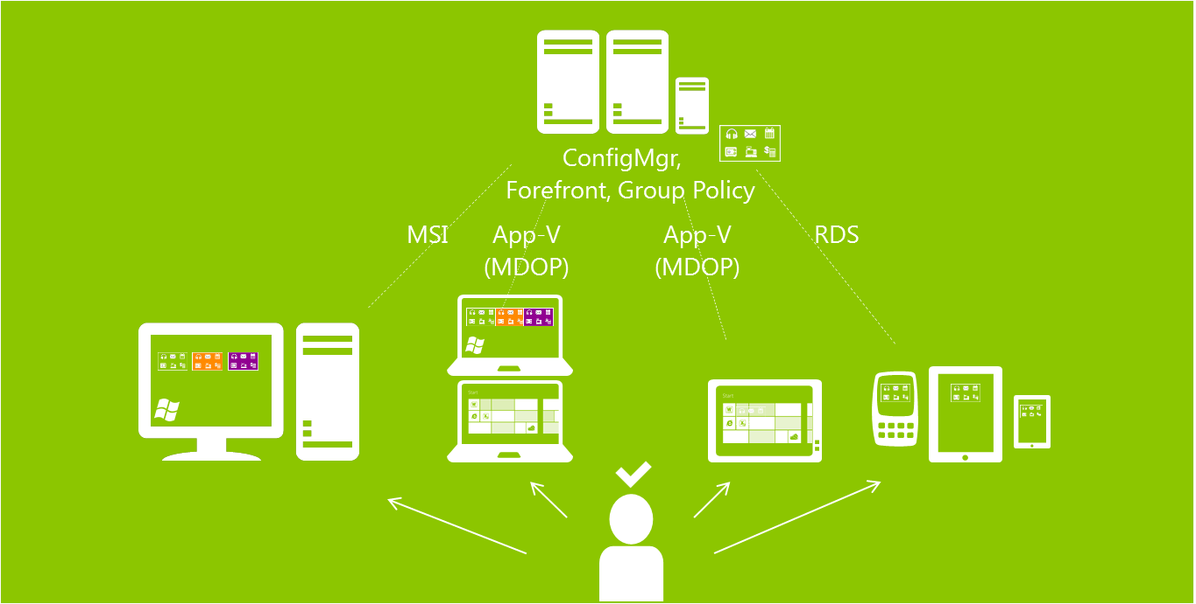
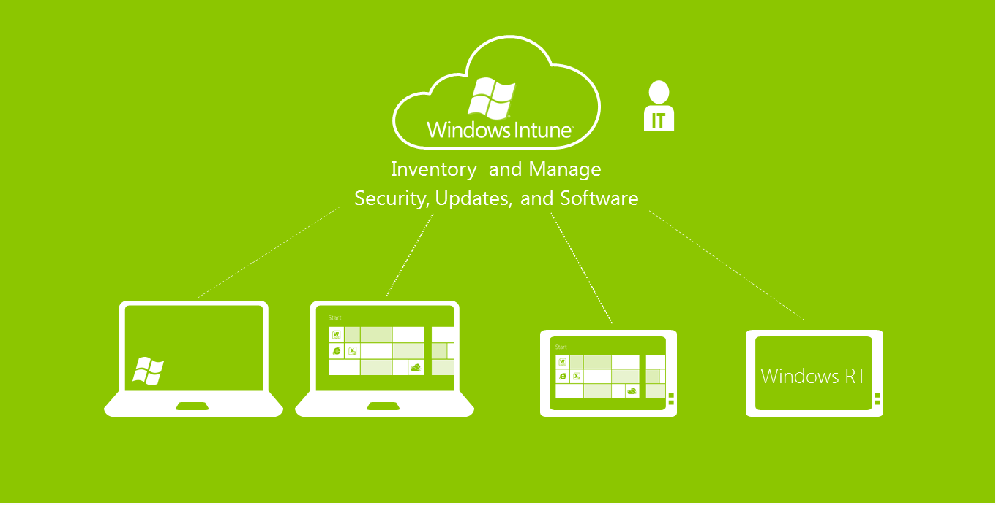
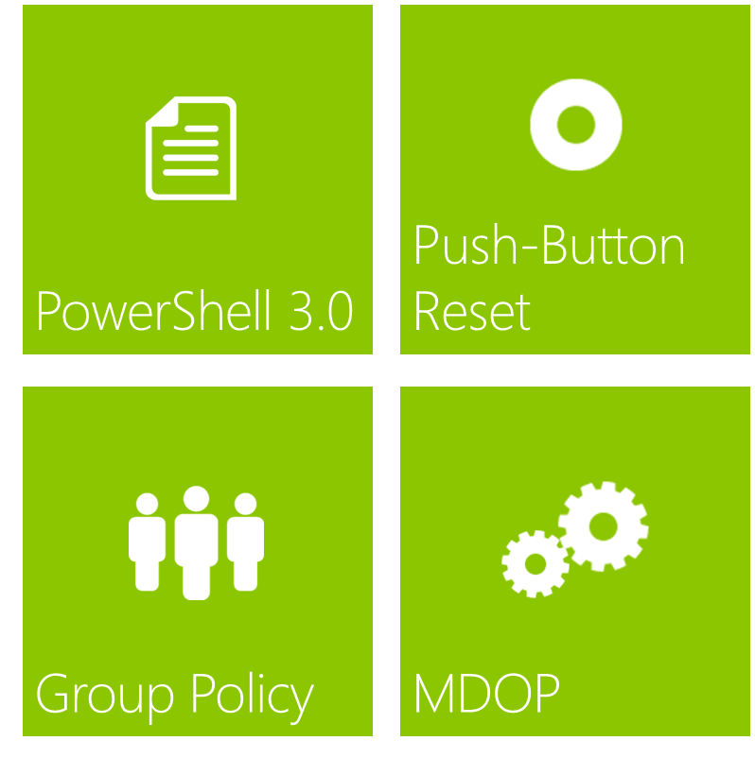
Unified Management Across Devices
Enabling user to access their apps from many devices
Unified Management
of Devices
Cloud management for Windows-based PC and tablets
Advanced Client Management With Windows 8 and MDOP
Notes:
Unified Management Across Devices
The ability to support today’s mobile workforce is one of the top priorities for our enterprise customers. We believe in providing multiple tools for your IT teams so that they can find a solution that best fit users’ needs and workstyles.
There are three primary solutions within the toolbox of unified management of devices; enabling users to access their apps from many devices, cloud management for PCs and tablets, and advanced client management with Windows 8 and MDOP.

Slide 15




Enabling App Access from Many Devices
System Center Configuration Manager,
System Center Endpoint Protection, Group Policy
MSI
App-V
(MDOP)
App-V
(MDOP)
RDS
  BENEFITS
  Centralized tool to manage
  user devices
  Increased security and compliance for devices
  User focused and device relevant application delivery
  Unified, consistent device management experience
Notes:
Enabling App Access from Many Devices
Key Messages:
With Flexible Workstyle solutions, customers can support a wide range of user devices in their enterprise.
The benefits include a centralized tool to manage all user devices, increased security and compliance for all devices, and user-focused and device-relevant application delivery.
With Configuration Manager, you can use the same platform to manage Windows-based PCs or tablets, Apple Mac computers, Linux servers, Apple iOS devices, or Google Android devices with a single console view. And with System Center 2012 Endpoint Protection integrated into the product, you don’t need to purchase and set up a parallel antivirus software management infrastructure. More important, Configuration Manager is a user-centric management model, so access, authentication, authorization, and reporting are based on the user, and the device accessing the corporate network is associated with the user.
[CLICK]
For example, the infrastructure is intelligent enough to know that a user is accessing from a corporate-owned PC that meets all corporate data security policy, so that data encryption is enabled on the PC with sufficient memory and storage, and that network connection is accomplished with DirectAccess or through a VPN. In that case, when the user is trying to access or install apps from the Configuration Manager Application Catalog, the device gets a wide choice of applications available to the user based on the functional role. The device also gets the choice of installing these apps via Microsoft Installer Package (MSI) or App-V, or running it as remote app or apps in a remote desktop.
[CLICK]
If that user is accessing from a smartphone or personal device, IT can set up the policy so that the user only gets the choice of accessing and running apps as remote apps. The selection of applications can also be limited.
IT will also have the ability to track and report exactly who has access to the corporate network, and with which devices. IT can also determine how long each device has been accessing the corporate network and whether the user is the primary user on that device.

Slide 16


Cloud Management for Windows Devices
IT
Inventory and Manage
Security, Updates, and Software
  BENEFITS
  No on-premise infrastructure required
  You always have the latest capabilities
  Manage from virtually anywhere
  Can compliment existing
  on-premises infrastructure
Notes:
Cloud Management for Windows Devices
Key Messages:
Keeping a corporate network safe and secure is important for organizations.
On-premises solutions such as Configuration Manager are very powerful, but it can be a challenge to manage PCs that are not on the corporate network. Windows Intune is a cloud solution for managing Windows-based PCs and tablets.
Windows Intune is an online management solution. With Windows Intune, you can manage x86-based PCs (and any mobile devices connected through Exchange ActiveSync) that are often not connected to the corporate network. You can remotely log on to a management console and centrally [CLICK]:
Manage the deployment of Microsoft updates and service packs to all these non-domain joined PCs.
Manage and update endpoint-protection policies onto these devices even when these devices are outside the corporate firewall.
Ensure that these devices have the latest anti-malware software in place.
Additionally with Windows Intune, you can push software to Windows-based computers, and you can publish applications to Windows-based computers, Android devices, and iOS devices through the self-service portal.
You can also provide remote assistance to resolve PC issues (as long as the PC has an Internet connection), track hardware and software inventory to efficiently manage corporate licenses used, and deploy software through the cloud.
These PCs have access to enterprise features available in Windows 7 Enterprise, such as BitLocker Drive Encryption to ensure that data is safe even when the device is lost. Windows Intune helps you offer a Flexible Workstyle solution that allows users to work how they want—from home, on the road, or in the office—and you can help them to be managed and secured.

Slide 17


Advanced Manageability with Windows 8 and MDOP
Windows PowerShell 3.0
Push-button reset
  Improve Routine Task Automation:
  PowerShell 3.0 provides workflows, robust connections, and additional capabilities improving routine task automation
  Keep Users Productive:
  Restore corporate image while preserving user data
  Restore corporate image while removing all user data
Group Policy
  Simplify Desktop Configuration:
  Refresh Group Policy Settings remotely
  Determine status of replication across a domain
  Reduce number of reporting tools required
MDOP
  Advanced management with MDOP:
  Powerful change management for Group Policy with Microsoft Advanced Group Policy Management (AGPM)
  Accelerate desktop repair with Microsoft Diagnostics and Recovery Toolset (DaRT)
Notes:
Advanced Manageability with Windows 8 and MDOP
Four other key technologies can help make managing Windows 8 easier: Windows PowerShell 3.0, Group Policy, push-button reset, and the advanced management tools in MDOP.
First, PowerShell 3.0 makes using PowerShell easier than ever before through increased coverage and integration with the PowerShell Integrated Scripting Environment (ISE), which makes searching for, using, and creating scripts simpler—to the benefit of beginning, intermediate, and expert scripters. PowerShell 3.0 increases IT admin productivity by providing workflows to enable the robust execution of tasks that survive the unpredictable nature of infrastructure environments.
Second, there are three key investments for Group Policy in Windows 8 and Windows Server 2012, and they focus on improving Group Policy troubleshooting:
You can remotely update policy on one or many client computers, in an easier way.
You can more easily determining the status of GPO replication across a domain.
And it provides a single place for gathering Group Policy–related information, reducing the number of reporting tools required for Group Policy.
The third is push-button reset. This is really two capabilities:
The first is Refresh Your PC, and this restores the Windows image while preserving user personalization settings, data, and Windows 8 apps, getting a user back to a good state while keeping data intact.
The second is Reset Your PC, which restores the Windows image while removing all user data and applications, preparing PCs for recycling, donation, or reuse.
And last is MDOP. In MDOP, Advanced Group Policy Management provides a central location to manage the GPOs across your organization. For example, approval workflows can help reduce errors while its rollback capability makes restoring previous GPO versions easy. Another feature of MDOP is the Diagnostics and Recovery Toolset, which I’ll demo in a later session. This toolset can help you more quickly troubleshoot and repair PCs.

Slide 18
Summary
Unified
Management
Mobile Broadband
DirectAccess
BranchCache
Folder Redirection
User Experience Virtualization
Application Virtualization
Notes:
Summary
I’ve thrown a lot at you in this session. You learned about several enhancements in Windows 8, including:
Mobile Broadband
DirectAccess
BranchCache
These features can give your users access to the corporate resources they need across locations and devices.
I also talked about some key features of MDOP that can help users be productive anywhere and on any devices. UE-V, combined with Folder Redirection, enables users’ operating system and application experiences to roam across devices, operating system versions, and virtual/physical boundaries. For applications, there’s App-V, which enables anywhere access to applications that are dynamically available on any authorized PC without installation—online or offline—even over the Internet. Virtual applications look and feel like traditionally installed applications, taking advantage of the full Windows environment.
The last thought I want to share is that App-V and UE-V are better together than alone. Combined, they give users a consistent experience and reliable access to applications and business data, whether those users are online or offline, local or remote, across the range of PCs they use. The combination helps users work as productively out of the office as they do when they are in the office.

Slide 19
Resources
TechNet Evaluation Center
Download Microsoft software trials today.
technet.microsoft.com/evalcenter
Microsoft Virtual Academy
Take a free, online course.
microsoftvirtualacademy.com
IT Camps
Find an additional IT Camp near you.
technet.microsoft.com/globalitcamps
Microsoft Certifications
Get certified on Microsoft Products & Technologies.
aka.ms/certifications

Slide 20



© 2012 Microsoft Corporation. All rights reserved. Microsoft, Windows, Windows Vista and other product names are or may be registered trademarks and/or trademarks in the U.S. and/or other countries.
The information herein is for informational purposes only and represents the current view of Microsoft Corporation as of the date of this presentation. Because Microsoft must respond to changing market conditions, it should not be interpreted to be a commitment on the part of Microsoft, and Microsoft cannot guarantee the accuracy of any information provided after the date of this presentation. MICROSOFT MAKES NO WARRANTIES, EXPRESS, IMPLIED OR STATUTORY, AS TO THE INFORMATION IN THIS PRESENTATION.

