Slide 1
Windows 8 Apps

Slide 2
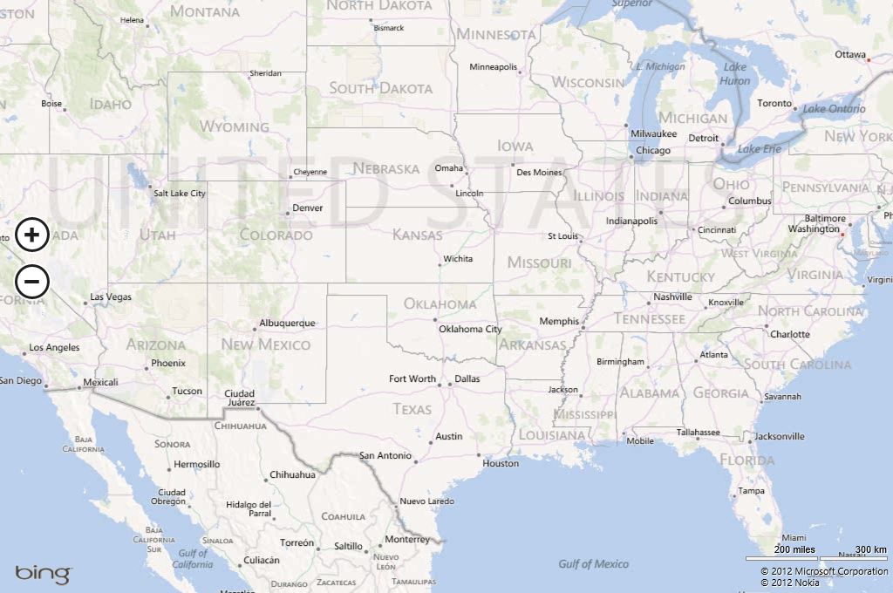
Not traditional
desktop apps
Consume data
differently
Live Tiles—not icons
Multiple views
Notes:
Windows 8 Apps
Key Messages:
Windows 8 apps provide a rich, immersive experience
Apps support multiple views
Apps use tiles
Windows 8 apps are different from traditional desktop apps.
[CLICK]
In a traditional desktop app scenario, there's essentially one view of the app. Sure, you can resize the windows or minimize the app, but the desktop app's data is presented in one format.
On the other hand, Windows 8 apps support multiple views through a single window. The view can be horizontal or vertical on a given device and can resize automatically based on the device. The view can also be snapped, with another app placed right next to it. This functionality enables even greater flexibility for consuming content with Windows 8.
Instead of using the icons of a traditional desktop application, Windows 8 apps use tiles. Tiles provide a much richer experience for the user. Not only do tiles convey more information but they can also be updated, live, on the fly. Even when the app itself isn't running, a tile can receive updates. For example, a sports app might communicate live scores of your favorite teams through its live tile.

Slide 3


Touch First
No chrome—full-screen experience
Designed for Touch and Pen Input
But not at expense of keyboard
and mouse
Notes:
Touch First
Key Messages:
Windows 8 apps are touch-centric
Apps are also keyboard and mouse friendly
Apps are chromeless
Windows 8 apps are touch-first.
Windows 8 apps are designed for both touch and pen input, making them perfect for tablet and mobile devices. For example, to switch between open apps, you simply swipe from the left edge. Other actions are available through gestures, such as the ability to pinch and zoom using two fingers. Interaction with Windows 8 apps is designed to be intuitive and easy to use. Apps also work well with numerous input sources, such as a traditional mouse and keyboard.
Windows 8 apps are chromeless, which means you won't find the traditional toolbars and menus that you'd find in a desktop application. Windows 8 apps provide a full-screen immersive experience for the user, one in which interaction with the app becomes seamless and the user can concentrate on the information conveyed within the app.

Slide 4


New Ways to Interact
App commands
App Switcher
Snapping
Notes:
New Way to Interact
Key Messages:
Windows 8 apps provide new ways to work.
With the chromeless interface comes new ways to work with the apps, including app commands, the app switcher, and snapping. Think of app commands as a command interface for the app, where you can present tools and navigation to the user. The app switcher is a touch-friendly interface for quickly switching among Windows 8 apps. And last, you can snap Windows 8 apps side by side to work more productively.

Slide 5



And Communicate
  Contracts
  Examples
    Searching
    Sharing
Notes:
New Ways to Communicate
Key Messages:
Apps can communicate with each other through contracts
Windows 8 apps can communicate with one another. Apps expose contracts, which are interfaces that enable other apps to search and share content between apps. This means that apps from different publishers can work with each other's data in ways never before imagined.
Previously, interaction between apps meant exposing an API; then, anyone who wanted to interact with the app needed to learn each API from each different app publisher. The difference with Windows 8 apps is that the contracts are standardized within Windows 8 itself, so developers can use the functionality easily and consistently.

Slide 6




Developing Windows 8 Apps
Apps can be easy to develop
Using Many Familiar Languages
Visual Basic
Visual C++
Visual C#
JavaScript
Notes:
Developing Windows 8 Apps
Key Message:
Apps can be developed in numerous languages
The app development process is also easy with Windows 8. Developers can use languages that are familiar to them, including JavaScript with HTML and CSS. Once developed, Windows 8 apps are distributed through the Windows Store.

Slide 7
The Windows Store
Apps are distributed through the Windows Store
Many popular apps from familiar names
Apps pass certification tests
Apps can be controlled through Group Policy
Notes:
The Windows Store
Key Messages:
The Windows Store is how users get apps
Apps must be certified
The Windows Store is where developers publish applications to the general public for self installation. To be offered in the Windows Store, apps must pass a series of certification tests to help maintain a quality user experience.
Like other application storefronts, the Windows Store offers apps from a variety of publishers in numerous categories. For example, it offers games, apps for kids, and apps from familiar companies.
The Windows Store experience is familiar to users and developers alike, and IT pros can control apps and the Windows Store through Group Policy.

Slide 8

Demo: Windows Apps

Slide 9
Demo: The Windows Store

Slide 10


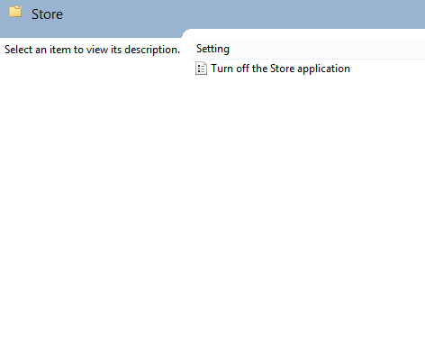



Manage With Familiar Tools
Work On Your
Own Device
AppLocker is used to manage access for individual apps
Group Policy-based Management
Disable Access to the Windows Store
Enable installation of LOB apps
Privacy Settings
Disable automatic download (but not automatic updates)
See http://technet.microsoft.com/library/hh832040.aspx for more information.
Notes:
Manage With Familiar Tools
Key Messages:
IT manages apps using familiar tools
Group Policy and AppLocker are used
Organizations can manage several aspects of the Windows Store experience. In many cases, they can manage these aspects using technologies that are already in place in most organizations. For example, let's say you want to prevent users from using the Finance app. To do so, you can use AppLocker. As you'll see later, AppLocker is one of the stars of Windows Store management. Using AppLocker, you can prevent access to specific apps based on user or group membership.
The settings for the Windows Store are helpful for controlling access to the store. But what about organizations that need to load their own line-of-business (LOB) apps? You use Group Policy to enable the installation of custom, internal-use apps, in a process called sideloading.
What if you want to prevent access to the Windows Store itself. How might this be accomplished? Group Policy. You can enable or disable access to the Windows Store based on the individual user or device, or based on group membership. This functionality provides great flexibility for certain power users, who can utilize the Windows Store while call center staff would be prevented from accessing the store. Content URLs are sent to Microsoft for evaluation and improvement of the Windows Store. Organizations can prevent this process be changing the privacy settings appropriately. Like other settings, privacy settings are controlled through Group Policy. Using Group Policy, you can also disable the automatic downloading of updates, although the updates themselves can't be disabled; users can still choose when to update their apps.

Slide 11

Sideloading Windows 8 Apps
Sideload LOB apps
Apps are
APPX plus
Supporting
files
No certification
necessary
Notes:
Sideloading Windows 8 Apps
Key Messages:
Sideloading is how businesses load their own apps
Sideloaded apps are internal-use only
The Windows Store is where apps are shared and sold to the public for use in Windows 8. But what if your organization needs to distribute an app to your internal sales staff? Windows 8 enables a process for internal distribution called sideloading.
Sideloading an app means taking an internally developed app (which is a .appx file along with supporting files) and distributing it to one or more computers within an organization. In a typical scenario, you have an application that the sales or support staff uses. These staff members are "on the go" and using the app on the road or out in the field. This is the perfect scenario for a Windows 8 app because the staff can use the apps on mobile devices or tablets.
Apps that are sideloaded don't need to pass through the rigorous Windows Store certification process, but the app will still pass through the Windows App Certification Kit prior to its internal release.
Sideloading is an excellent way to enable users to utilize the touch-centric, immersive Windows 8 experience for the LOB app. As you'll see in the coming slides, sideloaded apps are easy to deploy, and offer numerous ways to get the app distributed to users.

Slide 12





Sideloading Requirements
Key requirements:
-or-
Sideloaded product key
Signed by trusted CA
Domain joined
-and-
For domain-joined computers, enable the “Allow all trusted applications to install” policy
Notes:
Sideloading Requirements
Key Messages:
Sideloading requires Windows 8 Enterprise
Devices must be on the domain or have sideloading certificate
App must be signed
Sideloading is supported on Windows 8 Enterprise and Windows RT Devices.
Sideloading an app can be accomplished after a few other requirements are met. As with controlling apps through Group Policy, the device on which the sideloaded app is to be installed needs to be [CLICK] joined to the domain. As an alternative, [CLICK] a sideloading product key needs to be installed on the device for the sideloaded app to be allowed.
Regardless of whether the device is joined to the domain or has the sideloading product key, [CLICK] the app must be signed by a trusted certificate. This typically means obtaining a certificate from a trusted certificate authority. Windows 8 has numerous root certificate authorities installed and trusted as part of the operating system. A self-signed certificate can also be used, as long as the device is configured to trust the root certificate.
[CLICK]
When a device is joined to the domain, it needs to have the Allow all trusted applications to install Group Policy configured.
These are the only two requirements for sideloading: installing a sideloading product key or installing on a domain-joined computer; and having the app signed by a trusted certificate. With those requirements, an app can be deployed onto user devices in one of several ways.

Slide 13



Flexible App Deployment
Fundamental:
ESD Systems:
  Per-user with PowerShell
  MDT 2012 Update 1
  Per-computer with DISM
  System Center 2012 Configuration Manager
Notes:
Flexible App Deployment
Key Messages:
Numerous tools for deploying apps.
MDT 2012, System Center 2012 Configuration Manager, DISM, and more
Apps can be installed in many different ways, enabling an organization to continue using the same tools and processes that it uses for software deployment today. Tools like PowerShell and Deployment Image Servicing and Management (DISM) are used, as are System Center 2012 Configuration Manager, Microsoft Deployment Toolkit (MDT) 2012, Windows Intune, and other electronic software distribution (ESD) systems. More on this later.
Apps can be installed on a per-user basis, provisioned automatically within an image, or installed using one of the aforementioned tools. A typical scenario would be to sideload the app onto development and testing computers for quality assurance (QA). This would be accomplished using PowerShell, as you'll see later in this session.
It's also likely that you'll want to include the app in the appropriate system images so that it's installed as new devices are deployed. You'll see a demonstration for app provisioning later in this session, too.
After the app has been tested, it's not really practical to distribute it throughout a large organization using only PowerShell. How might you get the app onto everyone's device? Larger-scale distribution within the organization is accomplished with an ESD system like MDT 2012 Update 1 or Configuration Manager. You'll see Configuration Manager and other examples of deployment later in this session.

Slide 14
The Sideloading Process
Sideloading has development and IT tasks
Development:
IT:
  Packages and runs Windows App Certification Kit
  Signs the app
  Validates with the Windows App Certification Kit
  Distributes to QA
  Distributes organization-wide
Notes:
The Sideloading Process
Key Messages:
Two types of tasks, development related and deployment related
Developers create, sign, and validate the app
IT staff revalidates and tests the app and then deploys it
As briefly alluded to earlier, the sideloading process can be divided into two distinct phases: development-related and deployment-related.
Tasks that a developer would typically perform include validating and signing the app.
Validating an app consists of packaging it using the tools available in Visual Studio. As part of the packaging process, the developer runs the Windows App Certification Kit. This kit runs the same tests that Microsoft does as part of the process to prepare and certify an app for the Windows Store. The Windows App Certification Kit is an automated wizard and can also be executed from the command line.
A developer would also cryptographically sign the app, likely using a certificate provided by the organization. Recall that in order to sideload an app, it needs to be signed by a certificate trusted by the target device.
Once the app is tested and signed, the developer can hand the app package off to IT. With the app package in hand, the IT staff begins the deployment process. In many organizations, the process calls for the IT staff to validate the app package. Even though the developer already ran the Windows App Certification Kit, the audit process might call for IT staff to run the same test on the app package.
The Windows 8 software development kit (SDK) includes a command-line interface into the Windows App Certification Kit. This interface makes it easy for IT staff to validate the app without having to install Visual Studio.
Most organizations will also utilize some form of QA testing for apps. In this case, the IT staff can then install the app on the appropriate QA devices for testing the app itself. Distribution at this point is probably done using PowerShell because the app needs to be installed on only a handful of devices for the QA cycle.
Once the app has been tested, IT staff can begin the organization-wide distribution. You'll see a few different ways to do this in the coming demos.
Apps can also be added to installation images using DISM so that the app doesn't need to be installed after the image has been deployed.

Slide 15
Demo: Preparing to Sideload an App

Slide 16
Demo: Sideloading an App Per User

Slide 17
Demo: Provisioning an App in an Image

Slide 18

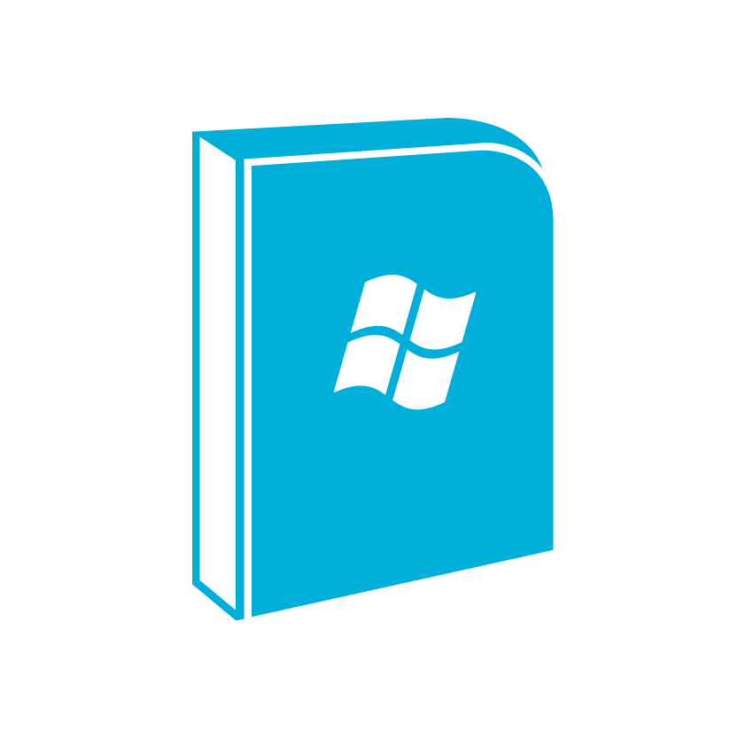

Powerful Deployment
Several installation types
Deployment types can be prioritized
Notes:
Powerful Application Deployment
Key Messages:
System Center 2012 Configuration Manager makes it easy to deploy applications
Configuration Manager 2012 includes capabilities that enable enterprise-level management of applications. Configuration Manager uses a new application model that can utilize multiple deployment methods for a given application. You can publish or push apps by using almost any requirements you define, such as the primary device, operating system versions, virtual or physical, specific users or groups, and so on.
The type of deployment can be prioritized, so if you have more than one type that would match, like a Windows Installer and Script Installer, you can set the priority so that the preferred installation method is chosen first. When you create a deployment, you can also configure how Configuration Manager detects which type of installation to use, and you can set dependencies so that an application has all of its prerequisites installed as well.

Slide 19

Flexible Deployment
User Device Affinity
Deployment types set per-device
Simplified Process:
  Create Application Wizard
  Distribute Content Wizard
  Deploy Software Wizard
1
2
3
Notes:
Flexible Application Deployment
Key Messages:
Configuration Manager's User Device Affinity helps with multi-device deployment
Deployment process for applications uses the Create Application Wizard
Have your users ever needed to access their applications from multiple devices? Of course they have. Without Configuration Manager, you'd need to make sure that the app is installed on every device that the users might encounter. However, with Configuration Manager's User Device Affinity (UDA), you can tie a user to a device. This means that you can deploy software without needing to pre-install it on all of the various devices that a user might use during the course of their work since UDA will install the app for them.
Even better, the type of deployment can be configured based on the type of device or the way the user needs to work with the software. For example, on the user's main device, a standard Windows Installer–based deployment might be used, whereas on a temporary or presentation device, the deployment might be done using App-V.
The overall process for app deployment is easier with Configuration Manager 2012 than with previous versions.
In Configuration Manager 2012, you first [CLICK] create an application within the Configuration Manager Software Library. As part of the Create Application Wizard, you choose the various settings related to the application, such as its deployment types and dependencies. Once the application has been created in Configuration Manager, [CLICK] it needs to be deployed. This can be accomplished with the Distribute Content Wizard within Configuration Manager Software Library. Finally, [CLICK] the Deploy Software Wizard is used to deploy the software, usually to a group of devices.

Slide 20


Self-Service
Application Catalog:
Web-based interface for choosing software and device management
Software Center:
Client software program for choosing software to be installed
Notes:
Self-Service
Key Messages:
Software Center and Application Catalog promote self-service
Software Center is a client software package
Application Catalog is served via a web application
With its user-centric model for software management, Configuration Manager 2012 helps to alleviate some of the administrative overhead that traditionally goes along with software deployments. Two features of Configuration Manager 2012 help with this: the Application Catalog and Software Center. Both of these features put control in the hands of the user while still enabling IT staff to maintain and support the device.
Software Center is a client software package that lets users choose the software to be installed on their device. Of course, IT staff can still require software to be installed on a device. Even if the user removes the application, Configuration Manager will reinstall it.
The Application Catalog serves a similar purpose but does so through a web application. This means that users can access the Application Catalog using a web browser for maximum flexibility.
The Application Catalog can also be used to wipe mobile devices, and users can access the Application Catalog from web browsers. Aside from installing software, users can also use the Software Center to schedule software installation, configure remote access settings, and perform other tasks based on the organization's policies. IT staff can exert control over which of these features are available as well.

Slide 21
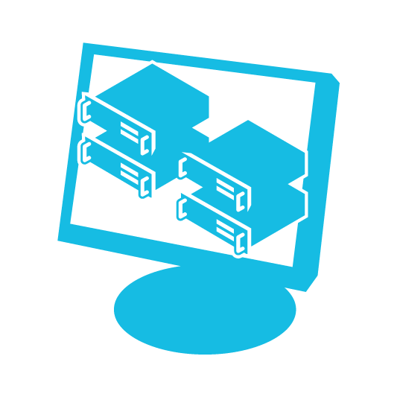

Monitoring
Built-in Monitoring
State-based monitoring around deployments
Notes:
Monitoring
Key Messages:
Configuration Manager can also monitor deployments
State-based monitoring is used
[CLICK]
All of the features that Configuration Manager brings to software deployment are great timesavers for an IT staff. But how does IT monitor the application deployments?
[CLICK]
The answer is Configuration Manager. Configuration Manager also includes monitoring capabilities that help IT staff manage application deployment. IT can then take action to remediate errors that prevent an application from being deployed, such as when requirements aren't met for the application on a given device.
[CLICK]
State-based monitoring is used for application deployment in Configuration Manager. Monitoring information is provided for the specific deployments such that you can track overall numbers related to a deployment. This can be helpful in cases where there's a problematic deployment or a class of devices for which application deployment consistently fails.

Slide 22
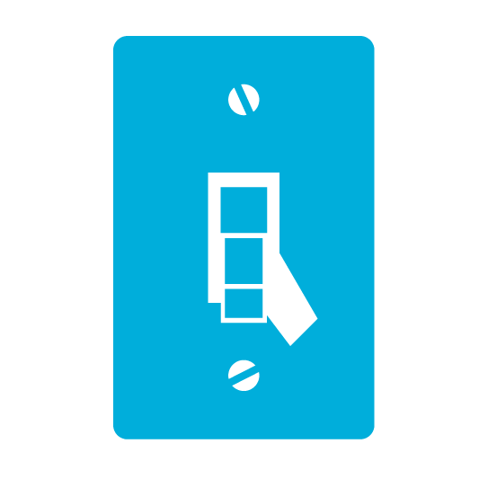

Configuration Manager SP1
Support for Windows 8 App Deployment
  Deploy individual appx packages
  Link to Windows Store (deep linking)
Support for Windows 8 features
  Windows to Go
  Networking enhancements
  User State Virtualization
Notes:
SP1 - Windows 8 Friendly
Key Message:
Configuration Manager Service Pack 1 supports Windows 8 app deployment
Service Pack 1 of Configuration Manager 2012 adds support for deploying Windows 8 apps. The support is quite advanced, offering the ability to create a deployment type for individual .appx packages, as an organization would create for LOB apps or the ability to link into an application in the Windows Store (i.e., deep linking).
Using Configuration Manager 2012 SP1, an organization can meet the needs of LOB apps deployed on a large scale, using the same interface and deployment techniques that are already familiar.
Other highlights of Configuration Manager 2012 SP1 include:
Configuration Manager supports Windows To Go.
Configuration Manager supports Windows 8 features, such as metered Internet connections and Always On Always Connected.
You can configure user data and profiles configuration items for folder redirection, offline files, and roaming profiles.
As you can see, Configuration Manager makes deployment of traditional desktop applications easy. The addition of self-service options to Configuration Manager 2012 enhances the overall goal of empowering users. With the release of Configuration Manager 2012 SP1, the power and flexibility of application deployment is also available for Windows 8 apps. This makes Configuration Manager a true solution for enterprise-wide software deployment.

Slide 23
Demo: Distributing an App
Using MDT 2012 Update 1

Slide 24
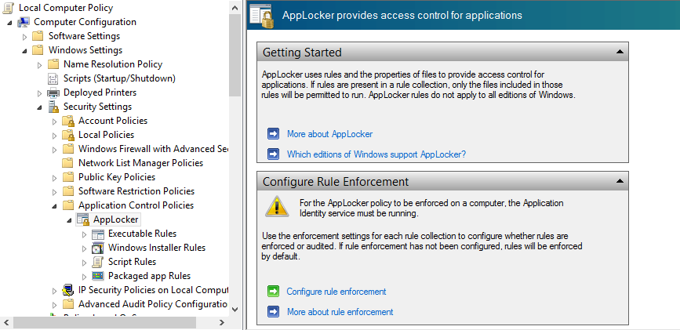
Management Options
Windows PowerShell
Group Policy AppLocker
Notes:
Management Options
Key Messages:
Familiar tools used for management of apps
Don't need to learn new tools for Windows 8
Windows 8 apps offer a rich, immersive experience across devices. Using a chromeless interface, users interact with Windows as never before. Users also have access to a wide variety of software through the Windows Store.
How can IT keep a handle on devices and software in the enterprise in order to maintain a supportable environment? With all of this power in the hands of the user, IT needs the tools and techniques for management. Microsoft has empowered not only the user but also the IT professional.
Microsoft recognizes that the ability to install software needs to be limited in many enterprises. And as an IT pro, you don't want (or have time) to manage and support individual users and devices; the goal is to reduce the amount of time spent performing mundane administrative tasks. To that end, there have been numerous enhancements to familiar IT tools. That's a key point: You don't need to learn new tools or ways to manage your environment. The same tools you use today have just been enhanced to add features and support for Windows 8 app management.
The coming slides examine the tools and their enhancements for Windows 8 app management.

Slide 25

Windows Powershell
Add-AppxPackage
Get-AppxLog
Get-AppxLasterror
Get-AppxPackage
Get-AppxPackageManifest
Remove-AppxPackage
Add-AppxProvisionedPackage
Remove-AppxProvisionedPackage
Notes:
Windows PowerShell
Key Messages:
PowerShell includes several new cmdlets for Windows 8 apps
Cmdlets used for installation, troubleshooting, and removal of apps
Windows PowerShell now includes additional commands for working with Windows 8 apps. You already saw how to use the add-appxpackage command to install a package, but what happens when something goes wrong? Aside from the add-appxpackage command, there are a few other commands that are helpful for the IT pro to use for supporting Windows 8 apps, two of which are helpful for diagnosing app installation problems.
The two PowerShell commands that assist in troubleshooting installation problems are get-appxlog and get-appxlasterror. The get-appxlog command returns the installation log from a package. This command can be run for an individual package or for all installed packages. The get-appxlasterror command examines the app package installation logs and returns the last error encountered for the current PowerShell session.
Other PowerShell commands are helpful for working with packages. The get-appxpackage command provides a list of app packages that are installed. The basic command obtains information for an individual user profile, but you can use a command-line switch to get the list for all users on a device. You can also find apps by a certain publisher and other such criteria to help narrow the scope of the command.
You can get the manifest of an app package by using the get-appxpackagemanifest command. This command provides overall information about the package itself and can be used on a package that's not installed.
You can remove a package by using the remove-appxpackage command. This command has an interesting command-line parameter called -whatif. Using the -whatif parameter is like a dry run of the command; it shows what will happen if the command is executed but without actually running the command.
When working with provisioned apps, such as those provisioned in a DISM image, you can use the app-appxprovisionedpackage and remove-appxprovisionedpackage commands.
All of the commands used for package management accept some common parameters, such as -verbose, -debug, and parameters for error handling and output handling.

Slide 26



AppLocker
Restrict applications
Policies built for:
  Windows Store apps
  LOB apps
Policies built using:
  Individual app package
  List of apps installed
Notes:
AppLocker
Key Messages:
AppLocker enables advanced application control policies
Policies can be applied with complex rules to allow or deny app execution
AppLocker has been updated for Windows 8 app policies
AppLocker is an advanced feature for software policies in an enterprise.
AppLocker makes it possible for IT to restrict the applications that can be executed on devices within the network. Policies can be applied in a number of flexible ways to target applications. For example, you can apply policies using various attributes and properties, such as the application's publisher or version or an individual file's signature, and numerous others. And AppLocker doesn’t only restrict standard executable files; it can also restrict scripts like VB Scripts and batch files, DLL files, MSIs, and others.
When working with Windows 8 Apps, AppLocker can examine an app package directly in order to create a policy. AppLocker can also look at all of the apps already installed on a computer and create policies that apply to those apps. Once created, that policy can be applied to other computers on the network. The practical implication is that AppLocker policies can be applied both for apps that come from the Windows Store and for those that are sideloaded.

Slide 27
Demo: Using Windows Powershell

Slide 28
Demo: Controlling Access with AppLocker

Slide 29







Summary
Reduced
Costs
Agility
Windows Store Requirements
  Group Policy control
    Access
    Automatic download
    Privacy
Sideloading tools:
  Per user: PowerShell
  Per image: DISM
Easy To
Implement
Self
Service
Notes:
Summary
Key Messages:
Organizations can distribute apps using the Windows Store or locally through sideloading
Familiar tools are used to manage apps in the enterprise
App deployment is achieved using familiar tools like System Center 2012 Configuration Manager
Organizations use the Windows Store to distribute apps to the public. The Windows Store offers numerous flexible options for payments: You can provide a free app, use one of the pricing tiers, offer in-app purchasing, and more.
Organizations can control many aspects of the Windows Store experience by using nothing more than Group Policy. Access to the store itself can be controlled through Group Policy, and this access control can be applied to an individual user, device, or group.
AppLocker, which can tie into Group Policy, can be used to apply more advanced rules surrounding app usage. You can create rules such that only certain individuals or groups can execute certain apps.
With that said, automatic updates can't be controlled through Group Policy and of course you need to make sure that the device is joined to the domain in order for Group Policy settings to be effective.
Windows 8 Enterprise and Windows RT Devices support app sideloading, and you can sideload apps onto devices that meet a few requirements. The device needs to be joined to the domain or have the sideloading product key installed. For domain-joined devices, the Group Policy Allow all trusted applications to install setting must be enabled. Whether the device is joined to the domain or the sideloading product key is installed, the device must also have the appropriate trusted root certificates installed for the app being sideloaded.
Once the requirements are met, sideloading an app can be accomplished using the PowerShell add-appxpackage command, and this is typically used when deploying to other developer machines or for quality assurance. The DISM tool can be used to add a package to an image so that the package doesn't need to be installed separately. Other tools for deployment include MDT 2012, Configuration Manager 2012, and Windows Intune. Each of these was covered during this session.
Management of Windows 8 apps can be done using PowerShell commands to inventory and obtain error information about packages deployed on a device. More advanced tools like Configuration Manager can be used for package management. I also discussed some of the changes for Configuration Manager 2012 SP1 in this session. A tool such as AppLocker can be used to provide advanced management of apps, including apps downloaded from the Windows Store and sideloaded apps.

Slide 30
Resources
TechNet Evaluation Center
Download Microsoft software trials today.
technet.microsoft.com/evalcenter
Microsoft Virtual Academy
Take a free, online course.
microsoftvirtualacademy.com
IT Camps
Find an additional IT Camp near you.
technet.microsoft.com/globalitcamps
Microsoft Certifications
Get certified on Microsoft Products & Technologies.
aka.ms/certifications

Slide 31



© 2012 Microsoft Corporation. All rights reserved. Microsoft, Windows, Windows Vista and other product names are or may be registered trademarks and/or trademarks in the U.S. and/or other countries.
The information herein is for informational purposes only and represents the current view of Microsoft Corporation as of the date of this presentation. Because Microsoft must respond to changing market conditions, it should not be interpreted to be a commitment on the part of Microsoft, and Microsoft cannot guarantee the accuracy of any information provided after the date of this presentation. MICROSOFT MAKES NO WARRANTIES, EXPRESS, IMPLIED OR STATUTORY, AS TO THE INFORMATION IN THIS PRESENTATION.

