Slide 1
Flexible Workstyles: Access to Windows
Notes:
Opening
One of the most prominent new trends with the Consumerization of IT is “Bring-Your-Own-Device” in the enterprise. IT teams around the world are considering how to enable and support the BYOD trend while optimizing their current investment and infrastructure. We believe in providing multiple tools in the IT toolbox (not a one-size-fits-all solution). We offer several technologies that you can use to design the right solution for your users’ unique needs.
In this session, I’m going to focus on providing flexible access to Windows—across devices and locations. I’ll talk more about providing flexible access to users’ data, settings, and applications in the next section, and I’ll wrap up that discussion by talking about some of our management tools. I’ll start this discussion with one of the new features in Windows 8 that the IT pros I talk to are really excited about, and that is Windows To Go.

Slide 2

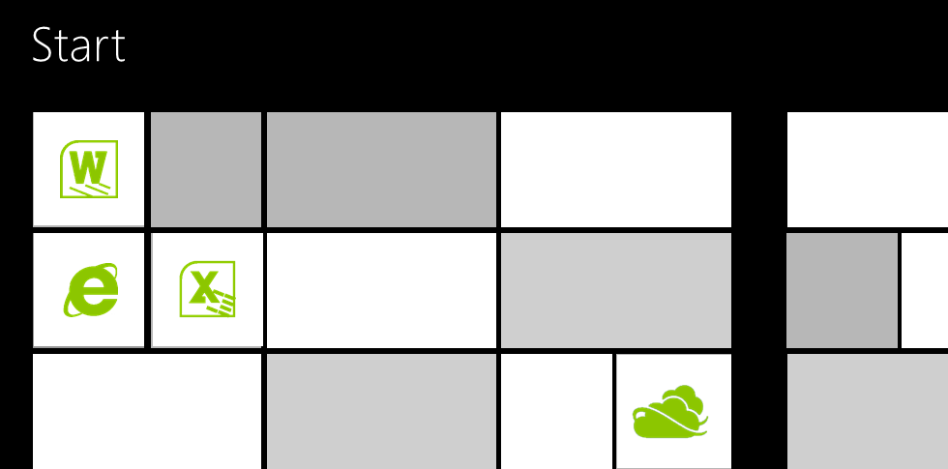

Windows To Go
App-V
Windows To Go
Folder
Redirection
FIREWALL
App-V
Folder
Redirection
App-V
Folder Redirection
  BENEFITS
  Consistent Windows 8 experience on any x86 PC
  Works online or offline
  Easy to use
  and personalize
  Local data is protected
  Easy to deploy and manage
01100111
01100111
11010011
11010011
11001001
11001001
10001001
10001001
Booting from
internal hard drive
Booting from
external USB drive
BitLocker
Notes:
Windows To Go
Key Messages:
Windows 8 enables additional ultra-mobile workstyle through a bootable USB that turns almost any PC into a secure Windows 8 corporate PC.
With Windows To Go, IT gains a new model for corporate environment deployment to users. IT can provide a managed corporate image on a bootable USB drive, and users can boot Windows 8 corporate image from any compatible PC (i.e., any compatible Host PC capable of running Windows 8). Users can get their applications, data, and personalized Windows environment in the same way they would with a standard PC.
As mobility scenarios grow, it’s becoming more challenging for IT to enable ‘anywhere, anytime’ for users. For instance, some users may need to occasionally work in extreme environments (e.g., military, employees biking to work). Also, contractors or contingent staff make up a large percentage of any organization's workforce. While these contractors demand the same level of agility as the full-time employees to get their work done, organizations have challenges in providing them with the access to the corporate environment, and, at the same time, controlling the cost of hardware and backend infrastructure.
Let’s see a scenario that shows how Windows 8 enables an ultra-mobile workstyle or contingent staff:
[CLICK] Let’s say, a contractor receives his new USB drive at work. Immediately after he plugs it into one of the kiosk PCs, he can boot up a new Windows 8 corporate environment. Because the USB drive is already encrypted by his IT department with BitLocker Drive Encryption in Windows 8, he is able to quickly enter an encryption pin that lets him unlock the drive. Once he enters the pin, his work desktop shows up with his personalized apps, data, and settings the moment he logs in.
[CLICK] At home, he connects his Windows To Go USB drive to his personal laptop running Windows 7. By using the encrypted Windows 8 USB key, he can follow the same process he uses back at the office to access his apps and data to finish a project due the next morning. The USB key also automatically helps find his home WiFi, and DirectAccess works automatically in the background, allowing him to post the documents to his company SharePoint site.
[CLICK]
When he logs offs and removes the USB from his personal PC, he feels good that no corporate data left behind. His IT department knows that the network is safe from the security threats of his personal machine. As a standard user, he can’t access or even view the hard drive of his personal PC when he starts the Windows To Go environment. And if he loses his USB, BitLocker Drive Encryption will keep the data safe. In addition, Windows To Go provides tools to manage, patch, and provision his work environment with greater ease and speed, so he can be productive on any device.
With the Windows To Go USB drive experience, he continues to see improvements that make technology easier and more convenient to use, both personally and professionally. Instead of bringing a carload of equipment to set up a post-sales training session, he simply plugs the Windows To Go drive into an on-sight customer PC. A user goes on vacation and brings his Windows To Go drive with him. The USB drive is small and easy to fit in his travel bag. If an emergency arises, he can instantly access the resources he needs to solve issues back at the office. The Windows To Go USB drive experience saves users time and companies money by letting users live their normal lives minus the inconvenience of having to remember to carry all their devices and minus the added cost of purchasing multiple technologies to accomplish their goals.

Slide 3



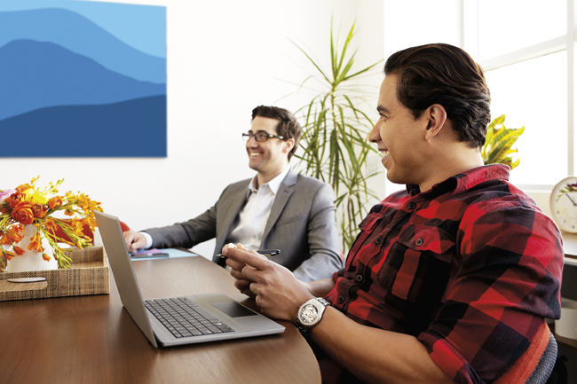

New Use Cases
Bring Your
Own Device
(at work)
Shared PCs
Travel Light / Work from Home
Contractors
Licensing
  SA*/VDA license
  (For primary device)
  SA*/VDA license
  SA*/VDA roaming use rights
  SA*/VDA license
  (For secondary device)
  Companion Device Add-on**
* Requires qualifying OS for SA
** Requires primary device with SA or VDA
Notes:
New Use Cases
Key Messages:
Windows To Go supports four main use cases:
Users travel light without sacrificing productivity
Embraces “Bring Your Own Device” while minimizing infrastructure costs
Gets contingent staff up and running faster without compromising security
Enables free-seating capability even when users roam across mobile workstations
Based on the new Windows 8 Software Assurance, Windows To Go enables new mobility scenarios. For example:
Contractors: Get contingent staff up and running faster without compromising security. Any Windows SA or Windows VDA licensed device is able to run Windows To Go from anywhere.
BYOD: Embrace “Bring Your Own Device” while minimizing infrastructure costs.
For primary device: Any Windows SA or Windows VDA licensed device is able to run Windows To Go from anywhere.
For secondary device: Any device licensed with the companion device add-on for Windows SA may run Windows To Go from anywhere.
Travel Light: Users travel light without sacrificing productivity. With roaming rights, the primary user of any a Windows SA or Windows VDA licensed device can run Windows To Go from a personally-owned or third-party owned PC from home or on the road without additional license requirement.
Shared PC: Enable free-seating capability even when users roam across mobile workstations. Any Windows SA or Windows VDA licensed device is able to run Windows To Go from anywhere.

Slide 4

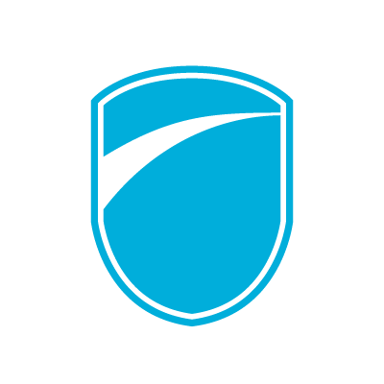



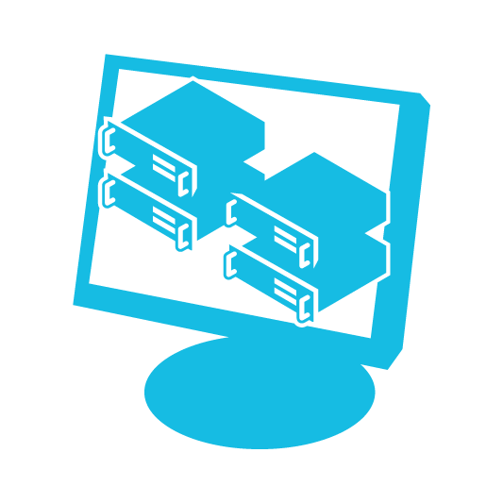

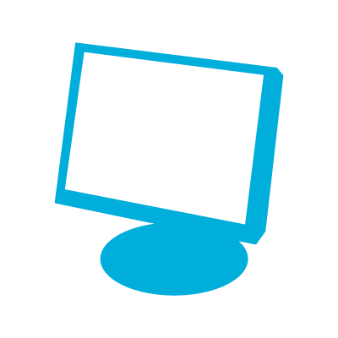

Consistent Windows 8 Experience
Enhanced mobility
  Easy to use
  Secure and manageable
Travel light
Managed and unmanaged PCs
Provides drive encryption
Easy to configure a host PC
Prevents accidental data leakage
Embrace BYOPC
Get contingent staff up faster
Resilient to unintended ejection
Manage with existing infrastructure
Full-fidelity desktop experience
Stay connected with DirectAccess
Enable free seating
Microsoft Desktop Virtualization
Notes:
Consistent Windows 8 Experience
[CLICK]
Makes users more mobile:
Users travel light without sacrificing productivity
Embraces “Bring Your Own Device” while minimizing infrastructure costs
Gets contingent staff up and running faster without compromising security
Enables free-seating capability even when users roam across mobile workstations
[CLICK]
Easy to use:
Can boot from both managed and unmanaged PCs (x86 devices)
Easily configure a host PC to start up from a USB device
Resilient to unintended removal of the USB device from the host PC
Provides full fidelity desktop experience and broad hardware ecosystem support
[CLICK]
Secure and manageable:
Provides drive encryption with Windows BitLocker
Prevents accidental data leakage through separation from the host PCs internal hard drive
Enables you to deploy and manage Windows To Go with existing infrastructure
Stays connected to corporate resources via encrypted tunnel with DirectAccess
Leverages Microsoft Desktop Virtualization technologies to accelerate deployment of corporate resources

Slide 5

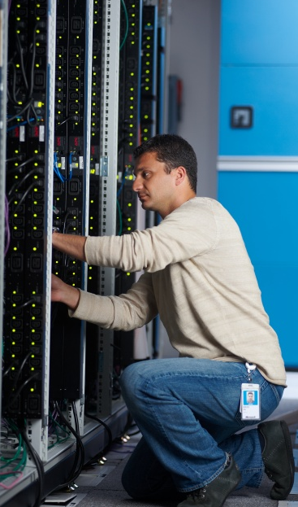


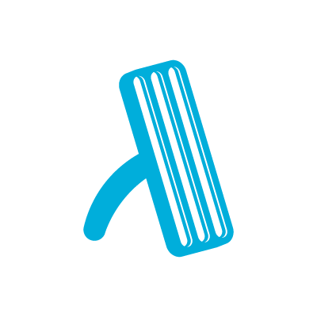



What’s Different
Work On Your
Own Device
Internal disks
are offline
Trusted Platform Module isn’t used
Hibernate is
disabled by default
Windows Store
is disabled by default
Push Button
Reset isn’t available
Windows RE
isn’t available
Notes:
What’s Different
Windows To Go workspace operates just like any other installation of Windows with a few exceptions. These exceptions are:
Internal disks are offline. To ensure data isn’t accidentally disclosed, internal hard disks on the host computer are offline by default when booted into a Windows To Go workspace. Similarly, if a Windows To Go drive is inserted into a running system, the Windows To Go drive will not be listed in File Explorer (formerly Windows Explorer).
Trusted Platform Module (TPM) isn’t used. When using BitLocker Drive Encryption a pre-operating system boot password will be used for security rather than the TPM because the TPM is tied to a specific computer and Windows To Go drives will move between computers.
Hibernate is disabled by default. To ensure that the Windows To Go workspace is able to move between computers easily, hibernation is disabled by default. Hibernation can be re-enabled by using Group Policy settings.
Windows Recovery Environment isn’t available. In the rare case that you need to recover your Windows To Go drive, you should re-image it with a fresh image of Windows.
Push Button Reset isn’t available. Resetting to the manufacturer’s standard for the computer doesn’t really apply when running a Windows To Go workspace, so the feature was disabled.
Store is disabled by default. Apps licensed through the store are linked to hardware for licensing. Since Windows To Go is designed to roam to different host PCs, access to the store is disabled. You can enable the store access if your Windows To Go workspaces won’t be roaming to multiple PC hosts.

Slide 6
Requirements for Windows To Go
For USB drives
For host PCs
Specific hardware requirements
Certified for us as a Windows To Go drive
Windows 7 or Windows 8 certified
Windows RT Devices are not supported
Mac is not a supported scenario
Capable of USB boot (enabled)
USB 2.0 port or greater (no hubs)
1 GHz or faster matching processor
2 GB or greater memory
DirectX 9 graphics device
Notes:
Requirements for Windows To Go
[CLICK]
USB devices that are certified for Windows To Go:
Are built for high, random read/write speeds and support the thousands of random access I/O operations per second that are required for running normal Windows workloads smoothly.
Use components that support wear-leveling features such as TRIM, improving the longevity of the drive.
Have been tuned to ensure they boot and run on hardware certified for use with either Windows 7 or Windows 8.
Are built to last. Certified drives are backed with manufacturer warranties and should continue operating under normal usage. Refer to the manufacturer websites for warranty details.
[CLICK]
When assessing the use of a PC as a host for a Windows To Go workspace you should consider the following criteria:
Hardware that has been certified for use with either Windows 7 or Windows 8 operating systems will work well with Windows To Go.
Running a Windows To Go workspace from a computer that is running Windows RT Devices is not a supported scenario.
Running a Windows To Go workspace on a Mac computer is not a supported scenario.
[CLICK]
Detailed characteristics that the host computer must have to use Windows To Go:
Capable of USB boot
USB boot enabled in the firmware. (PCs certified for use with Windows 7 or Windows 8 can be configured to boot directly from USB, check with the hardware manufacturer if you are unsure of the ability of your PC to boot from USB)
The processor architecture of the PC must support the image on the Windows To Go drive.
External USB hubs are not supported. You must connect the drive directly to the host PC.
A 1Ghz or faster CPU is required with at least 2GB of memory and a DirectX 9 graphics device with a WDDM 1.2 or higher driver.
Last, Windows To Go supports USB 2.0 ports or greater.

Slide 7
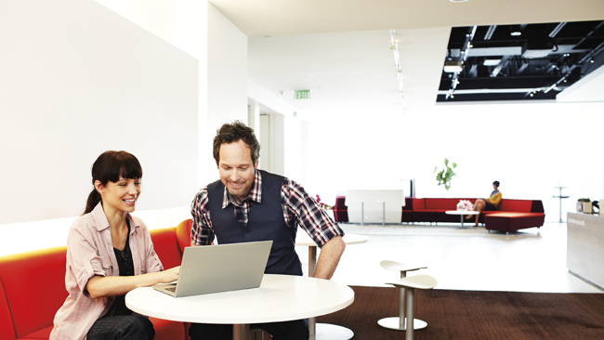
Demo: Windows To Go

Slide 8





Embracing BYOD
Virtual
Desktop
Infrastructure (VDI)
Hosted Applications
(RemoteApp)
Office 365
  BENEFITS
  Secure, fast browsing
  Rich user experience;
  Touch enabled with Windows 8 devices
  Centralized management
  of app & data (IT)
  Enhanced security
  and compliance (IT)
  Great choice of Windows-based devices
Powered by Remote Desktop Services (RDS)
FIREWALL
  WINDOWS 8 ADVANCEMENTS
  High fidelity RemoteFX experience on LAN / WAN
  Multi-touch support for modern applications and devices
  Support for local USB, Lync, etc.
Notes:
Embracing BYOD
Key Messages:
With Windows 7 Flexible Workstyle solutions, IT can embrace the BYOD trend, letting employees bring their personal PC or tablet for work.
The benefits include a rich user experience, centralized management of apps and data, enhanced security and compliance, and great choice of Windows devices in a responsible way.
Windows 8 along with investments in VDI improves the user’s experience even further by supporting touch and high latency connections.
Microsoft Office 365 enables secure, anywhere access to email and calendars, Office Web Apps, web conferencing software, and file sharing capability.
Microsoft VDI also supports non-Windows-based devices.
As BYOD becomes common today, IT has a challenge in how to enable BYOD, while ensuring end-user productivity and securing the corporate environment. With Windows 7-based devices, IT can embrace the BYOD trend by providing:
A rich user experience
With centralized management of apps and data
And enhanced security and compliance
All of that on a great choice of Windows-based devices
But Windows 8 streamlines the experience even further. By lightly touching the remote access icon on an employee’s Windows 8 tablet, she can login and open a VDI session running in the corporate data center with all her data, applications and settings, as if she were working in the office. For example, she can access her corporate SharePoint sites to submit her timesheet, which she forgot to do before leaving for vacation—from her own Tablet.
Windows 8 enables the user to have high-fidelity experience when working in VDI scenarios:
Touch on a local device
3D graphics
Full multimedia experience
USB and Lync support
[CLICK]
Windows 8 helps you deliver a VDI solution that is more cost-efficient and allows for more streamlined management. Our user can take advantage of her personal device and use Lync on her tablets to IM and talk to her colleagues. She can operate on a more secure corporate network connection, wherever she happens to work from at the moment, as long as she has internet connection and can start a VDI session. In fact, she can use many non-Windows-based devices to access her VDI desktop via the Remote Desktop Protocol.
She can also use her personal devices with Microsoft Office 365. Instead of logging into her virtual desktop, she can just get on the internet and access her corporate applications by using Office 365. She can save her work online, which means the data is safely stored in a data center somewhere. She will be able to access and work easily later, even on her phone.

Slide 9

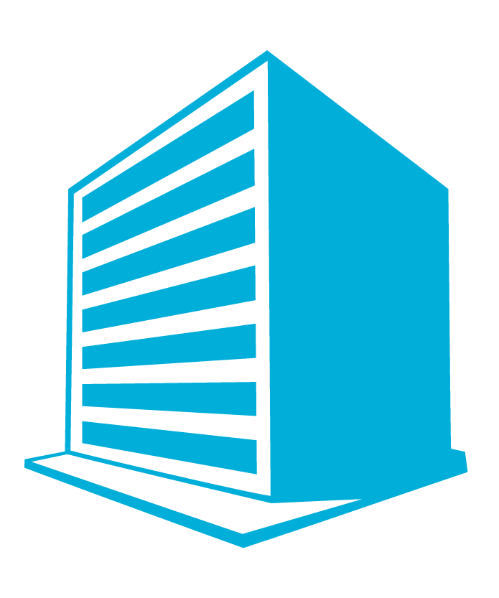

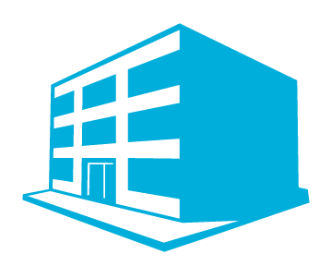



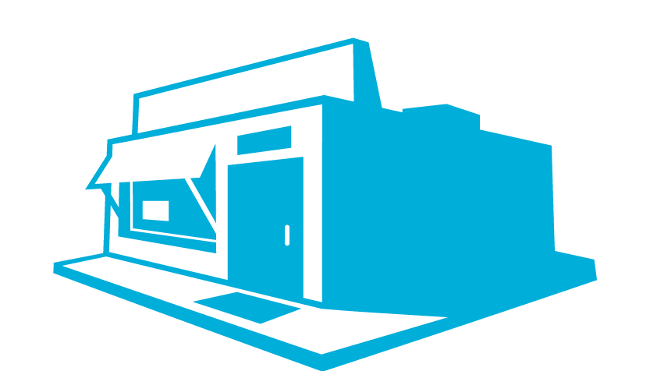

VDI Simplified
  Microsoft VDI: Powered by Remote Desktop Services (RDS)
  Corporate
  Office
  Desktop Sessions
  Pooled
  VMs
  Personal
  VMs
  Branch
  Office
RemoteFX
  1 platform | 1 experience | 3 deployment choices
FIREWALL
  BENEFITS
  Rich User Experience Everywhere with RemoteFX
  Simple to deploy, easy to manage
  Best Value in VDI – high performance at lower cost
  Home
  Library/Coffee house
Notes:
VDI Simplified
VDI provides secure access to Windows from many connected devices (e.g., desktops, laptops, mobile devices, and non-Windows-based devices). It provides users the flexibility to access their desktops from the connected devices they choose. It simultaneously empowers IT to keep users happy by giving them a consistent and personalized experience across multiple devices while ensuring the security of the corporate environment.
VDI is an alternative desktop delivery model that gives users secure access to centrally managed desktops running in the datacenter. VDI is powered by Windows Server 2012 Remote Desktop Services (RDS) . RDS provides a single platform to deliver any type of hosted desktop, and RemoteFX provides a consistently rich user experience. RDS enables organizations to choose the deployment method that works best for them—all by using the one platform:
Session-based desktops. Session-based desktops provide users access to applications, data, and shared desktops that are centralized in the datacenter. The user can access such information from a webpage, through a SharePoint portal, on a local desktop, or over the Internet.
Pooled VMs. Pooled VMs give users access to high-performance desktops from any connected device. VDI assigns users VMs on-demand from an existing pool. When they log off a VM, VDI returns the VM to the pool for another user.
Personal VMs. Personal VMs give users access to a personal, high-performance desktop over which they have full administrative control.
With all three VDI deployment methods, the App-V Shared Content Store enables IT to point desktops to a single copy of an application on disk, significantly reducing storage requirements by eliminating redundant application binaries. Additionally, Windows User State Virtualization maintains users’ data and settings across physical and virtual sessions. VDI empowers enterprises with unified management of centralized desktops and corporate data by using Microsoft System Center 2012. IT can extend existing management tools and processes to the VDI environment. I’ll talk more about these technologies in the next session, though.

Slide 10
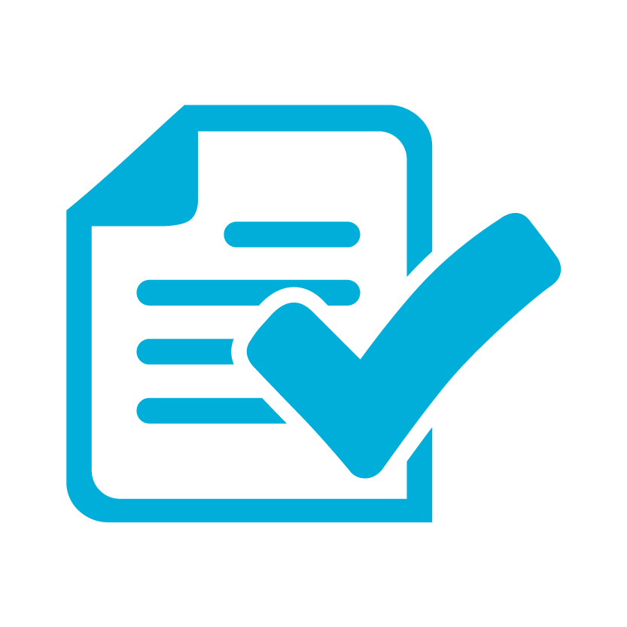
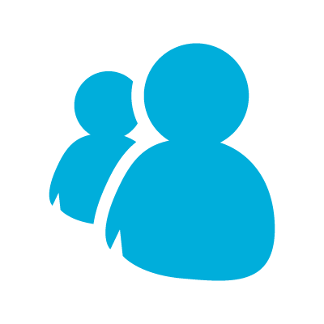


Benefits of Microsoft VDI
Rich experience everywhere
Best value for virtual desktops
  Efficient management
Rich multimedia experiences
Fairshare
Simplified wizard
True USB and multi-touch remoting
User disks
In-box management console
Consistently rich performance
Lower-cost storage
Intelligently patching
Notes:
Benefits of VDI
Key Messages:
VDI in Windows 8 delivers the following benefits:
Rich Experience Everywhere
Best value for VDI
Efficient Management
Back to VDI in Windows Server 2012, we have focused on providing the following benefits:
[CLICK]
Rich Experience Everywhere. RemoteFX provides rich multimedia experiences through inbuilt software GPU or via hardware GPU in the server. Users can use tablets and any USB peripheral, thanks to true USB and multi-touch-remoting capability. Users receive consistently rich performance over high latency, low bandwidth networks such as wide area networks (WANs).
[CLICK]
Best value for VDI. FairShare ensures high system performance by dynamically distributing system resources. User disks provide the flexibility to deploy lower cost pooled- and session-based desktops, without sacrificing personalization. Support for lower cost memory such as SMB for file sharing and Direct Attached Storage (DAS).
[CLICK]
Efficient Management. Simplified wizard makes VDI easier to set up with automatic configuration of VMs. The in-box management console provides powerful administration for users, VMs, and sessions, without requiring additional tools. VMs and sessions can be intelligently patched through randomization and throttling of tasks, ensuring high system performance.

Slide 11
Demo: Session-Based VDI

Slide 12
Demo: VM-Based VDI

Slide 13

Client Hyper-V
Windows 8 VM
Windows Server VM
Windows 7 VM
Linux VM
  Benefits
  Robust , secure, manageable and scalable developer platform
  Choice in a broad range of devices, including laptops
  and various USB peripherals
  Easy to create and host multiple virtual environments
  Run multiple operating systems on a single Windows 8 PC
Notes:
Client Hyper-V
Key Message:
With Client Hyper-V, Windows 8 provides IT developers a robust, flexible, and efficient virtualization platform for application development and testing.
On PCs running Windows 8, Client Hyper-V provides a robust virtual platform for developers and IT pros. It leverages the security, scale, and manageability of Windows 8 and Server Hyper-V platforms, providing developers with a robust development platform.
Developers can choose from a broad range of devices, including laptops and various USB peripherals. And Client Hyper-V enables them to create and host multiple, virtual development-and test- environments on their PCs, thereby improving efficiency while minimizing impact to IT operational costs. Also, Client Hyper-V uses the same VHD format as Hyper-V on the server, so it allows IT and developers to easily deploy these VMs for functional testing and user testing.

Slide 14
Benefits of Client Hyper-V
Robust virtualization platform
Flexibility of choice
Improvement in efficiency
  Large VM configurations
  Use any 64-bit device with SLAT enabled
  Set up dev/test on a single computer
  32- and 64-bit operating systems
Supports a diverse set of devices
  Transfer VMs between client and server
    Wireless networking
    Sleep and hibernate
    Up to 12 monitors
    Most USB peripherals
  Multiple forms of storage
  Support for 3D, audio, and multitouch
  Leverages Windows 8 enhancements
    Secure boot
    Configuration Manager integration
    BitLocker
Notes:
Benefits of Client Hyper-V
[CLICK]
Robust virtualization platform:
Supports extremely large VM configurations (32 virtual processors and 512GB RAM).
Supports both 32- and 64- bit operating systems, including the same flavors of Linux supported by Server Hyper-V.
Supports multiple forms of storage, including IDE, iSCSI, SMB and USB flash drives.
[CLICK]
Flexibility of choice:
Developers and IT pros can use any 64-bit device with SLAT, or Second Level Address Translation, enabled to run Client Hyper-V.
[CLICK]Support for as many as 12 monitors, most USB peripherals, [CLICK] wireless networking, [CLICK] and sleep/hibernate.
[CLICK]Support for 3D; audio and multi-touch enables developers and IT pros to do more inside the VM.
[CLICK]
Improvements in efficiency:
Developers no longer need to buy new hardware to set their dev/test environments.
VMs can easily be transferred between Client and Server Hyper-V machines.
Client Hyper-V leverages [CLICK] security and management enhancements of Windows 8 (such as BitLocker, [CLICK] secured boot, and [CLICK] Configuration Manager integration).

Slide 15
Summary
User Behavior or Characteristics
VM-Based VDI
Session-Based VDI
Client Hyper-V
Windows To Go
Works across multiple PCs
Always connected
Limit LOB applications
Always connected
Multitasking and personalization
BYOD
Contractor
Requires business compliance
Developer or IT pro
Develop or test locally
Notes:
Summary
To take advantage of desktop virtualization, you should start by identifying the business problems you’re trying to solve and then understanding how different desktop virtualization solutions can address your specific business needs. One size does not fit all.
Choosing an operating-system virtualization technology depends on the scenario that you’re trying to address. We recommend VDI for scenarios in which the primary business requirements are enabling flexible access to Windows from multiple managed or unmanaged devices, enhancing business security and compliance, and centralizing desktop management.
Powered by Windows Server 2012 RDS, VDI saves time and resources by offering one platform, with one experience based on RemoteFX, and three deployment choices: sessions, pooled VMs, or personal VMs. Session-based VDI and pooled VMs are better suited to providing users access to centrally hosted Line of Business (LOB) applications with high degrees of scalability. Personal VMs are more beneficial when users need a high level of personalization, operating-system isolation, and application compatibility.
When considering VDI, take into account potential investments required to expand the datacenter as well as the network bandwidth required to give users rich, uninterrupted access to hosted virtual desktops. As a result, VDI is good for every company but not necessarily for every desktop.
Of course, Windows To Go offers a new deployment model for corporate environment to user. IT can provide a managed corporate image on a bootable USB drive, and users can boot a Windows 8 corporate image from any compatible PC (i.e., any compatible Host PC capable of running Windows 8). Users can get their applications, data, and personalized Windows environment the same way as they would on a standard PC.

Slide 16
Resources
TechNet Evaluation Center
Download Microsoft software trials today.
technet.microsoft.com/evalcenter
Microsoft Virtual Academy
Take a free, online course.
microsoftvirtualacademy.com
IT Camps
Find an additional IT Camp near you.
technet.microsoft.com/globalitcamps
Microsoft Certifications
Get certified on Microsoft Products & Technologies.
aka.ms/certifications

Slide 17



© 2012 Microsoft Corporation. All rights reserved. Microsoft, Windows, Windows Vista and other product names are or may be registered trademarks and/or trademarks in the U.S. and/or other countries.
The information herein is for informational purposes only and represents the current view of Microsoft Corporation as of the date of this presentation. Because Microsoft must respond to changing market conditions, it should not be interpreted to be a commitment on the part of Microsoft, and Microsoft cannot guarantee the accuracy of any information provided after the date of this presentation. MICROSOFT MAKES NO WARRANTIES, EXPRESS, IMPLIED OR STATUTORY, AS TO THE INFORMATION IN THIS PRESENTATION.

