Slide 1
Windows 8 Overview

Slide 2


















Windows 8 is:
Modern
Fluid
Clean
Clutter-free
Notes:
Windows 8 is Modern
Key points:
The Windows 8 interface has been redesigned.
The redesign reflects today's flexible work styles.
Today's desktop computers run Windows 7. Over time, those desktops get pretty cluttered, full of Start menu programs and tons of icons on the desktop. Imagine a world free of that clutter, a world in which the desktop provides the icons and tools that you need to get work done.
[CLICK]
The Windows 8 user interface provides a clean look and feel, free from clutter. The Windows 8 desktop has the familiar look and feel that you've come to know from previous versions of Windows, but with Windows 8 you spend more time being productive and less time working with the interface to do so.
[CLICK]
Today's workplace is multigenerational, and no two work styles are alike. People use technology in different ways based on their preferences and roles. Windows 8 provides that flexibility with a modern, fluid interface that works whether on a PC, a tablet, or a phone.

Slide 3







Tablet Productivity
Exchange
SharePoint
Data Servers
Windows Store,
Windows Live, Office 365
FIREWALL
  BENEFITS
  Touch-first UI for new work styles
  Always on and always connected to keep you always up-to-date
  New interface provides at-a-glance access to critical data
  Keyboard, mouse, pen support
  Access to your corporate infrastructure and cloud apps
Touch First
Full Mouse and Keyboard support
Pen &
Handwriting support
Notes:
Tablet Productivity
Key points:
Windows 8 is a Touch-First experience with full keyboard and mouse support.
Windows 8 provides the manageability and security needed by IT.
Customers often say that they have to choose between the full productivity experience of a PC and the convenience of a tablet. Tablets historically presented productivity challenges since most business desktop and productivity apps didn't run on non-Windows tablets. Tablets also challenged IT because it can be difficult manage and secure non-Windows tablet.
[CLICK]
With an x86 Windows 8 tablet, users can have a “no compromise” experience – no more trade-off between productivity and convenience. Because it's Windows, you get the productivity, convenience and mobility. You can use the familiar user interface, your desktop line of business and productivity apps, and peripherals you use today on Windows 7.
Windows 8 delivers Touch first experience along with full support for mouse and keyboard, enabling you to move between work and personal activities easily and effortlessly. The new Windows 8 interface provides at-a-glance access to critical data and Windows 8 apps are always-on-always-connected to keep you up to date.
IT doesn't need to compromise either. Windows 8 provides the manageability and security that IT needs. Companies can take advantage of their existing management and security infrastructure for managing Windows 8 tablets.

Slide 4






Windows 8 Gestures
TOUCH
MOUSE
TOUCH
MOUSE
Point to the lower right corner of the screen.
Point to the bottom of the app and use the scrollbar.
Right click the app to see the app commands. Drag an app to the lower edge to close.
Press the Ctrl key while moving the mouse wheel to zoom in and out.
Point to an item to see more options.
Click an item to perform an action.
Notes:
Windows 8 Gestures
Key points:
Windows 8 is touch-first.
Intuitive gestures can be accomplished with mouse and keyboard.
The Windows 8 interface has been optimized for touch with full support for mouse and keyboard input. Corners in Windows 8 provide hot spots that can be touched or pointed to with the mouse. You can see app commands with a right-click of the mouse and dragging works well for both mouse and touch input.
Options are available for many items simply by pointing to them and many apps offer a scrollbar at the bottom that show more screens of the app.
The control key on the keyboard along with the mouse scroll wheel is used for contextual zooming which is intuitively done through the touch interface with the pinch gesture.
As you would expect, clicking or tapping an item performs the related action.
The Windows 8 interface is perfect for touch and pen input and provides full support for mouse and keyboard, thus enabling you to be productive regardless of your device or work style.

Slide 5








Like Windows 7—Only Better
Management
Security
Reliability
Desktop Experience
  Snapping
  Taskbar
  Jump Lists
  Pinning
  Thumbnails
Notes:
Like Windows 7—Only Better
Key points:
Windows 8 is like Windows 7, only better.
Familiar management tools for IT.
Familiar desktop experience with common features from Windows 7.
Features that were great in Windows 7 are even better. With Windows 8, workers have the best of both worlds: a powerful new way of working with your PC, and the flexibility and power of the Windows desktop. As an IT professional, you're probably concerned not only with how to use Windows 8 but also how to support it.
Windows 8 uses the same management tools that you already support in your organization. Tools such as System Center 2012 Configuration Manager, Microsoft Deployment Toolkit (MDT), and the Diagnostics and Recovery Toolset (DaRT) have been updated for Windows 8. Those tools have been enhanced, too!
Windows 8 contains all of the security and reliability features that you've come to expect from Windows. As you'll see, the changes in Windows 8 are incremental from Windows 7. For an IT pro, the changes enhance supportability and security. For example, there are new refresh and recovery options available with Windows 8. This means that you'll spend less time supporting Windows 8.
The features you expect to see in the desktop, like Jump Lists, the Taskbar, and Snapping, are still there in Windows 8. You can pin items to the desktop in Windows 8 and you can use thumbnails in Windows 8 too. The desktop experience is just like Windows 7, and that's what you'll see in our first demo.

Slide 6

Demo: Windows 8 Desktop

Slide 7
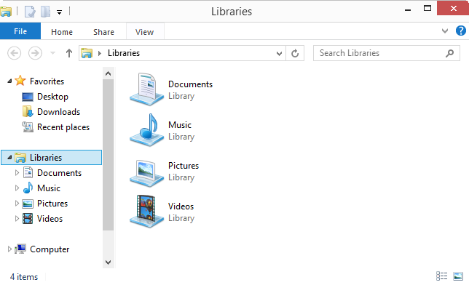
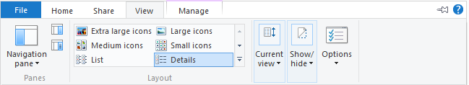
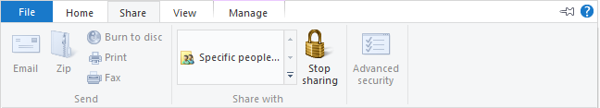
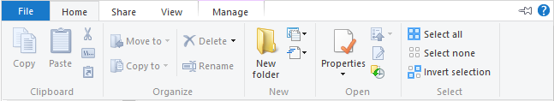
File Explorer
Same functionality
Ribbon improves discoverability
Copy/Paste, etc.
Sharing
View options
Better optimized
Notes:
Meet File Explorer
Key points:
File Explorer is the new Windows Explorer.
File Explorer is optimized for file management tasks.
File Explorer offers numerous ribbons with common tasks.
Windows 8 has made some improvements on Windows 7. One such improvement is File Explorer, the new Windows Explorer. File Explorer has quite a history, going all the way back to the days of MS-DOS. Over the years, the tool now known as File Explorer has evolved. It used to be called File Manager, and for a long time it was called Windows Explorer. With the release of Windows 8, Windows Explorer is now known as File Explorer.
File Explorer is, not surprisingly, used for file management tasks. Whether the task is to copy or move a file, to delete it or get its properties, when people use File Explorer they're working with files and folders.
[CLICK]
With this in mind, File Explorer has been optimized for file management tasks. Frequently used commands, such as those related to copying and moving files, are available in a top-level ribbon. Commands for accessing properties and creating new files and folders are available in the same ribbon.
[CLICK]
People share files more frequently today, and File Explorer provides a new Share menu that contains frequently used commands such as Zip and E-mail, along with advanced sharing and security.
[CLICK]
View options, which are also frequently used, have their own menu in File Explorer. You no longer need to go into Folder and Search Options and search through complex menus just to see hidden items or file name extensions; those are now available with check boxes right in the View menu.
File Explorer also has contextual menu options. When viewing a library such as the Picture library, you'll see tools that make sense for working with pictures. There are contextual tools available for things like Video and other libraries as well. This gives you the tools you need for the types of files you're working with at a given time.
This is Windows 8. The interface has been redesigned to give power users easy access to the options they need while at the same time staying out of the way of users who don't need those options.

Slide 8
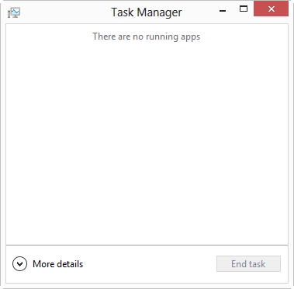
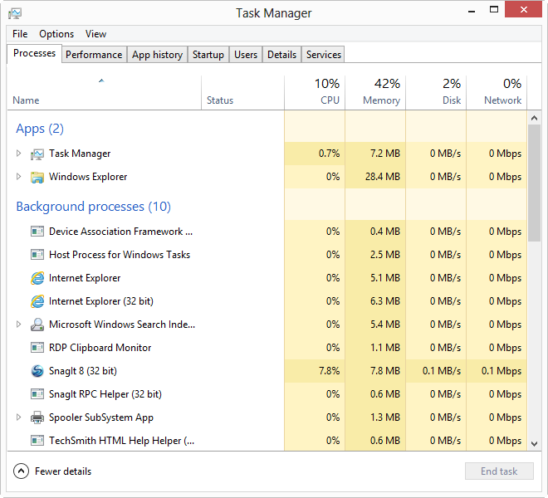
Task Manager
Or as much detail…
As little…
As you want
Notes:
Task Manager in Windows 8
Key points:
Task Manager provides common performance metrics.
Much more detail is available within Task Manager.
Task Manager has been enhanced in Windows 8.
With the new Task Manager, you can quickly see the running programs and can also end the tasks if there is an issue. But IT pros and power users frequently want to see more information about the running tasks and the overall status of the system. That's where More Details comes in.
[CLICK]
More Details really gives more details. Merely looking at the available tabs reveals that there is a lot of information and many options here. Task Manager will be shown in much more detail in an upcoming demo.
Like File Manager, the Task Manager interface has been redesigned to serve the needs of all types of users.

Slide 9
Demo: File Explorer

Slide 10
Demo: Task Manager

Slide 11




File History
File History
Notes:
File History
Key points:
File History provides per-file automated backup.
File History makes restoring easier.
Windows Backups can still be restored.
File History provides file-level backup for Windows 8. File History checks the file system once per hour (or on a configurable schedule) and notes any changes. File History copies those changes to an external device for safekeeping.
Why File History? It turns out that Windows Backup wasn't really being used. Our own research shows that Windows Backup was utilized on fewer than 5 percent of consumer PCs. The goal with File History was to make backups a seamless process that the user doesn't even have to think about.
[CLICK]
Further, File History makes the restore process easier. File restores are granular to the file level, and users can find and preview files before restoring them. If you have existing Windows backup sets from Windows 7, those can be restored in Windows 8; just search for File Recovery from the Start screen.
File History has been designed with the mobile and laptop experience in mind, detecting when the external device is connected. Users are in control of File History and can exclude folders, change the frequency of the copy process, and determine how long history is kept, among other settings.

Slide 12

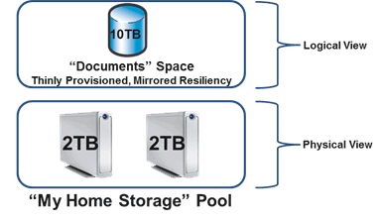

Storage Spaces
Notes:
Storage Spaces
Key points:
Storage Spaces enables powerful and flexible storage options.
Disks can be combined into a virtualized storage pool.
Thin provisioning helps to future-proof the storage space.
Storage Spaces is a tool that enables users and organizations to gather physical disks into a larger, virtualized space called a storage pool.
[CLICK]
A storage pool is simply a group of disks that has been joined together. As an IT pro, you can think of a storage pool as a raw, unpartitioned disk. Storage pools can then be partitioned into one or more virtual disks, called spaces, that can be used to store files and data.
One of the most exciting features of Storage Spaces is the ability to use Thin Provisioning. Thin Provisioning enables you to configure a larger mirrored space from a smaller raw pool. In other words, you might have only 2 terabytes of raw space but with Thin Provisioning you can make that a 5 terabyte storage space. You can then add more disks later in order to bring the physical capacity up to 5 terabytes.
Storage Spaces can also provide resiliency through two-way and three-way mirroring and parity. Also, you can effectively manage Storage Spaces by using Windows PowerShell.

Slide 13
Demo: File History

Slide 14
Demo: Storage Spaces

Slide 15






Internet Explorer 10
Fast and Fluid
Trusted
  Interoperable
New experience for Windows 8 devices
Security and privacy help for the real world
Supports modern standards
Full-screen, immersive experience
SmartScreen filter
HTML5, CSS3 and SVG
Navigation appears when needed
InPrivate Browsing
IE9, IE8, IE7, and Quirks compatibility modes
Fast and fluid browsing experience
Tracking Protection
Extensive management support makes Internet Explorer 10 the best browser for businesses
Notes:
Internet Explorer 10
Key points:
Two interfaces, one engine underneath.
An interface optimized for touch and an interface for the desktop.
Both interfaces optimized for speed and security.
Internet Explorer 10 has two faces. The first is a desktop app that is similar to Internet Explorer 9.
[CLICK]
The second is a Windows 8 app that provides a full-screen, immersive browser that offers a fast and fluid touch-first browsing experience, making it easy for employees to navigate the web and interact with business applications with easy to use gestures. Navigation appears when it's needed in this interface, keeping it free of clutter.
Furthermore the underlying platform is fully interoperable across both desktop and the new browser, enabling developers to write the same markup for both experiences. Line of business applications that require legacy ActiveX controls will continue to run in the desktop version of Internet Explorer 10.
[CLICK]
Internet Explorer 10 carries over the advancements made in earlier versions around security and performance. Tools like the industry leading SmartScreen filter continue to help protect corporate customers from socially engineered malware – while hardware acceleration ensures that web applications are fast. InPrivate browsing and tracking protection further enhance the security of the browsing experience.
[CLICK]
To help move the web forward, Internet Explorer supports modern standards like HTML5, CSS3 and SVG to give corporate developers the ability to build more powerful web applications. And, the investments you’ve made in your web based line of business applications carry over to Internet Explorer 10 with little effort because it supports IE9, IE8, IE7, and Quirks compatibility modes.
[CLICK]
IT Professionals continue to enjoy extensive management and configuration support in Internet Explorer 10. Internet Explorer 10 can be configured as needed using over 1500 group policies and strong deployment and management capabilities to make Internet Explorer 10 the browser of choice for enterprise.

Slide 16
Demo: Internet Explorer 10

Slide 17

Windows 8 Apps in the Enterprise
Cross Architecture
Write once, run across x86 and ARM
Use What You Know
  Same tools, languages, and back-end infrastructure you already have
Deployment
  Easier, faster deployment with Store, side-loading, and zero-install
Security
  Reduced system vulnerability with isolated app containers
Integration
Built-in App-to-App integration with Windows App Contracts
Notes:
Windows 8 Apps in the Enterprise
Key points:
Windows 8 apps are cross architecture.
Developers use familiar languages and tools to create apps.
Flexible deployment options for apps.
Apps have a reduced security footprint and are integrated with App Contracts.
Windows 8 apps are part of an overall app portfolio letting you target both touch and mouse/keyboard scenarios, enabling you to bring apps across laptops, desktops and tablets.
[CLICK]
Windows 8 apps run across architectures. An app written for Windows RT Devices (Windows APIs for building Windows 8 apps) can simply run on both x86 and ARM devices. Additionally, Windows Phone 8 shares a codebase with Windows 8, streamlining the app development process across the ecosystem.
[CLICK]
Developing Windows 8 apps starts from the same place – the same place devs have always started, with Visual Studio. We’ve also added more support in Visual Studio for web languages and technologies like HTML5, CSS3 and JavaScript and new templates for building Windows 8 apps using JavaScript, C#, VB, or C++.
Just like Desktop apps, Windows 8 apps can do NT Authentication and connect to remote SQL servers with WCF. So your devs can get started building Windows 8 apps with the same tools, the same languages and frameworks, and the same Skills they already have, leveraging the same Infrastructure you already use today.
[CLICK]
Windows 8 apps are fast and easy to deploy. You can deploy and update Windows 8 apps through the Windows Store. But you wouldn’t do that for a line of business app. Instead, you can side-load Windows 8 apps directly onto devices—using your existing electronic software distribution infrastructure. For example, you can deploy Windows 8 apps by using System Center 2012 Configuration Manager, the Microsoft Deployment Toolkit 2012, or even build custom images containing your LOB Windows 8 apps.
[CLICK]
Windows 8 apps are intrinsically more secure, because they are isolated from the system and other apps. While they can interact with the file system and Web services, being sandboxed in an app container makes it much more difficult for apps to install malware or compromise the performance and reliability of the system. We support Group policy and whitelisting/blacklisting with App Locker for Windows 8 apps.
[CLICK]
The way Windows 8 apps interact with each other is through Windows App contracts, like Search, Share, File Picker, Play to and Settings. Contracts are simple to implement and allow the user to interact with other apps and app data without leaving the context of what they are doing. They dramatically reduce the need for users to move and manage across multiple apps and reduce the need for expensive custom app integration.

Slide 18
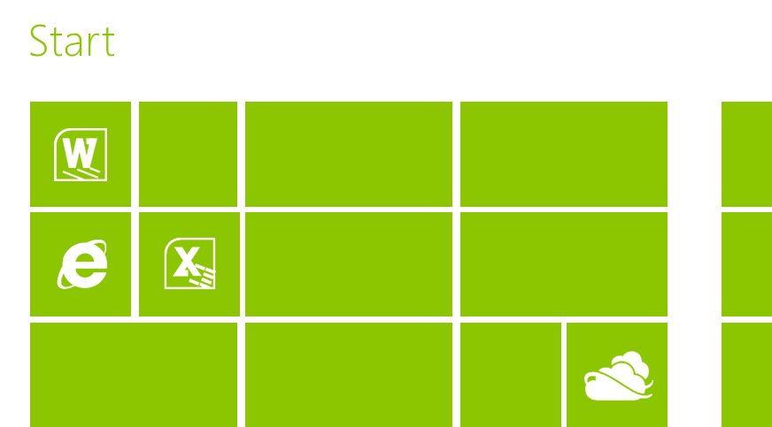










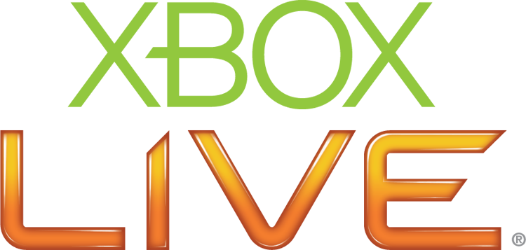
Delivering Windows 8 Apps
Download from Windows Store
Side Load from Your Infrastructure
Self-Service Portal (SSP)
Management
Infrastructure Cloud
Windows RT Devices
Public Apps
Custom LOB Apps
Application Delivery
Windows 8 (x86)
Notes:
Delivering Windows 8 Apps
Key points:
Flexible options for deployment.
Windows Store for publically available apps.
Sideloading for internal Line of Business (LOB) apps.
As customers continue developing great Windows 8 apps that increase employee productivity, we want to discuss how businesses can best deploy and manage Windows 8 apps.
[CLICK]
If you want to offer apps to the public, you can do so through the Windows Store. You have two options for selling your app on the Store: You can offer your apps for sale directly to the business user or offer the app as a free download, then manage the sales and licensing directly with the business. If you want a volume licensing scheme for your app you can use a signed receipt from the Windows Store. Signed receipts enable you to securely identify the user running the app. Receipts are a new feature available for apps that users acquire from the Windows Store.
[CLICK]
While the Windows Store is a great way to deploy apps to business customers, there are apps that IT admins will want to distribute directly to the end-users. This option makes sense for custom and proprietary line-of-business (LOB) apps, or enterprise software purchased directly from an ISV.
Distributing LOB apps involves a few steps including validating the technical compliance and signing the app. Once certified and signed, apps can be deployed by IT, after running the Windows App Certification Kit. The targeted devices need only a minimum of preparation, typically through Group Policy, in order to receive sideloaded apps.
The actual app deployment can be fully automated using tools like System Center 2012 Configuration Manager with Service Pack 1 or MDT 2012 Update 1. These familiar tools include deployment options for Windows 8 apps. You can also put Windows 8 apps in your Windows images using familiar tools like DISM too.
[CLICK]
And users can use the Self-Service Portal to install Windows 8 apps on both x86 and Windows RT Devices.

Slide 19
Demo: Windows 8 Apps

Slide 20
Demo: Start Screen

Slide 21
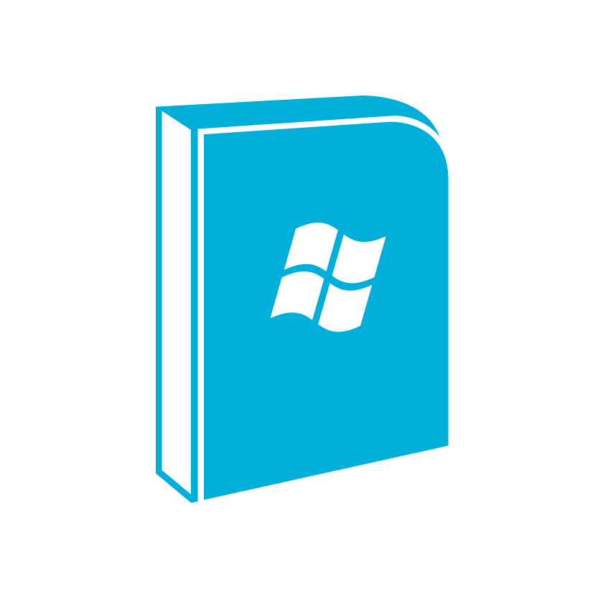






Summary
Like Windows 7
Only Better
Internet Explorer 10
Windows 8 Apps
File History
Many Improvements
Storage Spaces
File Explorer
Task Manager
Windows 8 Start Screen
Notes:
Summary
Key points:
Windows 8 is like Windows 7, only better.
Internet Explorer and other tools have been updated.
Windows 8 apps provide an immersive, touch-first experience.
The Start Screen has been reimagined.
Windows 8 reflects changes in today's workplace by providing an immersive experience that your users will love. Windows 8 gives people the freedom to get their work done in their way.
[CLICK]
Windows 8 brings forward features and tools from Windows 7, but it improves on them. Features like [CLICK] File Explorer and [CLICK] Task Manager have been updated and enhanced for today's users.
[CLICK]
File History and [CLICK] Storage Spaces provide new experiences tailored to today's modern environment. These and other tools in Windows 8 give users the ability to be more productive and enable users to access extended options more easily.
Internet Explorer has been updated for Windows 8, with interfaces both for the desktop and for the Start screen. Internet Explorer has been enhanced with more security, Adobe Flash, and support for HTML5 and CSS3 technologies.
Windows 8 apps provide a chromeless and immersive app experience designed with today's mobile and tablet devices in mind. Some apps feature live tiles that provide up-to-the-minute information right on the tile itself, even when the app isn't running. Apps can also share information more easily through contracts. Users obtain apps through the Windows Store.
Windows 8 provides a clutter-free desktop environment and a Start screen. The Start screen uses tiles and is optimized for touch and pen input. In many ways, the desktop in Windows 8 acts just like another app.

Slide 22
Resources
TechNet Evaluation Center
Download Microsoft software trials today.
technet.microsoft.com/evalcenter
Microsoft Virtual Academy
Take a free, online course.
microsoftvirtualacademy.com
IT Camps
Find an additional IT Camp near you.
technet.microsoft.com/globalitcamps
Microsoft Certifications
Get certified on Microsoft Products & Technologies.
aka.ms/certifications

Slide 23



© 2012 Microsoft Corporation. All rights reserved. Microsoft, Windows, Windows Vista and other product names are or may be registered trademarks and/or trademarks in the U.S. and/or other countries.
The information herein is for informational purposes only and represents the current view of Microsoft Corporation as of the date of this presentation. Because Microsoft must respond to changing market conditions, it should not be interpreted to be a commitment on the part of Microsoft, and Microsoft cannot guarantee the accuracy of any information provided after the date of this presentation. MICROSOFT MAKES NO WARRANTIES, EXPRESS, IMPLIED OR STATUTORY, AS TO THE INFORMATION IN THIS PRESENTATION.

