Slide 1
Windows 8 Camp

Slide 2









work/life
blur
more mobile
digital generation
multiple devices
tech
savvy
fast
paced
Notes:
Consumerization of IT
Users have broad access to consumer devices (e.g., laptop PCs, tablet PCs, and mobile phones using modern technology) at home, and this device proliferation leads to higher user expectations of technology at work.
According to a recent IDC study, affluent users ($98K or more annual income) around the world own an average 4.8 devices, while affluent users in the U.S. own 6.6 devices. Overall, there exists an estimated 700M personal computing devices worldwide in 2010, and this figure is expected to double by 2014 to 1.47B personal computing devices.
The digital generation entering the work place raises these expectations to a whole new level. This is a generation that has grown up completely fluent in the language of digital technology—from texting, instant messaging, and blogs to Facebook, YouTube, and Twitter. They have dramatically different beliefs about the tools they should be able to use at work.
These tech-savvy users are also increasingly mobile and operate in a fast-paced environment. The dynamic environment, along with ubiquitous connectivity, blurs the lines between people’s life and work. As the line blurs, people’s personalities and individual workstyles impact how they get their work done and what technology they prefer to use. As a result, users increasingly want a say in which technologies they use to get job done. This is the trend called “Consumerization of IT.”
Examples of Consumerization of IT include:
Bring Your Own Device (BYOD), in which users bring and use their own laptop PC, tablet PC, or smartphone to work.
Using social networking at work and for work.
A recent Forrester Research study showed that 35 percent of workers in the U.S. buy their own smartphone for work, use unsanctioned Web sites, or download unapproved applications on a work computer. Why?
24 percent of workers say the technology that they work with in their personal lives is better than what their job provides.
36 percent say they need the unapproved technology, and their employer won’t provide an alternative.
Nearly 40 percent say they use the technology at home and, well, they want it at work, too.
Consumerization of IT is great, as it unleashes people’s productivity and passion, innovation, and competitive advantage. We believe in the power of saying “Yes” to users and their technology requests in a responsible way. Our goal at Microsoft is to partner with you in IT to enable you to embrace these trends but also ensure the environment remains secure and well-managed.
But embracing Consumerization of IT is not easy for companies, and it represents some key challenges.

Slide 3

Windows 8 for Enterprise
Devices and Experiences Users Love
Enterprise-Grade Solutions
Notes:
Windows 8 for the Enterprise #1
Our strategy is to provide:
The experiences and devices that your users love and expect.
While delivering enterprise-grade solutions for your company.
This is where Microsoft and Windows provide unique value. No other company in today’s market has such deep experience with consumer and enterprise technologies—as well as an understanding of what consumers want and what enterprises need. We’re committed to providing you with highly secure and manageable technologies that offer the best possible experiences on Windows.
This is our long-term strategy, and with Windows 8, we are taking it to a new level.

Slide 4


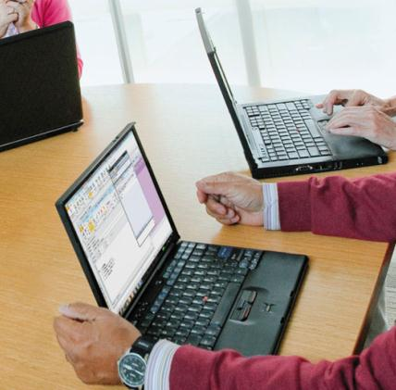

Windows 8 for Enterprise
Devices & Experiences Users Want
Devices & Experiences Users Love
Enterprise-Grade
Solutions
Enterprise-Grade
Solutions
Devices and Experiences Users Love
Enterprise-Grade Solutions
No Compromise Business Tablet*
New Possibilities in Mobile Productivity
Enhanced End-to-End Security
Management
and Virtualization
* x86 Tablets
Notes:
Windows 8 for the Enterprise #2
First, Windows 8 offers devices and experiences that users will love:
No compromise business tablet. We hear from business users today that they have to choose between convenience and productivity. With Windows 8 tablets (specifically x86 tablets), users can have a “no compromise” experience. Windows 8 delivers a touch-first experience along with full support for mouse and keyboard. It’s a no-compromise experience, in which users can have the convenience and mobility of a tablet combined with the power and familiarity of a full PC. This allows them to also move effortlessly between work and personal activities. Not only that, but users can have a connected experience with apps from the Windows Store while continuing to use the same desktop line of business (LOB) and productivity apps they currently use on Windows 7.
New possibilities in mobile productivity. Windows 8 delivers other technologies that help people stay productive, particularly as they are increasingly mobile.
Second, Windows 8 offers enterprise-grade solutions:
Enhanced end-to-end security. From the client device, to the network, and to back-end infrastructure—Windows 8 offers features that improve the security and reliability of the systems in your organization. From power-on to power-off, Windows 8 can provide a more secure foundation to help keep your businesses running.
Management and virtualization advancements. Windows 8 includes enhancements to manageability and virtualization features to help IT administrators manage their client PCs.

Slide 5
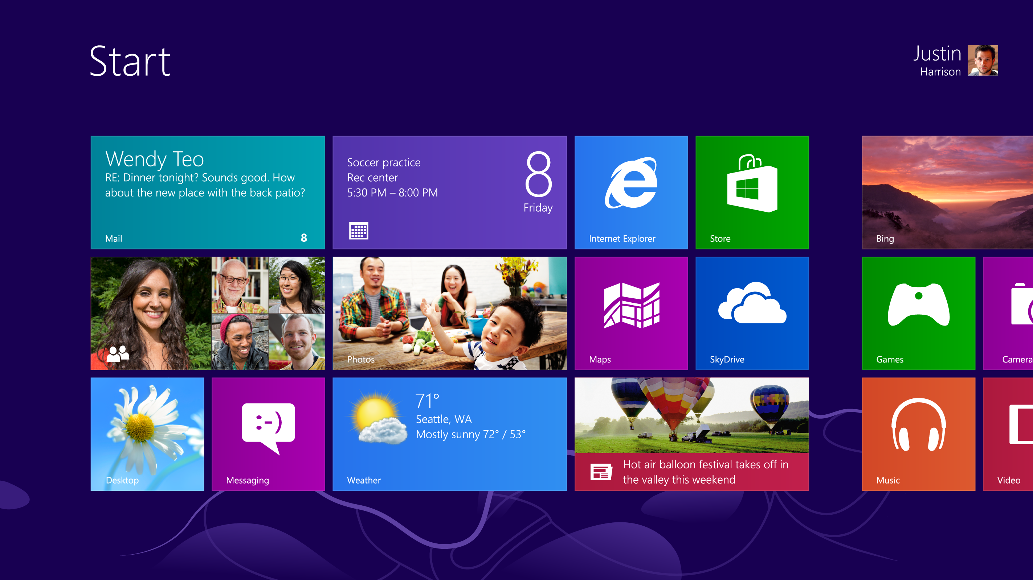
Notes:
Introducing Windows 8
With Windows 8, we reimagined Windows to focus on users’ lives. The
Beautiful
Fast
Fluid design
It’s smooth. It’s intuitive. And it gives users instant access to their contacts, apps, and information. They can spend less time searching and more time doing.
They’ll love browsing through the Windows Store and downloading apps to help them work more efficiently. Apps work together too, so they can share photos, maps, contacts, links, and whatever else they want.
No matter what they want to do, users can get it done quickly in Windows 8. Whether they’re completing a project, reading the news, or checking their email—they can use touch, mouse, and keyboard together—seamlessly—to do what they want, the way they want. They no longer need to choose one or the other. Windows 8 starts up quickly and is cloud-connected so users can access their photos, documents, and settings on any Windows 8 PC.

Slide 6

Great Experiences Across Hardware …
Windows RT device
Touch
Long battery life
Thinner, lighter, faster
Modern security
Sensors and security
New form factors
Notes:
Great Experiences Across Hardware …
Windows 8 is perfect for a range of devices. Because hardware innovation is broad in Windows 8, I’d like to explore a few key areas where we have worked with our partners.
[CLICK]
These are some of the things that you and your users will notice about Windows 8 PCs, either in the workplace or at a retail store:
Touch
Touch is clearly front-and-center for us. We’re requiring a minimum of five-finger touch displays, and we’re working with our partners to deliver touch-optimized devices. To ensure a great user experience with touch we’ve done extensive research into:
Response times required for touch
The sensitivity and precision required of a digitizer
The user experience of a flush bezel
Many other aspects of the user experience
These requirements are enforced with logo requirements.
Long Battery Life
One of the key design tenets of Windows 8 is to enable long battery life. With Windows 8, a new class of ultrathin PCs and tablets can turn on instantly, can run all day on a single charge, and stay connected to the Internet—so users’ PCs are ready when they’re ready.
Thinner, Lighter, Faster
As you have seen with today’s ultrabooks, PCs are already thinner and lighter than ever before. This will only continue with Windows 8. There will be thin and light tablets and ultra-portables that start and run faster than today’s PCs. Even installing Windows 8 on an existing PC will improve its performance because of the improvements we’ve made in the core operating system.
Sensors and Security
With Windows 8 we enable developers to take advantage of hardware innovation such as:
Low-power Bluetooth
GPS
Gyroscopes
Accelerometer
As well as security hardware technologies such as Trusted Platform Module (TPM) and Unified Extensible Firmware Interface (UEFI) boot.
New Form Factors
We believe users should have a choice.

Slide 7

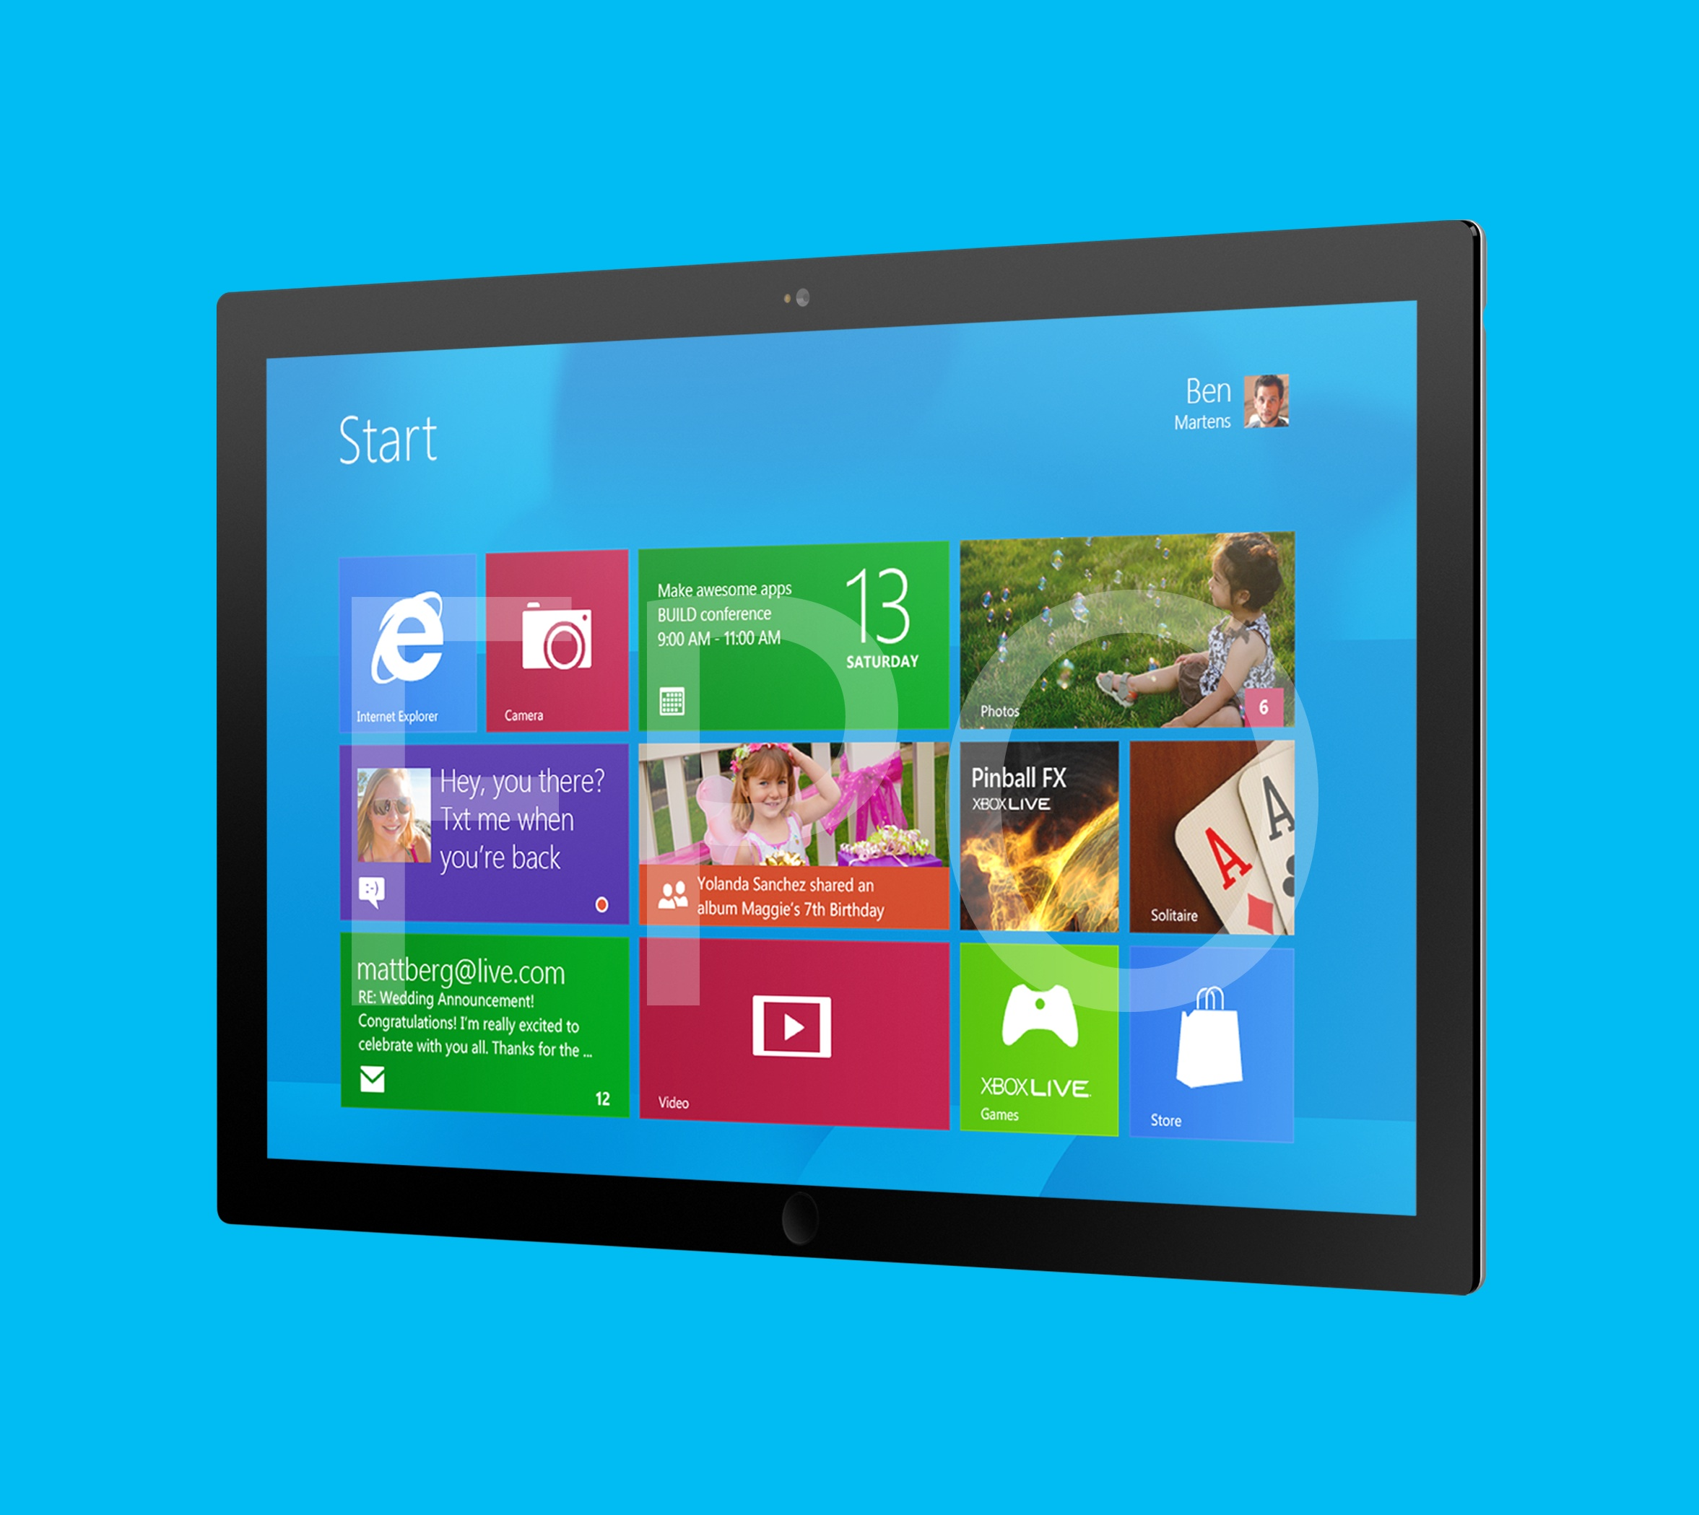
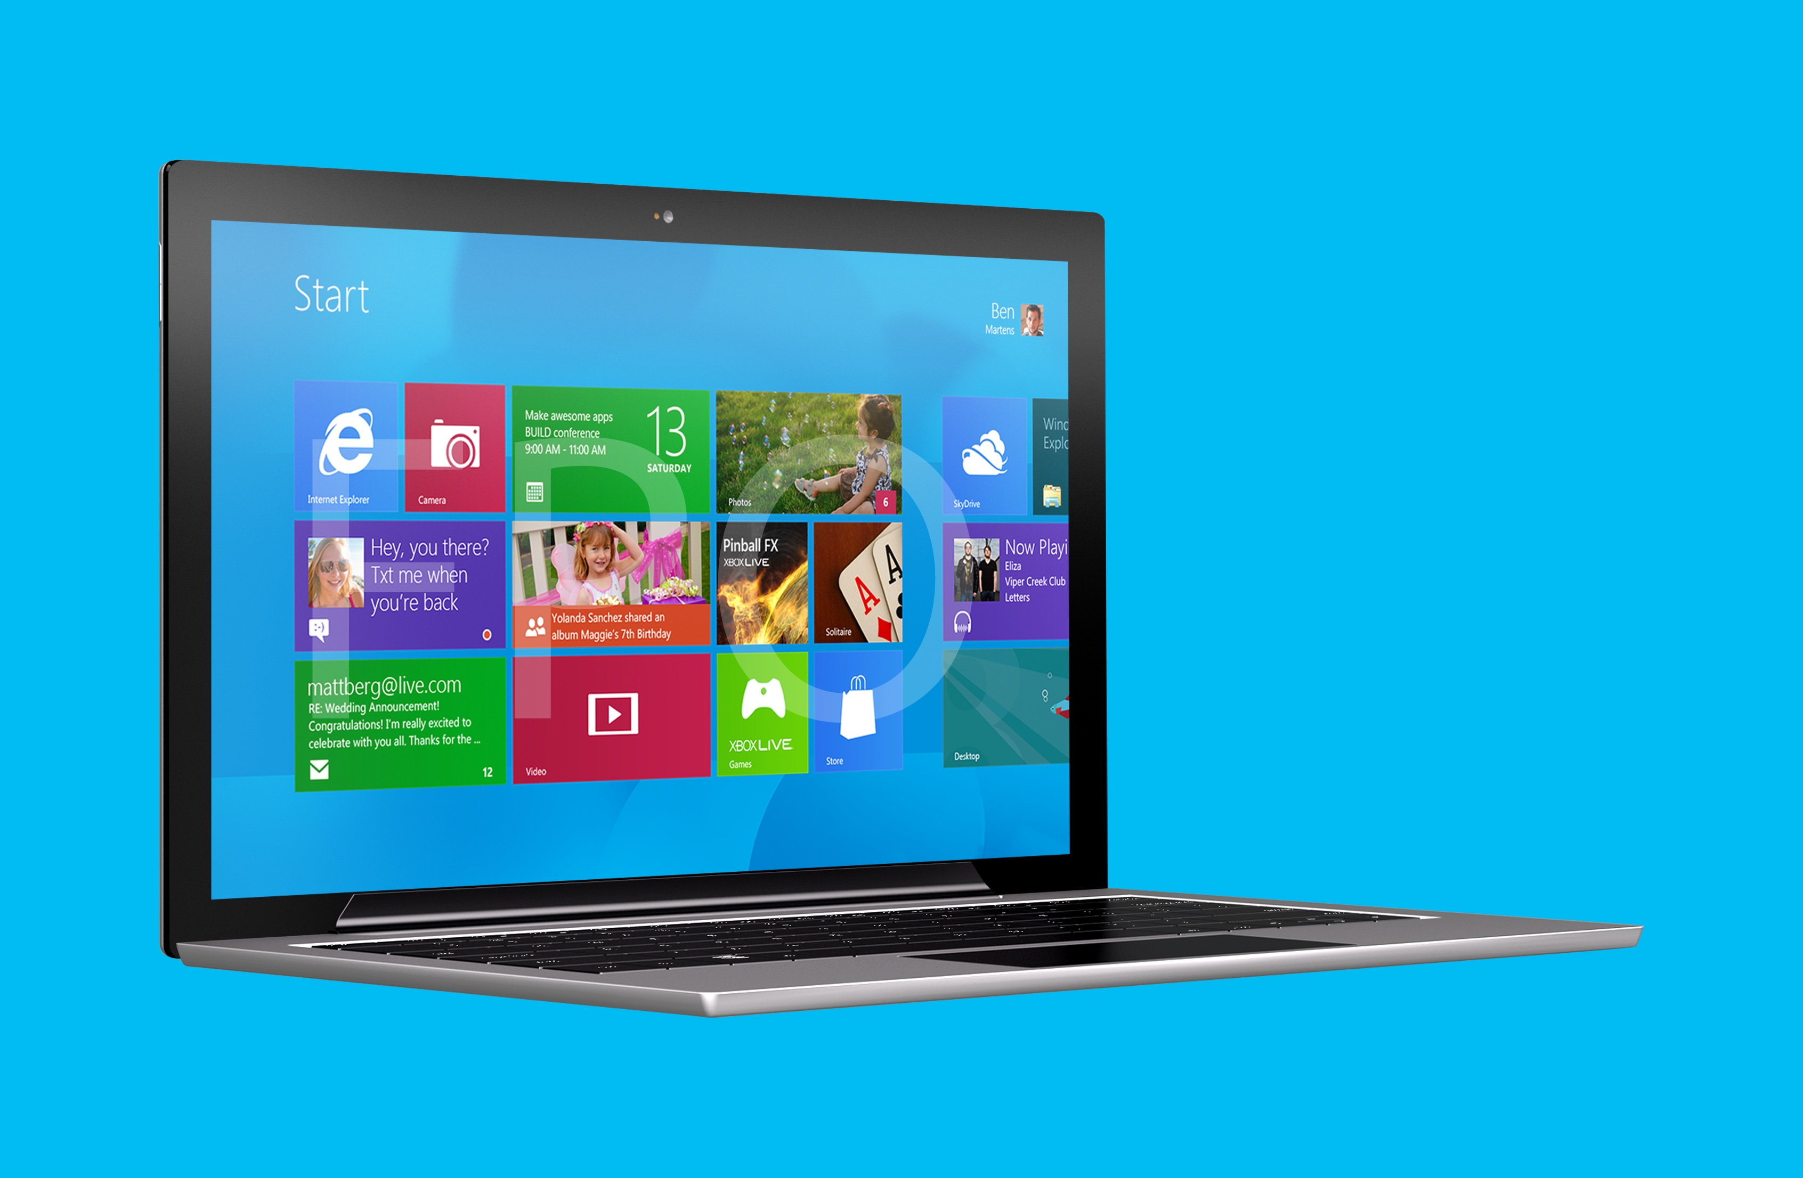

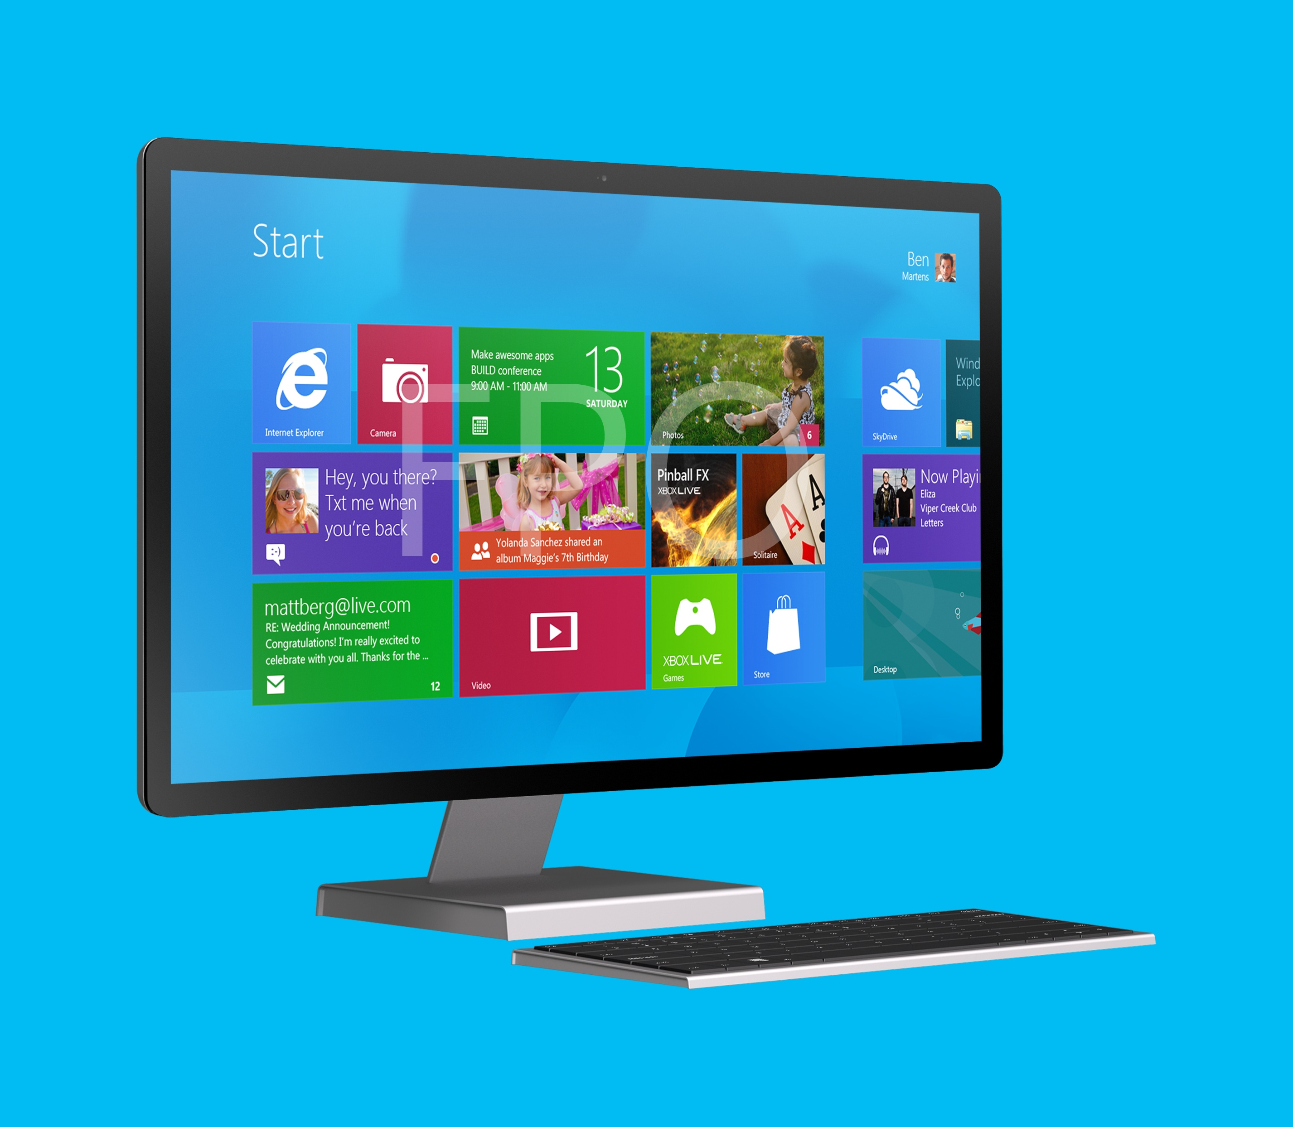
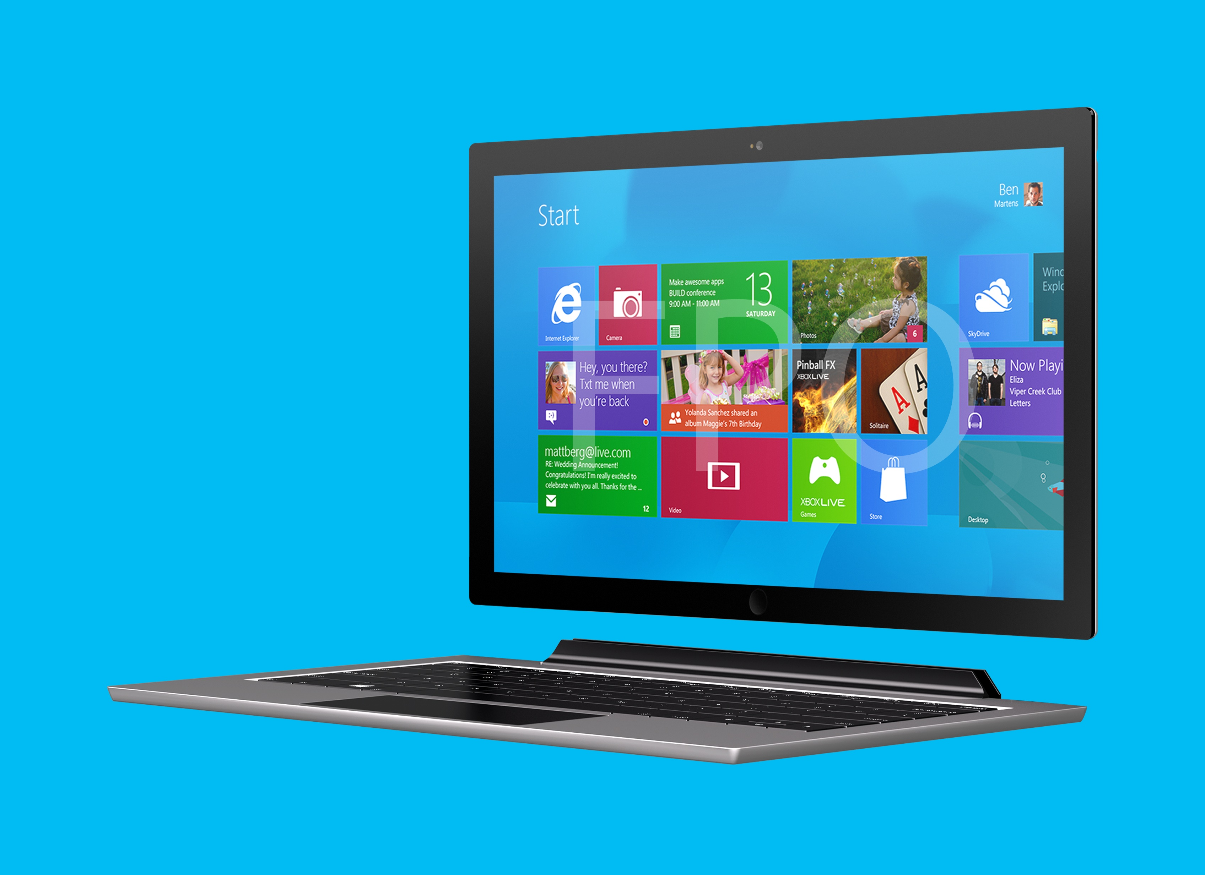

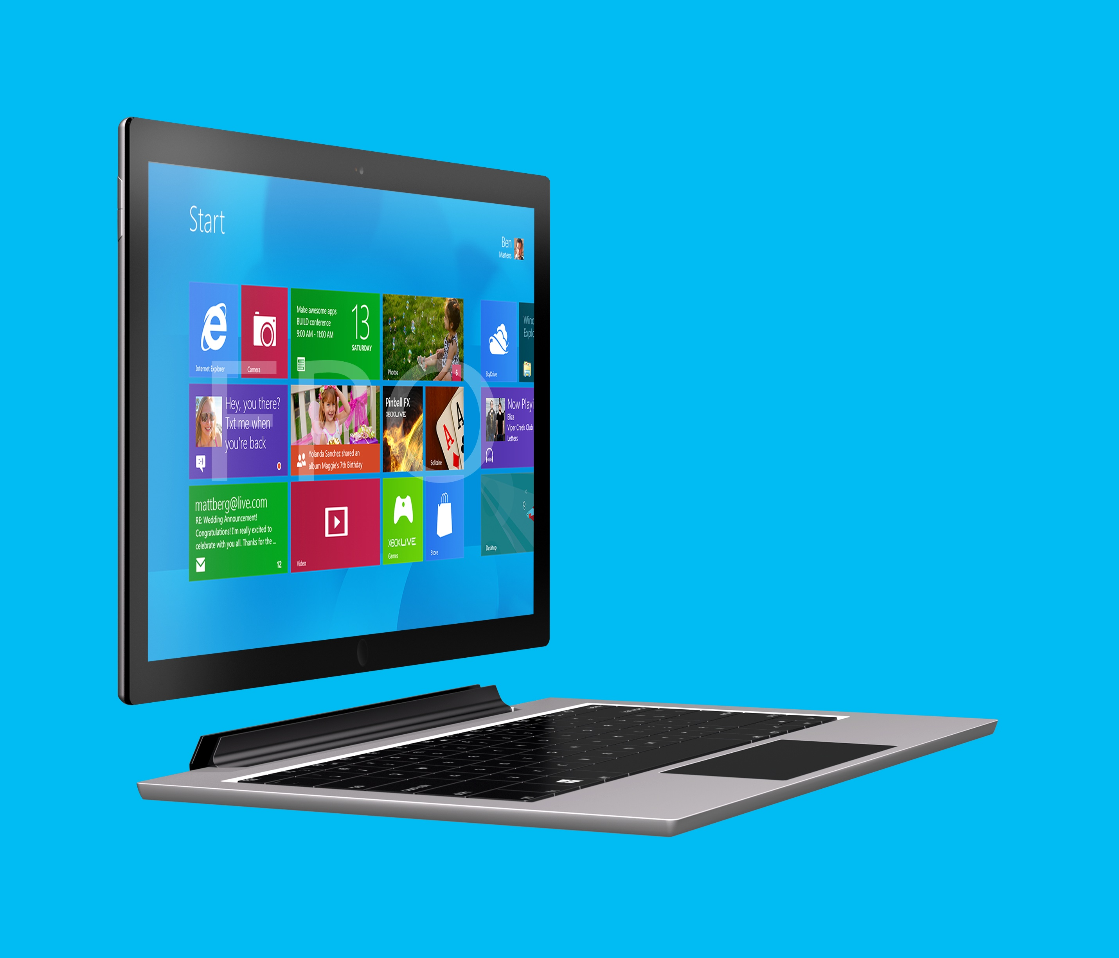
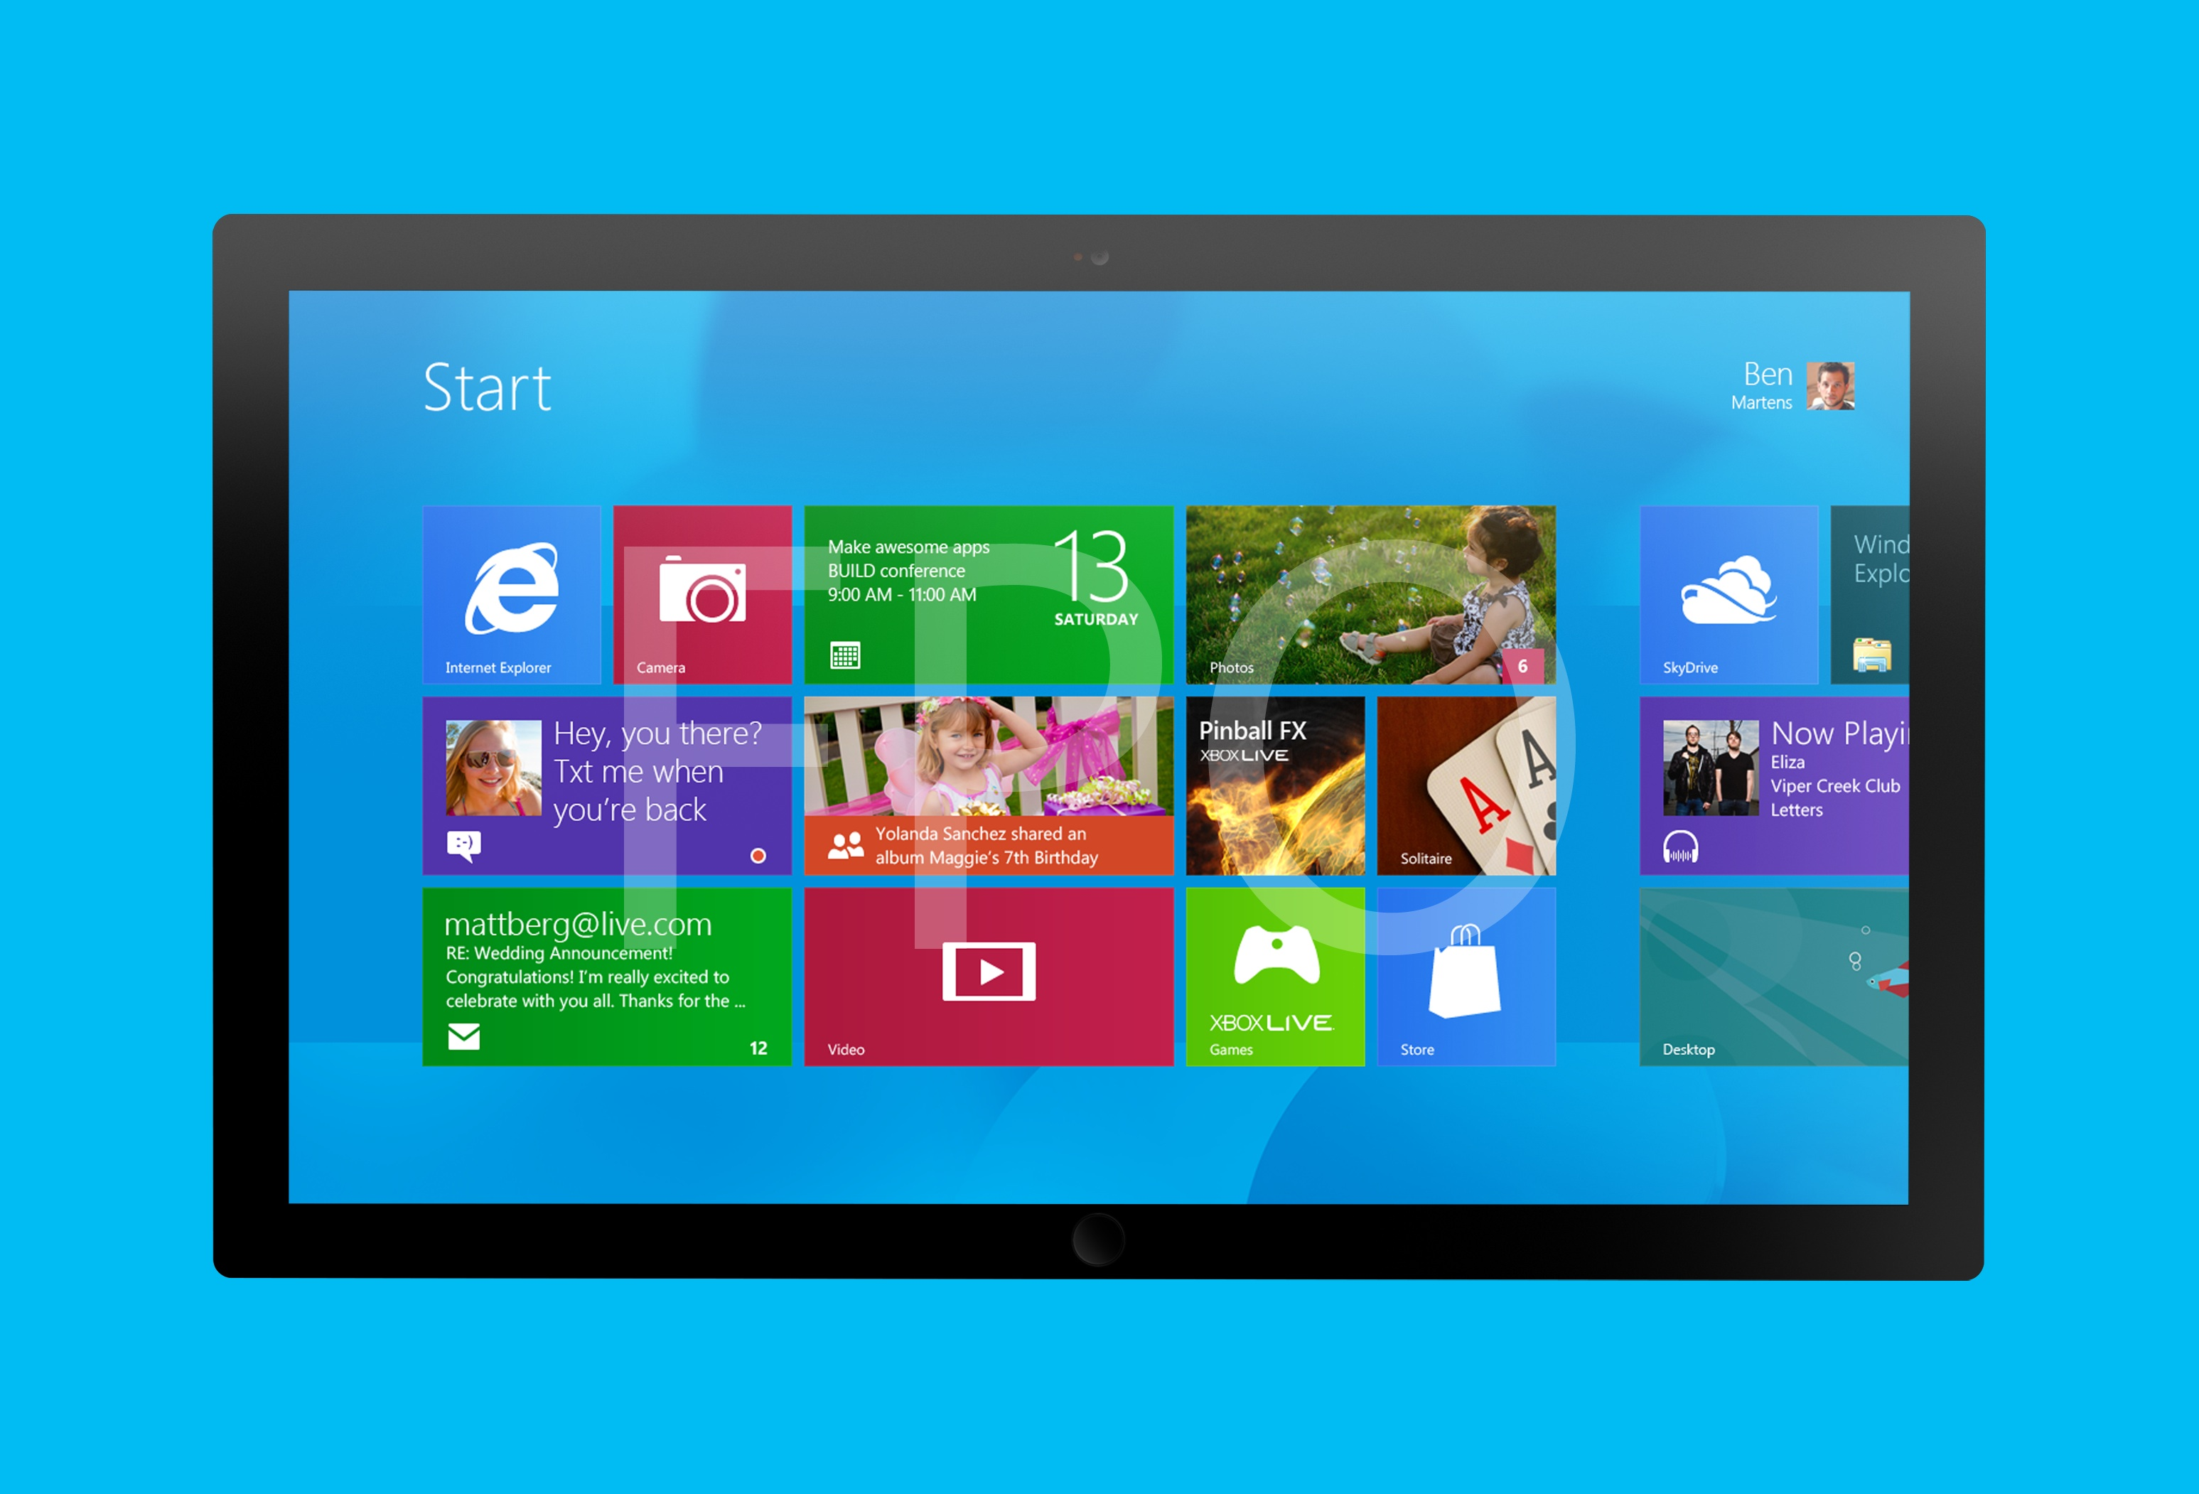

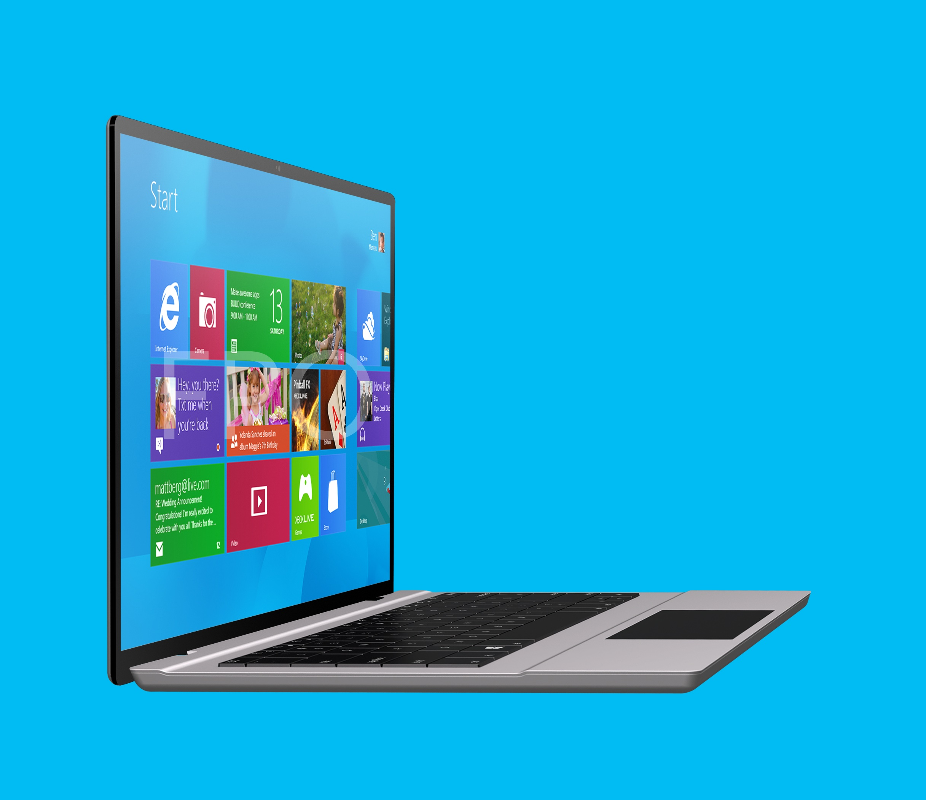
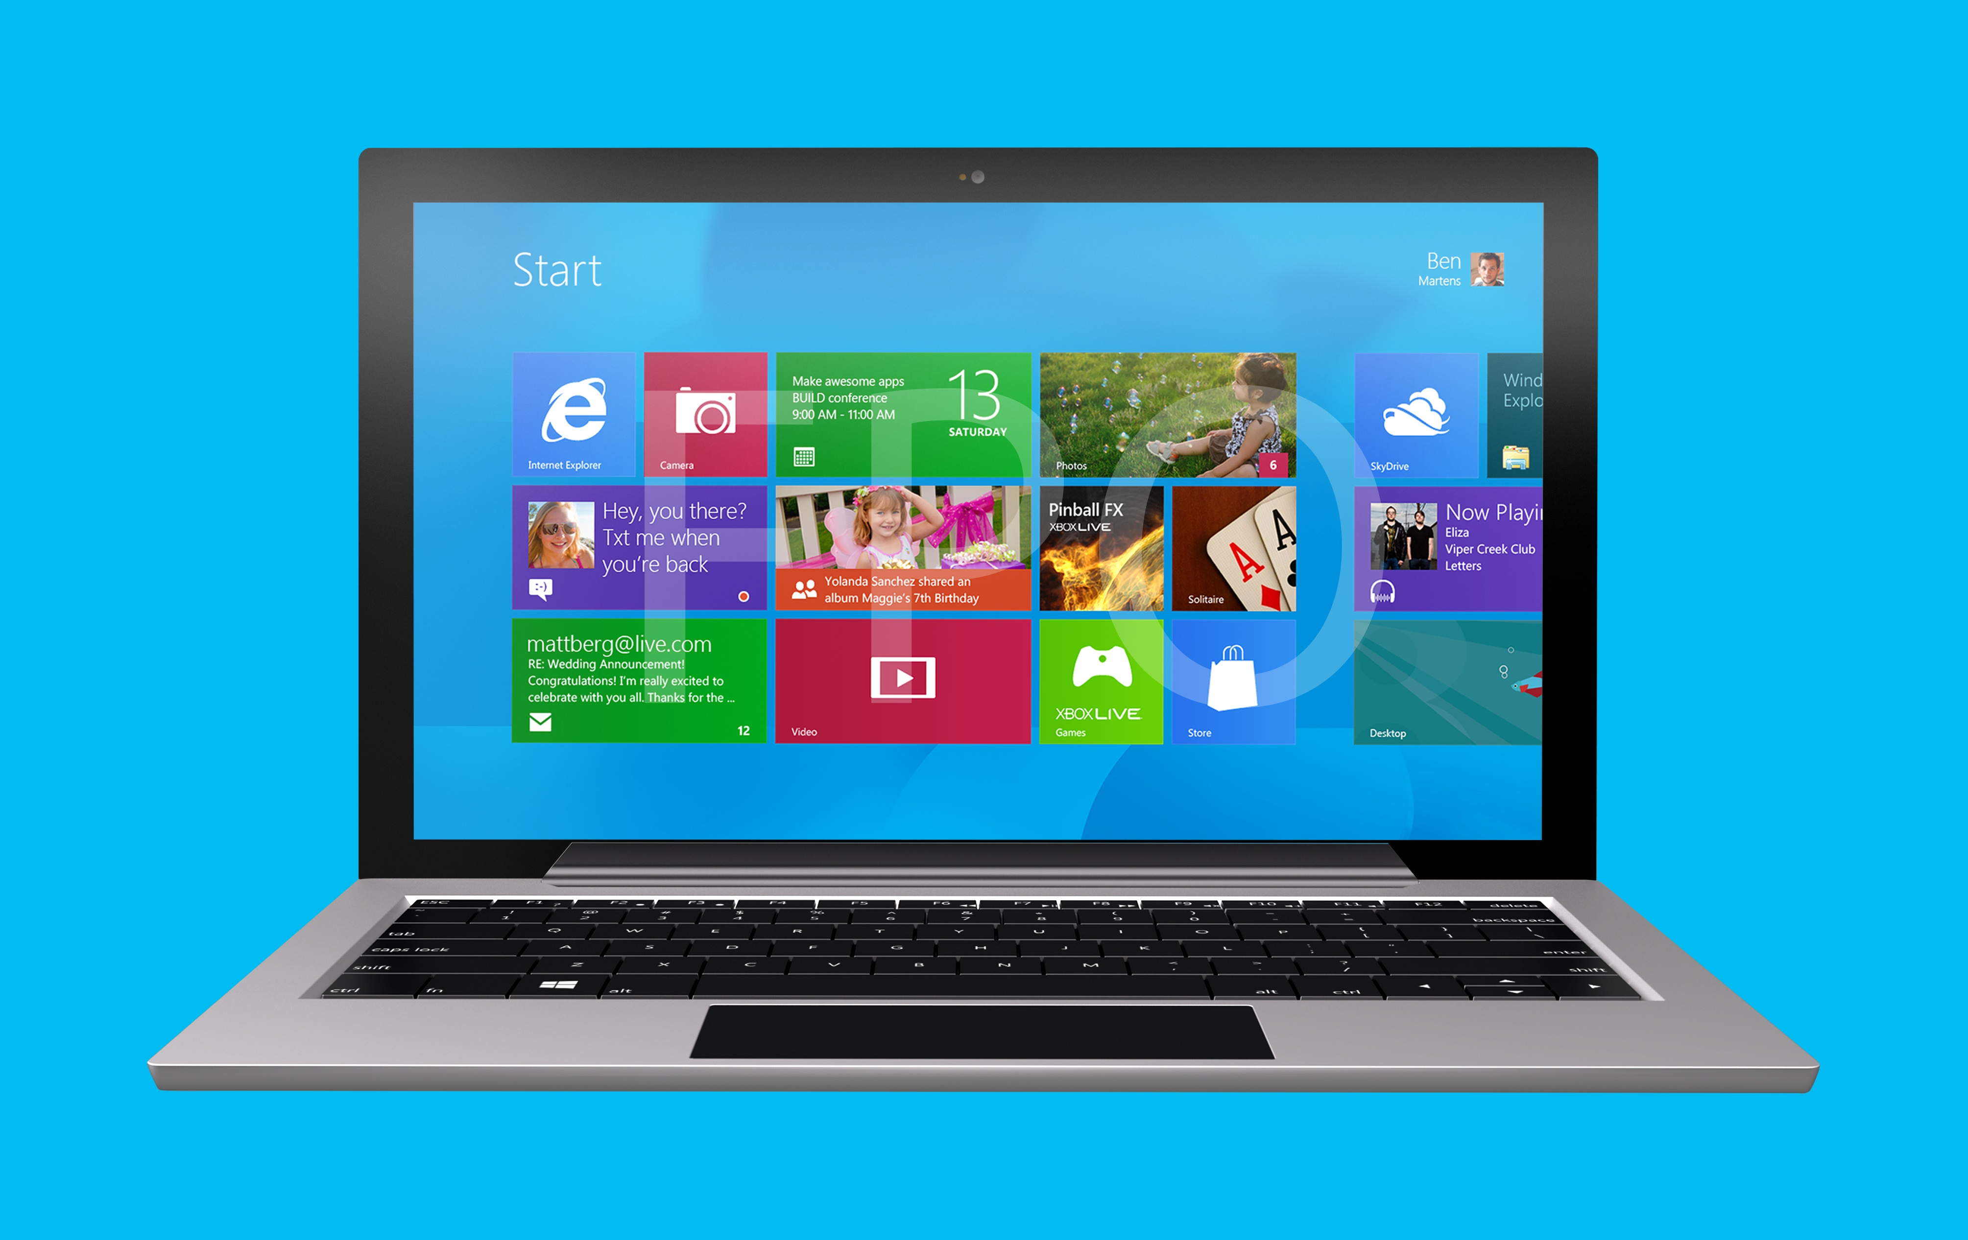

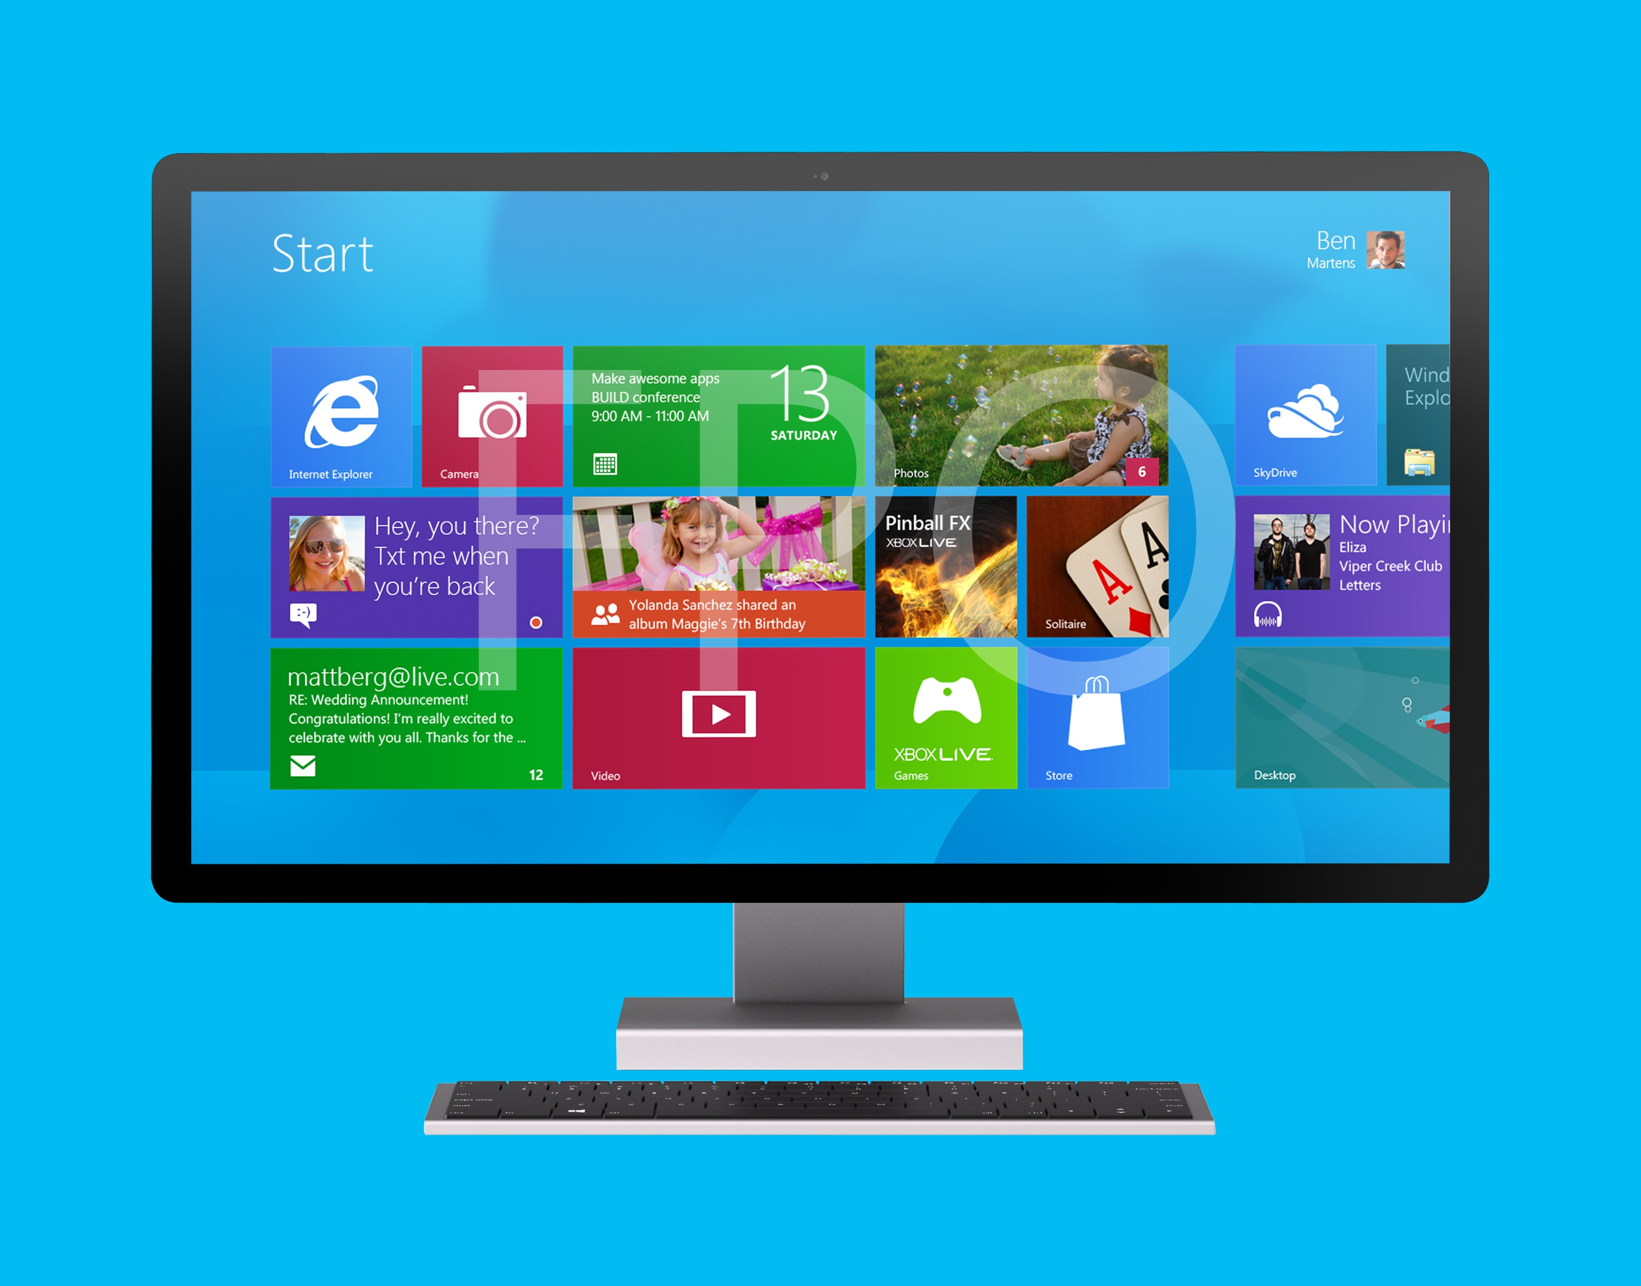
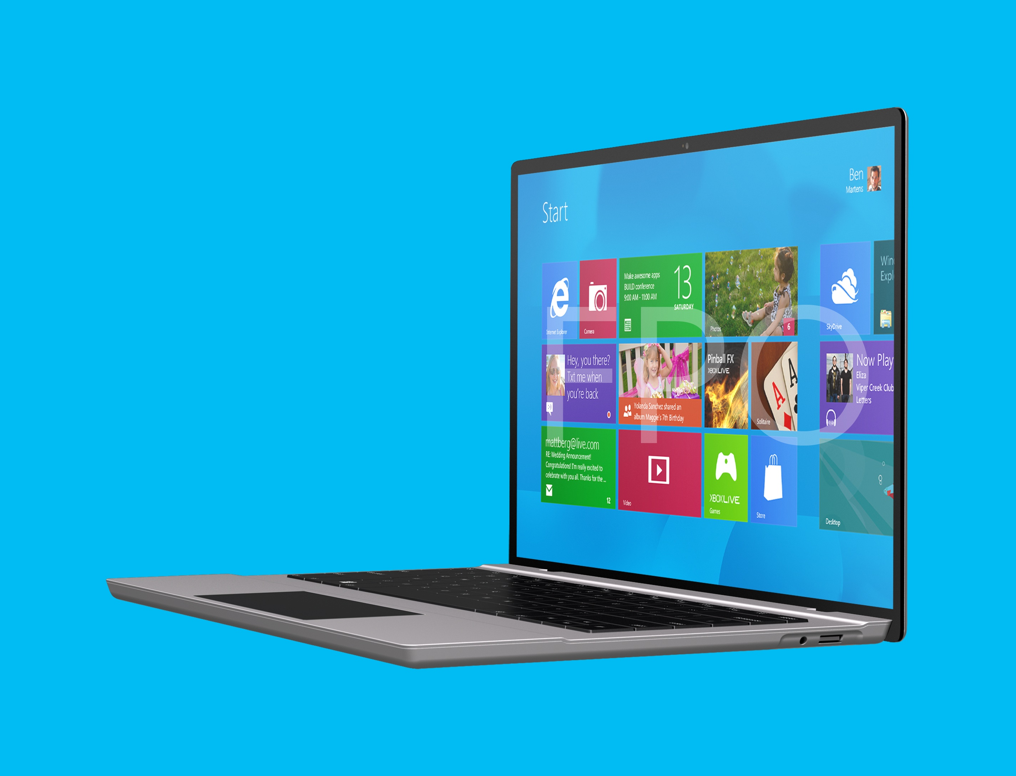
On A Variety of Form Factors
  Innovative
  Portable
  Powerful
  Specialized
  Unique
  Rugged
  Optimized for Enterprise
  New possibilities
  PCs for a variety of tasks
Notes:
Form Factor Variety
PCs will come in a variety of form factors, from tablets, to convertibles, to ultra-portables, to all-in-ones—there may even be some designs that you would not have thought possible. Together with our OEM partners, we provide great devices for every workstyle:
[CLICK] From devices for executives that are innovative, portable, powerful
[CLICK] To devices optimized for enterprise knowledge workers and everyday business tasks
[CLICK] And devices that are specialized and unique for specific tasks
[CLICK] To industrial devices like ruggedized machines in oil rigs and manufacturing lines
[CLICK] And of course a variety of companion devices that present new and fun possibilities
Windows-based devices are about CHOICES. Because we believe the device has to fit the job. We and our ecosystem are committed to providing choices to our customers.

Slide 8

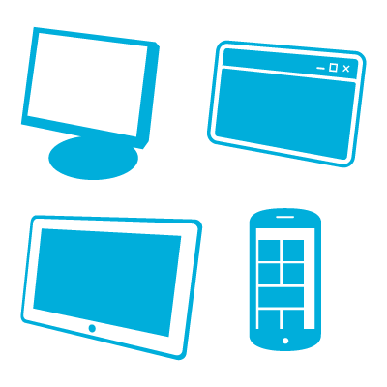












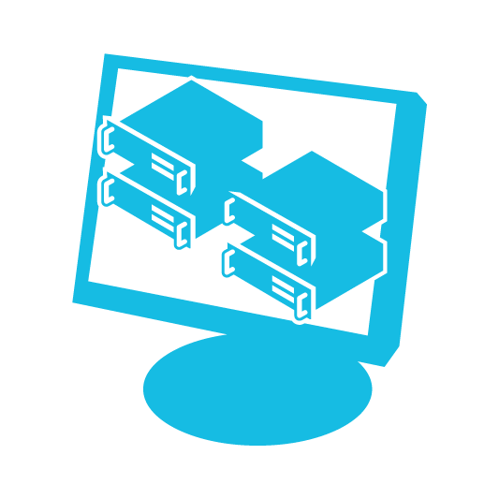
Windows 8 Editions
Windows 8 Professional
Windows RT Devices
Windows 8
Windows 8 Enterprise
Notes:
Windows 8 Editions
Before we move on to our sessions today, we should introduce the Windows 8 editions that are available. There is an edition of Windows 8 and Windows RT Devices designed to meet the needs of every organization from small, growing businesses to multi-national enterprises.
[CLICK] Windows 8 is the basic SKU for home users. It includes the core feature set that home users require but does not include key business features, such as support for the ability to join domains, process Group Policy, and so on.
[CLICK] Windows 8 Pro is for small- and medium-sized businesses. It delivers new levels of productivity, security, and mobility—without sacrificing performance or choice. It provides enhanced features that help to easily connect to company networks, access files on the go, encrypt data, and more. Windows 8 Pro is ready for business.
[CLICK] Windows 8 Enterprise edition is available through Windows Software Assurance. It includes all the capabilities of Windows 8 Pro, plus premium features designed to meet the mobility, productivity, security and manageability, and virtualization needs of today’s large businesses. Key examples are Windows To Go, DirectAccess, BranchCache, AppLocker, Virtual Desktop Infrastructure (VDI), and Windows 8 app deployment. Of course, you will learn about all of these features today.
[CLICK] Last are Windows RT Devices. Windows RT Devices run low-powered ARM processors, which helps OEMs build devices with long battery lives and new form factors (thin, light, and sleek devices). Also, Windows RT Devices are built on a new paradigm (preconfigured system on certified hardware), which helps ensure that users have high-quality and predictable experiences over time. While Windows RT Devices offer the great benefits I just mentioned, they have commonality and shared code with Windows 8, offering a consistent, great Windows experience. For example, Windows RT Devices support the new UI (including desktop). Both Windows RT Devices and Windows 8 can run apps from the Windows Store. Windows RT Devices are compatible with most peripherals, since they include class drivers for most peripherals, and the majority of mice, keyboards, printers, and USB storages are supported out of the box.

Slide 9








Today’s Sessions
Windows 8 Overview
Windows 8 Deployment
Access to Windows
Anywhere Productivity
Recovery and Security
Windows 8 Apps
Notes:
Today’s Sessions
We’re just about ready to start our first session:
[CLICK] Windows 8 Overview. You’ll be given an overview of Windows 8 and its core features. Not only will I explore the enhanced UI, but I’ll also look at improvements we made to key tools such as File Explorer, which is Windows Explorer with some great enhancements, and Task Manager. By the time we’re finished with the first session, you will have a good feel for Windows 8. Of course you’ll be impressed by the new design, but I also want you to take away from this session that it’s just like Windows 7—only a lot better!
[CLICK] Windows 8 Deployment. Once I’ve shown you around Windows 8 and the core tools, we’ll spend some time learning how to deploy it. This next hour is a deep dive into using System Center 2012 Configuration Manager and the Microsoft Deployment Toolkit (MDT) 2012 to deploy Windows 8. I’ll demonstrate both zero-touch and lite-touch installation.
[CLICK] Flexible Workstyles: Access to Windows. Next up, we’ll spend some time learning how Windows 8 enables you to provide flexible access to desktop environments running Windows 8. Of course you can expect to learn something about virtual desktop infrastructure (VDI), but you’re also going to see a new Windows 8 Enterprise feature called Windows To Go. This is a terrific way to deploy a portable workspace on a USB drive that users can boot on any compatible PC.
[CLICK] Flexible Workstyles: Anywhere Productivity. Following our session about providing flexible access to Windows, we’ll spend an hour talking about providing flexible access to users’ data, settings, and applications. This is a combination of User State Virtualization (USV), Folder Redirection and User Experience Virtualization (UE-V) in this case, and Microsoft Application Virtualization 5.0 (App-V). I’ll demonstrate UE-V and App-V during this session.
[CLICK] Windows 8 Apps. Delivering Windows 8 apps is another topic that many of you are keenly interested in learning about, and we’ll look at it in detail here. I’ll spend just a few minutes talking about what makes a Windows 8 app unique before we learn how to sideload LOB Windows 8 apps and how to manage them.
[CLICK] Recovery and Security. Our last session for the day will be about recovery and security. Windows 8 has some built-in capabilities for system recovery — push-button reset and refresh come to mind —but we’ll also learn about using the Microsoft Diagnostics and Recovery Toolset (DaRT) to troubleshoot and repair Windows 8 installations. And of course, I’m going to talk about many Windows 8 security improvements, including Secure Boot, virtual smart cards, and much more.
So, let’s get started with our first session: Windows 8 overview and some of its tools.

Slide 10
Resources
TechNet Evaluation Center
Download Microsoft software trials today.
technet.microsoft.com/evalcenter
Microsoft Virtual Academy
Take a free, online course.
microsoftvirtualacademy.com
IT Camps
Find an additional IT Camp near you.
technet.microsoft.com/globalitcamps
Microsoft Certifications
Get certified on Microsoft Products & Technologies.
aka.ms/certifications

Slide 11



© 2012 Microsoft Corporation. All rights reserved. Microsoft, Windows, Windows Vista and other product names are or may be registered trademarks and/or trademarks in the U.S. and/or other countries.
The information herein is for informational purposes only and represents the current view of Microsoft Corporation as of the date of this presentation. Because Microsoft must respond to changing market conditions, it should not be interpreted to be a commitment on the part of Microsoft, and Microsoft cannot guarantee the accuracy of any information provided after the date of this presentation. MICROSOFT MAKES NO WARRANTIES, EXPRESS, IMPLIED OR STATUTORY, AS TO THE INFORMATION IN THIS PRESENTATION.

